Slide 2
General Mills Sustainability Global Sustainability Summit
The Nuts & Bolts of a Successful Sourcing Program
August, 2014

Slide 3
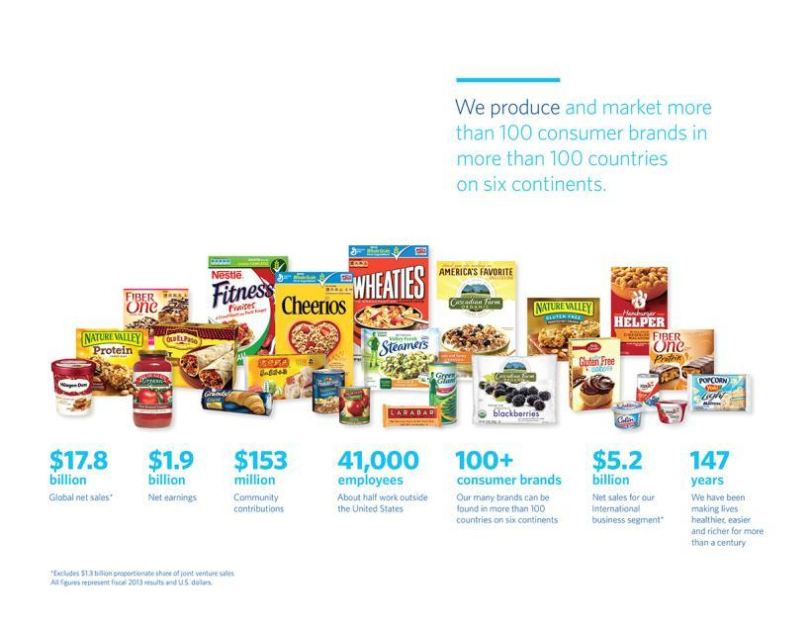
General Mills at-a-glance
Notes:
These numbers give you a better sense of our size and global scope.
As you can see, we truly are a global company. Nearly 30 percent of our net sales come from our International business segment, and about half of our employees work outside the United States.

Slide 4
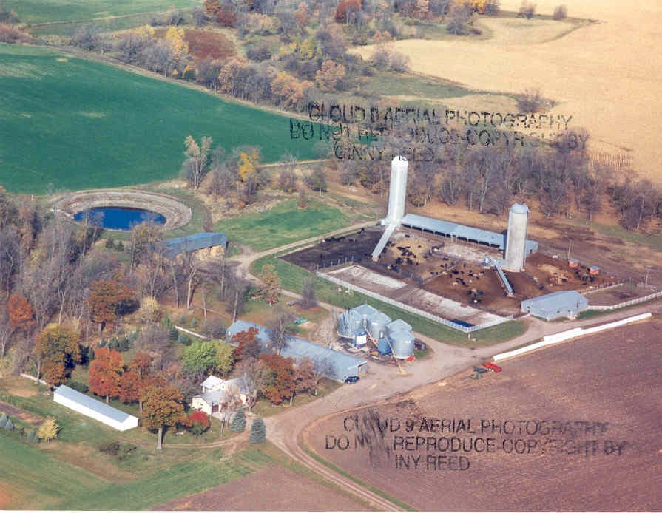
My Farm
Notes:
Slow-talking MN accent, Pragmatic, Sustainability = Business value

Slide 5
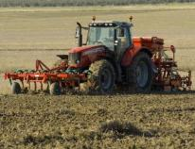
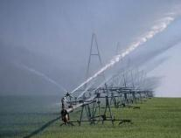
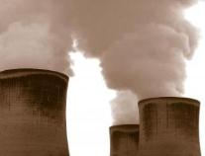
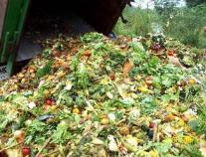
Food’s Big Impact
40%
World’s Land
70%
World’s Water
1/3
Greenhouse Gases
120 Billion Pounds
Food Waste
Notes:
Sustainability is not only an outgrowth of our values, it is an imperative to our business.
As a food company we are a big user of earth’s resources and these resources are increasingly being squeezed.
Providing food to the world:
-Uses 40% of the world’s land
-Uses 70% of the world’s freshwater
-Creates 1/3 of the world’s greenhouse gas emissions; and
-Generates huge amounts of waste.
As a global society we waste more than 30% of the calories produced every year. In a world where 1 billion people go hungry every day, this clearly is NOT the right thing to do.

Slide 6
Crunch Ahead!
Resources
Demand
Notes:
So what we have, is a vicious cycle. On one hand we have accelerating demand. On the other had many of society’s current tools to keep up with this demand are driving a decline in nature’s fundamental ability to produce these resources in the first place. We have a challenge, and our usual way of meeting the challenge only makes the challenge harder.
As I mentioned before, this vicious cycle is part of what’s driving the inflation we’re experiencing right now…today. If you look into the future, it will challenge the “sustainability” of our business.
Remember that these resources we’re talking about are the exact same resources we depend on as a company. When you look at this challenge from a resource perspective, Sustainability is not an option for us. It is not just something nice to do so we have beautiful landscape and interesting animals to observe, although that’s valuable. It is not just a good thing to do for society. It is not just the right thing to do, sustainability is an absolute must if we are to continue to run our business.
Now we wouldn’t be here today if we didn’t believe we can address this challenge. In fact it’s the very reason we’re here today. We are doing some very good work in this area and as you can see we need to do more and we need all of you to be a part of it.

Slide 7
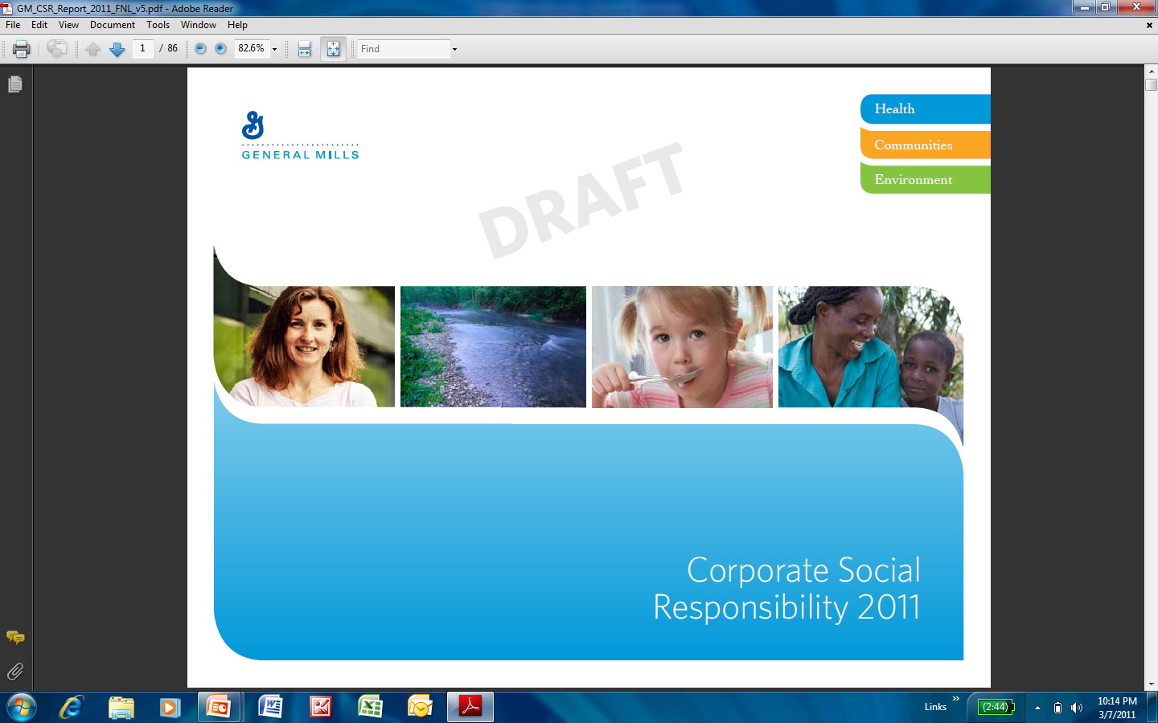
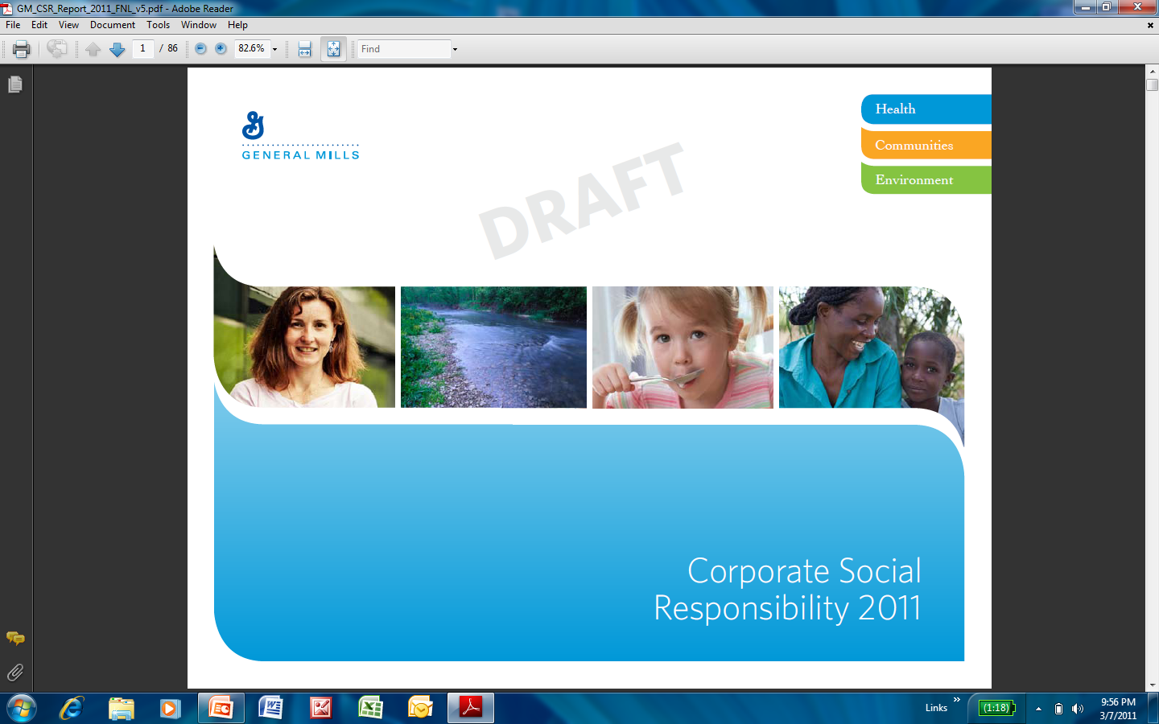
Our Mission: Nourishing Lives
HEALTH
Nourishment we provide
COMMUNITIES People we serve
ENVIRONMENT Planet we share
www.csr.genmills.com
Notes:
The efforts -- plentiful and powerful around the world – are grouped in three key areas: health, community and the environment.
The full CSR report, available online, provides rich detail on each segment, but let me give you a taste of each.

Slide 8
Conserve Resources and Strengthen
Communities Upon Which our Business Depends
Economic Efficiencies
Risk Management
Growth
Value Levers

Slide 9
Internal Supply Chain Metrics F12 Results v F15 Goals
 | Waste (lbs waste/lbs produced) | Water (gallons/lbs produced) | Energy (Kwh/lbs produced) | Greenhouse Gas (m-Tons/lbs produced) | Packaging (% Improved) | Logistics (gallons/ton shipped)
2015 Goals | -50% | -20% | -20% | -20% | 40% | -35%
F12 Total Co | -40% | -10% | -10% | -11% | 52% | -17%
Extend Packaging Metric to 60% by 2015
Volume deleverage -7% F12 v F10
Energy team Big G

Slide 10

Why Sourcing Matters
GHG Emissions Water Consumption
GMI is working on Sustainability programs across:
75% of our GHG footprint
99% of our water consumption

Slide 11
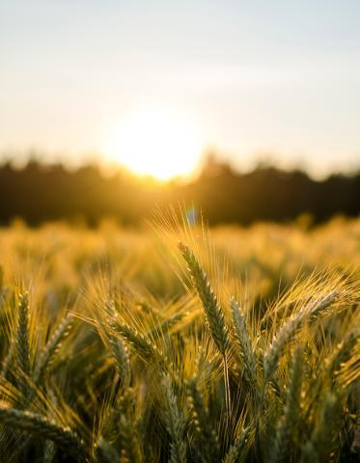
Sourcing
OUR GOAL is to sustainably source the raw materials we use in our products. We are committed to sustainably sourcing 100 percent of our 10 priority ingredients by 2020.
Our Strategies
Increase sustainability of ingredients
Collaborate to improve global water stewardship
Advance socially responsible supply chains
Notes:
In 2013, we committed to sustainably source 100 percent of our 10 priority ingredients by 2020. These ingredients represent 50 percent of General Mills’ total raw material purchases. It’s one important way we’re tackling the areas of greatest environmental impact in our supply chain.
Agriculture uses 70 percent of the world’s fresh water. Conserving water resources is crucial for the environment and for our business. We focus both on conserving water throughout our supply chain and improving the health of the watersheds we access.
By purchasing sustainable raw materials and promoting sustainable processes throughout our supply chain we can start to make a real difference. Because of the scope and scale of our supply chain, we work closely with growers, industry partners, nongovernmental agencies and other stakeholders to improve the sustainability of our value chain.

Slide 12
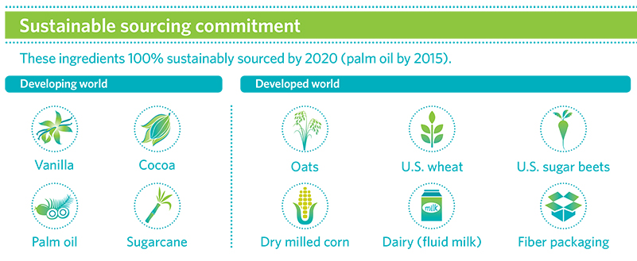
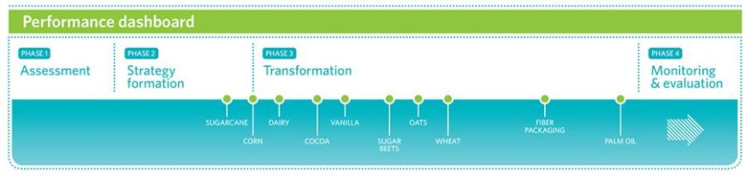
Increasing sustainability of ingredients
Notes:
Here you see our 10 priority ingredients and the progress we’re making toward our 2020 sourcing goal. Nine ingredients are in the transformation phase. Worthy of note: we’re on track to meet our 2015 commitment to source 100 percent of palm oil from sustainable, responsible sources.
Our approach is tailored for each ingredient and geography, whether we’re working with smallholder farmers in developing economies or commodity agriculture in developed economies.
In developed economies, we’re collaborating with industry groups, suppliers and North American growers to increase the sustainability of row crops such as oats, wheat, sugar beets and corn.
Take oats as an example. Oats are an environmentally friendly crop requiring less irrigation, fertilizer, chemicals and other inputs to grow compared with other row crops. General Mills is partnering with industry groups and farmers to increase sustainability in four key North American growing regions: the Snake River Valley in Idaho; the Red River Valley in North Dakota and Minnesota; the Northern Plains; and western Canada (Manitoba and Saskatchewan).

Slide 13

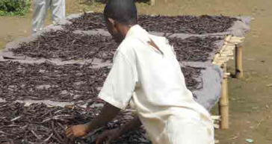







Definitions of Sustainability
Certification
Continuous Improvement
Origin Direct Investment
Self Verification
Sugarcane
Palm Oil
Row Crops: oats, wheat, sugar beets, corn
Dairy
Vanilla
Cocoa
Fiber Packaging
Animal welfare
Notes:
1:30
So what does sustainably sourced mean? It means something different for each one of the categories. GMI does not define what sustainability is. We work with key stakeholders and industry groups to determine it. We have classified the definitions of sustainability into 4 different types. 1) Certification 2) continuous Improvement vs an industry recognized framework 3.) Origin direct investment 4) Self verification. The important thing is to be clear in our communication on what it means.

Slide 14
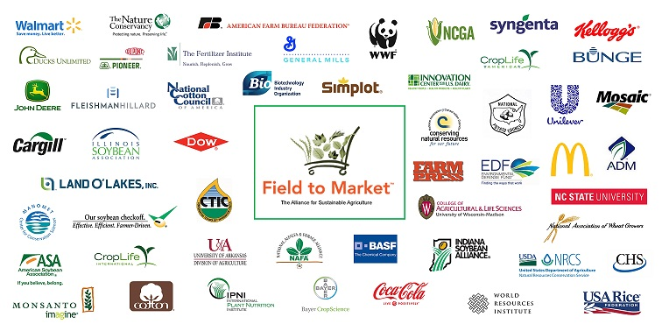
Field to Market Membership

Slide 15
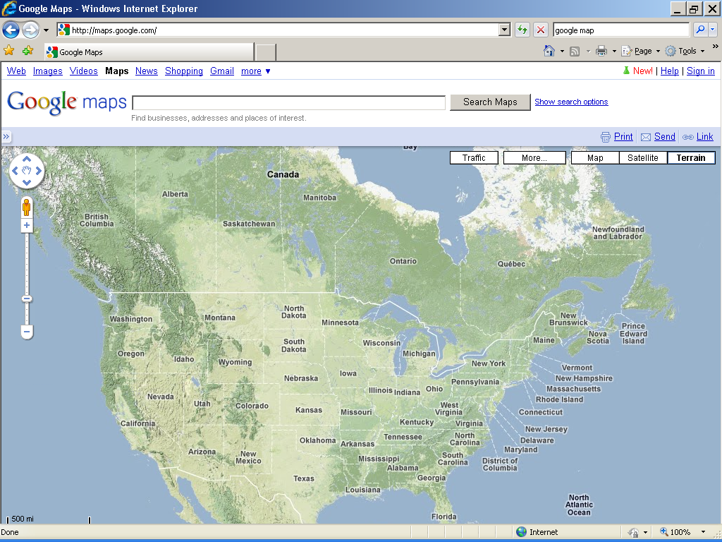

Scale by Validating Key Growing Regions Using Iseal Claim Methodology
1.Dairy 2.Sugar and wheat 3.Wheat and Sugar 4.Wheat
5. Wheat and Sugar 6.Oats
6
4
2
3
5
1
Notes:
Milk and sugar(beets) from California
Sugar (beets) and some spring wheat from the Red River Valley.
Sugar (beets) and wheat (spring and winter wheat).
Spring wheat from the Northern Great Plains, US leading production area of spring wheat (+50%) and 75%+ of Durham wheat. Also a priority area for WWF US.
Winter wheat from the Central High Plains, US leading production area of winter wheat (~50%).
Oats.

Slide 16

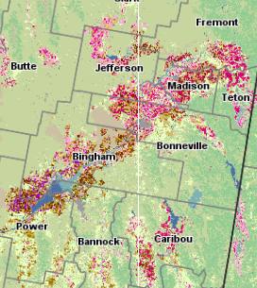

Idaho Regional Engagement: “Paving the Way” for FTM
Opportunities & Incentives for Improvements
Learning’s from Aggregate Information
Potato Processor & Shipper
Field to Market
SE ID Crop & Rotation Analyses
GMI Wheat
Benchmarks
0..
Sugar Processor
Data Facilitators
Grower & Regional Story
Sourcing Region
Sustainable Sourcing Claims Downstream
Efficiency Delivered Through Shared Cost
Grower Pilot Participants Capturing Data with Land.db
(boundaries & participation represent sourcing by GMI & other downstream companies)

Slide 17


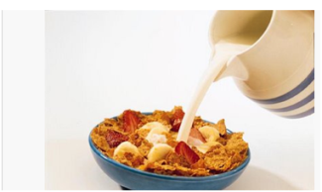



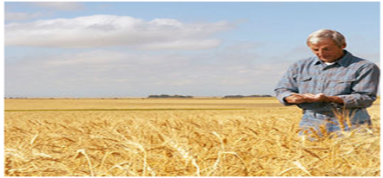












Analyzing the Sustainability Story of Southern Idaho Wheat Production
The Big Picture: Producers Making a Difference
Why measure?
Global attention to agriculture’s impact on the environment is turning to each individual's contribution. We live in a resource constrained world with an increasing population. To meet the future demand for food, we must increase efficient production while sustaining our natural resources.
How are we doing? (Focus areas & progress)
Program is now in it’s fifth year of data collection
Expansion of rotational crops to include spring wheat, winter wheat, potatoes, sugar beets and barley
Individual Grower Reports provide relevant feedback to each grower and Grower Workshops provide guidance for improvements
Did you Know?
Wheat is utilized in dozens of consumer food products and worth more than $500 million dollars to the Idaho economy.
What have we learned? (Understanding trade-offs & opportunities)
Baseline datasets need a minimum of three years of data, with 4-5 years of data preferred
Economics, weather and rotation have major influence on sustainability.
Other contributing factors include quality attributes, pest pressure and the yield potential of the field
Environmental Performance for Idaho Wheat Production (relative to benchmarks)
21 growers
115,500 acres characterized
4 years of data
6 Field to Market metrics
5 crops characterized
1 farm management recordkeeping system
+11%
+18%
CO₂
Human Element
Soil Carbon
GHG Emissions
+10%
+14%
+16%
Land Use
Water Use
Energy
+10%
+14%
+10%
Nitrogen Use
Yield
Soil Loss
Notes: This evaluation benchmarks pilot participants relative to the 5 year average for the corresponding Crop Reporting Districts. A positive value (upward arrow) suggests improvement in performance and a negative value suggests a decline in performance.

Slide 18
GMI Producer Engagements
Snake River (SE Idaho):
Wheat:
115,000 acres
Wheat, potatoes, sugar beets & barley
Partner: Syngenta
Western Canada: Manitoba & Saskatchewan:
Cereal grain: Oats & wheat
Oil: Canola
Pulses: Peas & Lentils
Partners: Pulse Canada, Canola Growers, POGA, Farmers Edge & Agri-Trend
Red River Valley:
Sugar Beets,
Partners: RRVSGA & American Crystal Sugar
N Plains:
Wheat & canola
Partners: ADM, CHS?
Ohio:
Wheat, corn & soy
Mennel Milling, EDF, Syngenta & Farmers Edge
Reed City Michigan:
Fluid milk
Michigan Milk Producers Association & DMI

Slide 19
The Sustainability Consortium
Proposed Changes to Cereal KPIs
In this prototype you will see changes described below.
No incremental response options- Focus on outcome-based metrics rather than practice-based programs, initiatives, etc.
Alignment of metrics with initiatives- Metrics were added to on-farm KPIs and aligned with tools such as Field to Market Fieldprint Calculator, Cool Farm Tool, and Stewardship Index for Specialty Crops. Initiatives will be added to Additional Guidance or Related Information as appropriate.
Common KPI format with metrics
Used new on-farm KPIs with metrics across FBA products.
Used new manufacturing, transportation and packaging KPIs with metrics across sectors.
Energy use, water use, GHG, worker health and safety
Actionability- Remove all Consumer and Retail Hotspots and KPIs. Remove all Hotspots and KPIs that have limited actionability or only occur in specific circumstances.
Consumer and Retail Food Waste were removed based on limited actionability by a brand manufacturer.
Methane Emissions from Rice Production, and Mycotoxin Contamination KPIs were removed due to limited scope of the KPI to the ingredients used.
Redundancy- Remove KPIs if the Hotspots is covered by other KPIs
Biodiversity Management Plan KPI was removed as the hotspots covered by Crop Protection Chemicals and Deforestation and Land Conversion KPIs.
Consolidated Human Toxicity and Crop Protection Chemicals KPIs into one.

Slide 20
Thank You & Contacts
Global Responsibility Report
http://www.generalmills.com/~/media/Files/CSR/2013_global_respon_report.ashx
10 x 20 Press Release
http://www.generalmills.com/Home/ChannelG/NewsReleases/Library/2013/September/sourcing_10
Steve.Peterson@genmills.com

Slide 21
Sustainable Sourcing through the Fertilizer Lens
Global Sustainability Summit
August 2014
Jenny Ahlen
Corporate Partnerships

Slide 22
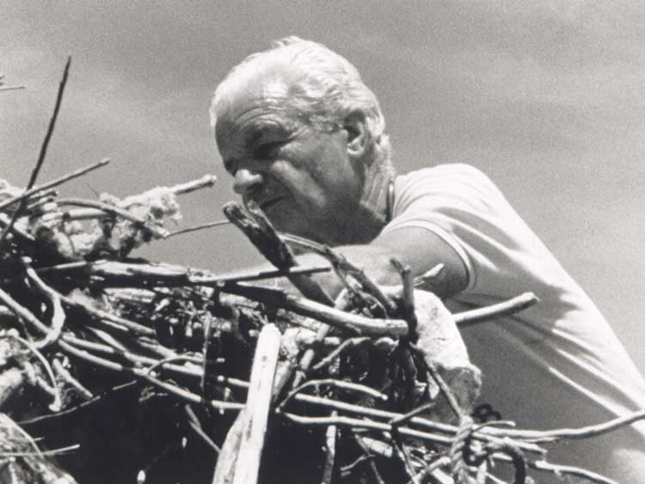
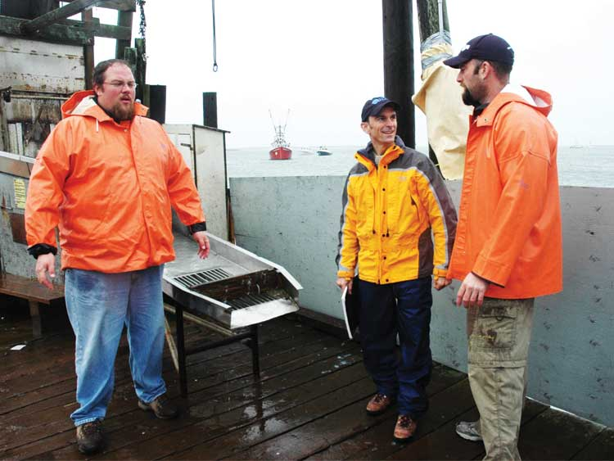
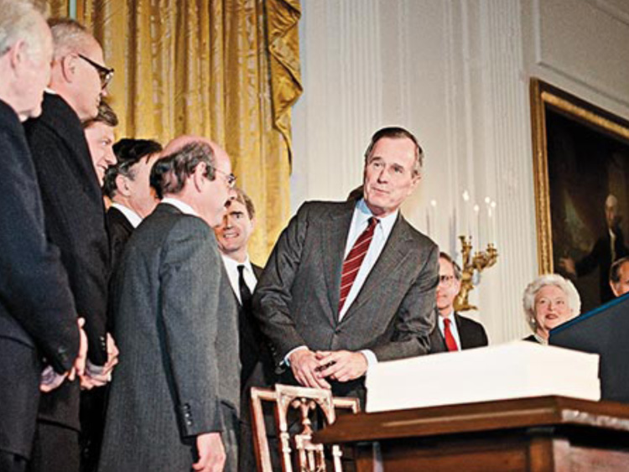
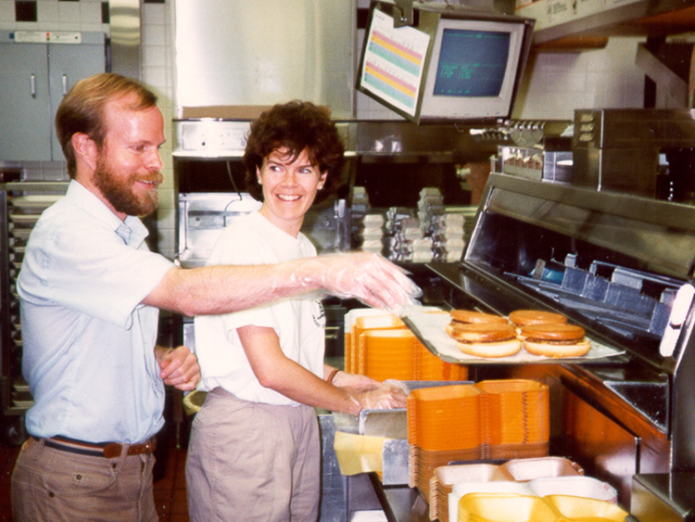
Science Based
Harnessing the Market
Nonpartisan
The Power of Partnerships

Slide 23

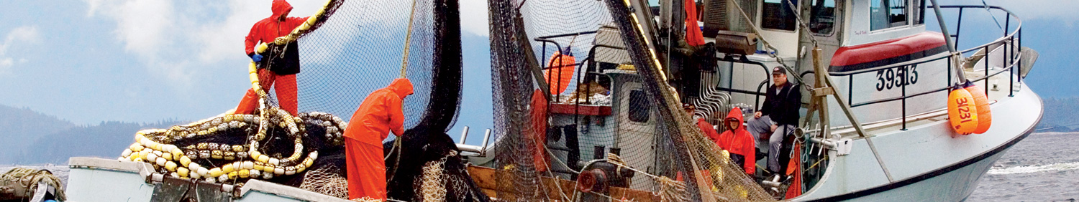


ENEGY & CLIMATE
OCEANS
ECOSYSTEMS
HEALTH

Slide 24
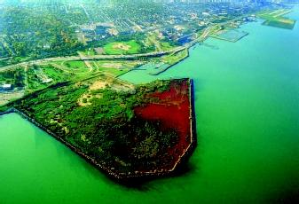
Feed
9 Billion People
More
Stabilize Climate
Protect Drinking Water
Restore dead zones
WHY SUSTAINABLE SOURCING?
WE MUST:
Increase Productivity
If we are going to feed
9 billion people by 2050
without destroying
the planet,
we must produce more
while reducing impacts
on water and climate
Increase
Fertilizer Efficiency
Reduce Fertilizer Emissions
Increase
Wetland Filters
Reduce
Fertilizer Runoff

Slide 25
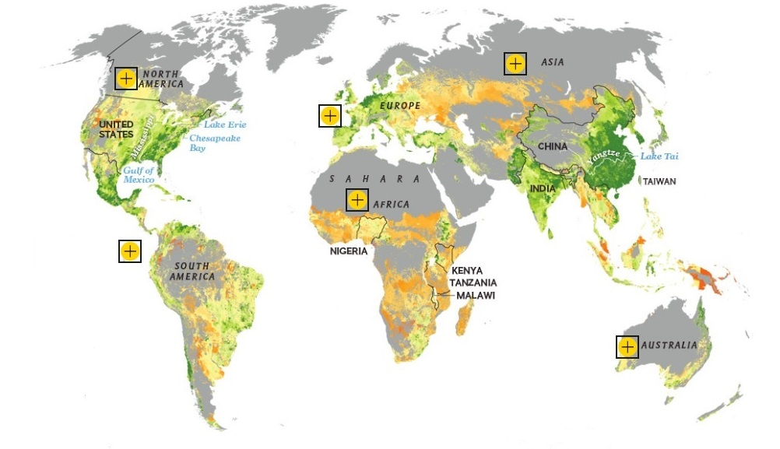
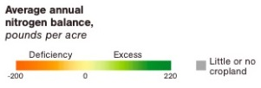

Average Annual Nitrogen Balance
© National Geographic 2013

Slide 26
Walmart

Slide 27


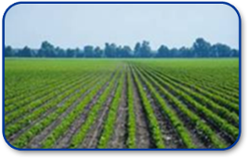
Walmart’s broad sustainability goals
To be supplied 100% by renewable energy
To create zero waste
To sell products that sustain people and the environment
Notes:
27
27

Slide 28
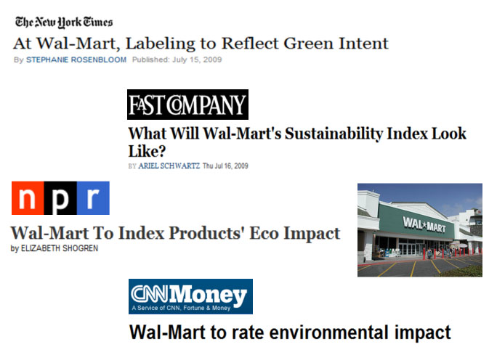
In 2009 Walmart made a commitment to the Sustainability Index

Slide 29
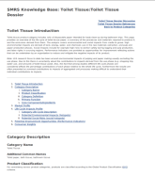
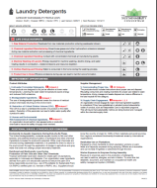
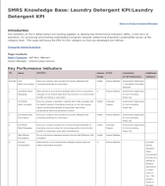
The Sustainability Consortium (TSC)
Key Performance Indicators (KPIs)
Category Dossier
Profile
Collect data on:
life cycle of product category and supply chain
environmental and social hotspots, and
improvement opportunities
Assess and synthesize product findings and improvement opportunities
Develop and disseminate metrics/questions to measure and track product category sustainability

Slide 30
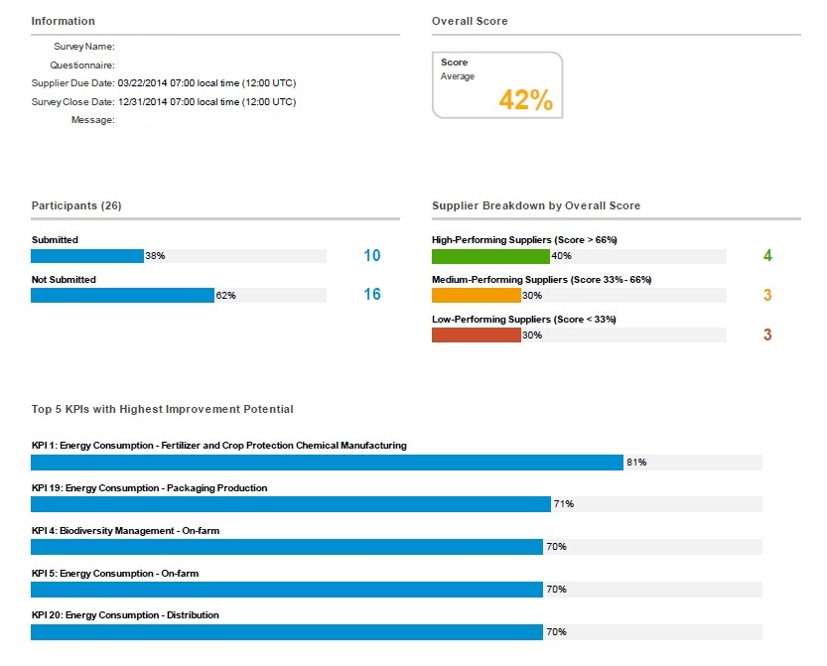
Example: Product Category Scorecard

Slide 31
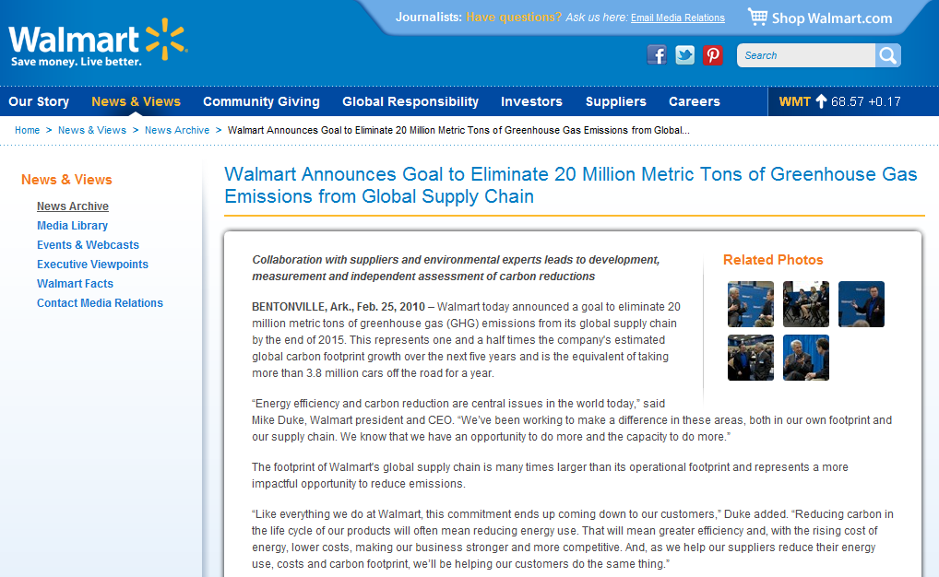
Walmart’s Supply Chain GHG Goal

Slide 32
Greenhouse Gas Hotspots in Products’ Supply Chains
Diesel use in seafood
Energy use at manufacturing
Chemical raw material production
Methane production in rice
Consumer electricity use
Fertilizer
Enteric fermentation
Chemical manufacturing
Raw material extraction energy use
Based on Walmart US product sales using LCA data and TSC hotspots
Consumer hot water use

Slide 33
Walmart’s Fertilizer Timeline
June 2012 Fertilizer initiative begins
November 2012 Buyers form fertilizer coalition
July 2013 Buyers ask suppliers for plans
September 2013 Suppliers submit plans
Summer 2014 Implementation of plans begins

Slide 34
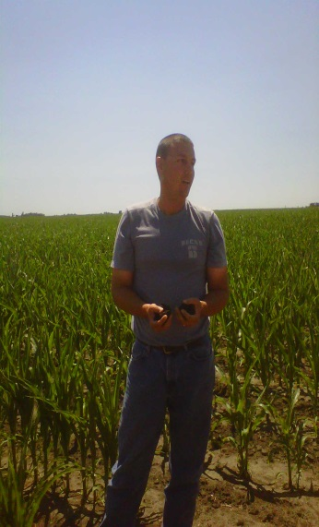
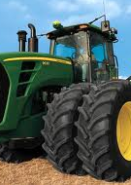
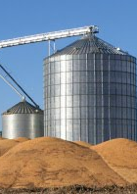
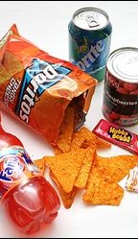
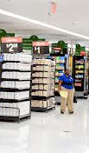
Key Supply Chain Stakeholders
INFORMATION SERVICES & TECHNOLOGY
AGGREGATORS (grain elevators)
FOOD COMPANIES
RETAILERS
FARMERS
Success Requires Engagement Throughout Supply Chain

Slide 35
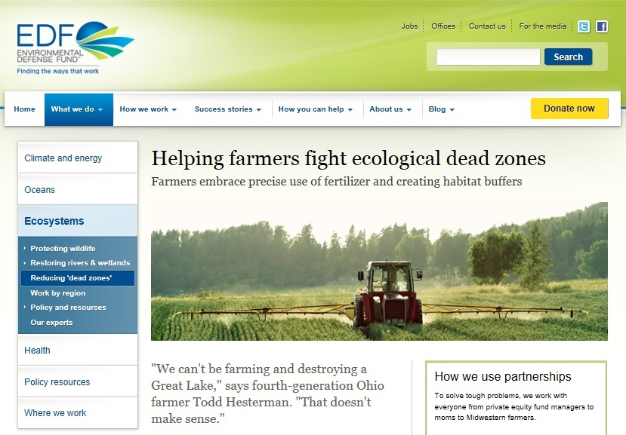
EDF’s Role

Slide 36
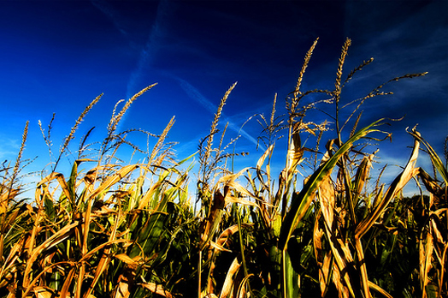
Adaptive Nutrient Management
Adaptive Management Process
Nitrogen’s
Rate
Form
Amount
Timing
Plan
Implement
Evaluate
Adjust
Network
Small groups of farmers
Lead by crop advisor
Share data and results
Aggregate reporting protects privacy
Tools for
Fine-Tuning Management
Strip trials
Cornstalk nitrate tests
Guided stalk sampling
Optical sensors
Adapt-N

Slide 37
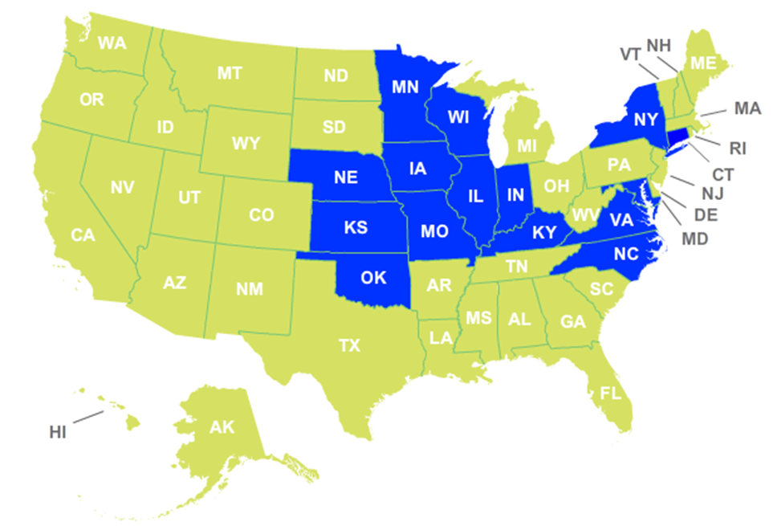
Adapt Networks
Coordinates crop advisors with groups of 10-20 farmers
Enrollment of nearly 1,000 farmers in 12 states and managing almost 1 million acres.
80% report changing management practices after participation
Average Results:
30 lbs/acre lower nitrogen use
$15/acre lower costs
0.25 MT CO2e/acre reduced
Maintained yield

Slide 38
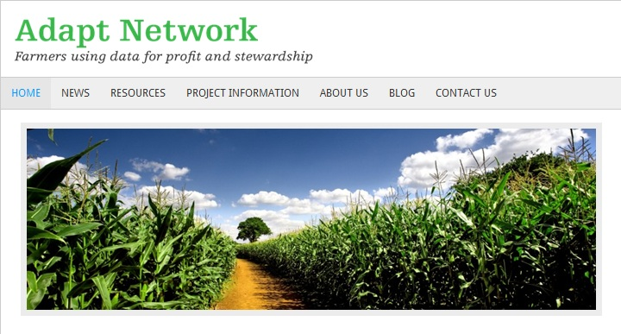
Tools, Technologies, & Practices

Slide 39
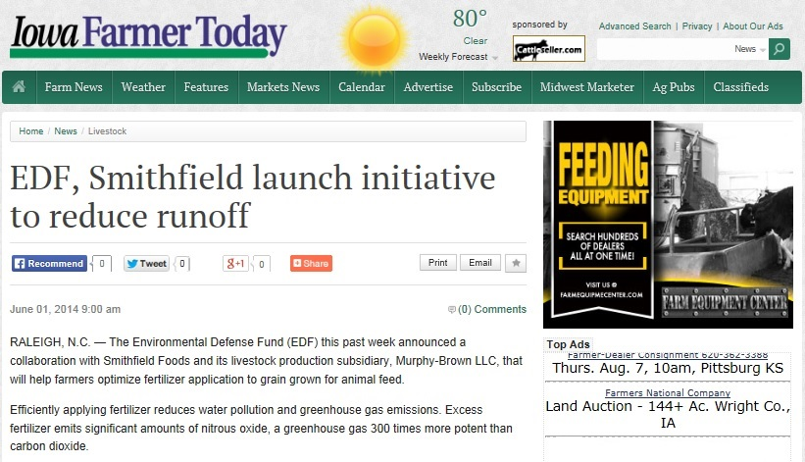
Collaborations

Slide 40


Questions?
Jenny Ahlen
Corporate Partnerships Program
Environmental Defense Fund Bentonville, AR
jahlen@edf.org
479-845-3811

Slide 41
Appendix

Slide 42
TEMPLATE: Plan
Walmart Supplier Toolkit - Fertilizer Optimization Sustainability Plan
Supplier Name: [supplier name, vendor #] Team: [Account Lead] , [Buyer]
Category: [Category] % of Category Sales: [percent]
Fertilizer Optimization Plan Objectives:
Identify, prioritize and deliver opportunities to improve fertilizer optimization, input cost reduction and GHG reduction, with consistently measured Greenhouse Gas (GHG) reductions.
Integrate preferences into conventional business processes and systems (e.g. contract-growing, bids, specifications, sourcing commitments, etc.).
Key Milestones:
Phase 1: Map & Benchmark
Identify and onboard supplier’s internal team, including sales, sustainability, and sourcing. [DUE DATE]
Define grower Points of Aggregation (i.e. mills, elevators) and Engagement Area(s) through Crop Mapping Exercise and/or other approaches. [DUE DATE]
Phase 2: Scope
Define the size of the prize for all parties by estimating opportunities for fertilizer optimization potential and possible programs to engage in the Engagement Area through Gap Analysis or other methods. [DUE DATE]
Identify the Programs, Agronomic Practices and Tools (e.g. Field to Market Pilot, NextField, Adapt Network, etc.), external stakeholders, agronomic resources, and costs to optimize fertilizer use. [DUE DATE]
Buyer/Walmart Meeting to report findings, implications, ROI prioritization, and recommendations. Agree to path forward and goals for Year 1, 3 and 5. [DUE DATE]
Phase 3: Implement
Track and report progress with programs and suppliers. Quarterly status update and Top to Top meetings. [DUE DATE]
Integrate preferences into conventional business processes and systems (e.g. contract-growing, bids, specifications, sourcing commitments, etc.). [DUE DATE]
Bold terms defined in guidance section.
Metrics and Goals:
Fertilizer Optimization Plan Finalized:
Growth of Business:
Program Level:
[date]
[Supplier growth vs. category growth]
[Select Level 1-4]
[Crop] | FY2014 |  | FY2016 |  |  | FY2018
 | Total | Engaged | Total | Engaged | % Inc. | Total | Engaged | % Inc.
[County 1] | [acres] | [acres]
[County2] | [acres] | [acres]
[County …] | [acres] | [acres]
WMT Priority Impact:
Sustainability Index Scorecard
On-farm efficiency and improvement KPIs could yield a 25% improvement potential
Other Goals
20MMT of GHG ; Small Farmers

Slide 43
Levels of Fertilizer Optimization Programs
Level 4: Network + Soil Health Participation in group/network led by trained agronomic advisor or employ highly specialized professional – AND – Soil health enhancements
Level 3: Network Participation in group/network led by trained agronomic advisor or employ highly specialized professional
Level 1: Benchmarking & Plan Benchmarking performance against local or national level and development a nutrient management plan
Level 2: Plan Evaluation Basic evaluation and adaptation of nutrient management plan

Slide 44
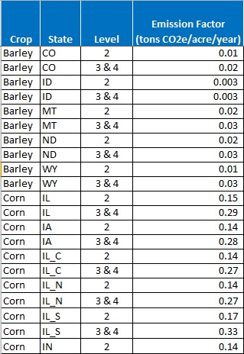
Calculating Emission Factors
Level 4: Network + Soil Health
Level 1: Benchmarking & Plan
Level 2: Plan Evaluation
Level 3: Network

