Slide 1


Charles M. Breen
Regulatory Consultant
Skip Shapiro Enterprises LLC

Slide 2
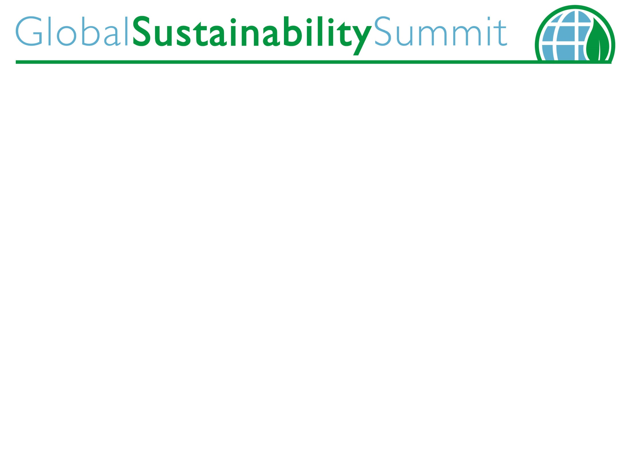
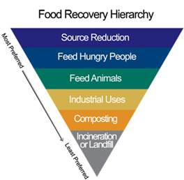
Re-purpose unsalable human food to valuable animal food

Slide 3
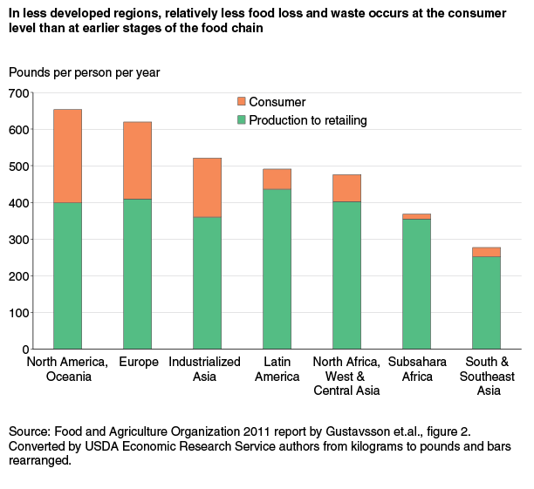
Food Loss between Production and Consumption
Approx. 133 billion pounds lost between production and consumption in N. America.
31% of food produced

Slide 4
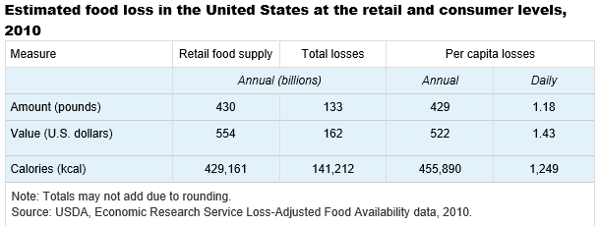

Slide 5
Opportunity & Challenge
Turning food losses into revenue as animal feed
  Abundant potential supply
  Good for the environment
  Good for producer and buyer of feed
Regulatory Compliance: Preventive Controls for Animal Food
  Need for fuller definitions
  Need for clear guidance
  Need to know how to comply and stay profitable

Slide 6
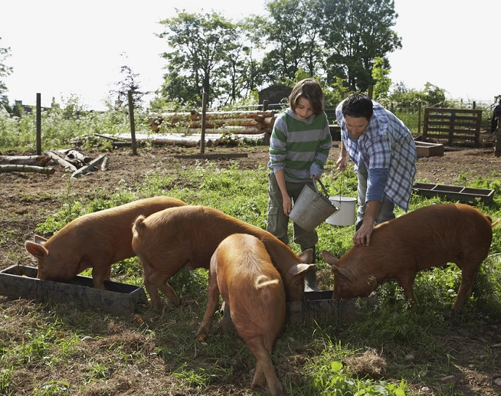
Proposed:
Current Good Manufacturing Practice and Hazard Analysis and Risk-Based Preventive Controls for Food for Animals

Slide 7
Among the Major Questions:
What does “reasonably likely to occur” mean?
How will inspectors be trained to evaluate “reasonably likely to occur?”
When will guidance be available?
What assistance will FDA provide?
What is the role of AAFCO, State Ag and other State regulators?
Do “holding” and “packing” apply to bulk grain storage?

Slide 8
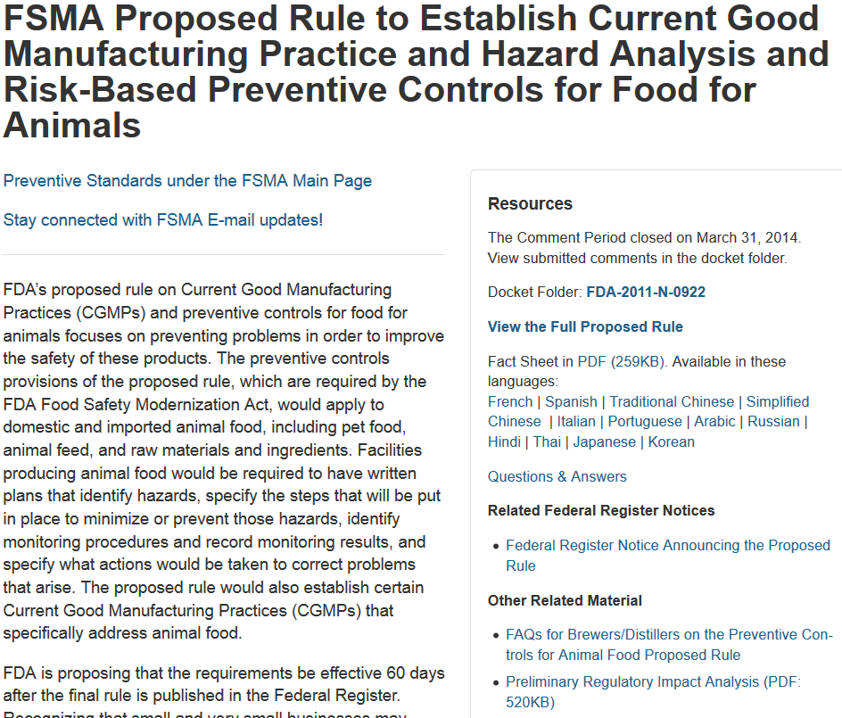
FDA Resource – Proposed Rules, Guidance, Information
  http://www.fda.gov/Food/GuidanceRegulation/FSMA/ucm366510.htm

Slide 9

Impact of Proposed Rule for Preventive Controls for Animal Food on Sustainability
by
Daniel G. McChesney, Ph.D.
Director, Office of Surveillance and Compliance
CVM/FDA
for
Global Sustainability Summit
August 14th 2014
Boston, MA

Slide 10
Summary of Requirements
Establish, for the first time, Good Manufacturing Practices for animal food
Hazard Analysis and Risk-Based Preventive Controls
  Each facility would be required to implement a written food safety plan that focuses on preventing hazards in foods

Slide 11
Who is Covered?
Facilities that manufacture, process, pack or hold animal food
In general, facilities required to register with FDA under sec. 415 of the FD&C Act
Applies to domestic and imported food
Some exemptions and modified requirements are being proposed
Notes:
Facilities that would be covered by the preventive controls requirements of the proposed rule are those that manufacture, process, pack or hold human food
In general, facilities required to register with FDA under current regulations are covered
The proposed rule would apply to domestic and imported food
Some exemptions and modified requirements are being proposed; we will cover these later

Slide 12
Background: Animal Food
Ensuring animal food safety is complex:
  Animal food is made for a wide variety of species
  Many animals consume one food as their sole source of nutrition
  Susceptibility to hazards varies by species and life stage (e.g., different salmonella serotypes are pathogenic to different species, different nutrient toxicities)
  Animal foods are handled in a wide variety of settings
    On farm (e.g., pig trough) vs. in home
  Potential impact on human health
    Human handling (e.g., kids handling pet treats)
    Human consumption of animal products (e.g., aflatoxin in dairy cattle feed can pass through to milk)

Slide 13
New Current Good Manufacturing Practices
Personnel
Plant and grounds
Sanitary operations
Sanitary facilities and controls
Processes and controls
Equipment and utensils
Warehousing and distribution

Slide 14
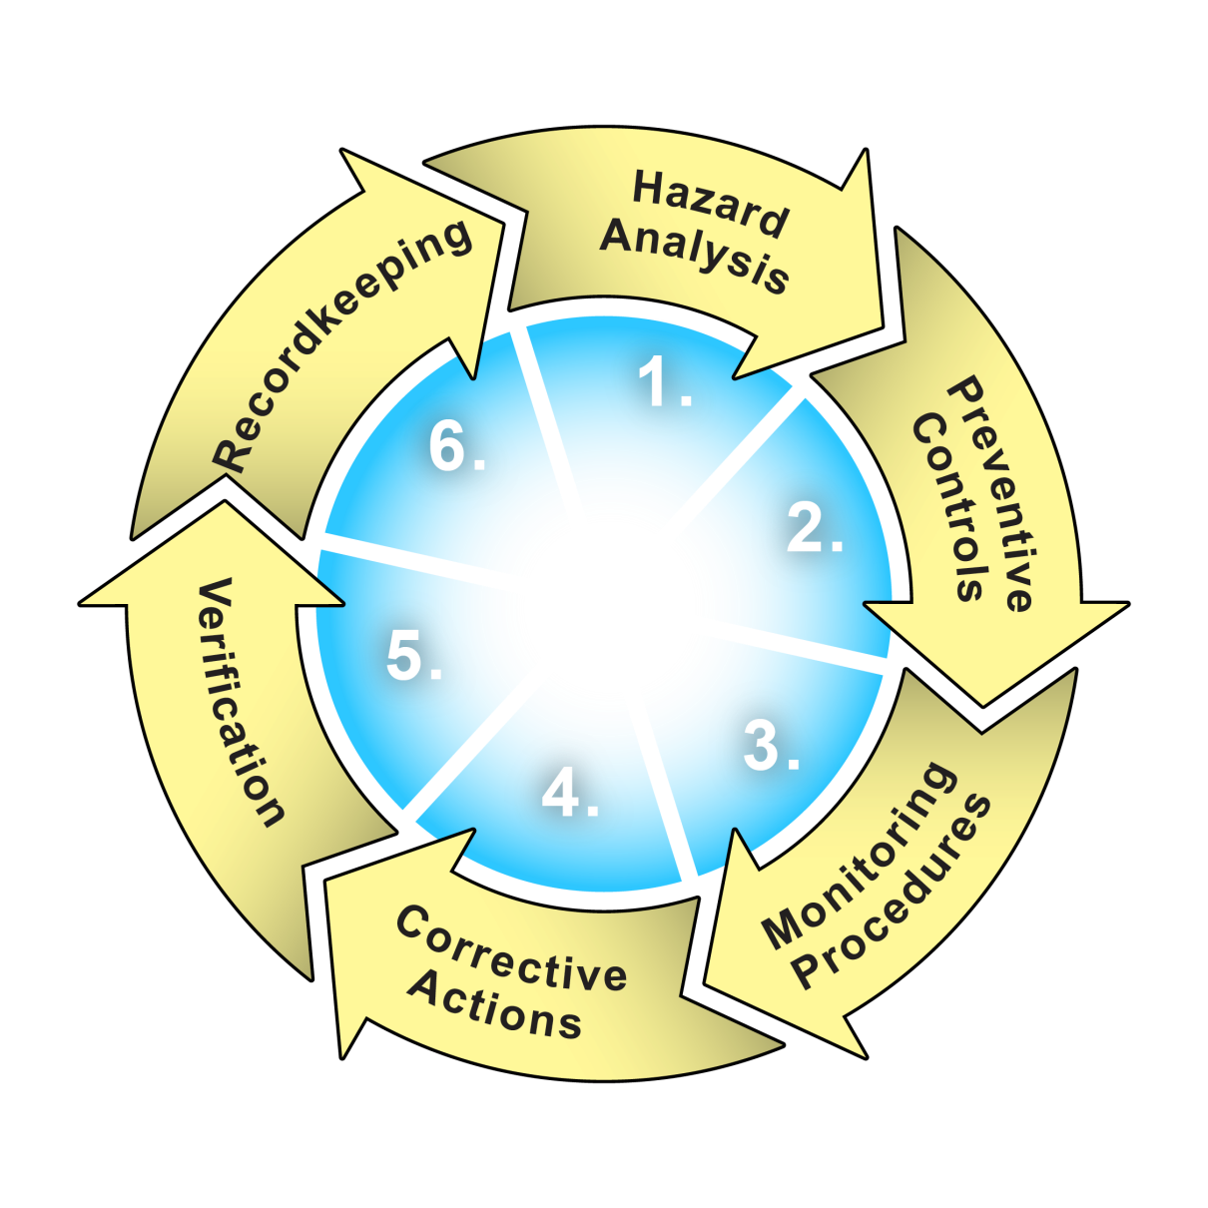
Hazard Analysis and Risk-Based Preventive Controls
Notes:
Covered facilities will be required to prepare and implement a written food safety plan, which would include the following:
Hazard analysis – identifies or evaluates known or reasonably foreseeable hazards
Preventive controls – would depend on which, if any, hazards are reasonably likely to occur
Monitoring procedures to provide assurance that preventive controls are consistently performed and records to document the monitoring required
Corrective actions that would be used if preventive controls are not properly implemented
Verification
Recordkeeping
In addition, the food safety plan would include a written recall plan.

Slide 15
Human vs. Animal
Preventive Controls
Human food firms can choose to apply human CGMPs and pc to all operations or animal CGMPS and pc to the animal food parts of the operation
Enacting legislation allows for difference’s in human and animal preventive controls
Different definitions of very small business

Slide 16
CGMPs: Comments
Stakeholders argued the proposed CGMPs were too stringent to be prerequisite requirements for all animal food facilities, given the diversity of the industry
  Keeping the structure of human food CGMPs
  Based on comments adjusting the requirements to be less prescriptive while maintaining the baseline protection necessary in all animal food facilities to protect against contamination that would be harmful to public health
  Based on comments, including a section with specific requirements for holding and distribution

Slide 17
Human food Byproducts
A large portion of animal food comes from byproducts of human foods, which include unsalable finished human foods, and certain human food processing waste streams
One industry group estimates that nearly 70 percent of waste from human food manufacturers goes into animal food
Some human food manufacturers merely hold (and pack) their byproducts for animal food, while others further manufacture and process their co-products to create a more valuable animal food
Byproducts can go directly to a farmer (to feed to animals on the farm) or to animal food manufacturers (e.g., feed mills, pet food manufacturers) for further processing. Large dairy farms, cattle feedlots, and swine herds are the most common recipients.
Byproducts can be fed directly or may be mixed with other raw materials or ingredients prior to feeding.
Safety concerns focused and minimal
  Chemical and physical

Slide 18
Human food Byproducts: Comments
These animal foods would not have any significant hazards that would necessitate preventive controls to protect the safety of the co-products for animal food use.
Each human food facility that packs and holds it byproducts for animal food use should not need to perform independent hazard analyses to come to this determination.
Requiring these facilities to perform hazard analyses and comply with the related requirements would fail to acknowledge differences in risk, would not “minimize, as appropriate, the number of separate standards that apply to separate foods,” and would not provide sufficient flexibility to be practicable (each required by FSMA).

Slide 19
Human food Byproducts: Comments
Stakeholders expressed concern about over regulation of the byproducts and duplicative requirements.
We decided to address all human food byproducts that are merely packed and held, instead of making a separate policy for spent brewers and distillers grains.
We will tentatively conclude that preventive controls will not apply to human food facilities that merely pack and hold byproducts for use as animal food that:
  Are in compliance with applicable human food safety requirements (e.g., human CGMPs and preventive controls for their human food, juice HACCP, etc.), and
  Follow applicable animal food CGMPs for holding and distribution

Slide 20
Exemptions and Modified Requirements -1
“Qualified” facilities:
  Very small businesses (3 definitions being proposed—less than $500,000, less than $1millon and less than $2.5 million in total annual sales of animal food
  OR
  Animal food sales averaging less than $500,000 per year during the last three years AND
  Sales to qualified end users must exceed sales to others

Slide 21
Exemptions and Modified Requirements - 2
Storage facilities such as grain elevators and warehouses that only store raw agricultural commodities intended for further distribution or processing
Activities within the definition of “farm,” including farm activities that are covered by the proposed produce rule
Notes:
Certain storage facilities such as grain elevators and warehouses that store only raw agricultural commodities (other than fruits and vegetables) intended for further distribution or processing are exempt from hazard analysis and risk-based preventive controls.
21

Slide 22
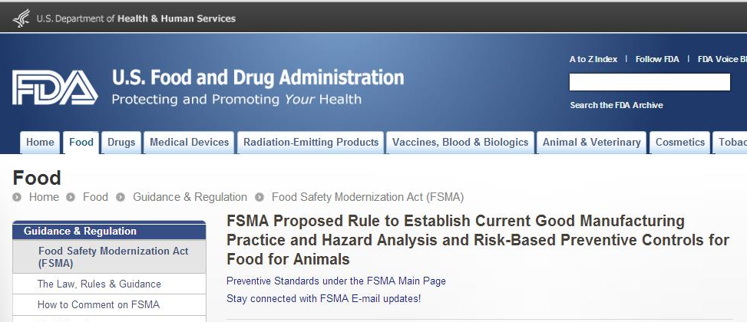
More Information Available
Web site:
http://www.fda.gov/fsma
Subscription feature available
Send questions to FSMA@fda.hhs.gov

Slide 23
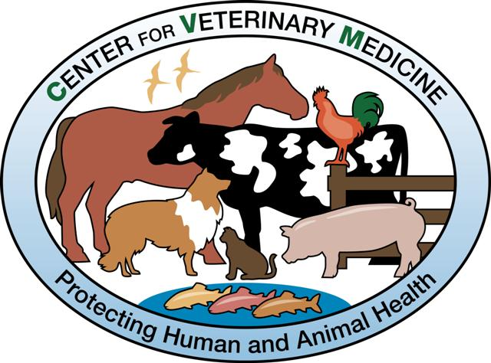
Thank You

Slide 24
Animal PC vs Human PC
Differences
Animal PC includes nutrient toxicities as a hazard
Animal PC does not include allergens as a hazard
Animal PC has two endpoint for judging hazards (animal and human health)
Animal PC must address animal food and human food used as animal food

