Slide 2

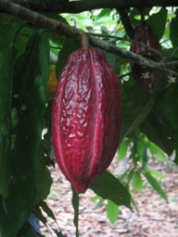

Sweet Successes in Cocoa Sourcing
FMI / GMA Global Sustainability Summit

Slide 3
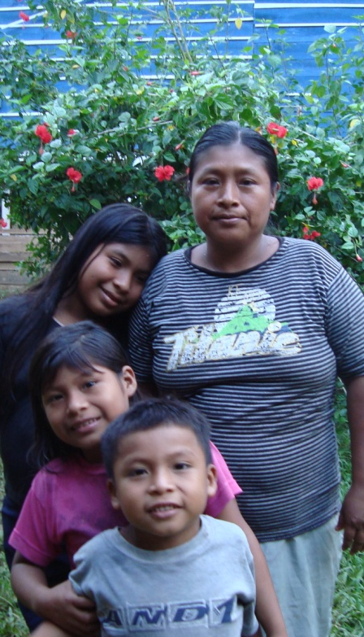
Who grows cocoa?
90% small farms (1-5 ha average)
5-6 million cocoa farmers globally
~40-50million people depend on cocoa for their livelihood
Notes:
90% producers are small scale (1-5 ha average)
5-6 million cocoa farmers globally
Typically the whole family is engaged in cultivation
Estimated 40-50million people globally depend on cocoa for their livelihood
Very few countries have large scale plantations – some exist in Brazil, Venezuela, DR, Malaysia, Hawaii and Ecuador

Slide 4
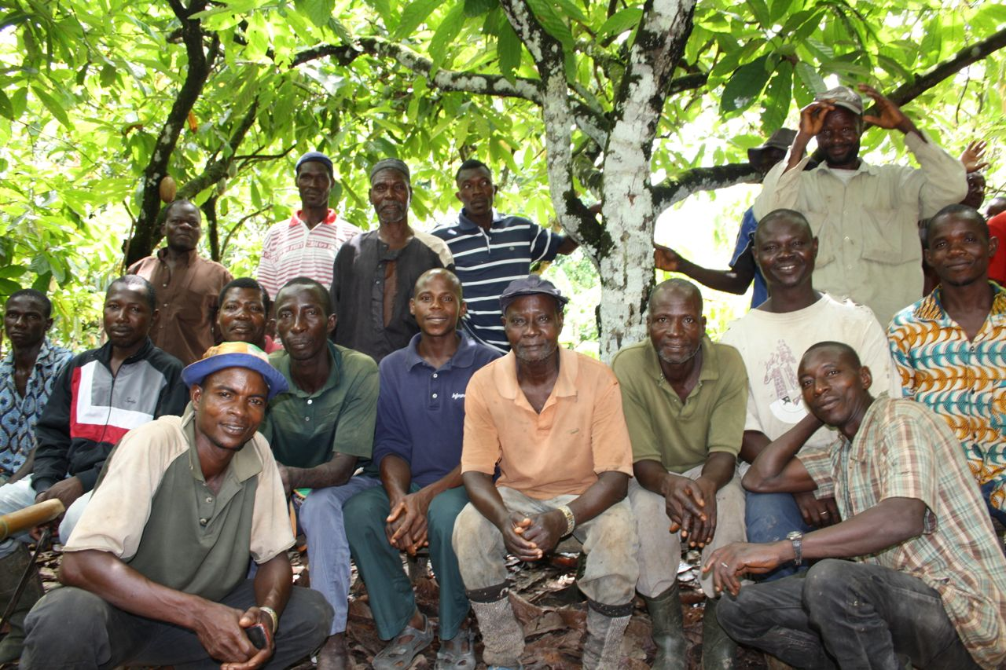
Challenges
Poverty
Pest & Diseases
Low Productivity
Biodiversity Loss
Weak Farmer Organizations
=
Youth are not choosing to grow cocoa and demand is outpacing supply
Notes:
Sector recognizes that broad collaboration and investment critical to secure future supply to meet estimated demand

Slide 5

TAWIAH AGYARKO-KWARTENG -
West Africa Cocoa Sustainability Manager
Notes:
As a company, learning whilst we grow our sustainability programming; farmers learning as they grow their farm businesses

Slide 6
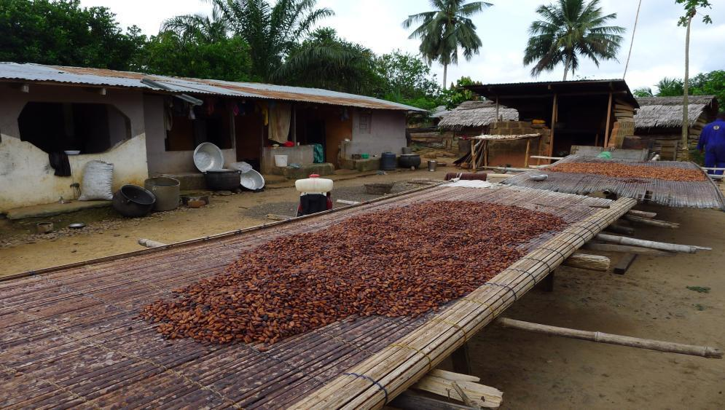
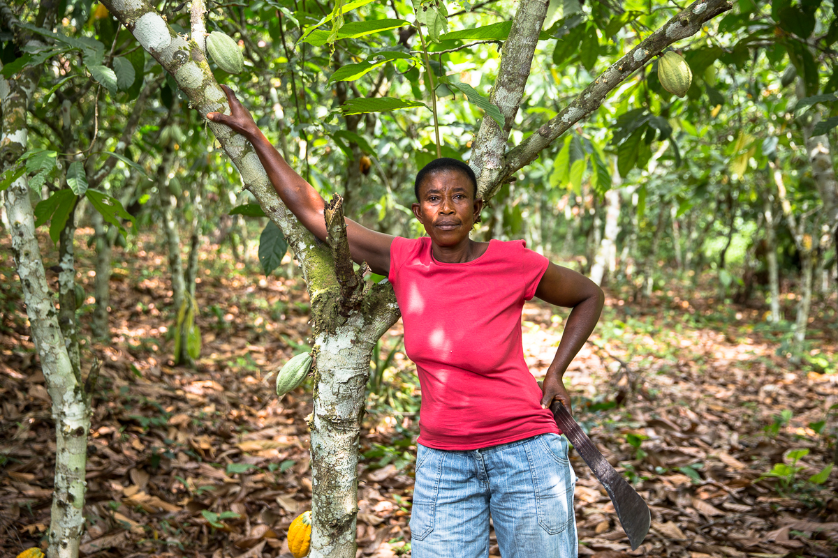
Cocoa is Hershey’s Key Commodity
Notes:
Cocoa community and farmer in Central region, Ghana
Cocoa growing is hard work, conducted in remote villages, often many hours from a good road.
To meet rising demand by consumers, cocoa growing needs to be modernized. It is quite possible for an average cocoa farmer in West Africa to triple how much cocoa he or she produces each year.
This increased production means family incomes will rise, more children will go to school and the rural economy will prosper.

Slide 7



Modernizing Cocoa Growing is Key
Common Objectives
Hershey Leadership
New trees
Farmer learning
Access to fertilizer
Community improvement
Engaged governments
Digital delivery
Standards
Notes:
For the forseeable future, cocoa remains of major importance to our industry and the region.
Here you see how the industry plan connects with our own.
There are 2 million small cocoa farmers in W. Africa so this work is often painstaking and slow going.
But we know these strategies will bring improvement to the farmers and communities.

Slide 8

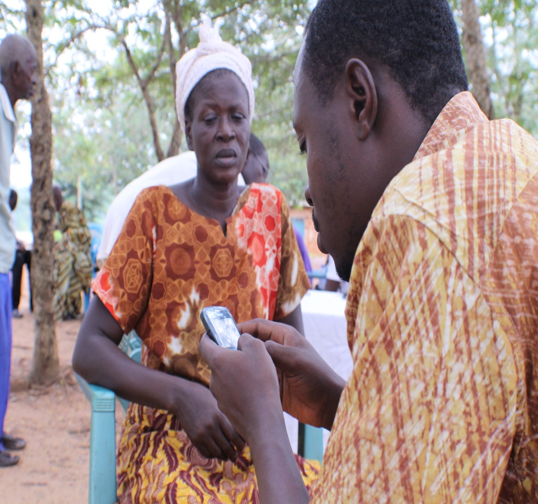
CocoaLink: Digital Extension Platform
45,000 registered farmers in Ghana
Over 1,000,000 free SMS sent
Voice service in local language
Impact of 3 year pilot
Increase in knowledge of cocoa production (planting, spraying, fertilizer application)
Improved practices related to pruning, weeding, use of protective gear, better farm maintenance
Improved yield and income
Transition to Cocoa Board management ongoing
Notes:
Increase in mobile penetration in Africa – opportunity
Together with Ghana Cocoa Board, developed a unique program to take advantage of this opportunity
Excellent example of a public private partnership; ownership by Cocobod; they are managing the program now
Pilot ended earlier in the year – great results validated the efforts

Slide 9
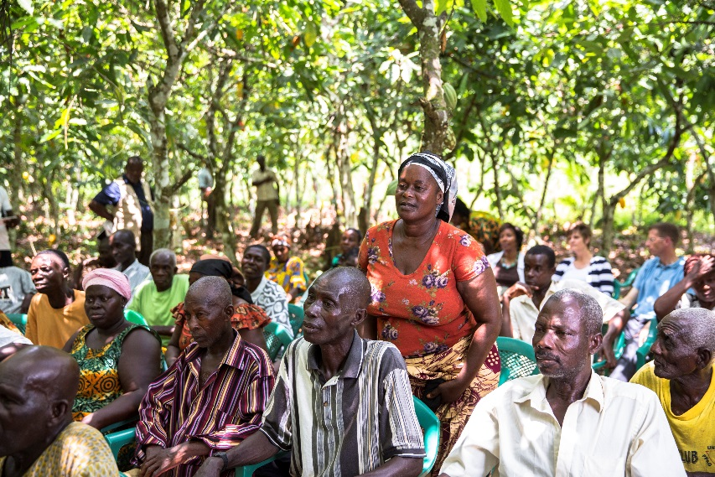


CocoaLink 2.0 : Expanding the Digital Extension Platform
2.0
Rich-content digital enhancements
Extended network of local information providers
Notes:
Future direction
Supporting government ownership with innovations
Building out the public private partnerships to ensure enrichment of content and wider network of farmers and extension agents reaching more farmers

Slide 10
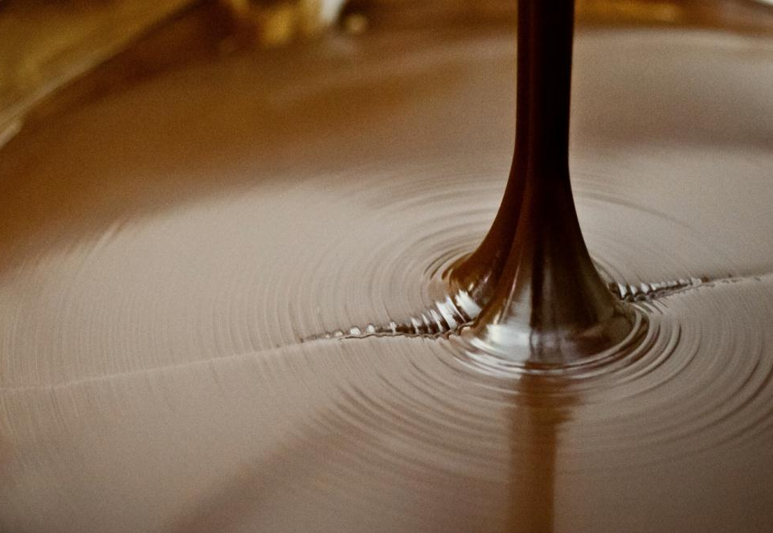
FMI/GMA Global Sustainability Summit
Dennis Macray
Chief Operating Officer
Theo Chocolate
www.theochocolate.com

Slide 11
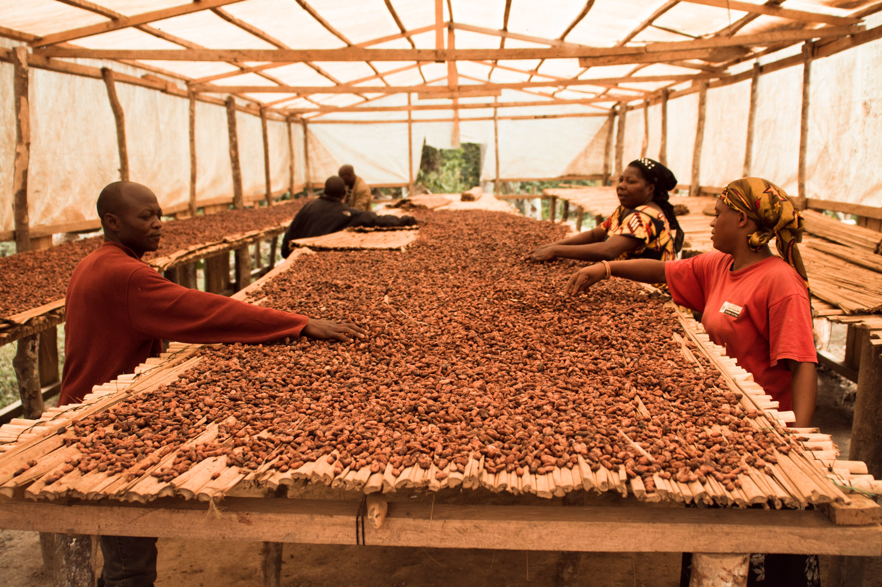
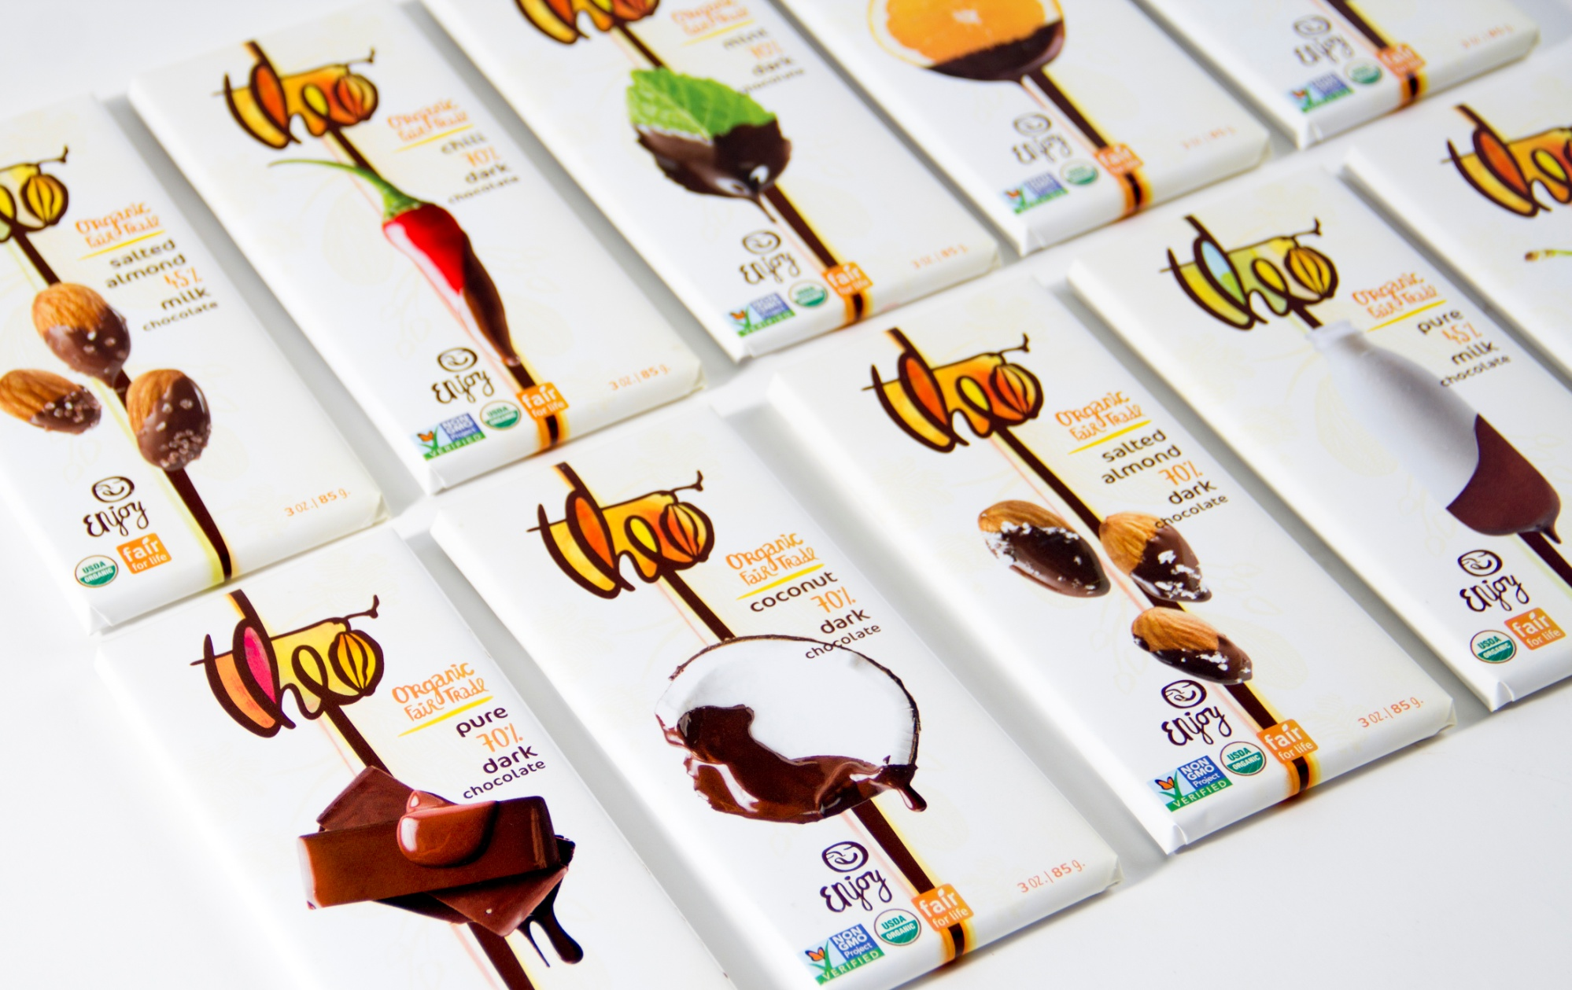
Strong Farmers Produce Great Cocoa that makes Delicious Chocolate

Slide 12
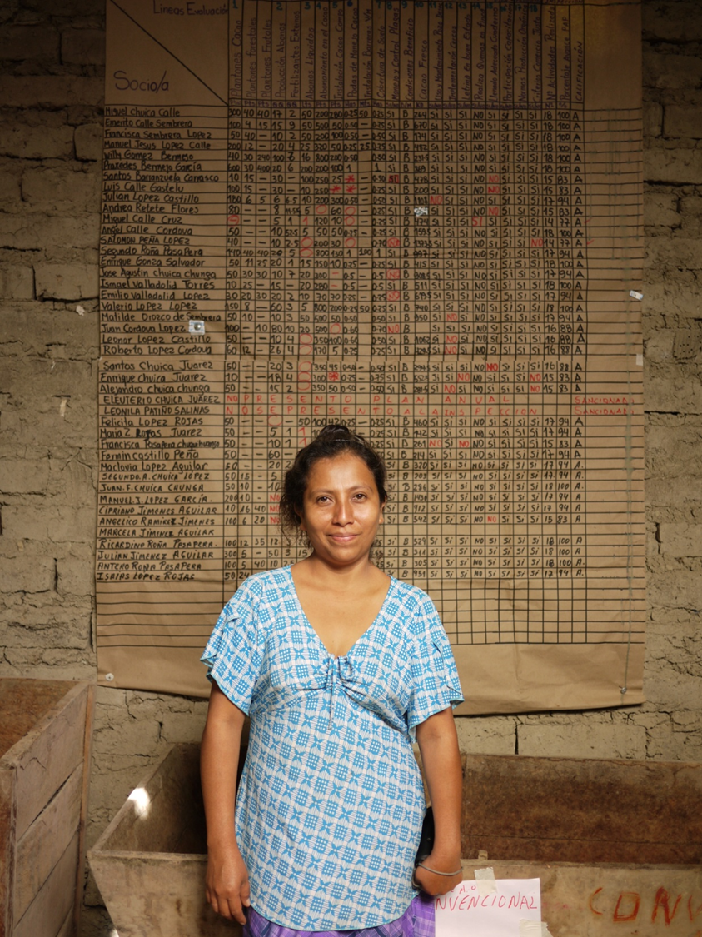
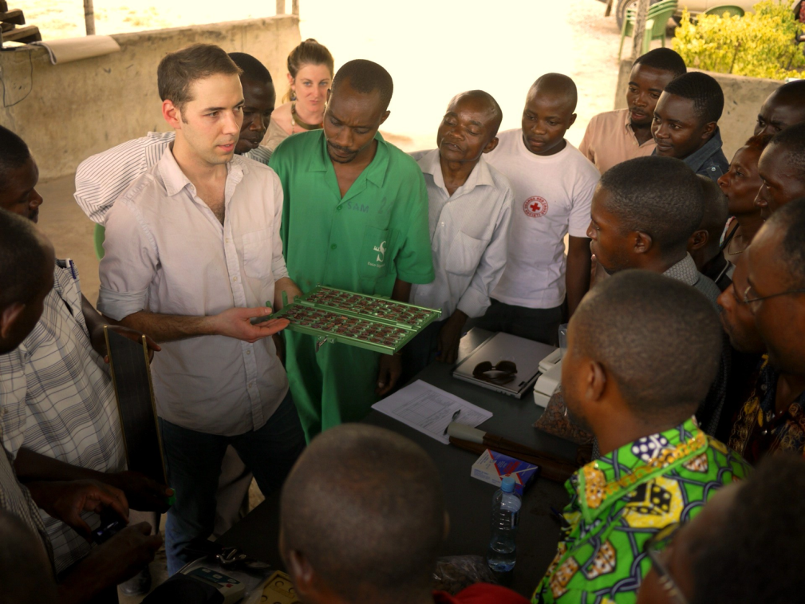
Theo Pillars of Sourcing
Quality + Premiums
Transparency
3rd Party Verification

Slide 13

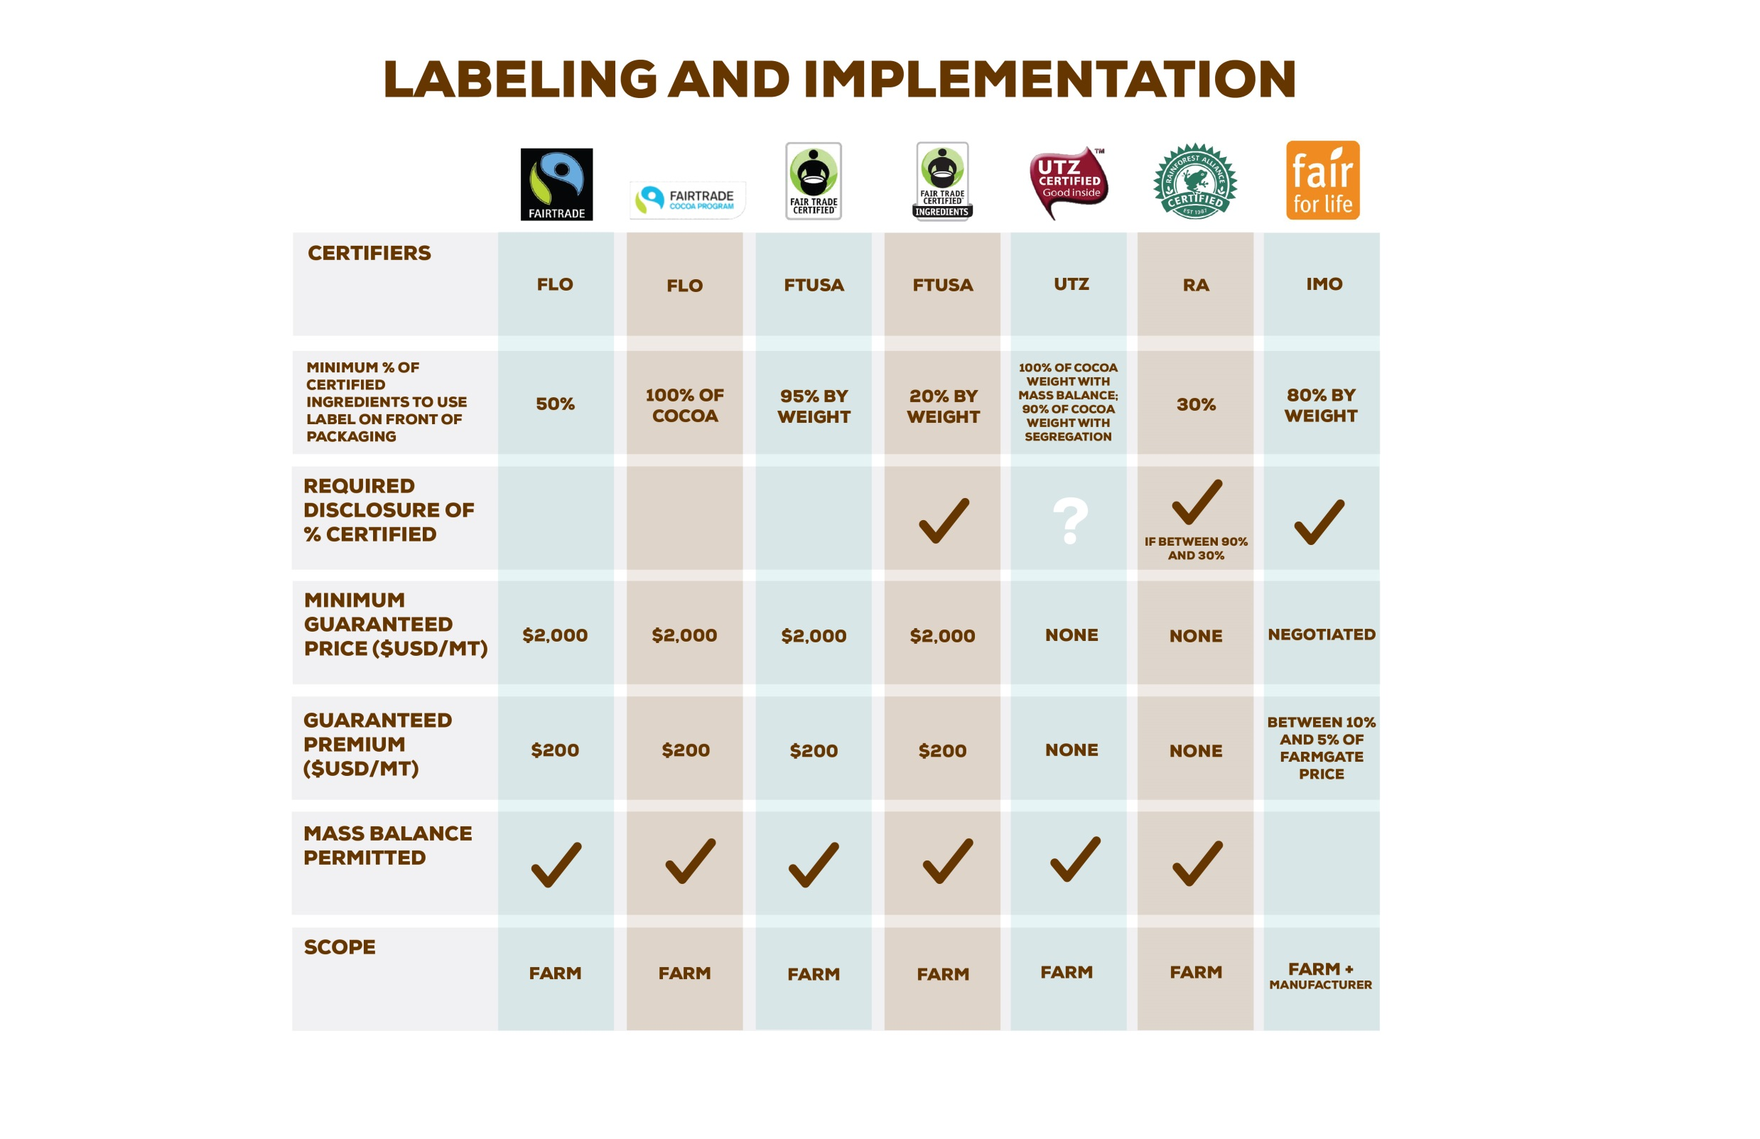

Slide 14


Slide 15
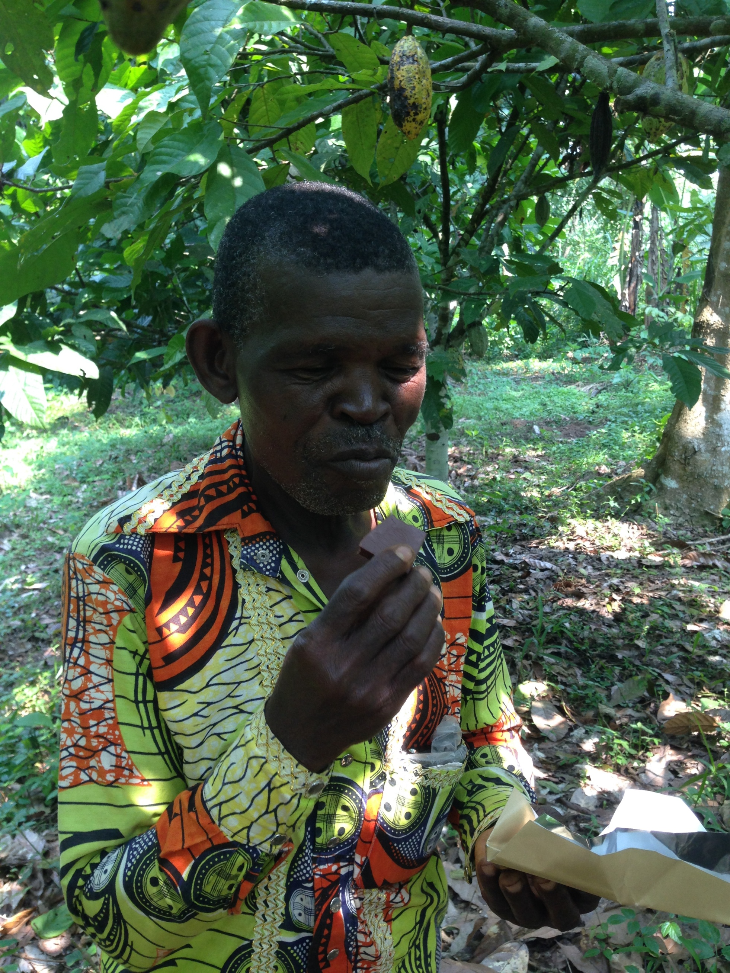
For more information:
https://www.theochocolate.com/our-product-info/our-cocoa-beans

Slide 16
Cultivating Entrepreneurship to Foster Rural Prosperity
Shayna Harris
Cocoa Sustainability Manager - Impact and Innovation
FMI 2014 Global Sustainability Summit
August 14th, 2014

Slide 17
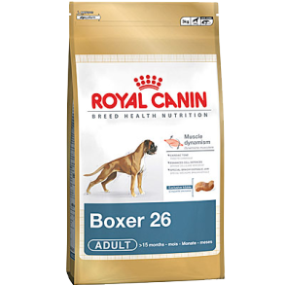
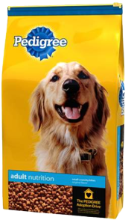
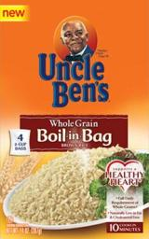








Mars Inc company overview
To know Mars, Incorporated is to understand our heritage, the Five Principles that guide us every day, and the objective of mutuality which is at the heart of how we operate, and has helped us become a successful global food business.
Quality, Responsibility, Mutuality, Efficiency and Freedom are the Five Principles that unite us across generations, geographies, languages and cultures.
Making a difference to people and the planet through our performance is part of our measure of success. Our focus areas include: our operations, our supply chain, health and nutrition, brands and our working environment

Slide 18






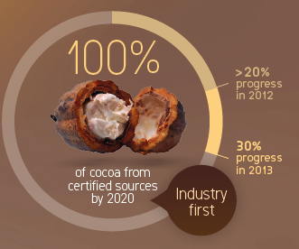
Putting our Principles into action to create mutual benefits
Making a difference to people and the planet through our performance is part of our measure of success. Our focus areas include: our operations, our supply chain, health and nutrition, brands and our working environment.
Our Operations
Health & Nutrition
Supply Chain
Our Brands
Working at Mars
Notes:
18

Slide 19
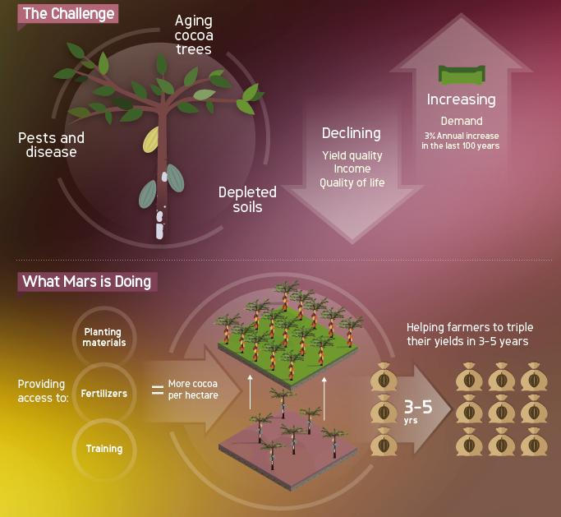

Slide 20
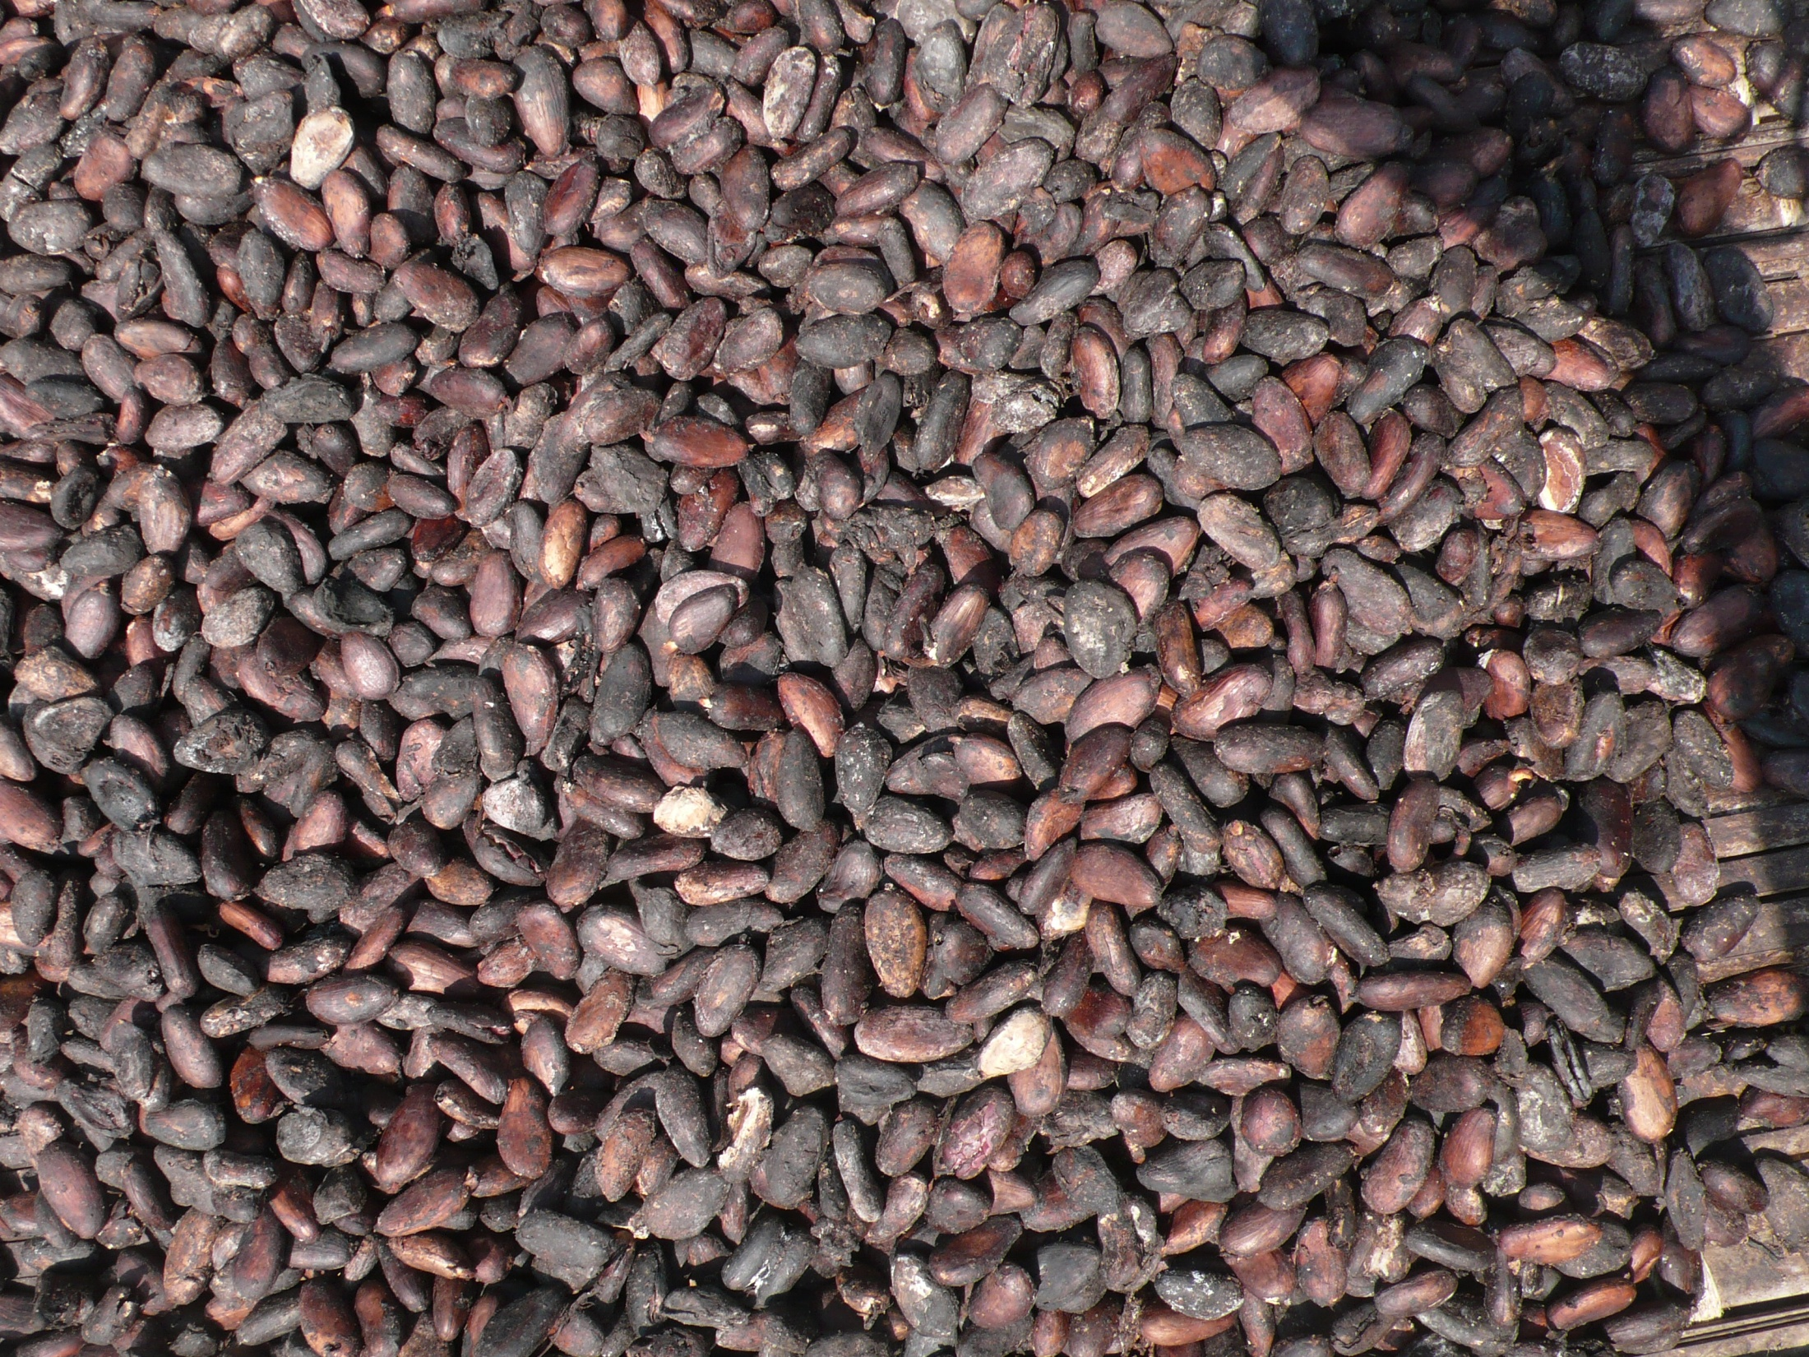
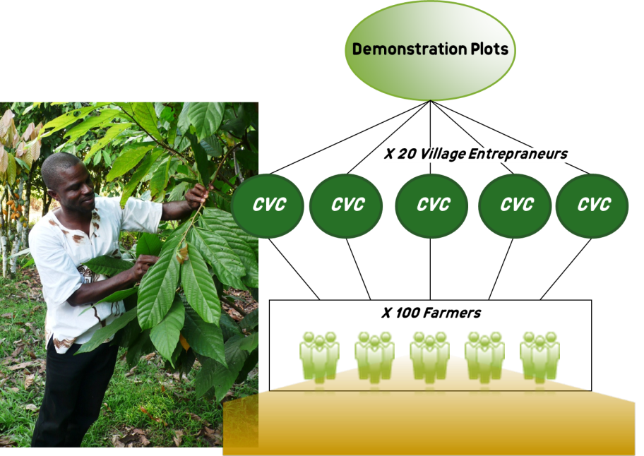
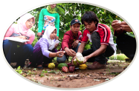
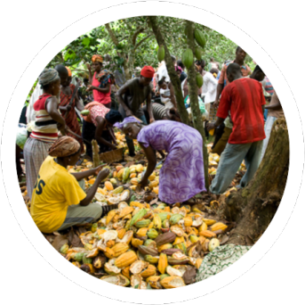

THE OPPORTUNITY
Notes:
The Opportunity
3x yields, improve incomes
New approach to distributing knowledge & materials
Privitizing the last mile via entrepraneurs
Neighbor to neighbor, demonstrating locally
Focusing on real factors for farmer adoption of new practices
Mention Indonesia and Cote d’Ivoire. Concept is scalable, but needs to be customized to different origins. Market conditions and environmental conditions make this different. Vision for CdI was born out of Indo, but there are inherent differences.

Slide 21
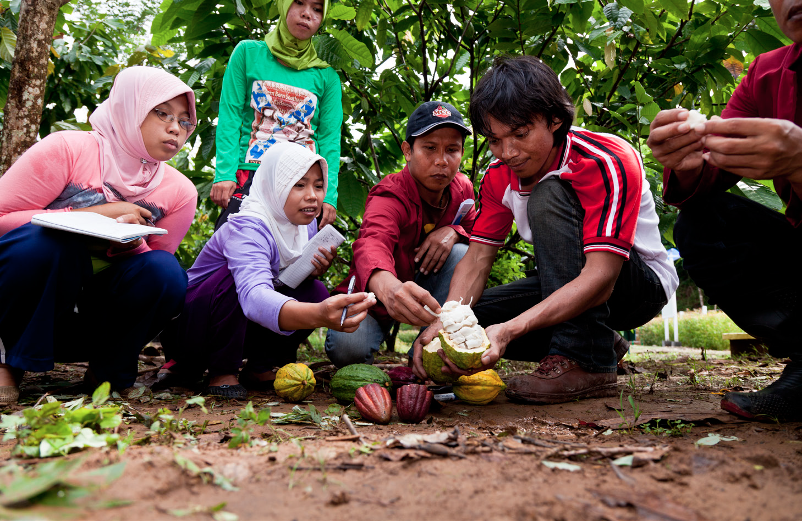
WHAT’S NEXT?
Notes:
What’s Next?
Collaborations! Our work is grounded in the philosophy that we must do this in partnership (public/private)
Must address the following – 1) Finding the successful entrepreneurs and early adoptor farmers 2) Laying the groundwork for growth during the pilot phase – collaboration with CNRA on planting materials, supply chain partners on est CVCs and input supply. Planning the right training capacity for growth 3) Listneing the the customer – learning what works and how it can be improved from the farmer, and sharing these lessons with others

Slide 22
Thank you! www.cocoasustainability.com
Shayna.Harris (at) effem.com

Slide 23

Thank you!
http://www.thehersheycompany.com/social-responsibility/
cocoa-sustainability.aspx
www.theochocolate.com/our-product-info/our-cocoa-beans
www.cocoasustainability.com
www.sustainablefood.org

