Slide 2


Slide 3

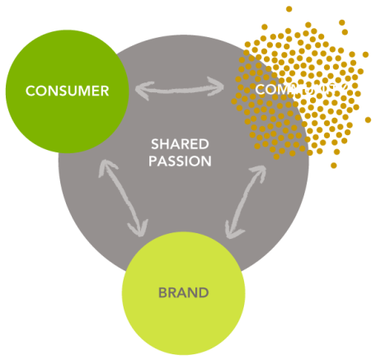

Slide 4
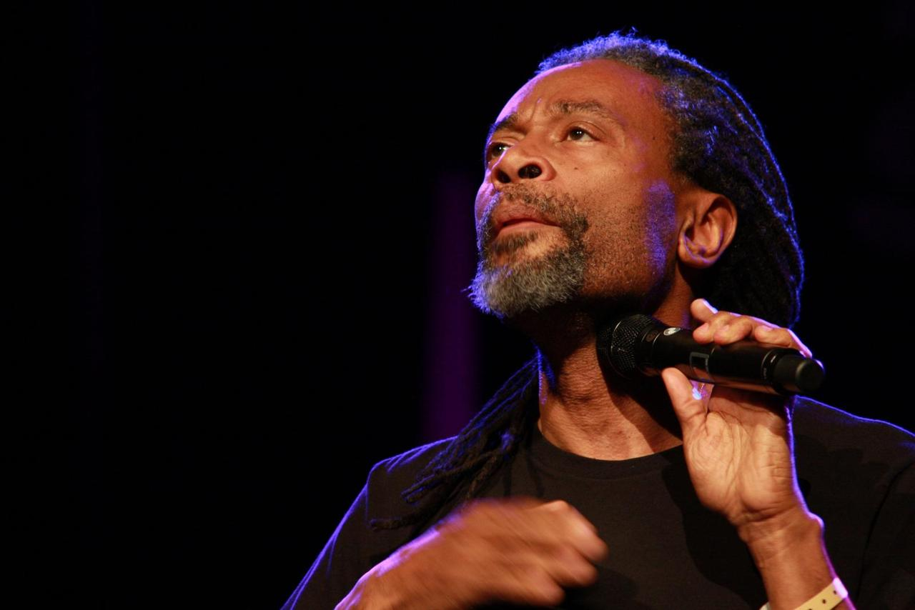

Slide 5


Slide 6


Slide 7


Slide 8


Slide 9
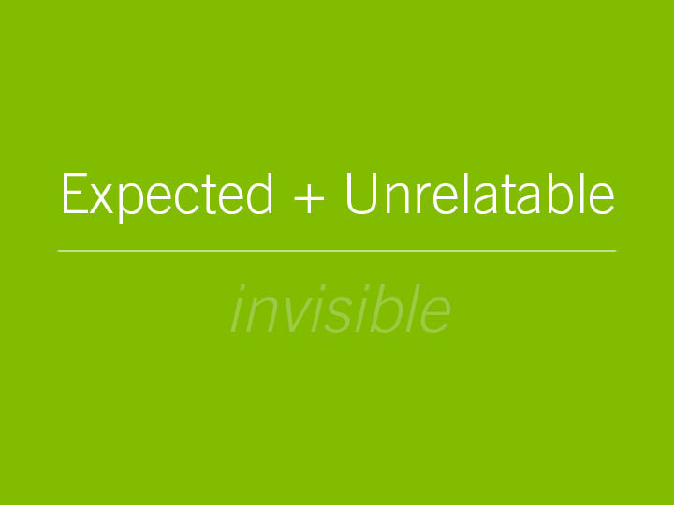

Slide 10


Slide 11


Slide 12
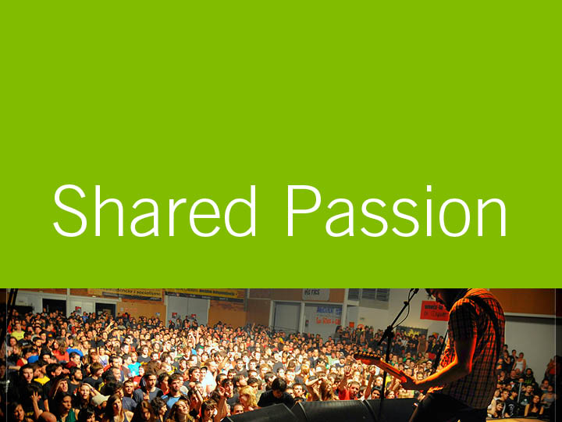

Slide 13


Slide 14
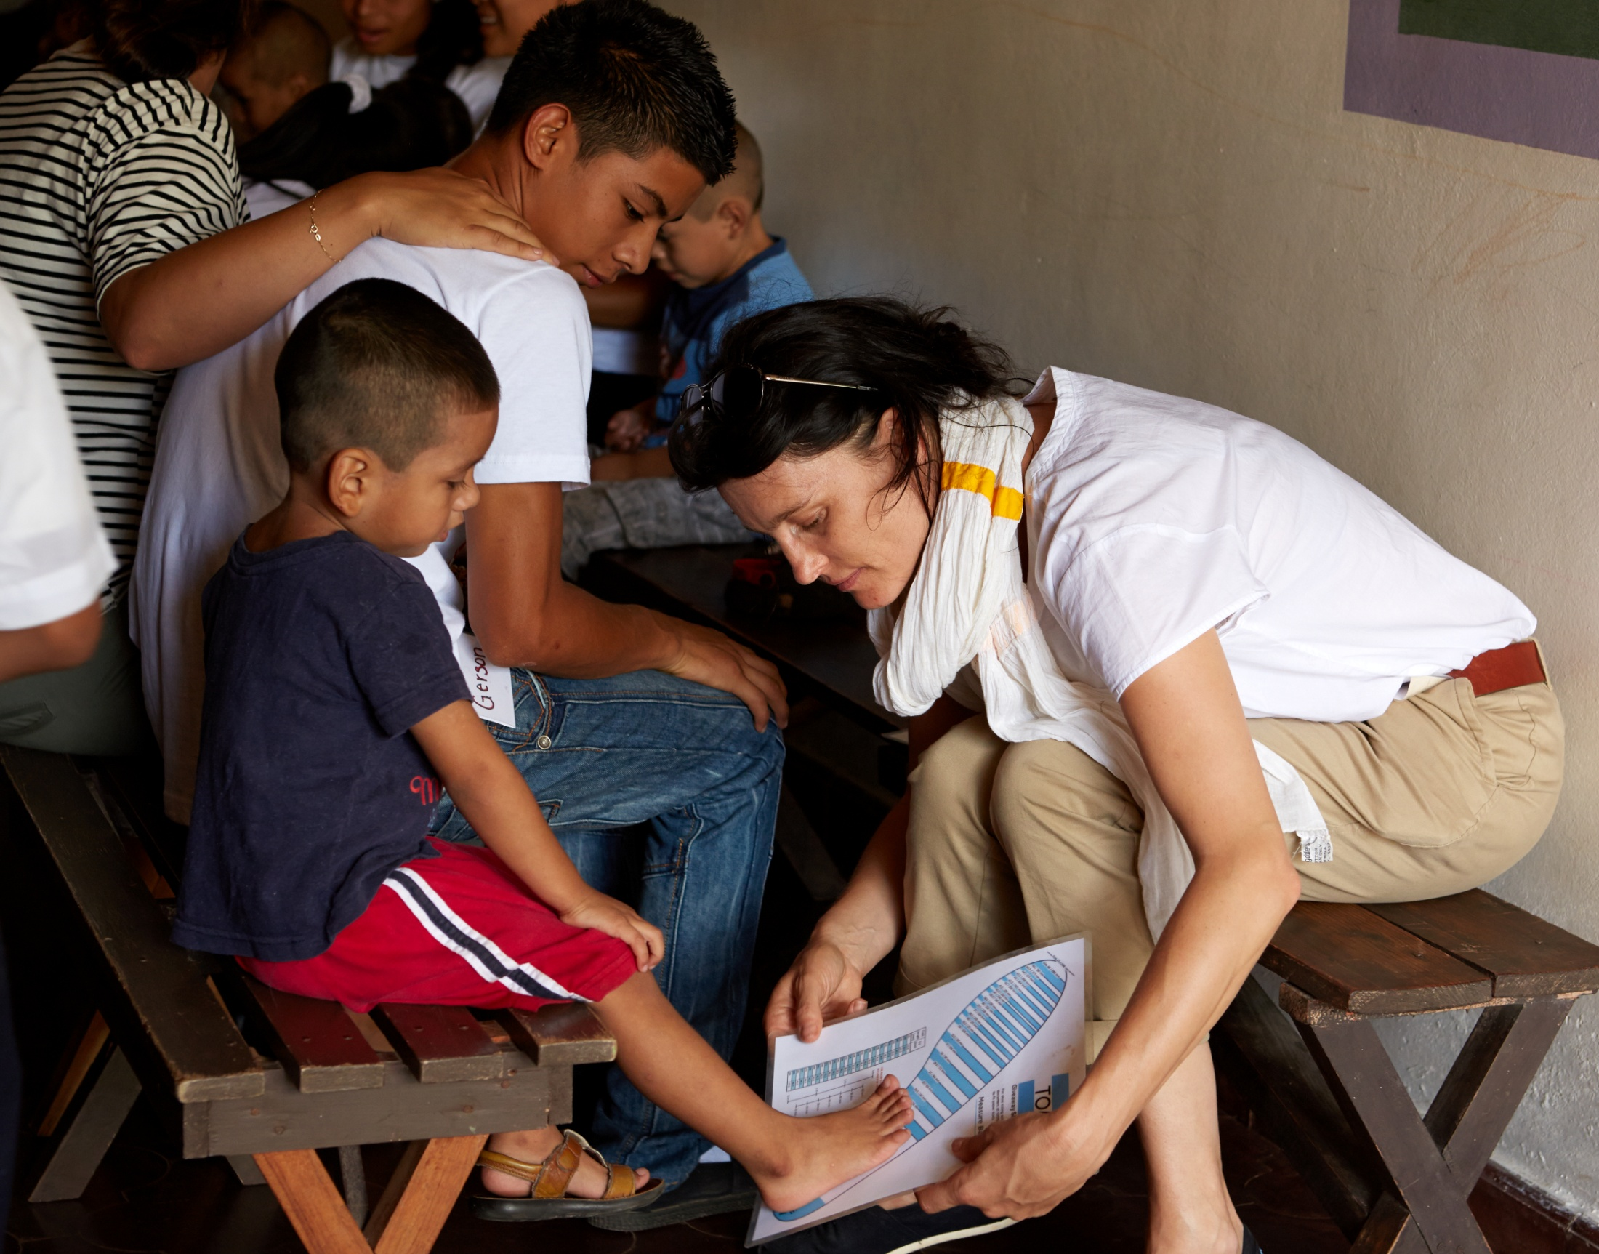

Notes:
Tom’s shoes

Slide 15


Slide 16
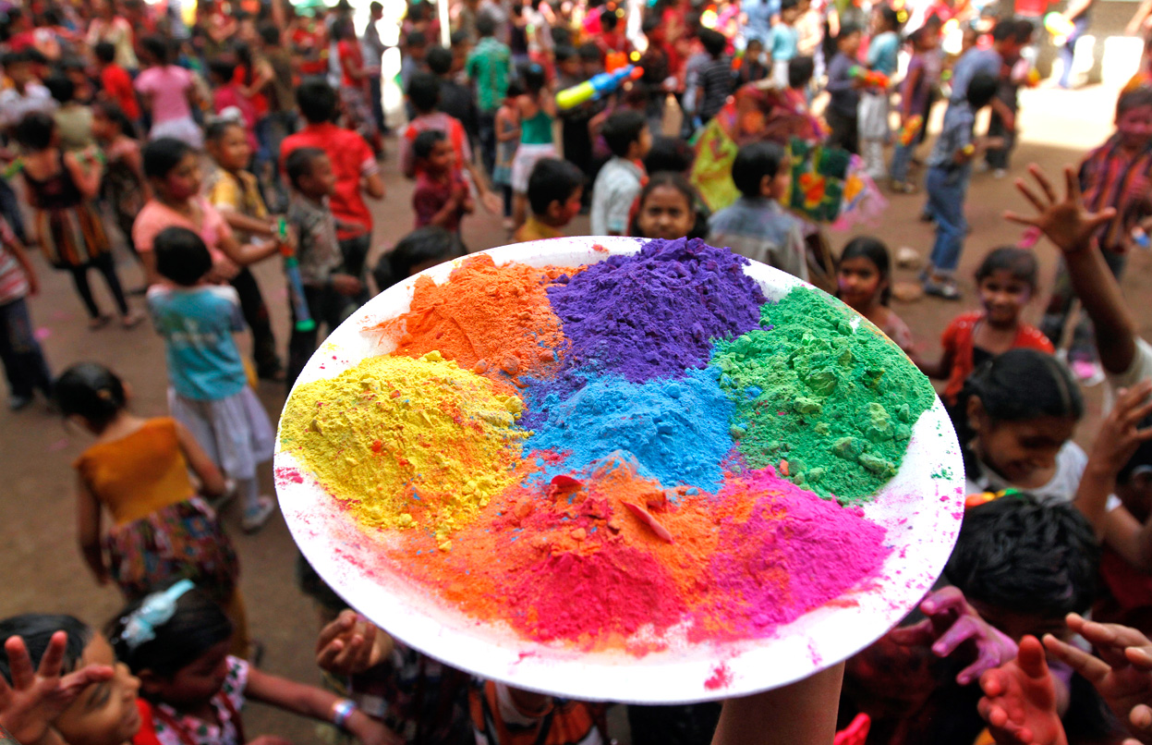

Slide 17
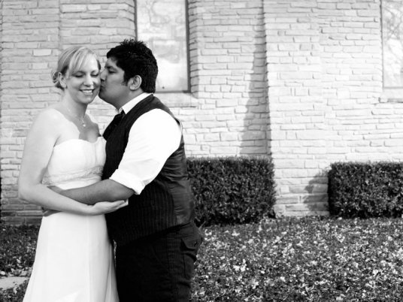

Slide 18
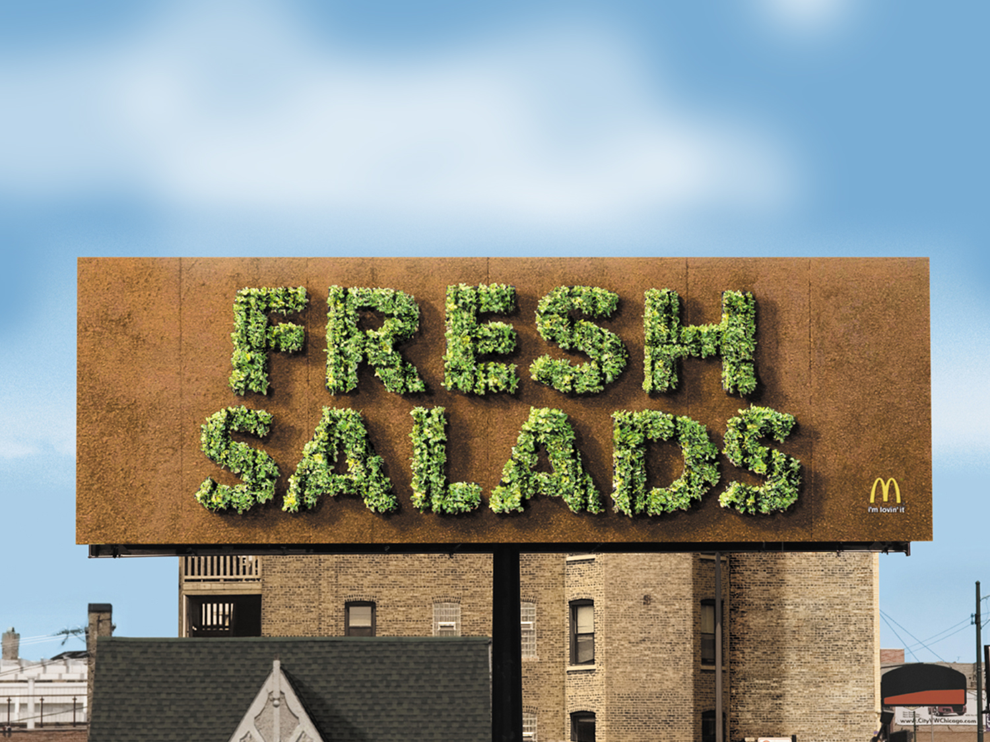

Slide 19
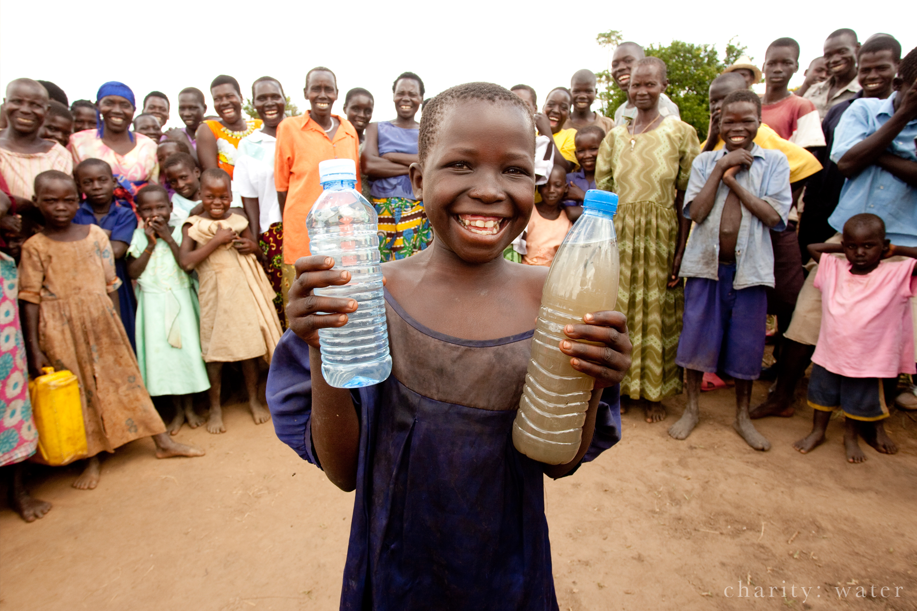
Notes:
Charity: water

Slide 20
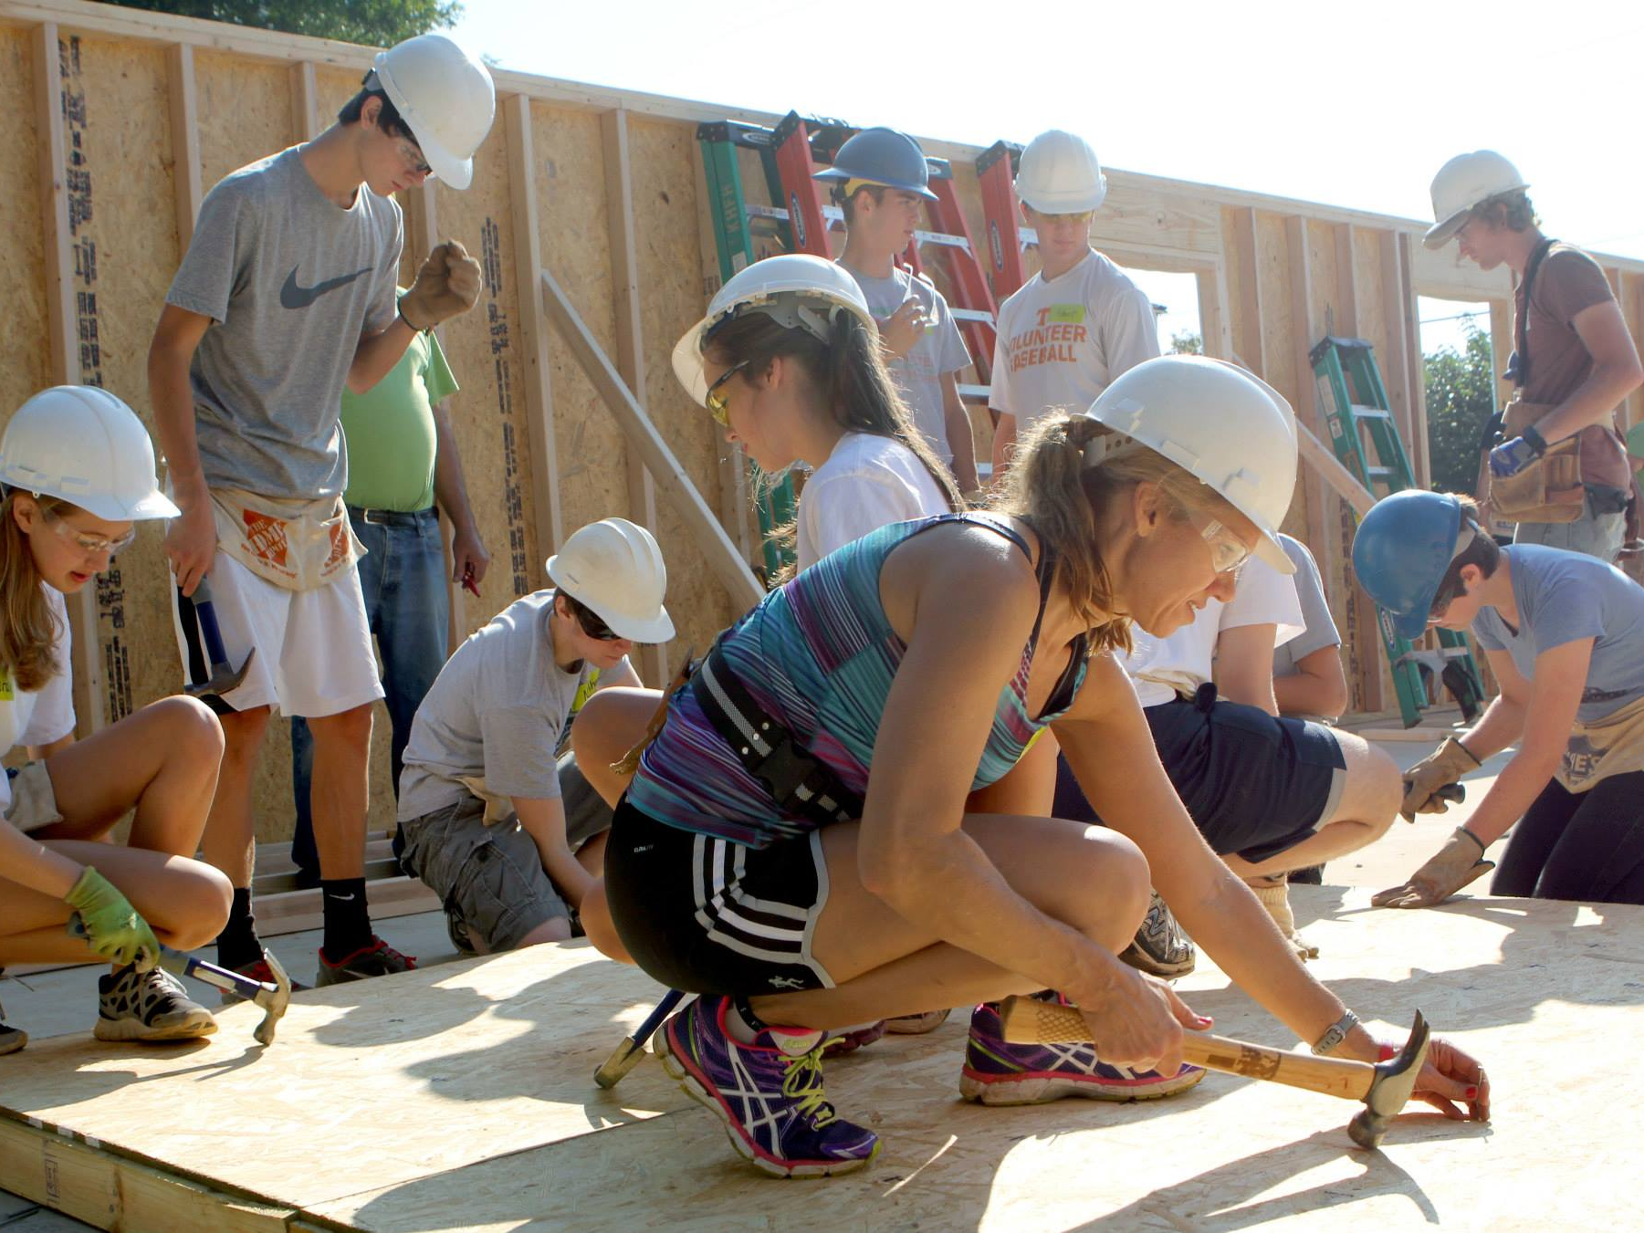
Notes:
Habitat for humanity

Slide 21
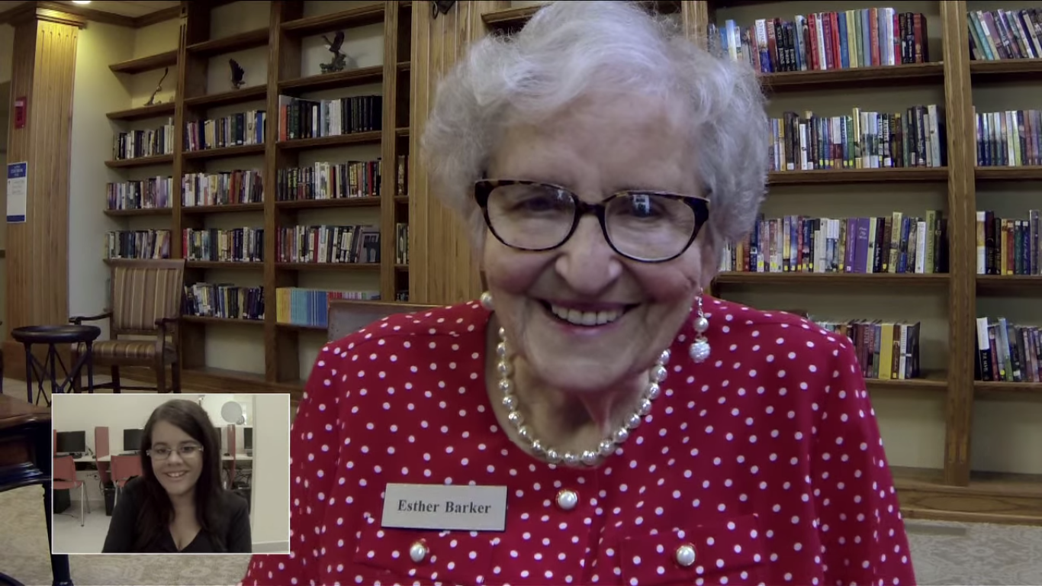
Notes:
Thought this language school idea worked for connecting – students get to practice their english with people in retirement homes http://www.adweek.com/adfreak/perfect-match-brazilian-kids-learn-english-video-chatting-lonely-elderly-americans-157523

Slide 22


Slide 23
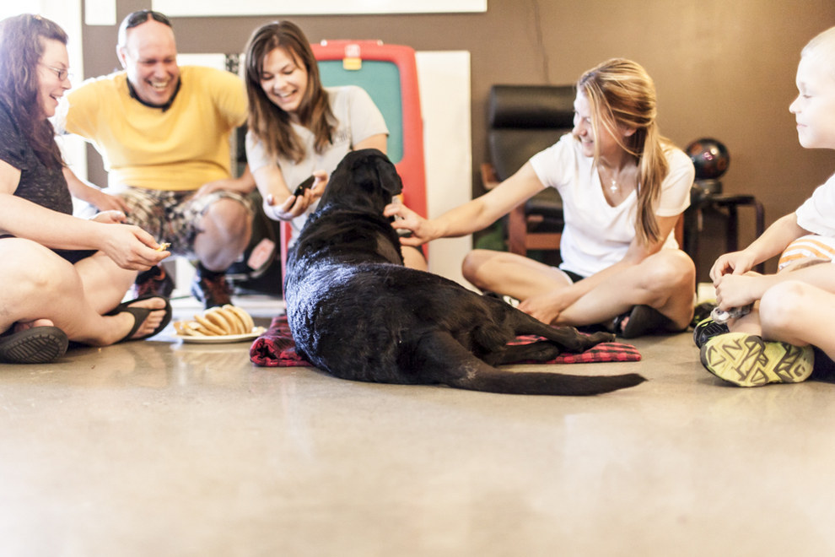

Slide 24
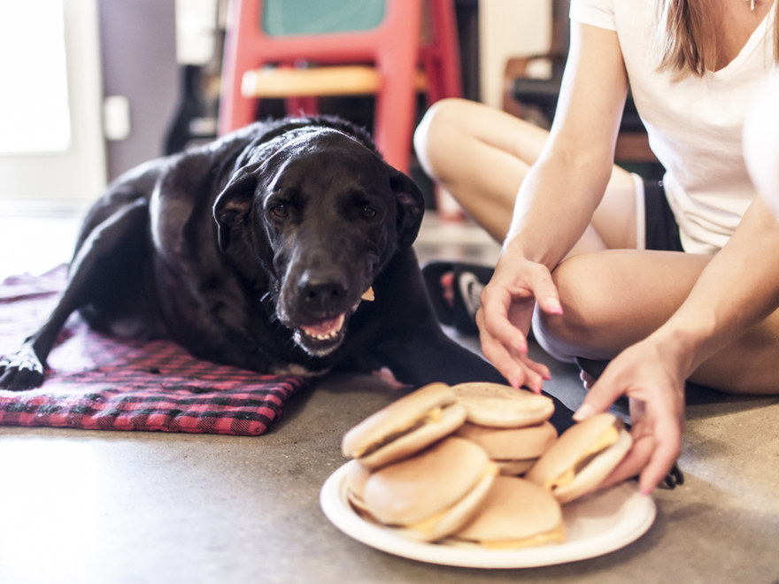

Slide 25
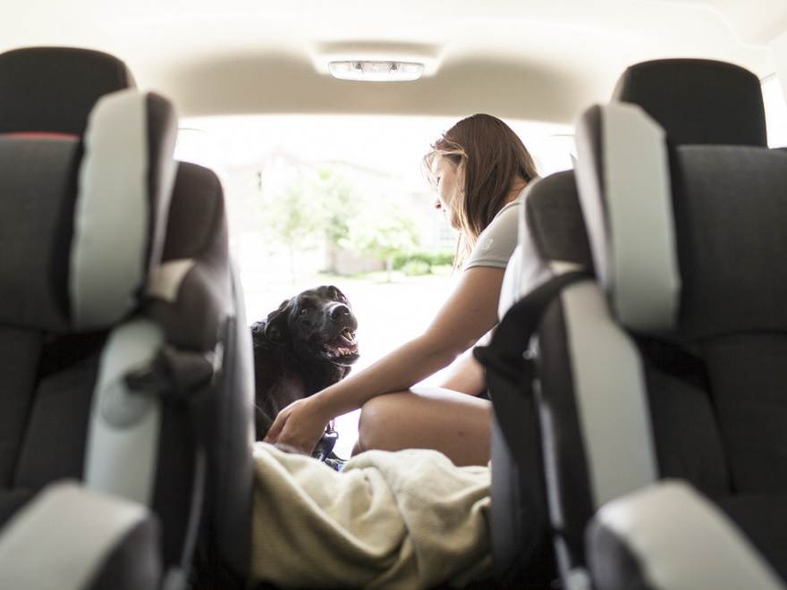

Slide 26
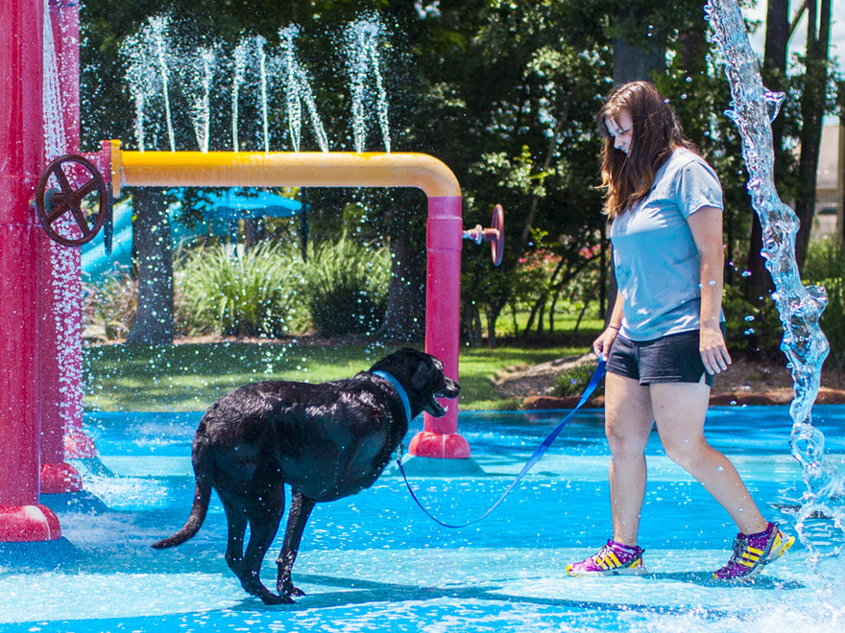

Slide 27
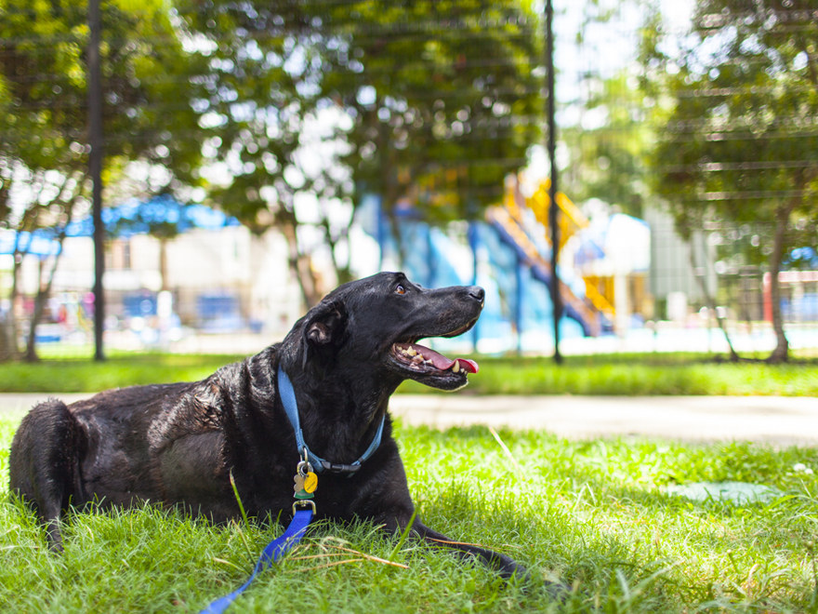

Slide 28
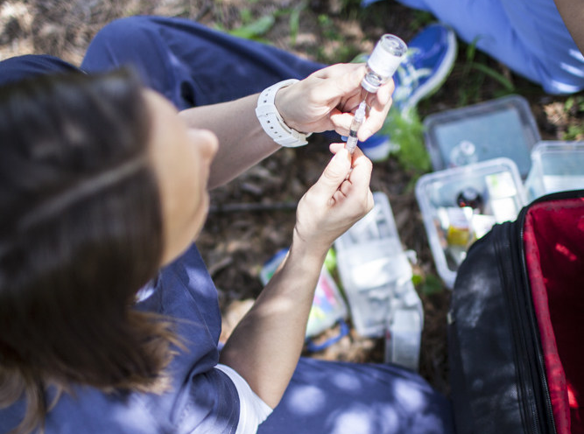

Slide 29
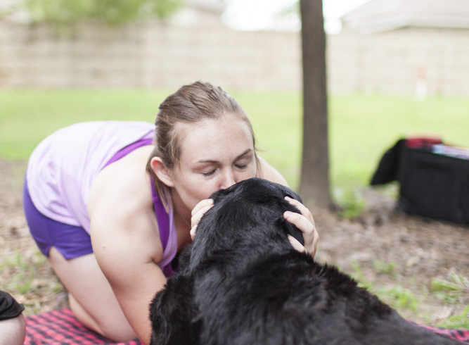

Slide 30


Slide 31


Slide 32
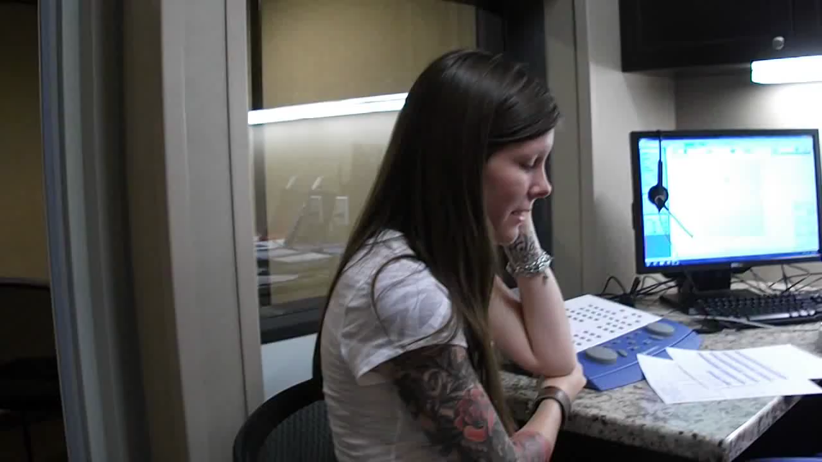

Slide 33
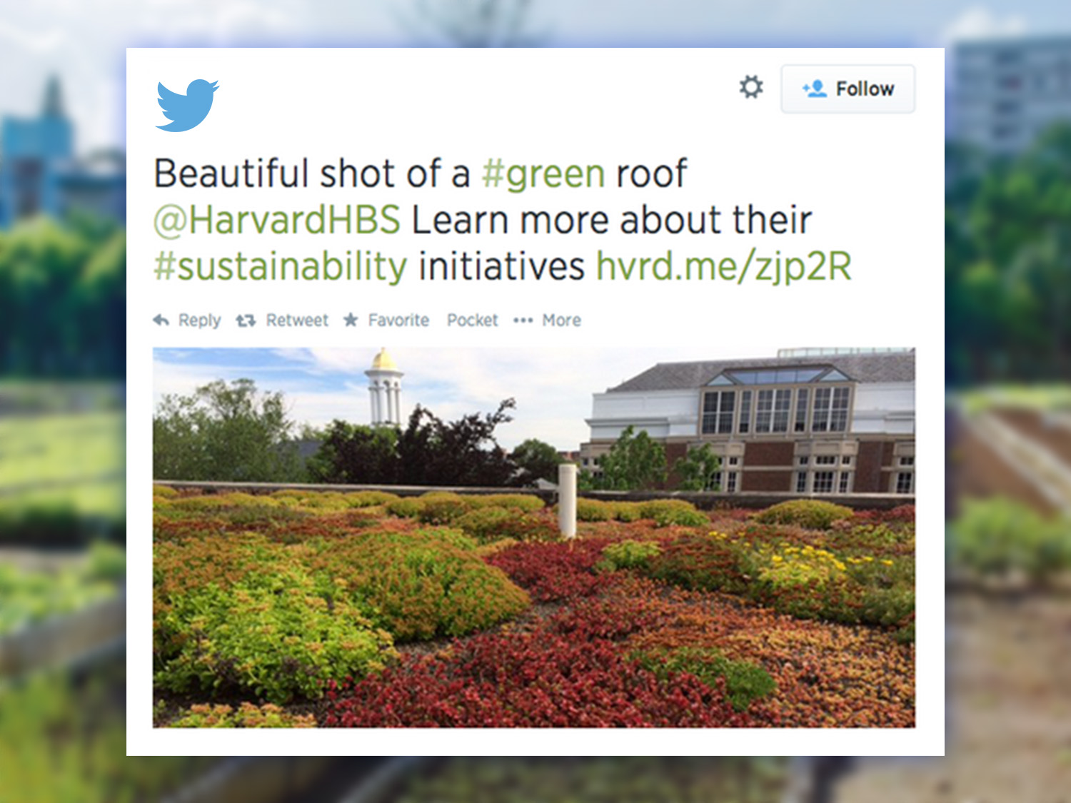

Slide 34
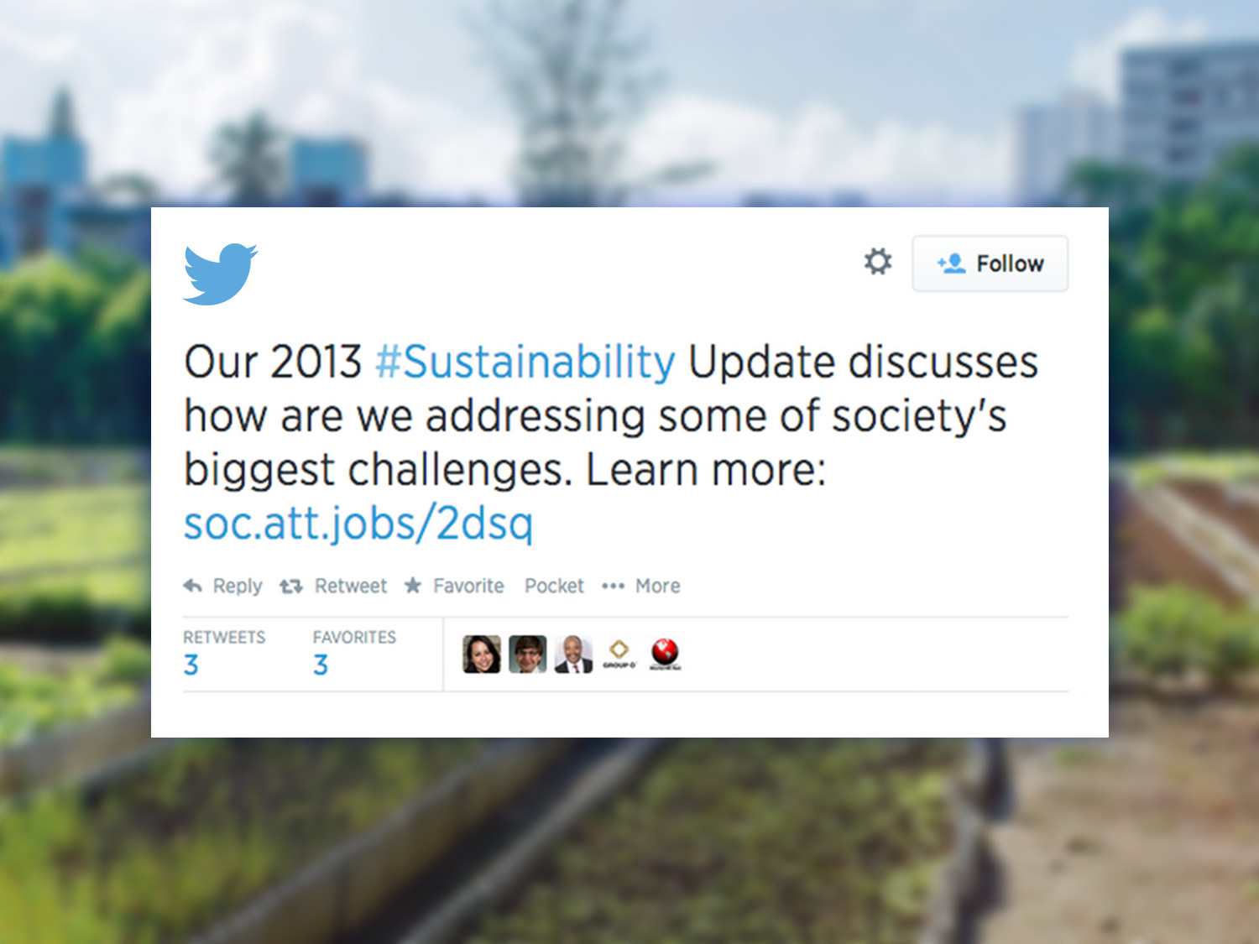

Slide 35


Slide 36
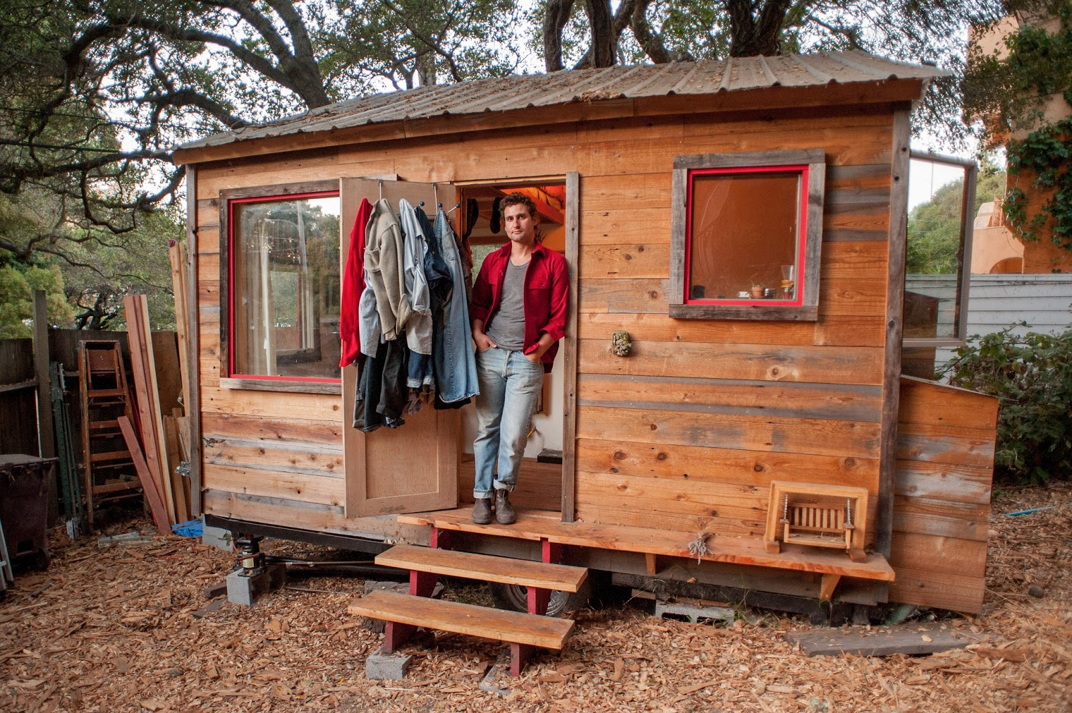

Slide 37


Slide 38
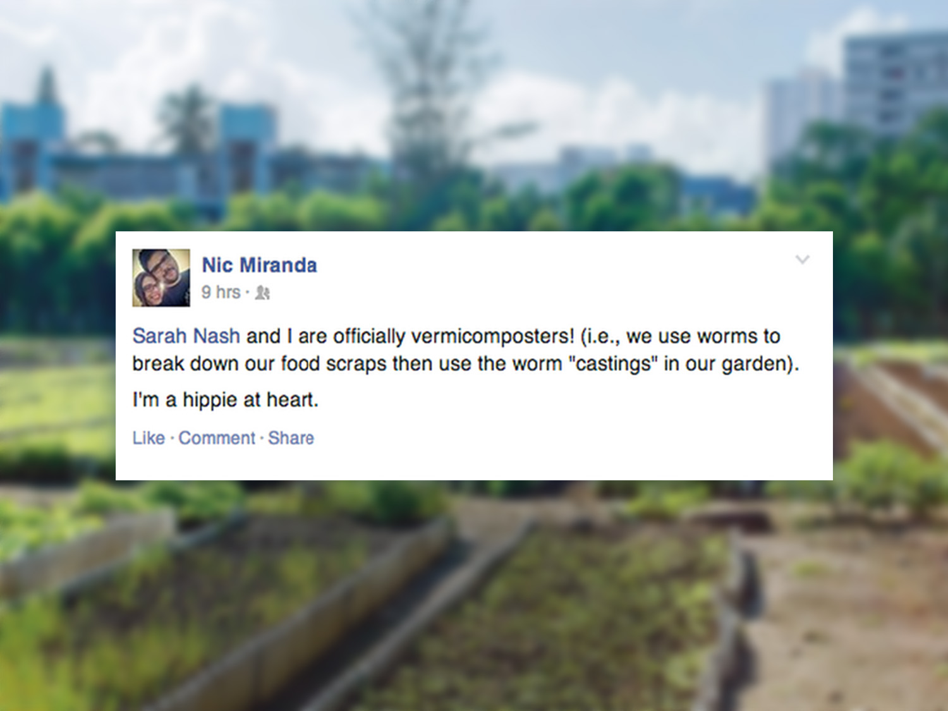

Slide 39
SHARED PASSION FRAMEWORK
CONSUMER INPUTS
COMMUNITY INPUTS
Primary Research
CRM Data
General Survey Results
Buzz Metrics
Online Listening
Common themes/buzz words
BRAND INPUTS
Stakeholder Interviews
Business Objectives
Space the brand can own

Slide 40


Slide 41
DIGORNIO SHARED PASSION
I have a passion
for pizza!
I spontaneously pursue my own happiness.
I love being part of pop culture and connecting with other rebels and rule breakers.
EAT AND LIVE
SPONTANEOUSLY
We refuse to accept limitations, and we will always challenge the status quo with a sense of humor.
Source: The Open Brand (2008) Love Triangle

Slide 42

Follower base has grown 773%

Slide 43
More engaged follower base

Slide 44
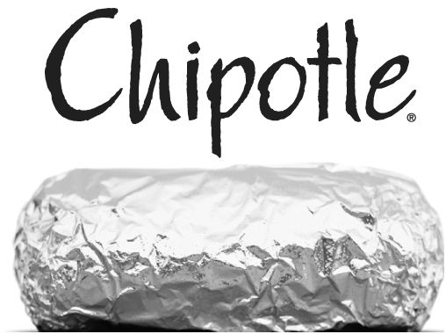

Slide 45
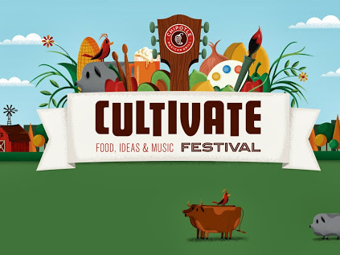

Slide 46
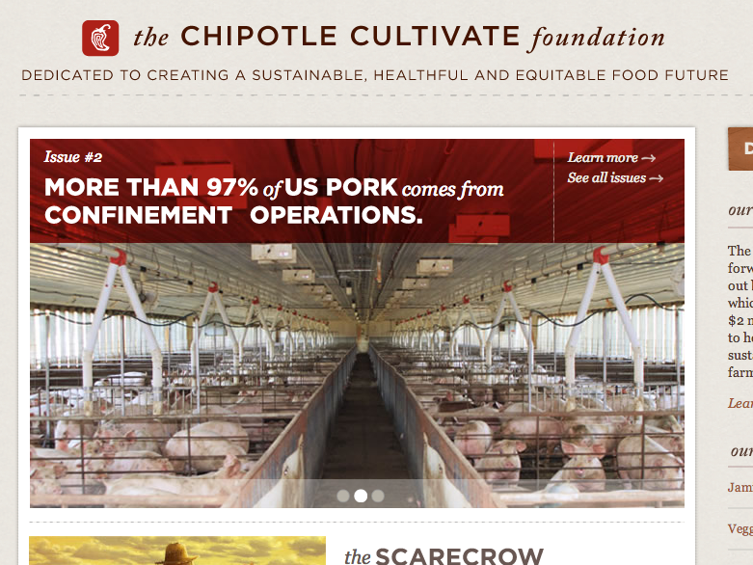

Slide 47

Notes:
http://www.theguardian.com/sustainable-business/unilever-project-sunlight-children-catalyst-sustainable-living

Slide 48
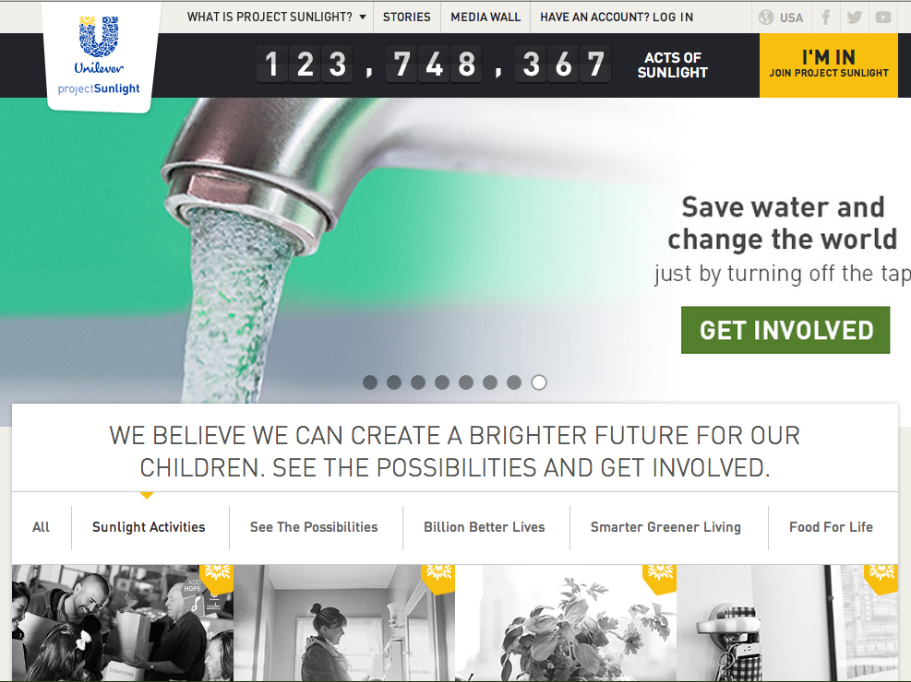

Slide 49
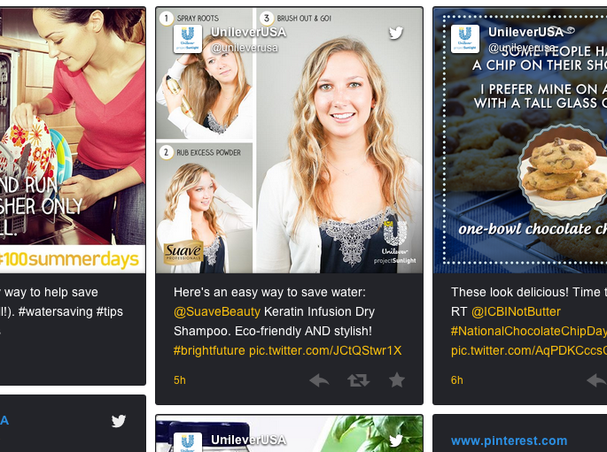

Slide 50


Slide 51
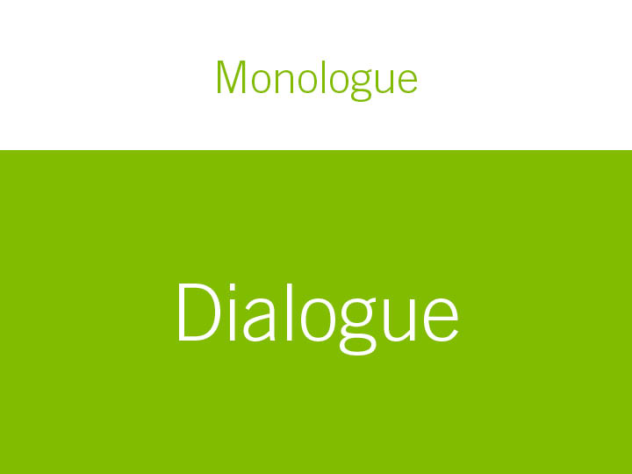
Notes:
Three way conversation

Slide 52
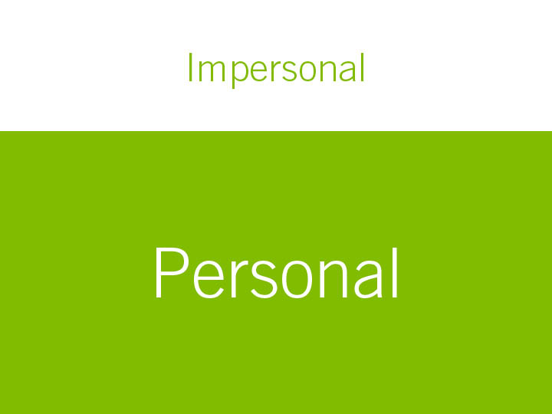

Slide 53


Slide 54
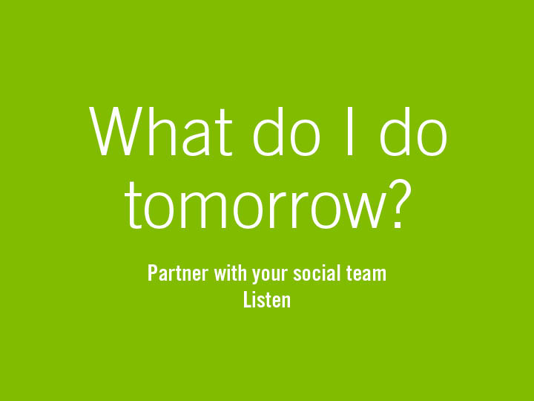

Slide 55
Step 1
Find your why

Slide 56
Step 2
Cultivate vs. Curate?

Slide 57
Step 3
Partner with social team
Notes:
Should be part of the talk track

Slide 58
Step 4
Listen

Slide 59


