Slide 2

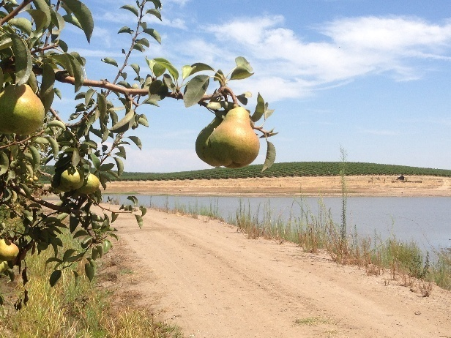

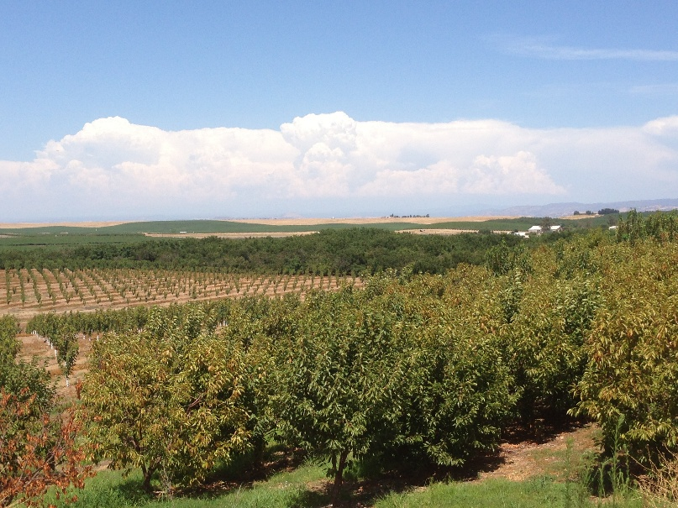
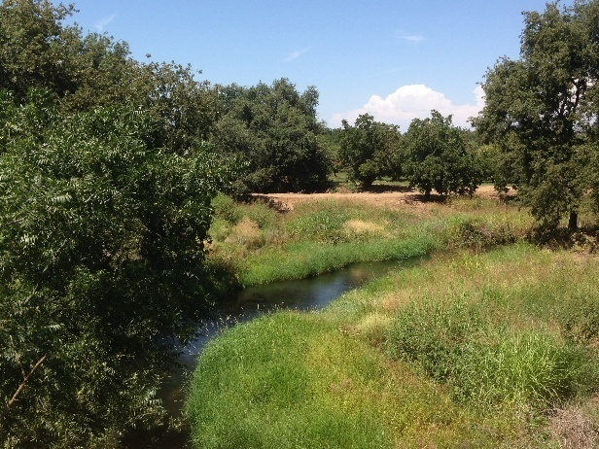
Jessica Costigliolo
M&R Company/Podesta Packing
Food Safety Manager
Cherries, Eggplant, Winter Squash, Apples, Pears, Wine Grapes, Walnuts
Grower/Packer/Shipper

Slide 3
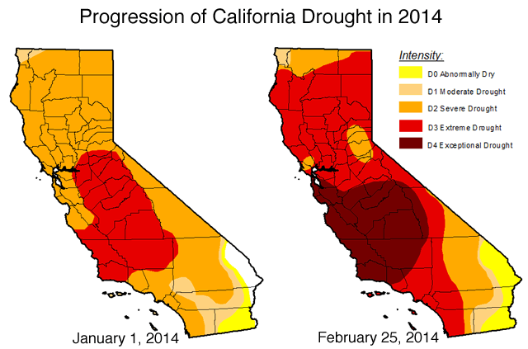
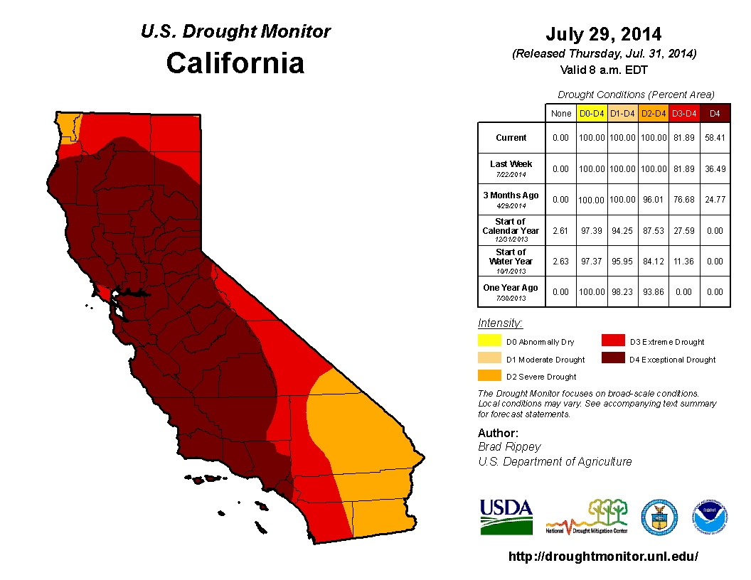
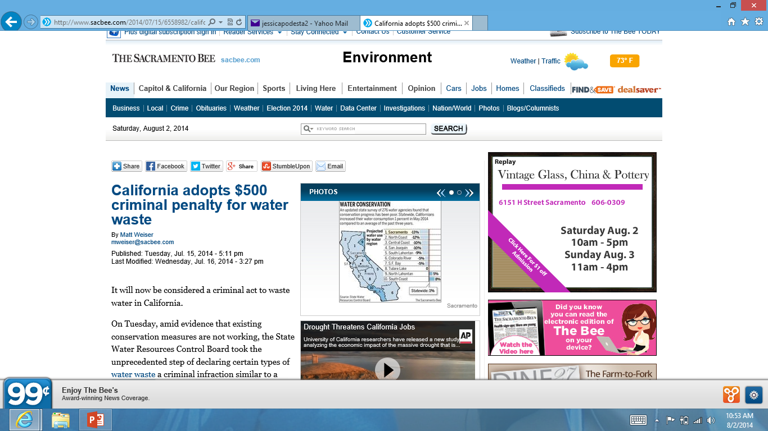
As of July 29th, 2014:
100% of California is in a severe drought
81% of California is in an extreme drought
58% of California is an exceptional drought
Sacramento
San Joaquin
Fresno
Sacramento Bee 7-15-14

Slide 4
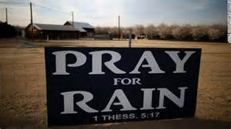
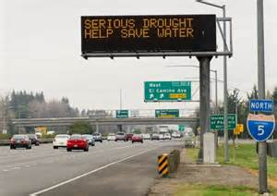
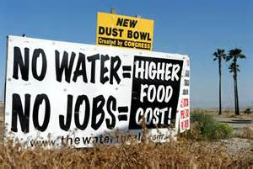

Slide 5
Impact on Agriculture
Reduction in planted acreage
  Tearing out permanent crops
    Bakersfield, Firebaugh, Fresno
Water Allocations
  0% allocations, 5%, 20% , single irrigation use
    State Water Project- Projected allocations of 0%-20%
Mandated Reporting of Surface Water Use
  Failure to report = Fines
  Restrictions on surface water use
Decreased Crop Yield
  In turn results in decreased labor and/or higher wage demands
  Uncertain impact on future yields

Slide 6
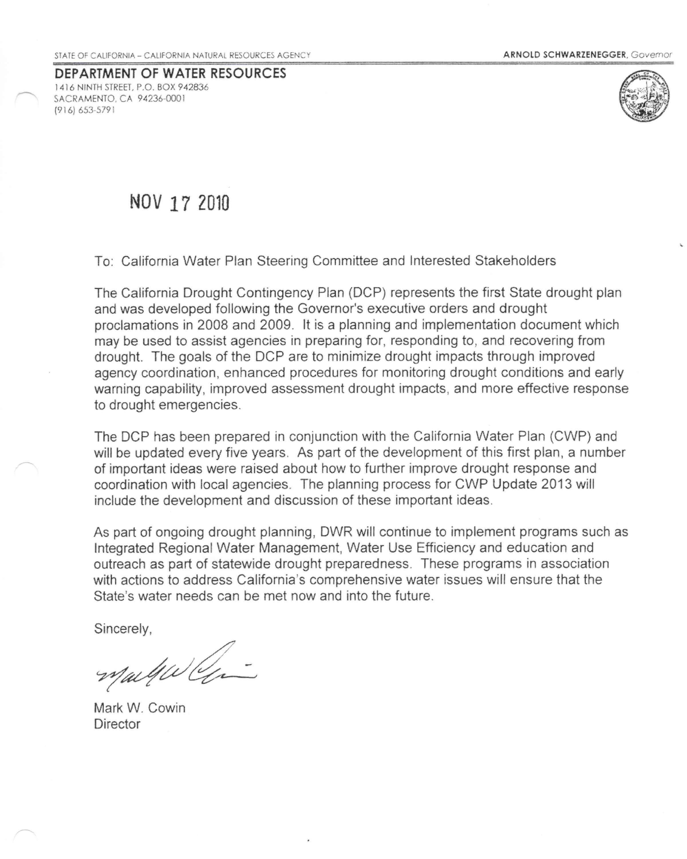
Governor declared a drought proclamation in 2008 and 2009 in the State of California.
California agriculture has been reforming their irrigation practices in order to respond to and recover from drought.

Slide 7
Irrigation Methods
Flood Irrigation: Gravity/Furrow
  Inexpensive but difficult to manage to get the highest efficiency
  In 2010, 43% of farmland in Ca used some form of gravity irrigation (Department of Water Resources)
Sprinkler Irrigation: 75%-85% efficient (Agriculture Guide)
  Pivot Irrigation: Sprinkler heads lowered to inches above ground
    Reduces evaporation and drifting in the breeze
Drip Irrigation: 90% efficient (Agriculture Guide)
  Drip emitters that slowly apply water to crop root zones
  Subsurface Drip: Buried plastic tubes containing emitters
    Reduces evaporation from soil surface
    Can be left in ground year after year

Slide 8
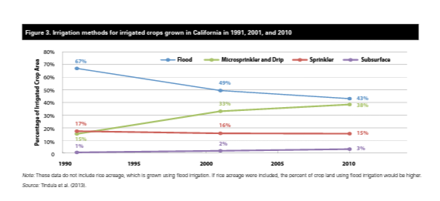
Pacific Institute/ NRDC June 2014
- Dwindling supplies of irrigation water and increasing regulation on it’s use have farms looking at options to minimize the impact on their operation.
It is clear that long term water solutions are required.
Growers are making the switch to more efficient irrigation systems

Slide 9
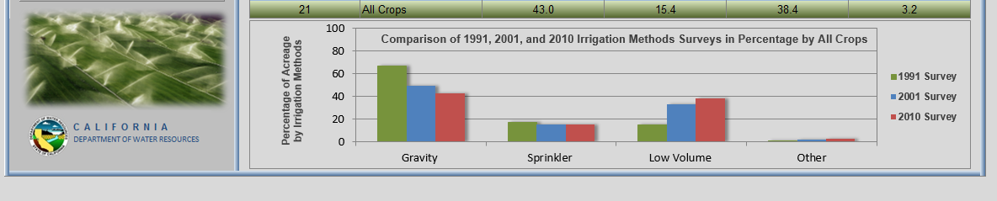
Case Studies
Ed Hale Jr., an alfalfa grower in the Imperial Valley converted a 2,600 acre field to drip irrigation. He estimates that drip uses about 2/3 less water, yet his crop yield has doubled.
Joe Muller and Sons in Yolo County, runs a buried drip irrigation system on 650 acres of tomatoes and peppers and has documented a water savings as great at 40%.
-Ed Weiser, Sacramento Bee

Slide 10
According to USDA’s Economic Research Service (ERS) Report Summary in September 2012:
Irrigators continued to make significant investments in new and improved irrigation systems, approximately $2.15 billion invested in 2008, a 92% increase over investments in 2003.
Although, less than 10% of irrigated farms used on-farm water management decision tools, such as soil moisture measuring devices, commercial irrigation scheduling services or computer based crop-growth simulation models.

Slide 11
Conservation Methods
Statistics show that growers are making the choice to move from surface irrigation to pressurized, more efficient irrigation systems, although there is still ample room to increase these numbers.
  Incentive Programs: PG&E
  Grants: Natural Resources Conservation Service, Bureau of Reclamation
Proper nutrient management: Understanding your soil make-up and needs
Join Water Coalitions
  Improve water quality while sustaining the economic viability of agriculture
  Ex: SJC &Delta Water Quality Coalition
Good regular maintenance on irrigation equipment
  leaks, clogs, check nozzles, check emitters, and clean screens
Monitoring Programs
  Soil Moisture Monitoring
  Irrigation Scheduling

Slide 12
Monitoring Programs
“Soil moisture sensor-based irrigation may be the future of irrigation technology. This technology makes irrigation a real time consideration, in which decisions are made in real time, not based on historical facts.”
- California Agriculture Water Stewardship Initiative
“With just a few clicks, growers can see the depth of their crop root zone, soil moisture levels by depth, temperature and water penetration…I use it like a fuel gauge in my car. If the moisture level is ¾ full, I can wait another day to water.”
- Ag Professional “Valley Irrigation”
“It is important, especially in times of drought to take the guess work and estimation out of properly watering crops”.
- Dr. Juan Encisco, Weslaco Extension Center

Slide 13
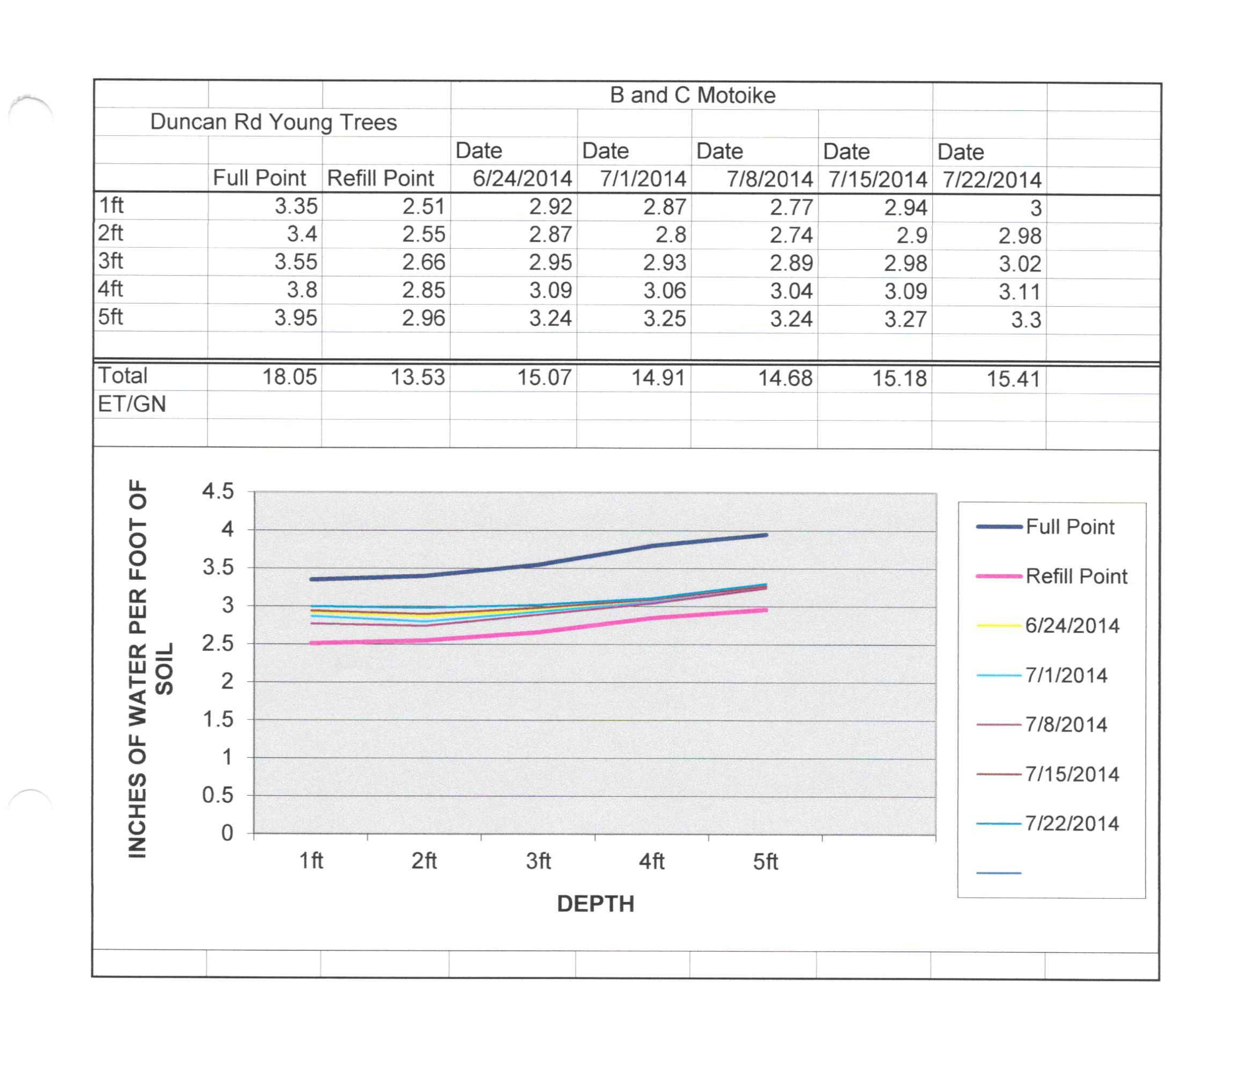
Goal:
Maintain a moisture level slightly above the Refill Point

Slide 14
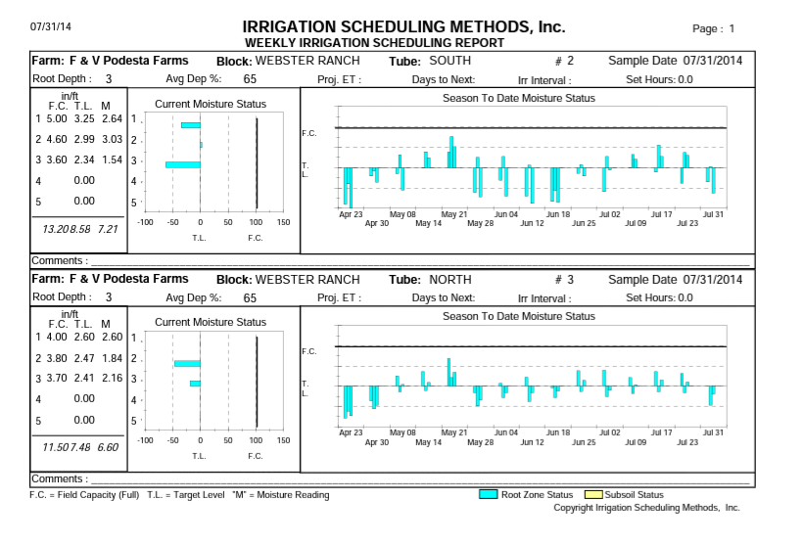

Slide 15
“Sustainability of irrigated agriculture will depend partly on whether producers adopt more efficient irrigation production systems that integrate improved on-farm management practices with efficient irrigation systems.”
– USDA Economic Research Service
In what ways can you and your company help reduce water waste and conserve?
Please read the report titled, “Bridging Concern with Action: Are U.S. Companies Prepared for Looming Water Challenges?” http://bit.ly/1tb82ES
Contact: Jessica Costigliolo jessicapodesta2@yahoo.com

Slide 16



Case Study: Drought Mitigation
New image

Slide 17
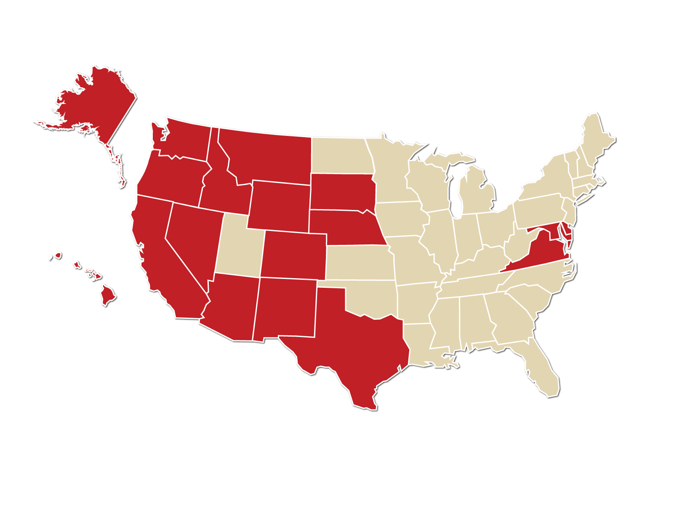
Safeway
Headquarters in Pleasanton, CA
Sales and other Revenue $36.1B
Number of stores: 1,335 in the U.S.
Number of Manufacturing Plants: 20 in the U.S.
Number of Employees: ~ potentially 250,000

Slide 18
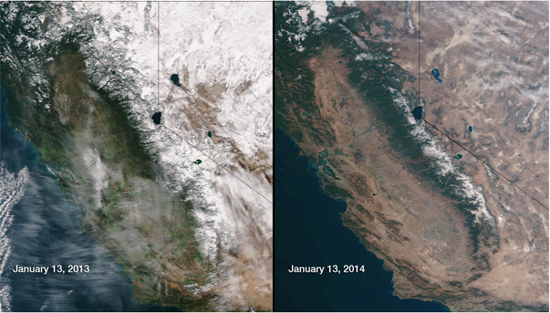
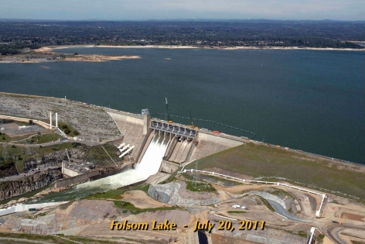
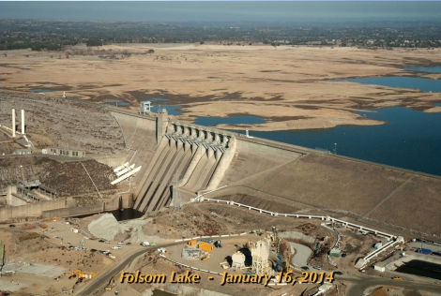
Current State - California
NOAA satellite image comparing January 13th
and
NASA images of Folsom Lake
Folsom Lake 2011
Folsom Lake 2014
http://www.nasa.gov/jpl/multimedia/california-drought-20140225/

Slide 19
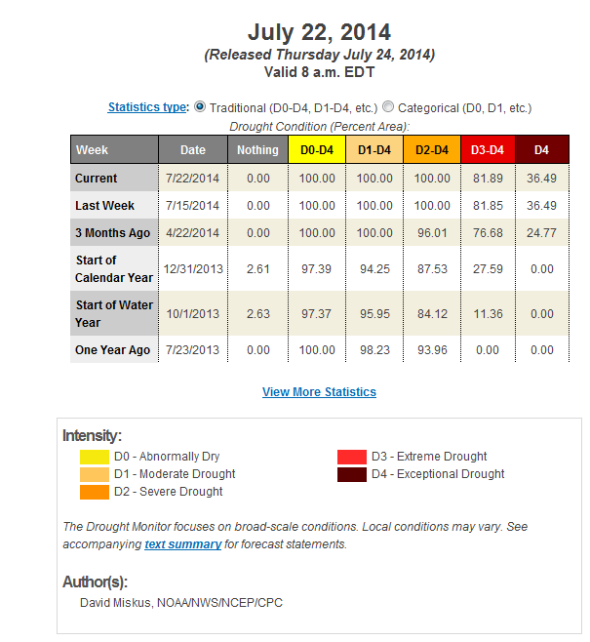
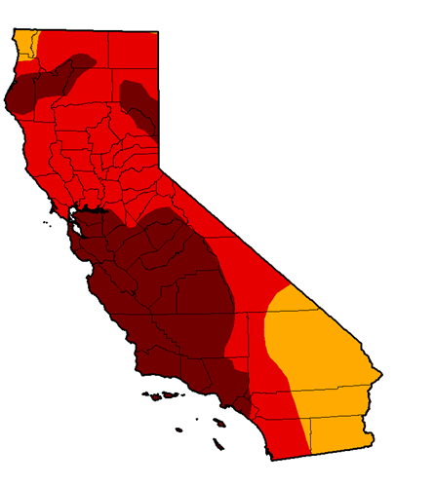
Current State
US Drought Monitor
California

Slide 20

Our Approach
Streamlined Employee Communication
Leveraged Resources
Established Water Strategy

Slide 21
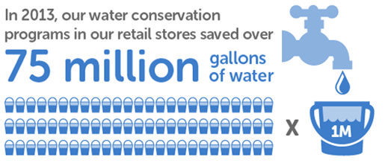
Established Water Strategy
Cross-Functional “Water Team”
Water Reduction Goal and Initiatives
Cross-Functional “Water Team”

Slide 22
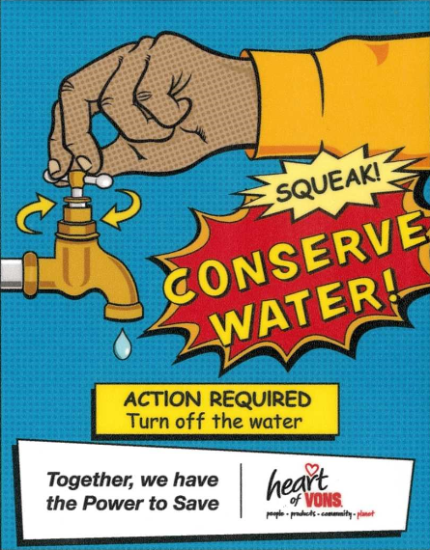
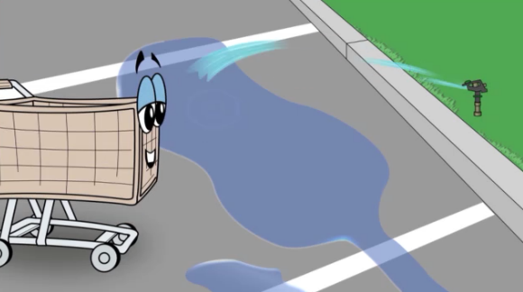
Streamlined Employee Communication
Internal video
5.5 x 7 signs in
production areas

Slide 23
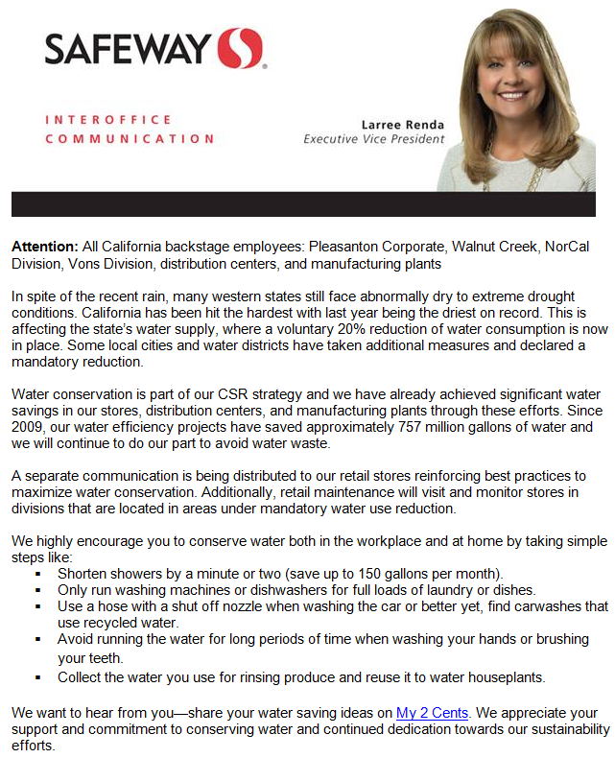
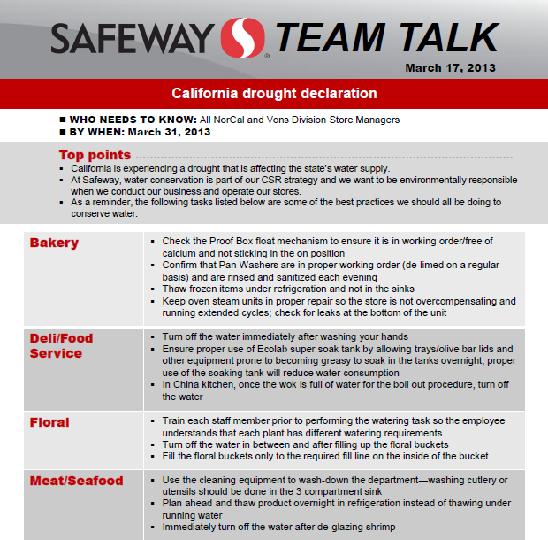
Streamlined Employee Communication

Slide 24
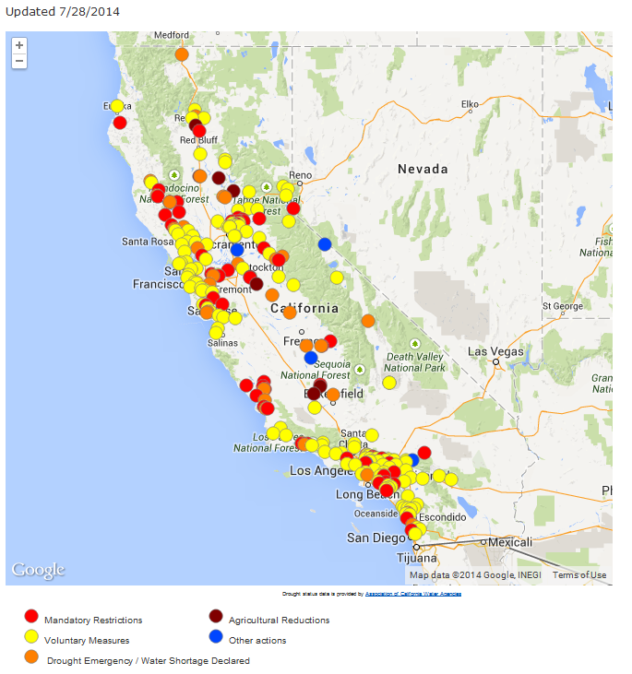
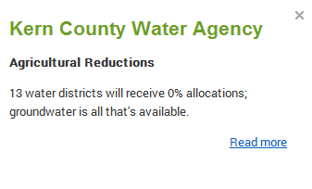
Leveraged Resources
Last updated 7/28/2014
http://www.acwa.com/content/drought-map

Slide 25
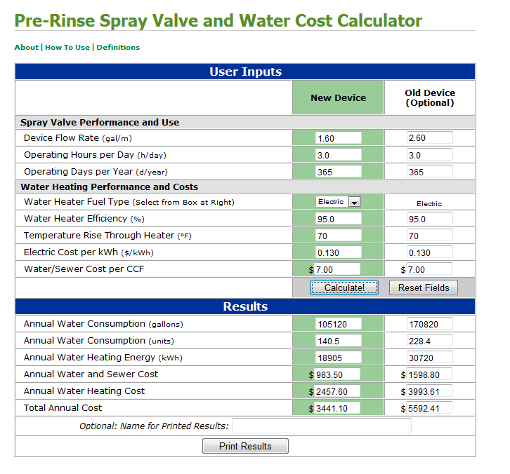
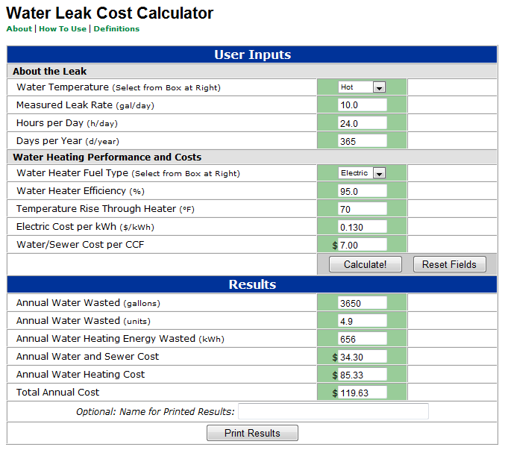
Leveraged Resources
http://www.fishnick.com/savewater/tools/watercalculator/

Slide 26


Looking forward
Monitor progress on current initiatives
Collaboration with others – vendors and growers

Slide 27
New image

Slide 28


Slide 29
Jessica Costigliolo
M&R Company/Podesta Packing
Food Safety Manager
Cherries, Eggplant, Winter Squash, Apples, Pears, Wine Grapes, Walnuts
Grower/Packer/Shipper

Slide 30
As of July 29th, 2014:
100% of California is in a severe drought
81% of California is in an extreme drought
58% of California is an exceptional drought
Sacramento
San Joaquin
Fresno
Sacramento Bee 7-15-14

Slide 32
Impact on Agriculture
Reduction in planted acreage
  Tearing out permanent crops
    Bakersfield, Firebaugh, Fresno
Water Allocations
  0% allocations, 5%, 20% , single irrigation use
    State Water Project- Projected allocations of 0%-20%
Mandated Reporting of Surface Water Use
  Failure to report = Fines
  Restrictions on surface water use
Decreased Crop Yield
  In turn results in decreased labor and/or higher wage demands
  Uncertain impact on future yields

Slide 33
Governor declared a drought proclamation in 2008 and 2009 in the State of California.
California agriculture has been reforming their irrigation practices in order to respond to and recover from drought.

Slide 34
Irrigation Methods
Flood Irrigation: Gravity/Furrow
  Inexpensive but difficult to manage to get the highest efficiency
  In 2010, 43% of farmland in Ca used some form of gravity irrigation (Department of Water Resources)
Sprinkler Irrigation: 75%-85% efficient (Agriculture Guide)
  Pivot Irrigation: Sprinkler heads lowered to inches above ground
    Reduces evaporation and drifting in the breeze
Drip Irrigation: 90% efficient (Agriculture Guide)
  Drip emitters that slowly apply water to crop root zones
  Subsurface Drip: Buried plastic tubes containing emitters
    Reduces evaporation from soil surface
    Can be left in ground year after year

Slide 35
Pacific Institute/ NRDC June 2014
- Dwindling supplies of irrigation water and increasing regulation on it’s use have farms looking at options to minimize the impact on their operation.
It is clear that long term water solutions are required.
Growers are making the switch to more efficient irrigation systems

Slide 36
Case Studies
Ed Hale Jr., an alfalfa grower in the Imperial Valley converted a 2,600 acre field to drip irrigation. He estimates that drip uses about 2/3 less water, yet his crop yield has doubled.
Joe Muller and Sons in Yolo County, runs a buried drip irrigation system on 650 acres of tomatoes and peppers and has documented a water savings as great at 40%.
-Ed Weiser, Sacramento Bee

Slide 37
According to USDA’s Economic Research Service (ERS) Report Summary in September 2012:
Irrigators continued to make significant investments in new and improved irrigation systems, approximately $2.15 billion invested in 2008, a 92% increase over investments in 2003.
Although, less than 10% of irrigated farms used on-farm water management decision tools, such as soil moisture measuring devices, commercial irrigation scheduling services or computer based crop-growth simulation models.

Slide 38
Conservation Methods
Statistics show that growers are making the choice to move from surface irrigation to pressurized, more efficient irrigation systems, although there is still ample room to increase these numbers.
  Incentive Programs: PG&E
  Grants: Natural Resources Conservation Service, Bureau of Reclamation
Proper nutrient management: Understanding your soil make-up and needs
Join Water Coalitions
  Improve water quality while sustaining the economic viability of agriculture
  Ex: SJC &Delta Water Quality Coalition
Good regular maintenance on irrigation equipment
  leaks, clogs, check nozzles, check emitters, and clean screens
Monitoring Programs
  Soil Moisture Monitoring
  Irrigation Scheduling

Slide 39
Monitoring Programs
“Soil moisture sensor-based irrigation may be the future of irrigation technology. This technology makes irrigation a real time consideration, in which decisions are made in real time, not based on historical facts.”
- California Agriculture Water Stewardship Initiative
“With just a few clicks, growers can see the depth of their crop root zone, soil moisture levels by depth, temperature and water penetration…I use it like a fuel gauge in my car. If the moisture level is ¾ full, I can wait another day to water.”
- Ag Professional “Valley Irrigation”
“It is important, especially in times of drought to take the guess work and estimation out of properly watering crops”.
- Dr. Juan Encisco, Weslaco Extension Center

Slide 40
Goal:
Maintain a moisture level slightly above the Refill Point

Slide 42
“Sustainability of irrigated agriculture will depend partly on whether producers adopt more efficient irrigation production systems that integrate improved on-farm management practices with efficient irrigation systems.”
– USDA Economic Research Service
In what ways can you and your company help reduce water waste and conserve?
Please read the report titled, “Bridging Concern with Action: Are U.S. Companies Prepared for Looming Water Challenges?” http://bit.ly/1tb82ES
Contact: Jessica Costigliolo jessicapodesta2@yahoo.com

Slide 43
Retail Food Prices and Drought
Food Marketing Institute’s Global Sustainability Summit
August 14, 2014
Annemarie Kuhns
USDA, Economic Research Service
The views presented here are those of the authors and do not necessarily reflect official policy of ERS or USDA.

Slide 44
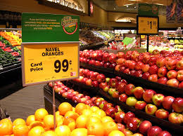
Agenda
Food price outlook
Price transmission process
Drought’s impact on retail food prices

Slide 45
2014 Inflation Predicted to be Near Historical Average

Slide 46
Price Transmission Pathway From Farm to Retail
Price transmission refers to the measurement of the effect of prices in one market on prices in another market
Food prices are affected by commodity prices, fuel prices, and surging global demand
Timing and magnitude of price transmission between the stages of production varies

Slide 47
Where a Consumer Dollar Spent on Food Goes
Notes:
47

Slide 48
Annual Percent Change in Price By Stage of Production

Slide 49
Monthly Percentage Change, 2012

Slide 50
Pass Through Percentages and Times
Retail Category | Pass-Through Rate (%) | Time to Pass Through (Months)
Beef | 6 to 18 | 1 to 2
Pork | 2 to 4 | 1 to 3
Poultry | 6 to 8 | 1 to 2
Eggs | 5 to 8 | 3 to 5
Milk | 5 to 18 | 1 to 5
Bread | 2 to 6 | 1 to 6
Oranges | 11 | 1 to 2
Lettuce | 16 | 1 to 2
Source: Leibtag, E. "How Much and How Quick? Pass Through of Commodity and Input Cost Changes to Retail Food Prices," American Journal of Agricultural Economics 91: 1462-67, 2009.

Slide 51
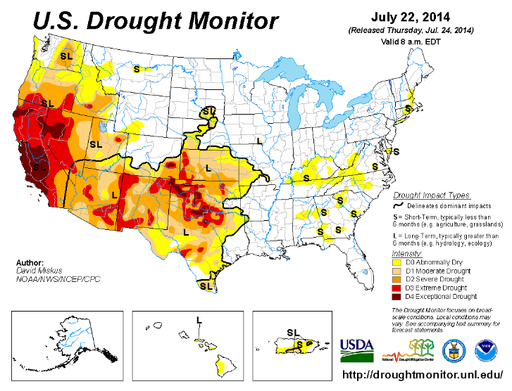

Slide 52
Drought Condition (Percent Area): U.S., including Alaska, Hawaii, and Puerto Rico
Time Frame | Date | Nothing | Abnormally Dry | Moderate Drought | Severe Drought | Extreme Drought | Exceptional Drought
Current | 7/22/2014 | 61.31 | 38.69 | 28.10 | 19.93 | 9.40 | 2.33
3 Months Ago | 4/22/2014 | 57.61 | 42.39 | 32.11 | 21.89 | 9.59 | 2.73
Start of Calendar Year | 12/31/2013 | 54.20 | 45.80 | 26.01 | 13.96 | 3.31 | 0.31
One Year Ago | 7/23/2013 | 42.47 | 57.53 | 42.25 | 28.20 | 10.48 | 3.20
Source: U.S. Drought Monitor
http://droughtmonitor.unl.edu/Home/TabularStatistics.aspx

Slide 53
Potential for Drought to Impact Food Prices
Too soon to tell exact impact
  Length and severity of drought is not yet realized
  Many crops affected have not yet come to harvest
Potential to have long an lasting effects on fruit, vegetable, dairy, and egg prices
Drought in Texas has the potential to further drive up beef prices

Slide 54
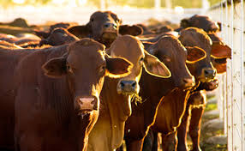
Retail Food Categories to Watch:
Beef and Veal
Beef and veal prices are up over 10% in 2014
Reductions in U.S. cattle inventory
    Herd sizes similar to the late 1950s
    Texas and Oklahoma drought further delays herd expansion
Increased exports and decreased imports
Culling rates decreasing

Slide 55
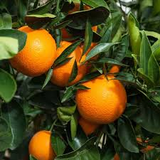
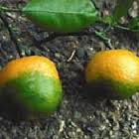
Retail Food Categories to Watch:
Fresh Fruits
Fresh fruit prices have risen 5.8% year over year
Citrus prices impacted by widespread greening in Florida
Polar vortex
Potential impacts from California drought

Slide 56
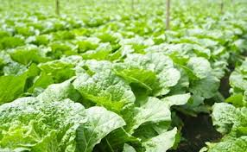
Retail Food Categories to Watch:
Fresh Vegetables
Fresh vegetable prices are up 0.8% in 2014
Lettuce prices have been increasing over the last several months
Watching for potential impact from California drought

Slide 57
Major California Crops
California grows over 90 % of the following crops in the U.S.:
Almonds, walnuts, and pistachios
Strawberries, grapes, kiwis, lemons, figs, plums, clingstone peaches, olives, and nectarines
Broccoli, artichokes, avocados, celery, garlic, and tomatoes for processing
Source: USDA, NASS, Pacific Regional Office – California, California Agricultural Statistics, 2012

Slide 58
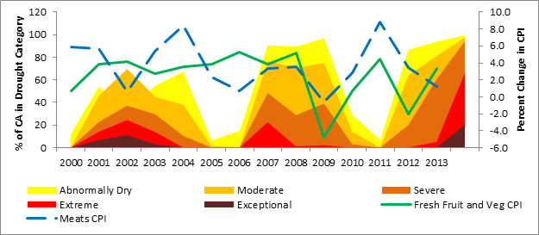
Drought Severity and Food Prices

Slide 59
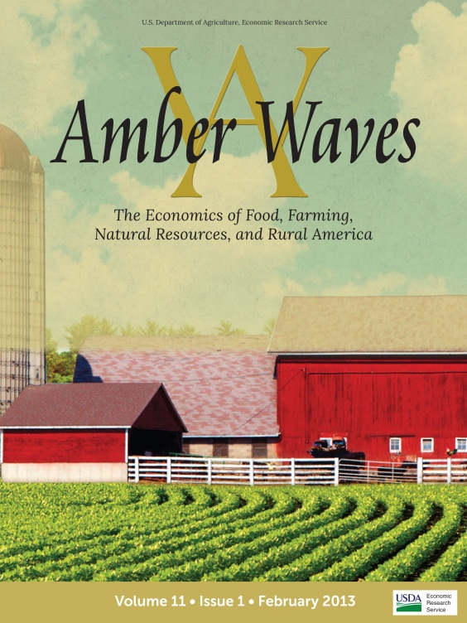
Amber Waves everywhere you want it!
Via web connection:
Get Amber Waves monthly features and data from any web connection! The new responsive web design automatically configures to fit mobile devices and tablets. www.ers.usda.gov
Via mobile app:
Get the full magazine each quarter delivered to your mobile bookshelf. Available for download on iTunes and Google Play.
Amber Waves magazine presents current ERS economic and policy research on agriculture, food, rural America, and the environment for policymakers, academics and the public.

