Slide 2
Sustainable value networks for the global food system: why and how?
@SallyUren
Forum for the Future
August 14, 2014

Slide 3

Forum for the Future is an independent non-profit working globally with business, government and other organizations to solve complex sustainability challenges.
London
New York
Mumbai
Singapore
Notes:
KEY SLIDE
We work locally and internationally with offices in the UK, US, Asia Pacific and India.
OUR FUTURE AMBITIONS (TO 2015)
Forum to have global reputation for our high-impact systems-change work
To have helped launch sustainable business models
Forum to be an international organization with five bases: London, New York, New Delhi, Sao Paulo & Singapore.

Slide 4




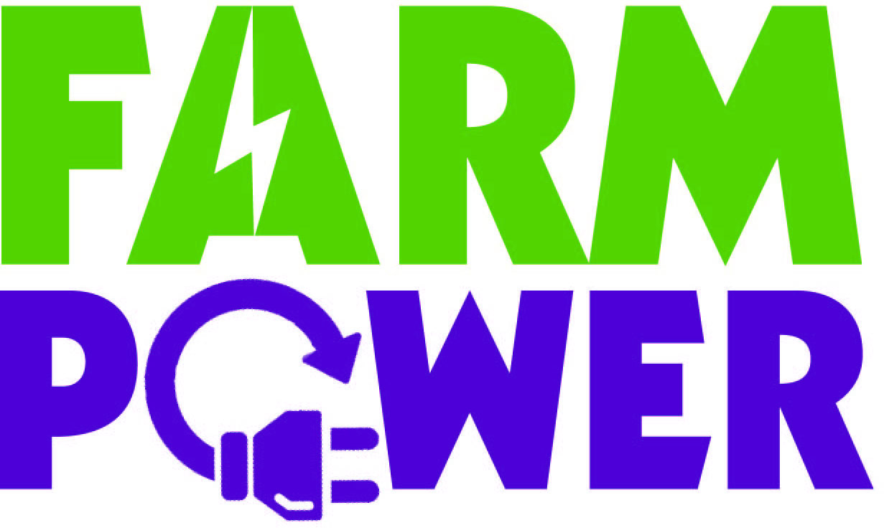


What we do
Innovative coalitions and collaborations
Leading company transformation
Notes:
We believe it is critical to transform the key systems we rely on to ensure a sustainable future. We call this moment of transformation #theBIGshift. Some key examples are our Sustainable Shipping Initiative and the Dairy 2020 coalition.
Pepsico: Using a scenarios based process, we worked with senior teams to develop long term sustainability outcomes that have been incorporated into PepsiCo’s business model on a global level. As a result of this work, among other things, PepsiCo set up a new team to focus on sustainable agriculture to help it mitigate the supply chain risks of climate change and water scarcity.
Dairy 2020: 40 organisations across the dairy industry came together to create a common vision and roadmap for sustainable dairy. Jim Paice (MP, Minister of State for Agriculture and Food) publicly endorsed this initiative. The NFU have based their new dairy strategy on Dairy 2020 and the initiative laid the groundwork for new contracting practices in the UK dairy sector.
We work with leading organisations in one-to-one partnerships eg strategy, innovation..
O2 – catalysed and created their sust strat, bring it to life and embed, eg eco rating to drive mobile phone industry wide improvements all the way through to the consumer. Consumer insight was that for same quality and price, would go for more sust option. Raised standards across the board.
And we design and run collaborative projects around whole sectors, industries, or complex challenges.
gg Dairy 2020 which at least some of you should remember! Future of UK dairy industry. But also eg future of tea, or getting renewables onto farms.

Slide 5
6 factors shaping the future of the global food system

Slide 6
1. Increased demand, decreasing supply

Slide 7
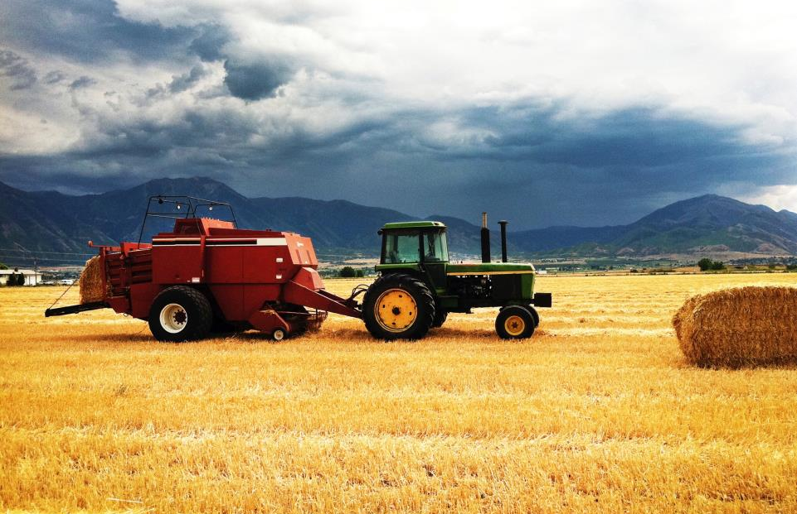
Peak everything
“In next 40 years, we have to produce as
much food as we did in the last 8000 years”
– WWF

Slide 8
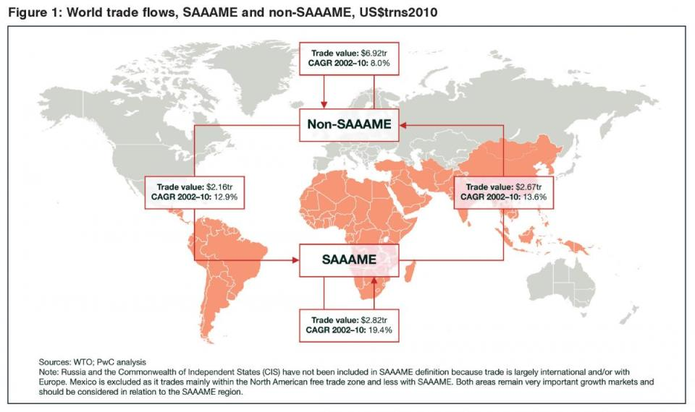
Seismic shifts in the global economy

Slide 9
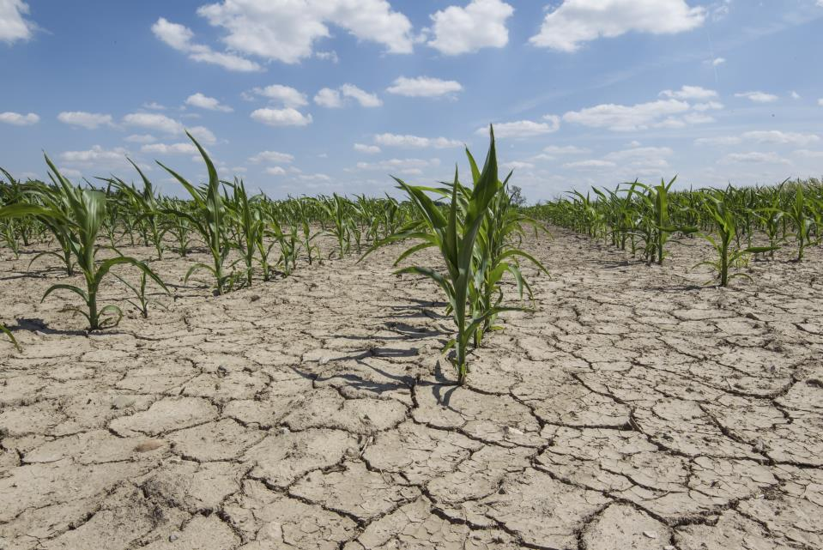
Resource scarcity could become the new normal

Slide 10

Another new normal?

Slide 11
2. Health and nutrition are taking center stage

Slide 12
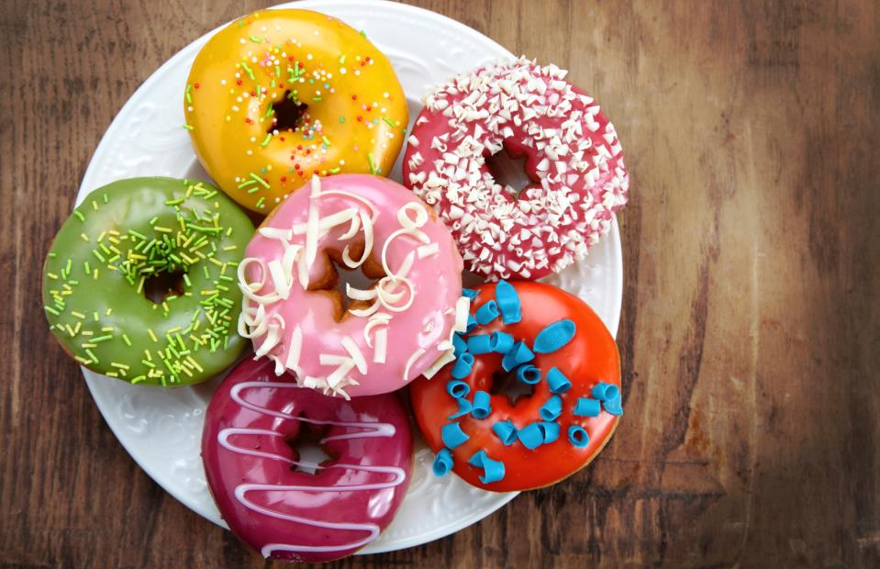
2. Health and nutrition are taking center stage
Additional medical spending due to obesity in US is now $190 billion per year & now exceeds even that for smoking
Notes:
With increasing knowledge of the causes of diseases as well as environmental impacts, our diet and what we eat will come under closer scrutiny over the next decade. increasing interest by customers and governments in health and nutrition
Stats:
In 2010, over one-third of US adults were obese. 17% of US children were obese.
The additional medical spending due to obesity in US is now $190 billion a year & now exceeds even those of smoking. This equals 20.6% of US healthcare expenditures.
Gov’t
There is increasing interest from governments in introducing taxation and other measures to “nudge’’ behaviour onto prevention of ill-health.
Although New York failed to introduce a soda tax in 2013, Mexico was successful and there are likely to be others that follow suit.
Nutrition regulations
Pressure to reduce fats, sugars and salts /product reformuation. - volutary initiatives - national salt reduction initiative in the US - The National Salt Reduction Initiative (NSRI) is an unprecedented public-private partnership with more than 90 state and local health authorities and national health organizations and major food companies like Target, Delhaize America, Kraft, Unilever, and others undertaking a voluntary partnership to reduce the amount of salt in packaged and restaurant foods (accounting for 80% of salt in American diets).
Source: World Economic Forum 2010 And FAO 2012
http://www.fao.org/news/story/en/item/117486/icode/

Slide 13
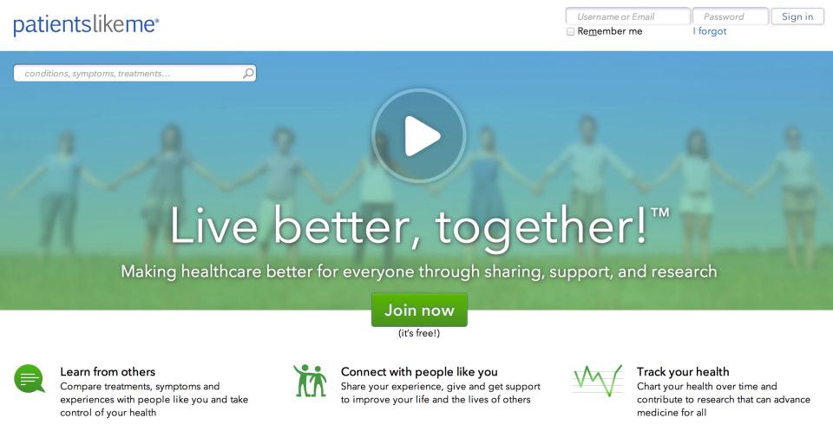
People are taking more responsibility for their health
Notes:
And people trying to take more responsibility themselves anyway as more info and networks available.
According to a study by Bain Capital, 80% of consumers seek healthy choices to combat stress, lack of time, and toxic eating.
Also potential weak signals…
Patientslikeme.com enables people to share information that can improve the lives of patients diagnosed with life-changing diseases. It’s a platform for collecting and sharing real world, outcome-based patient data, and has data-sharing partnerships with doctors, pharmaceutical and medical device companies, research organizations, and non-profits.
Withings Wi-Fi Scale automatically sends an individual’s weight to a personal web page that they can access via PC or phone, allowing them deeper insight into their progress and fitness. of a person’s overall health.
New devices for the iPhone can control a blood-pressure cuff and test blood glucose levels. This real-time monitoring data can be downloaded to a PC, and/or sent to a doctor for review.
Implications for Target:
How is Target helping to tackle and prevent the obesity / healthcare crisis? And helping people to take responsibility for their health?
Is Target ready for the potential spread of ‘fat taxes’?
IEmployee healthcare costs rising

Slide 14
3. The digital explosion

Slide 15

3. The digital explosion
Of the world’s 7 billion people, 6 billion have mobile phones.
Only 4.5 billion have
access to sanitation.
Notes:
Access to digital technology continues to rise
Set up….
Availability & access to digital technology will reach more critical thresholds
As the quote says – by the end of this year there will be more mobile devices than people in the world…
The image on the right is the $12 smart phone that is being produced in China but Bunnie Studios - contract-free, non-promotional and unlocked
Image: Of the world’s seven billion people, six billion have mobile phones. However, only 4.5 billion have access to toilets or latrines – meaning that 2.5 billion people, mostly in rural areas, do not have proper sanitation. In addition, 1.1 billion people still defecate in the open. http://www.un.org/apps/news/story.asp?NewsID=44452#.U2xADYxZTIU
The “internet of things” is also growing as sensors and actuators located in physical objects grow smaller, cheaper and more powerful and can be linked together. This has huge potential for cyber-physical systems to improve productivity in the production process and the supply chain through, but also for individuals too. You could mentioned our work around IOTA here
-----
Additional stats:
The global penetration of digital technologies will continue to rise.
Almost 40% of the world’s population is now using the internet, while mobile-cellular penetration is approaching 100%. ²⁷
Since 2009, internet penetration in households has grown fastest in Africa, with annual growth of 27%, followed by 15% annual growth in Asia and the Pacific.²⁸
In 2012 alone, humans generated more data than over the course of our entire history. The rate of production of data more than doubles every two years.²⁹ As our ability to analyze this data through changes in computing power and advancing techniques such as natural-language processing, pattern recognition and machine learning, we will see more and more usage in fields as varied as science, business, politics, and public health.

Slide 16
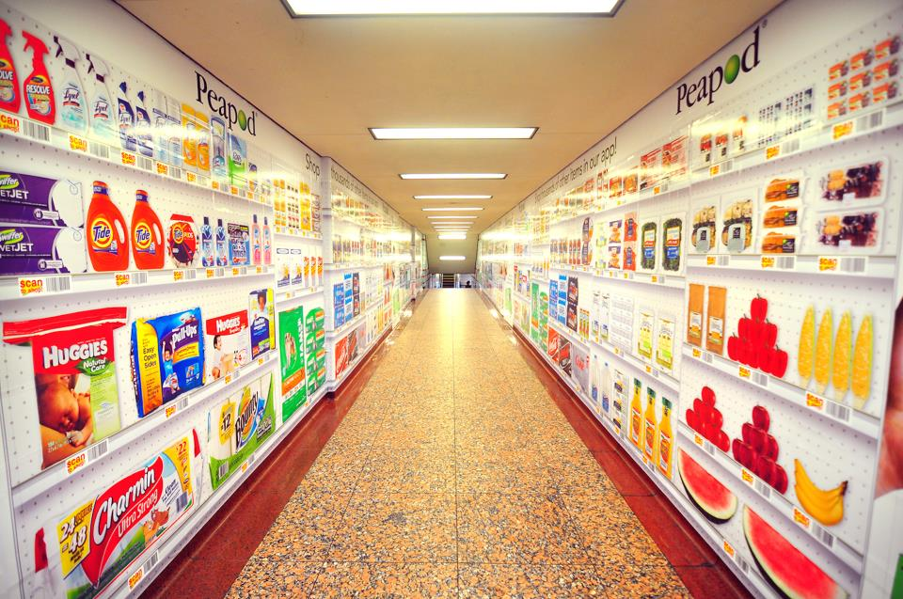
…unleashing a wave of disruptive business models with digital technology at their heart
Notes:
Retail opportunities are increasingly ubiquitous and mobile. Making transactions is becoming easier and easier through mobile payments and presets for regularly consumed goods. Not only is it easier to shop and pay, but stores are increasingly popping up in new and unexpected places.
Trend:
The rise of ‘virtual’ retail –
Tesco in South Korea and Tesco at Gatwick airport in the UK
Now in philidelphia - Online grocery service Peapod allows consumers to shop "virtual shelves" at train platforms in Philadelphia.
We are seeing:
Virtual displays in subway stations / airport – look exactly like in store
Shopping via smart phone
Delivered straight to your door
Implications for Target:
New business models
Shifting consumer expectations
Focus on ‘on the move’ convenience for busy lives
Key questions:
how you can harness this technology to help you achieve your ambitions and enable more people?
How can you be agile and flexible to adapt and evolve with the technology?

Slide 17
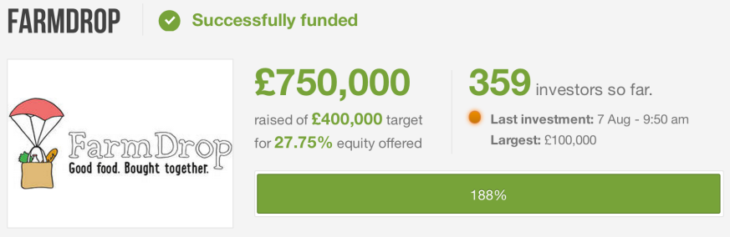
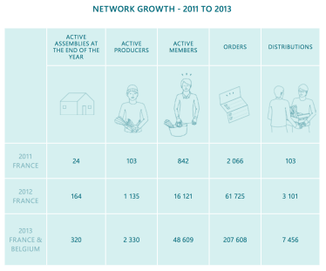

Notes:
New models that combine social value with economic returns and environmental benefits:
Farmdrop and Food Assembly are both click and collect models connecting farmers and eaters via drop-off hubs – built-in aim to build communities around food and increase returns to farmers without a retailer.
Farmdrop just completed a crowdfunding exercise getting £710k after asking for £400k
Food Assembly has grown rapidly in France and Belgium since 2011 and is now launching in Germany, Spain and UK.
Not yet a threat to traditional retail but they could have an impact… they tap into a social need and use tech to respond.

Slide 18
4. Entering an era of ultra-transparency

Slide 19
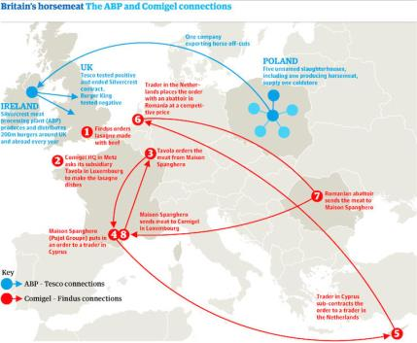
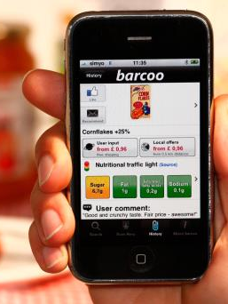
Nowhere to hide
Notes:
Going hand in hand with the emergence of disruptive technologies – is the notion of radical transparency. More people have more access to information, and its much more difficult for people to hide things away.
Example/images:
Horsemeat scandal results in slide in sales of red meat in Britain
Sales of beef down 3% for the year according to latest industry figures with frozen burgers and ready meals hit the hardest
http://www.theguardian.com/uk-news/2014/jan/10/horsemeat-scandal-sales-red-britain
Barcoo
Barcoo Mobile Phone App The Barcoo mobile phone app encourages transparency by allowing consumers to scan barcodes to find social and environmental information about the company and product. The OpenLabel iPhone application enables anyone to scan a product barcode and append their comments. The information is collected from a range of sources, such as company statements, recognized social responsibility studies, and user feedback. The app also has a price-comparison service and displays “traffic light” signals showing how healthy a product is.

Slide 20
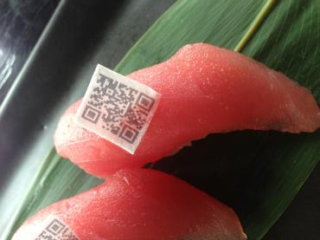
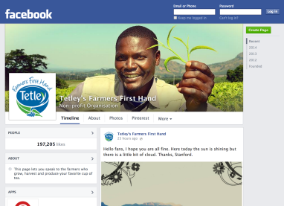
Empowering some…
Notes:
Some in the food industry and using this trend to engage with consumers in a new way
Examples
Tetley’s Farmer’s first hand.
Social media offers new ways to reconnect people with where their food comes from, and build brand trust
Tetley’s Farmer’s First Hand Facebook page more popular than main brand page – tea growers stay in touch with customers
Enabling farmers on tea estates to use phones and cameras provided by Tetley to stay in touch with tea drinkers via Facebook.
Edible QR Codes
In July 2013, Harney Sushi, a restaurant in San Diego, has created edible rice paper QR codes to address the problem of seafood fraud -- a reported 52% of fish is being mislabeled in Southern California, the highest rate of mislabeling in the US. The QR codes will allow diners to pull up details on the provenance and stocks of the fish they’ve ordered, and in the case of their albacore tuna, a redirect to a YouTube video on the Washington-based fisherman behind the catch.

Slide 21

…and costing others
Notes:
http://www.forbes.com/sites/gyro/2012/11/06/lets-get-naked-a-guide-to-brand-transparency/
When Pink Slime Attacks
In March 2012, a single petition posted on change.org by an everyday mother started a movement – against the use of ‘pink slime’ in school meals
Pink slime occurs when sub-par beef scraps and connective tissue are mixed with ammonia to turn formerly inedible meat into edible ground beef. Gross..
Social media and angry moms everywhere fueled this movement.
Pink slime was removed from school cafeterias nationwide in only 10 days. A number of food store chains stopped selling it.
Demand for it went down so dramatically that Beef Product Inc. shut down three of its four factories only three weeks after the beginning of the social media storm.

Slide 22
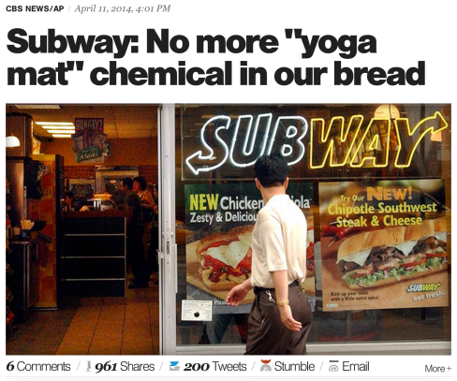
…and costing others
Notes:
The most recent I can think of off-the-bat without doing research is the “yoga mat” chemical – Subway was targeted by a mommy blogger, but ~500 food products from Little Debbie Honey Buns, Pillsbury Toaster Strudel, and many items served at McDonald's, Burger King and Starbucks were also on the list published by the environmental Working Group: http://www.cbsnews.com/news/subway-no-more-yoga-mat-chemical-in-our-bread/ *NOTE: I did not make this change so will leave you to judge (I don’t think we want to shame 1 organization, so wouldn’t use the headline with Subway in it).

Slide 23
5. Changing consumer expectations

Slide 24

5. Changing consumer expecations
mega trends
my world
our world
the world
Notes:
The ‘Green consumer’ is already behind us – a new world and new markets of opportunity await
Look at survey results from the pre-work:
Context: explain why we’re no longer talking about a niche minority consumer group
Only 10% of consumers don’t care at all about social and environmental issues. Most of us care about certain issues. We just need to be engaged. That is changing as we start to feel the effects of global trends at home.
This slide
Once far-off trends are starting to hit home for the first time. They are changing consumer attitudes and what we see as important. In China, for example, the government is introducing progressive water pricing, to cut water use per US$ of GDP by 60% by 2020. A recent global consumer survey by National Geographic and Globescan showed that consumers in China and Russia have the fastest growing consumer concern about environmental issues.
In parallel, we’re developing more sophisticated consumer segmentations that can unlock opportunity
As the green consumer market grows and matures, we’re developing a more sophisticated understanding of the issues and factors that resonate with different consumer groups, how they influence purchasing behaviour and measures like brand preference, and the communications platforms and campaigns that can engage the more ‘unusual suspects’.
Diagram is taken from ‘Rethinking Consumption’ by BBMG, Globescan and SustainAbility. They show the results of a global consumer survey across six countries (UK, India, Brazil, Germany, China, USA) with 6000 consumers.

Slide 25
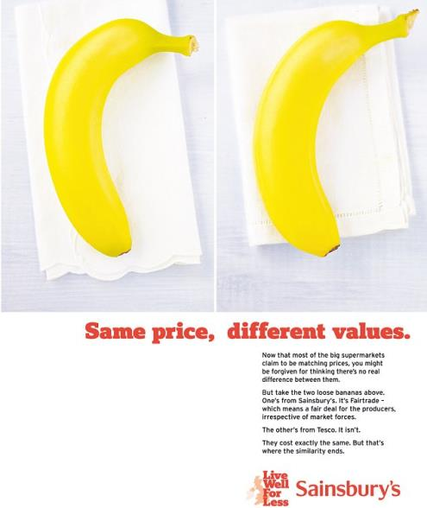
Values increasingly matter
Notes:
http://j-sainsbury.co.uk/media/1488636/csr_factsheet_new_fashioned_values.pdf
By having to put more thought into what they buy, consumers are taking a greater - not lesser - account of what personally matters to them.
Bullet 1: When asked about the importance of doing business in a responsible manner, the number of respondents that marked this as 8 out of 10 or higher, varied only from 70% in the C2 bracket to 75% for C1s and DE (with AB at 71%):
Bullet 2: figures are for the 12 months up to Sept 2012. Total number of customers making sustainable choices was up 5%.
Bullet 3: as evidenced in diamond jubilee and Olypmics, record levels of support to sport relief and Sainsbury’s million meals appeal
Data cited in this report draws on Sainsbury’s own sales figures, or Kitchen Dynamics 2012, a report commissioned
by Sainsbury’s from Mintel using a nationally representative sample of 2,500 parents of children aged between five to 12 years.
The field work took place during June to September 2012

Slide 26
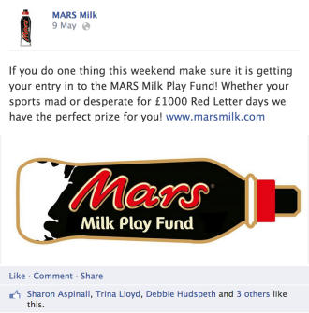

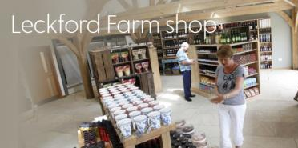
Brands need to act locally to connect with consumers
Notes:
Big brands are tapping into people’s concern for local issues
We’re seeing brands increasingly connecting with people at a local level – and making things more relevant to them. More personalisation and making issues relevant to people on a local level. Consumer campaigns through to building resilient local supply chains. The impact can high be visible quickly as a consequence.
Examples:
Mars Milk – campaigns supporting local community groups thrive http://www.marsmilk.com/
Opportunity:
Brands led communications empowers people to act & connect to important issues
Mass personalisation is cheaper and more feasible that ever before (distributed manufacturing, 3d printers etc)
There is an opportunity for more local activity to exist & encourage strong, resilient local supply chains
For example – the pocket solar factory – allows people to produce clean energy, cheaply, quickly

Slide 27
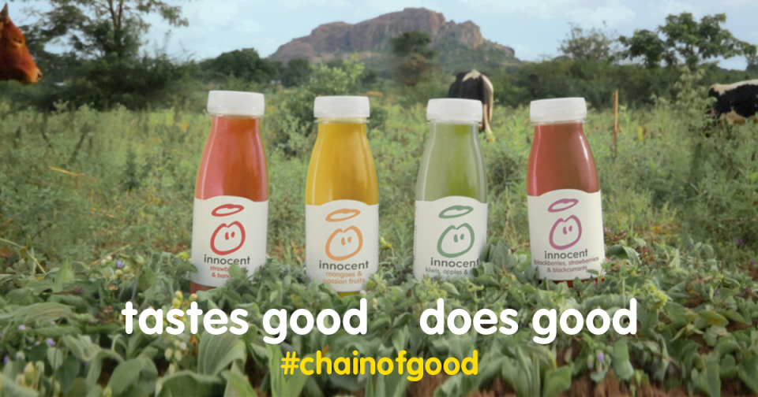
And become problem solvers
Leading brands are pushing ahead with
social marketing and purpose-driven messages
Notes:
See more on Forum for the Future’s website: http://www.forumforthefuture.org/blog/beyond-greenwash-greatness-big-brands-are-turning-society%E2%80%99s-problem-solvers
See more from Innocent Drinks: The video for Innocent Chain of Good is quite good (https://www.youtube.com/watch?v=LeXgxN24loc), but the Irish video for Innocent Chain of Good is even better! https://www.youtube.com/watch?v=0c17bhtmmds

Slide 28
6. Changing attitudes towards the food industry

Slide 29
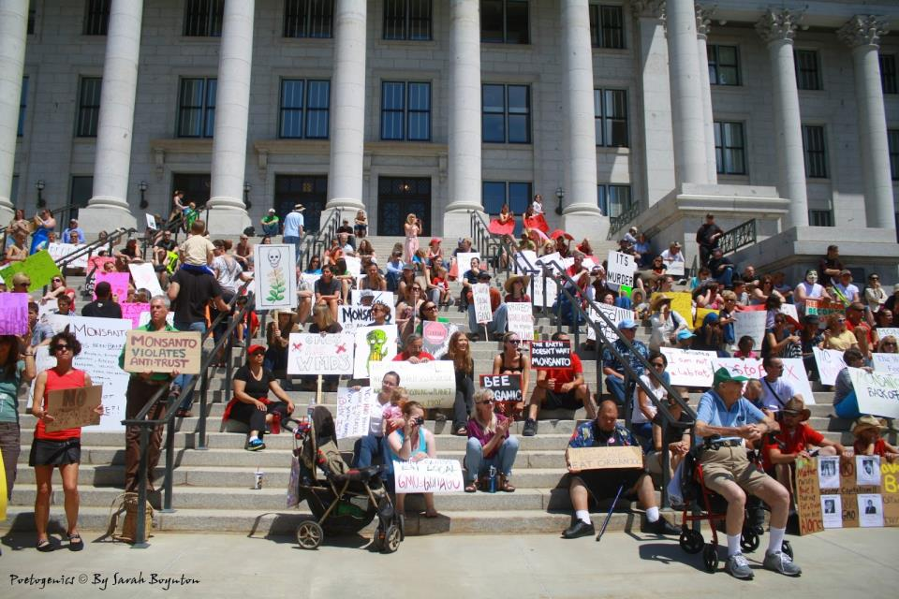
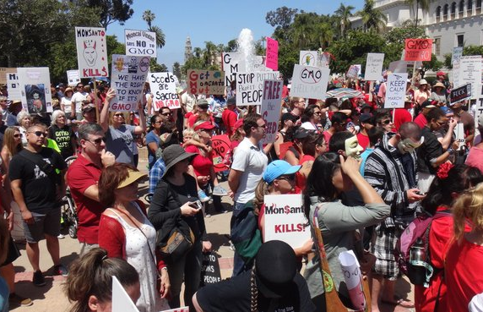
Civil society: willing to march
Notes:
The photo shows the international March Against Monsanto, which took place on May 25th 2013. Protestors marched throughout US cities, from Washington DC to Miami, Dallas, and Anchorage.
The food industry is facing increasing scrutiny. There is growing sentiment in favor of reforming American agriculture and interest in questions about where our food comes from and how it was produced.
Rising Activism Against Big Brands
The international “March Against Monsanto” took place on May 25th, 2013 and included protestors throughout US cities, including Washington DC, Miami, Dallas, and Anchorage, and around the world. A second international march took place on October 12th, 2013 in the US, England, France, Germany, and other countries around the world. Likewise, Oxfam’s Behind the Brands campaign named and shamed a range of food companies using a scorecard that ranked companies based on supply chain accountability. In April 2013, Mars, Mondelez, and Nestlé agreed to address inequality for women in their cocoa supply chains as a result of the campaign.

Slide 30
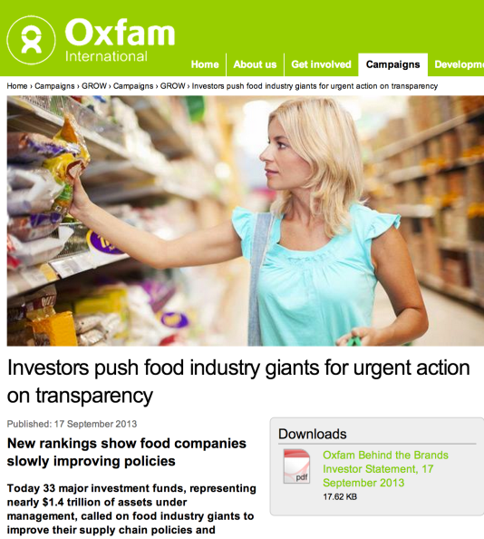
Investors: waking up
“Investors are increasingly rewarding companies that address sustainability challenges across their global supply chains.”
Bennett Freeman
Sustainability Research and Policy at Calvert Investments

Slide 31
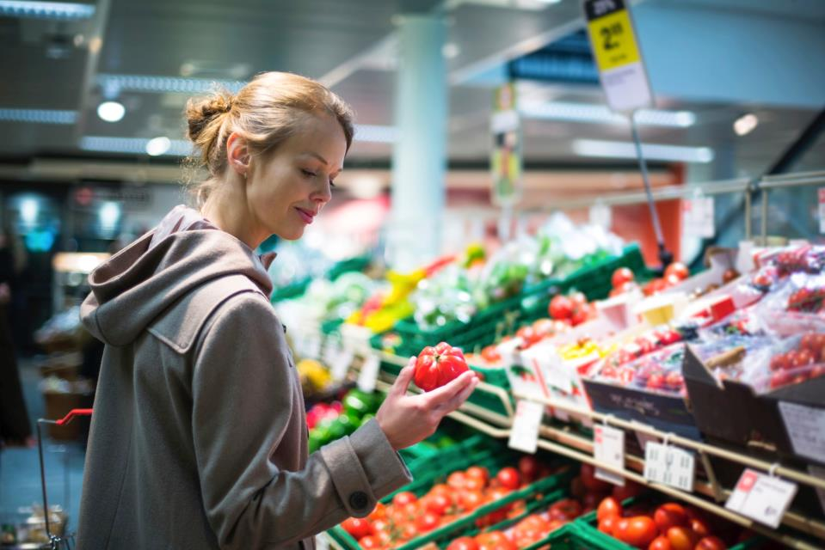
The implications
Consumers are becoming more discerning, demanding localized products, seasonal products.
Over the next 5-10 years, we could see the emergence of more distributed and localized models of production and consumption
Issues like food waste become history, as closed-loop, circular economies scale up
Notes:
Consumers are becoming more discerning, demanding localized products, seasonal products.
Over the next 5-10 years we could see the emergence of more distributed and localized model of production and consumption
Issues such as food waste could be history, as closed-loop, circular economies scale up
Supermarkets need to be more pro-active in marketing foods which are healthier and more environmentally friendly – What about a two for one offer for Broccoli? What about putting Fresh produce at the centre of a supermarkets marketing strategy. They need to promote imperfect fruit? Recipe promotions?
Governments also need to help consumers make sound ethical choices on sustainable healthy food and to encourage greater consumption of fresh produce.

Slide 32
How do we respond to this rapidly changing context?

Slide 33
From supply chains to sustainable value networks
Connected consumers
Restorative approach
Sustainable market mechanisms
Resilient value chain
Empowered producers
Notes:
How to we create value all along the chain rather than take it away

Slide 34
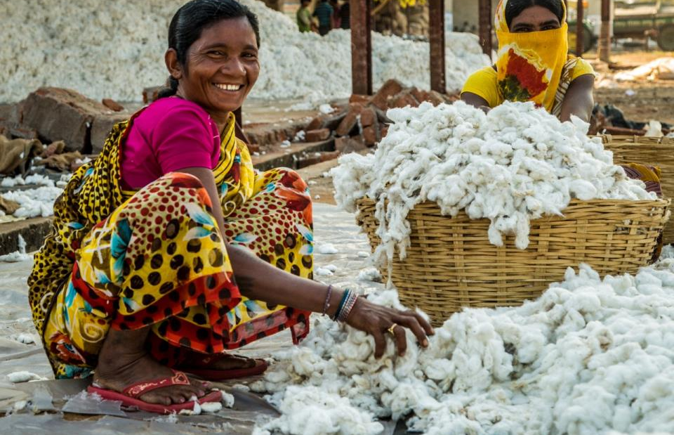
1. Towards sustainable livelihoods and empowered producers
Notes:
First we need sustainable livelihoods for all but beyond that we need producers that feel empowered and feel ownership over their activities
Image source: Pants to Poverty, Fairtrade and organic underwear

Slide 35
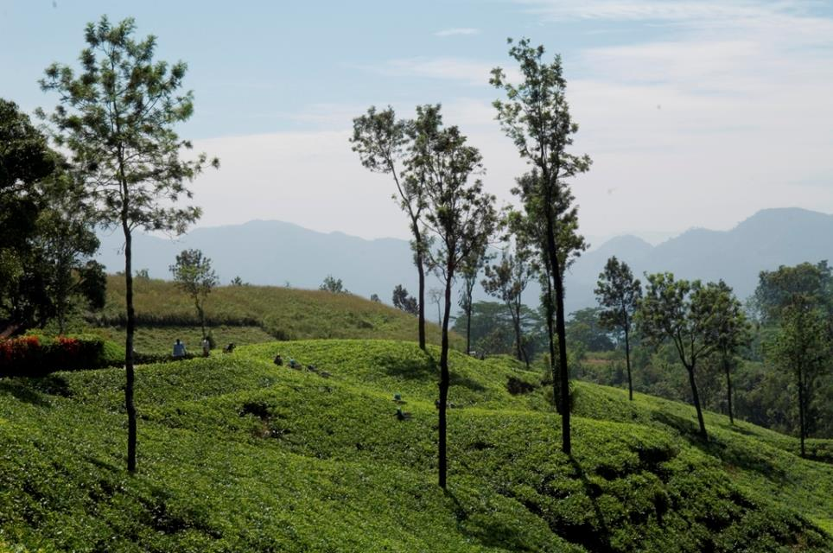
2. Towards sustainable and restorative production
Notes:
Could use the sustainable grazing example listed under principle 3 – it fits both.
Could also use a forestry example: plenty of examples of organisations funding reforestation either directly or via carbon off-setting – I can look into specific examples if you want to go down this route. Perhaps Kimberly Clark? (info here: http://www.sustainabilityreport2011.kimberly-clark.com/planet/fiber/reforestation.aspx) Or Rainforest Alliance have a list of projects they’ve been involved in here: http://www.rainforest-alliance.org/climate/projects/forest-carbon

Slide 36
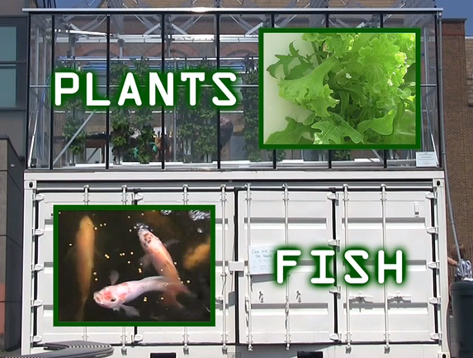
3. Towards low carbon and resilience
Source: explainingthefuture.org

Slide 37
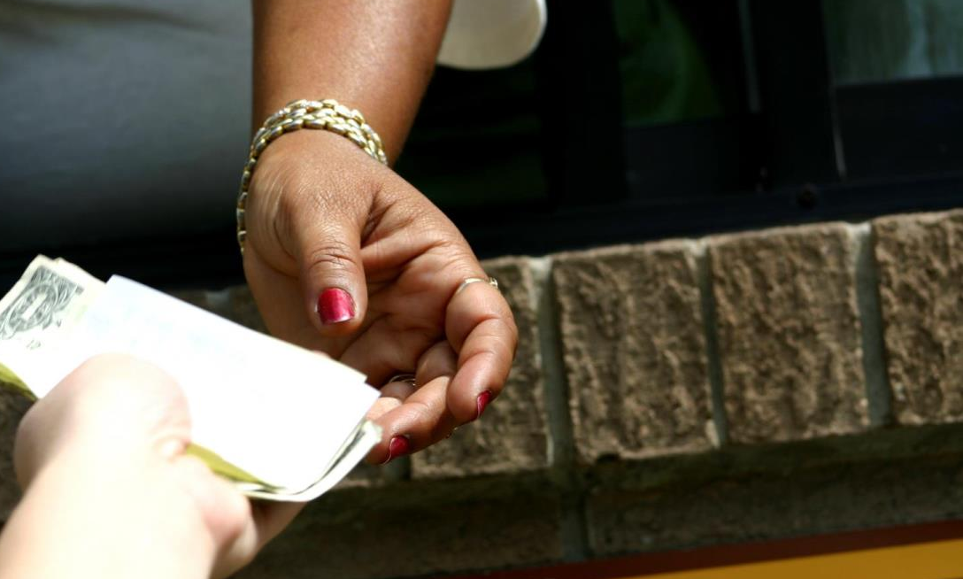
4. Towards sustainable market mechanisms

Slide 38

5. Towards engaged and connected consumers

Slide 39


Slide 40
Navigating the future
Just getting out of port?
Put your business in the future
What are the risks? The opportunities?
What can you address alone? In collaboration?
Need wind in your sails?
What does a sustainable value network for your goods and services look like?
What does business model innovation look like?
Experiment then scale

Slide 41
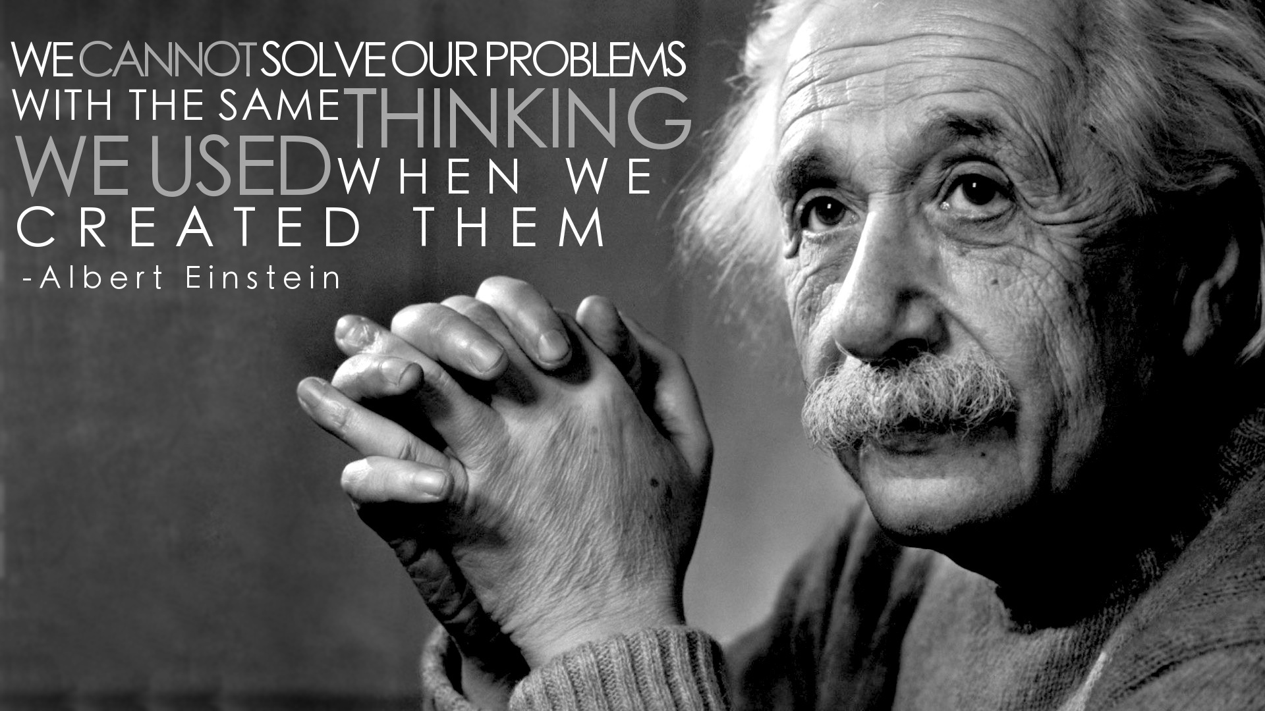

Slide 42
Dr. Sally Uren
CEO
Email: s.uren@forumforthefuture.org
Skype: forumsallyuren
Twitter: @sallyuren

