Slide 1
FMI – Industry Update from Top Thought Leaders
Bob Whitaker
Chief Science & Technology Officer
PMA

Slide 2

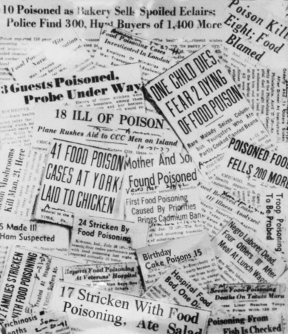

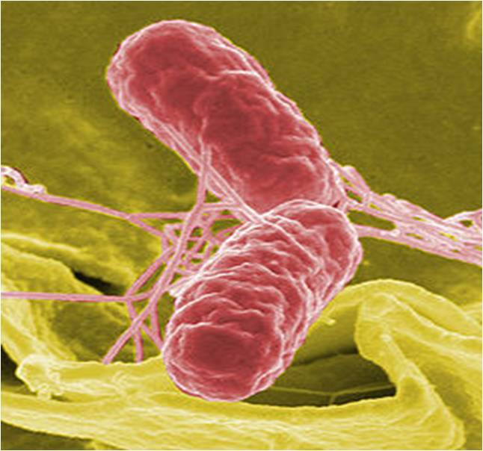
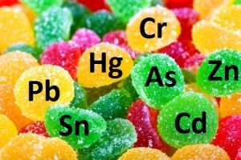
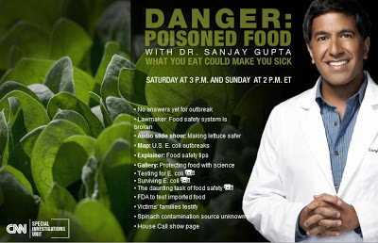

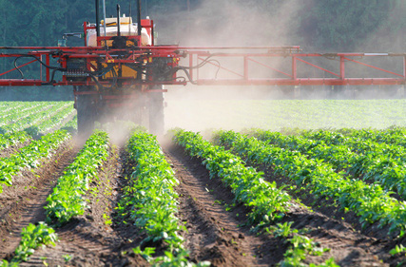

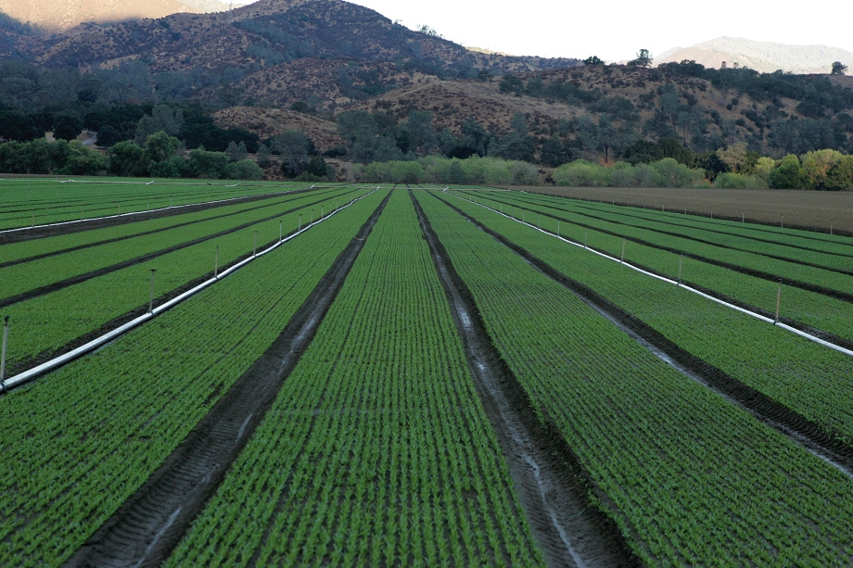
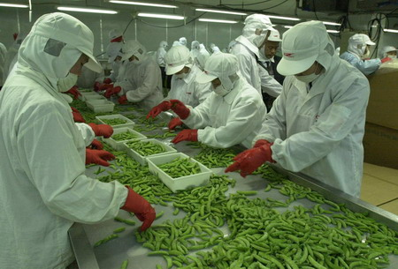
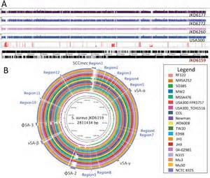

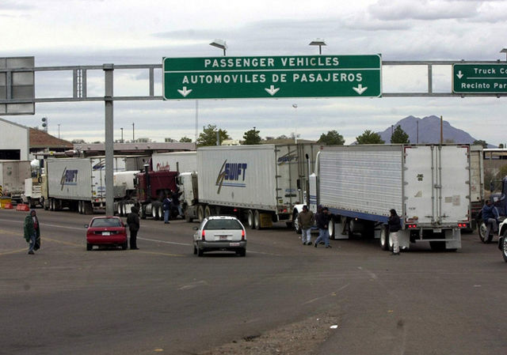

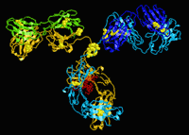

Top issues: PMA member priorities
60% do not have good knowledge of food production
45% don’t see transparency
77% Moms want to know more

Slide 3
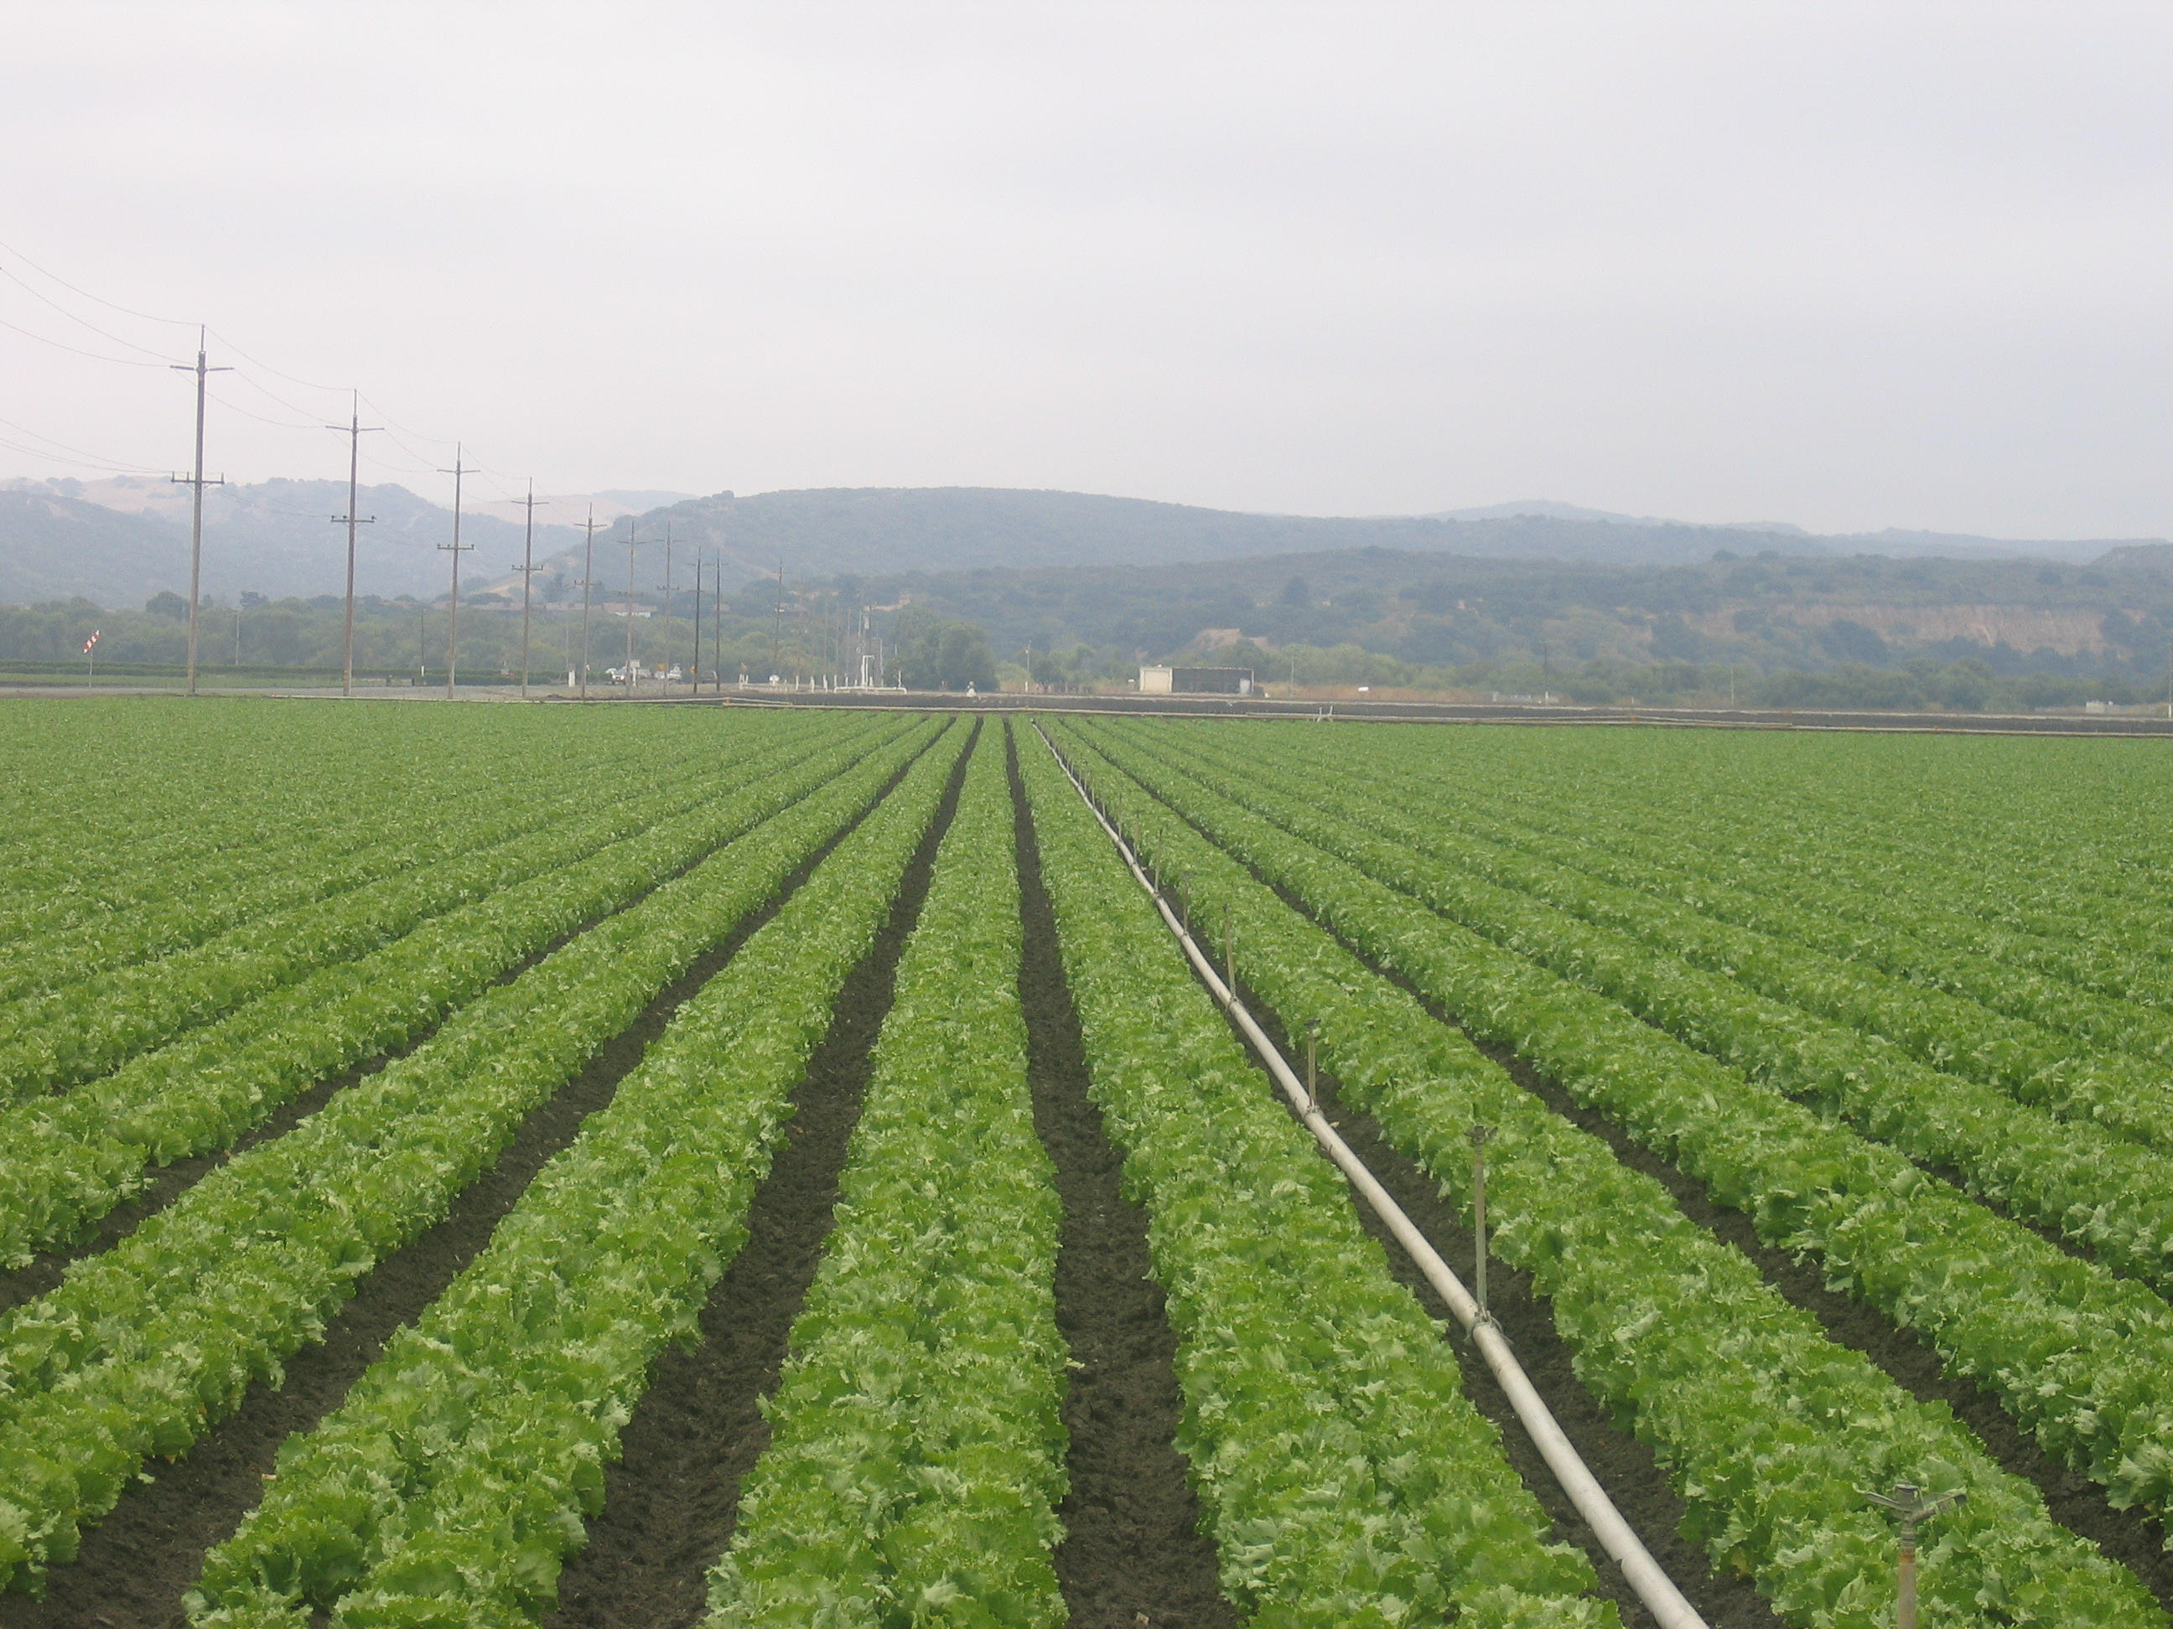
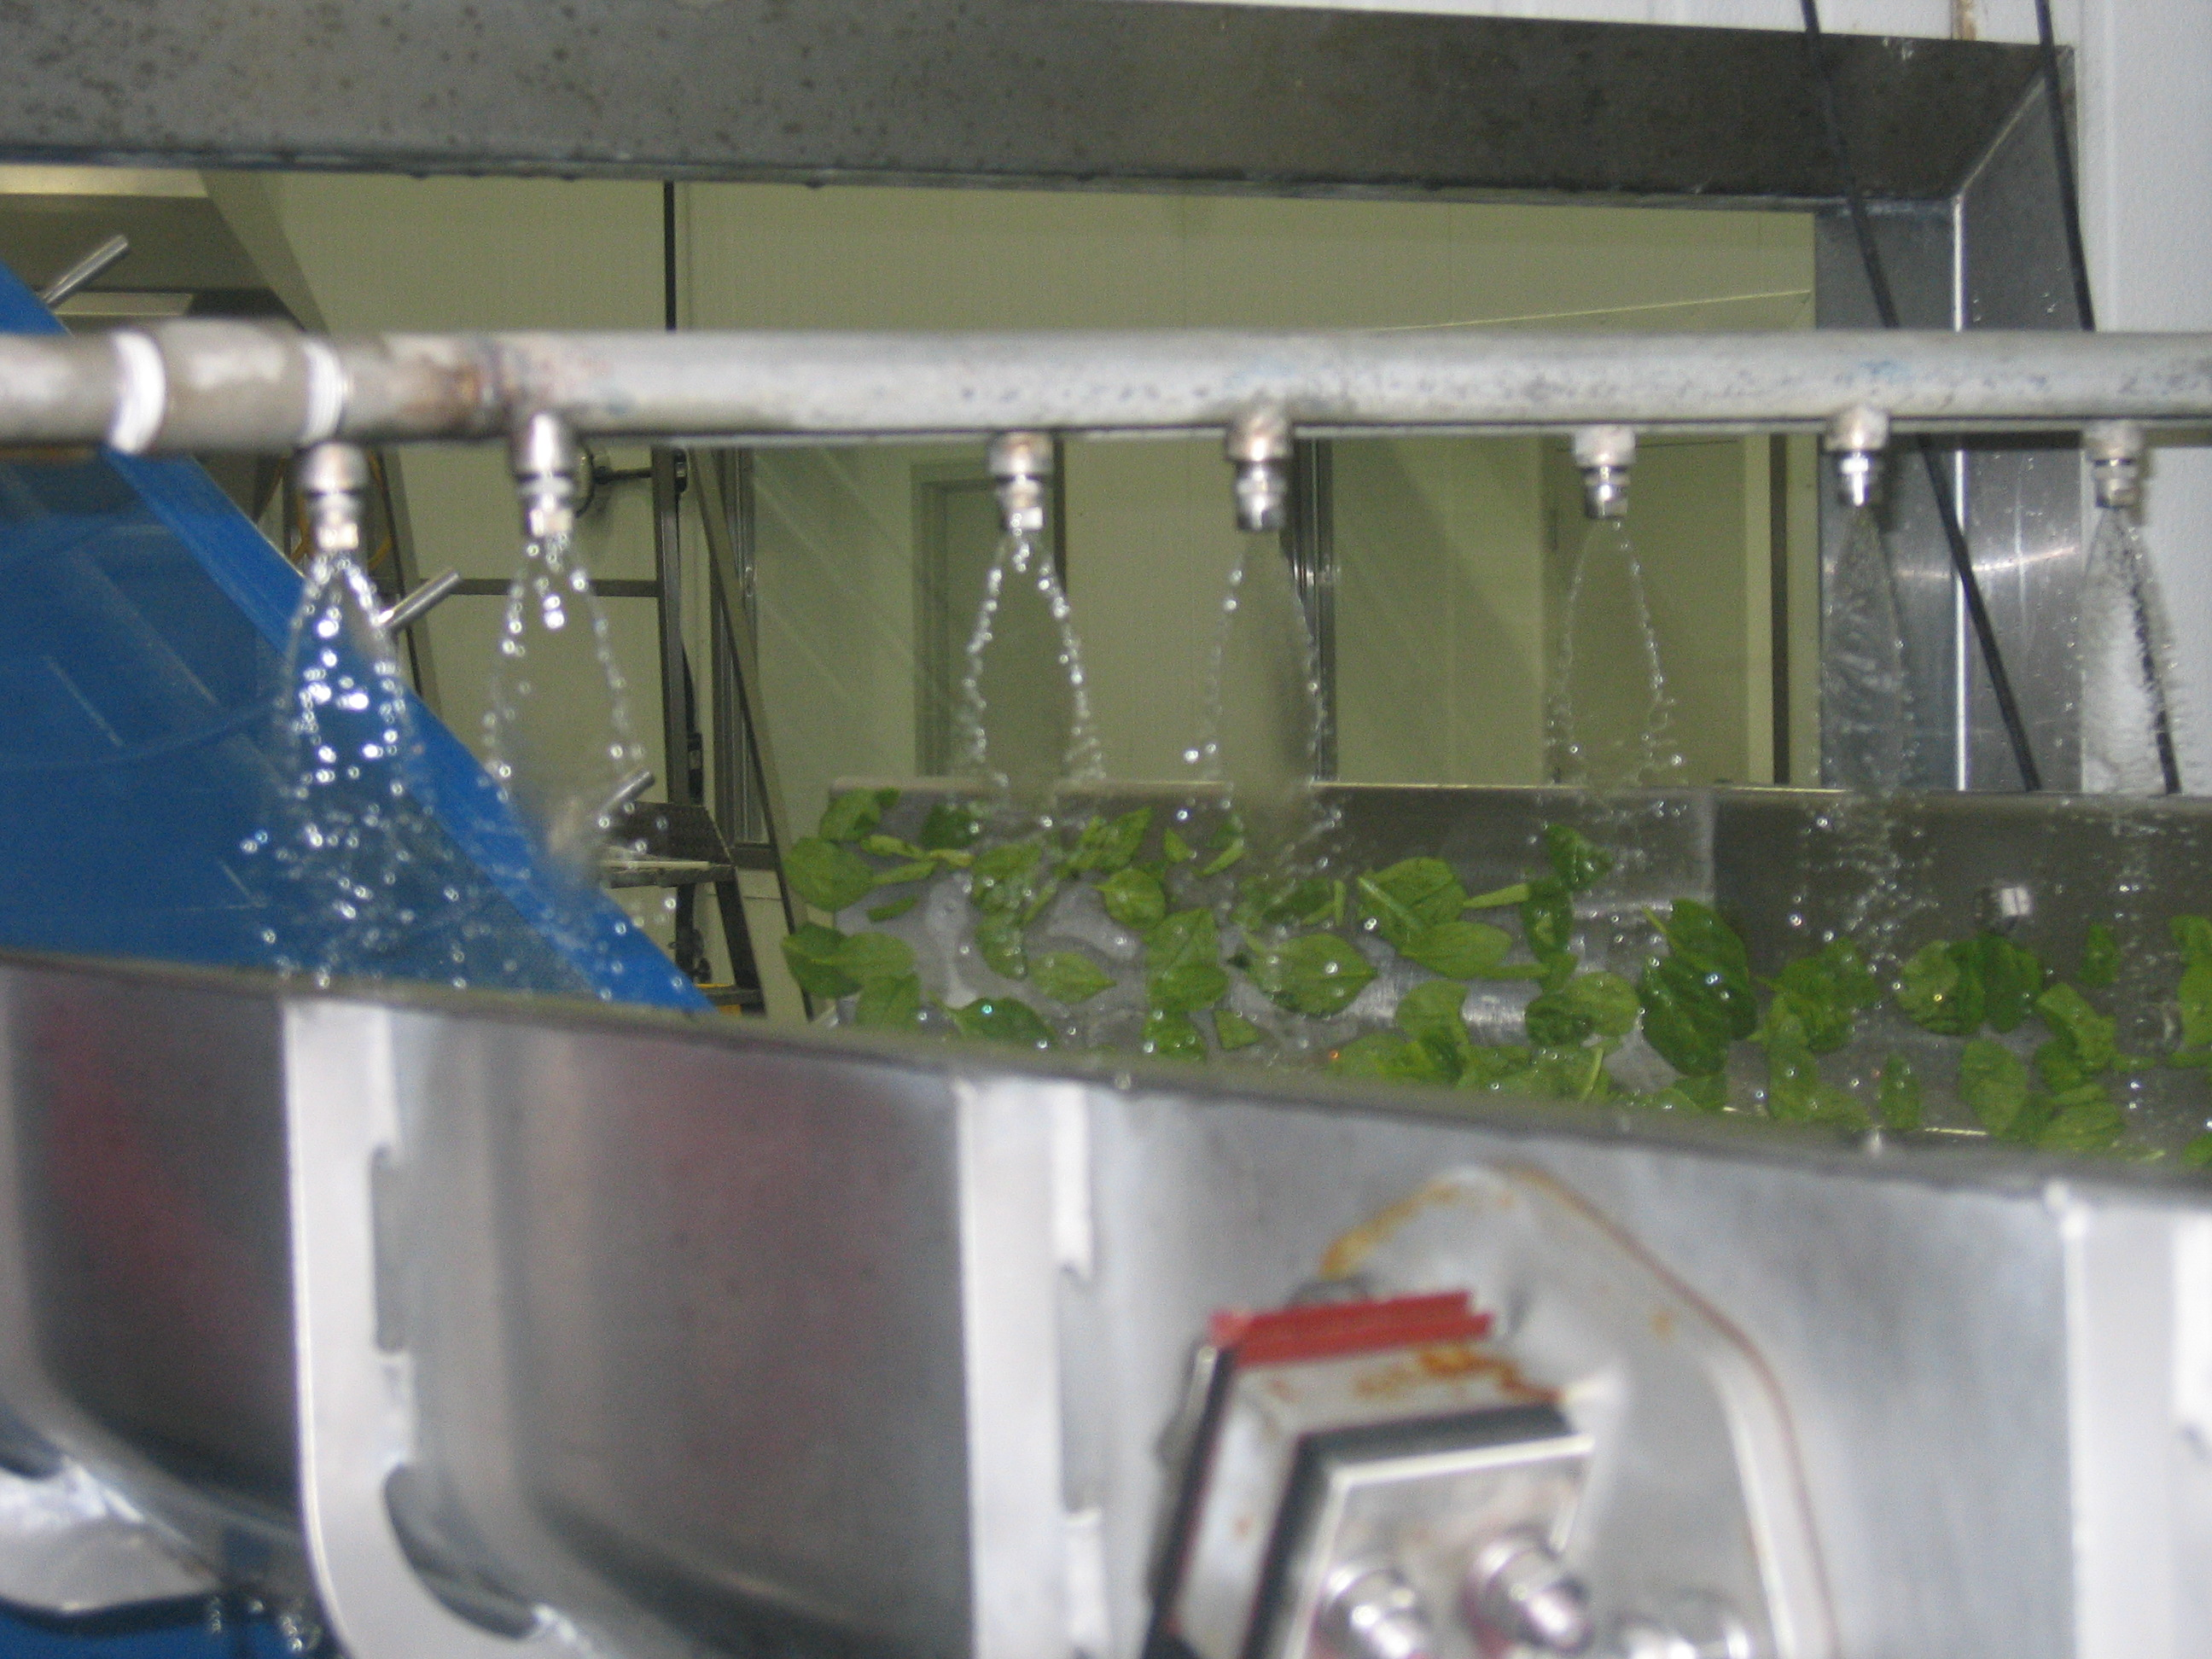



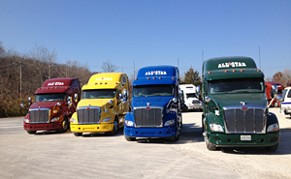

PMA priority: FSMA at a pivot point…
Impact? Depends on where you are and what you have done

Slide 4

PMA FSMA focus on education…
Supply chain focus
  Producers/buyers
  Commodity groups
  C-level connections
FSMA resource page
  Summaries
  Proposals
  PMA Comments
Webinars
Issues Leadership blog
Linked-In blogs
PMA events/roundtables
Evolving outreach

Slide 5



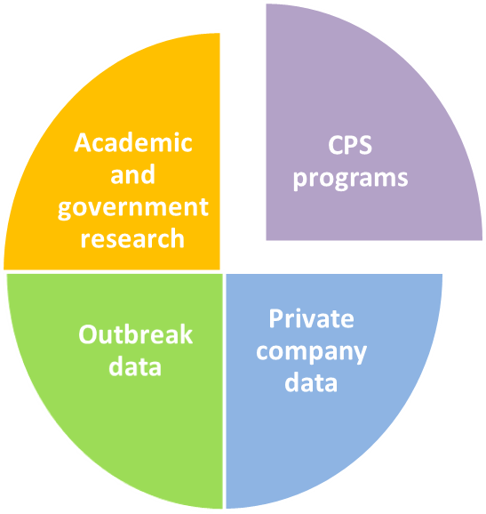
PMA priority: risk and science-based food safety programs
Important to focus on objectives
Keep poop out of food
Identify needs
Prioritize
Fund research
100 projects, $16.4M, 32 institutions
Public/private
Communicate results

Slide 6

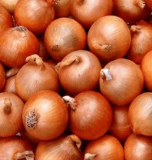


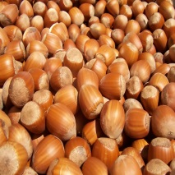


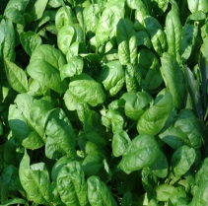
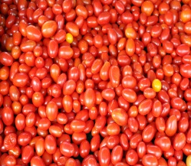

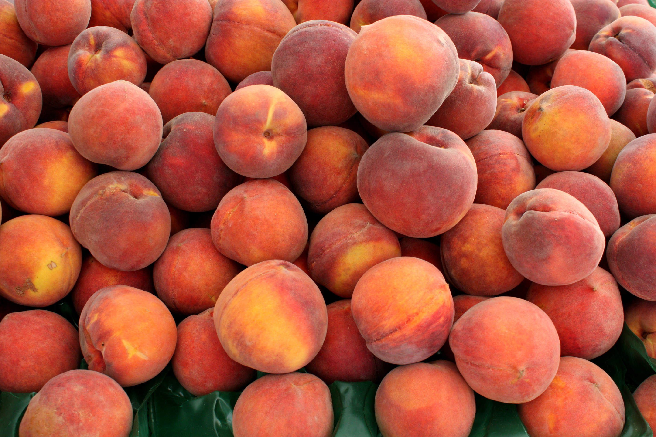

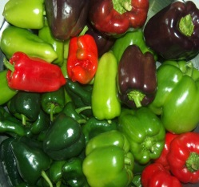



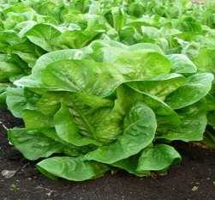


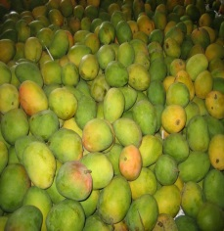
PMA priority: Lead, educate or convene
Every commodity/system has potential risks – food safety process driven…
Risk assessment
Core content
Webinars
Key learnings derived from research
Supply chain educational events
C-level discussions
Blogs

Slide 7
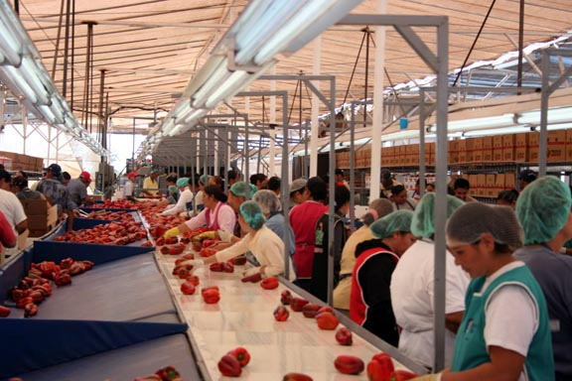
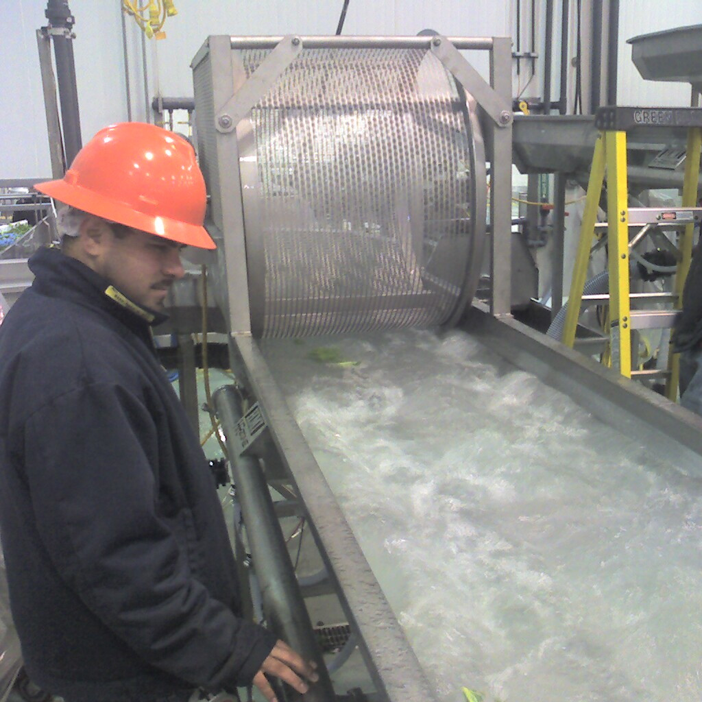




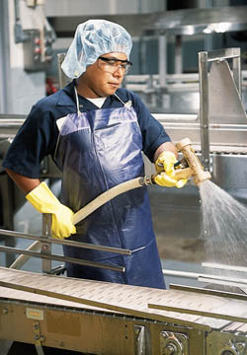
Engage industry – key science issues
FSMA/recent events brought focus - packinghouses, sanitation and verification

Slide 8

PMA priority: technology – an important piece of the puzzle…

Slide 9


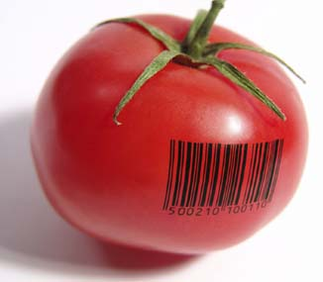
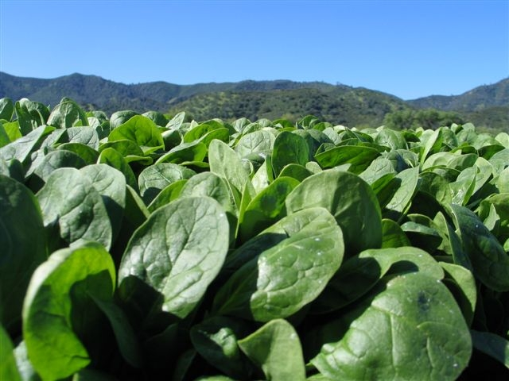
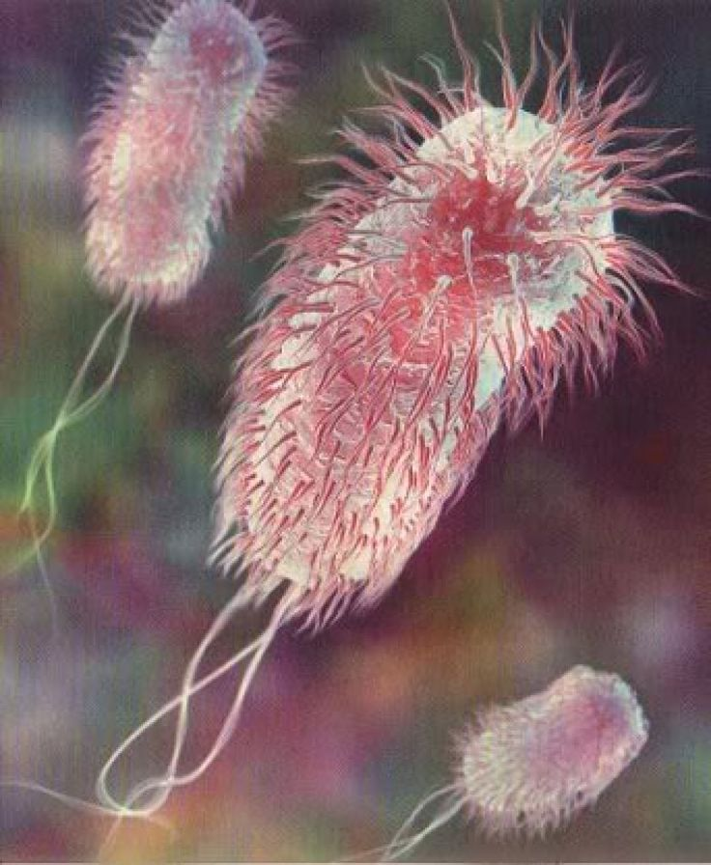
Technology portfolio – future of food safety?

Slide 10


PMA technology focus…
Educate and connect
Web content – go to resource
  Overviews
  Curation
Events
  Tech Talks – innovation
  Tech Knowledge - technology
Webinars
Linked-In blogs
"If you have always done it that way, it is probably wrong."
Charles Kettering
American Inventor, Engineer, Businessman

Slide 11


Bob Whitaker
BWhitaker@pma.com
Jim Gorny
JGorny@pma.com
Johnna Hepner
JHepner@pma.com
Ed Treacy
etreacy@pma.com
Cyndi Neal
CNeal@pma.com
Resources:
www.pma.com/technology
www.pma.com/fsma
www.pma.com/foodsafety
www.centerforproducesafety.org

