Slide 1
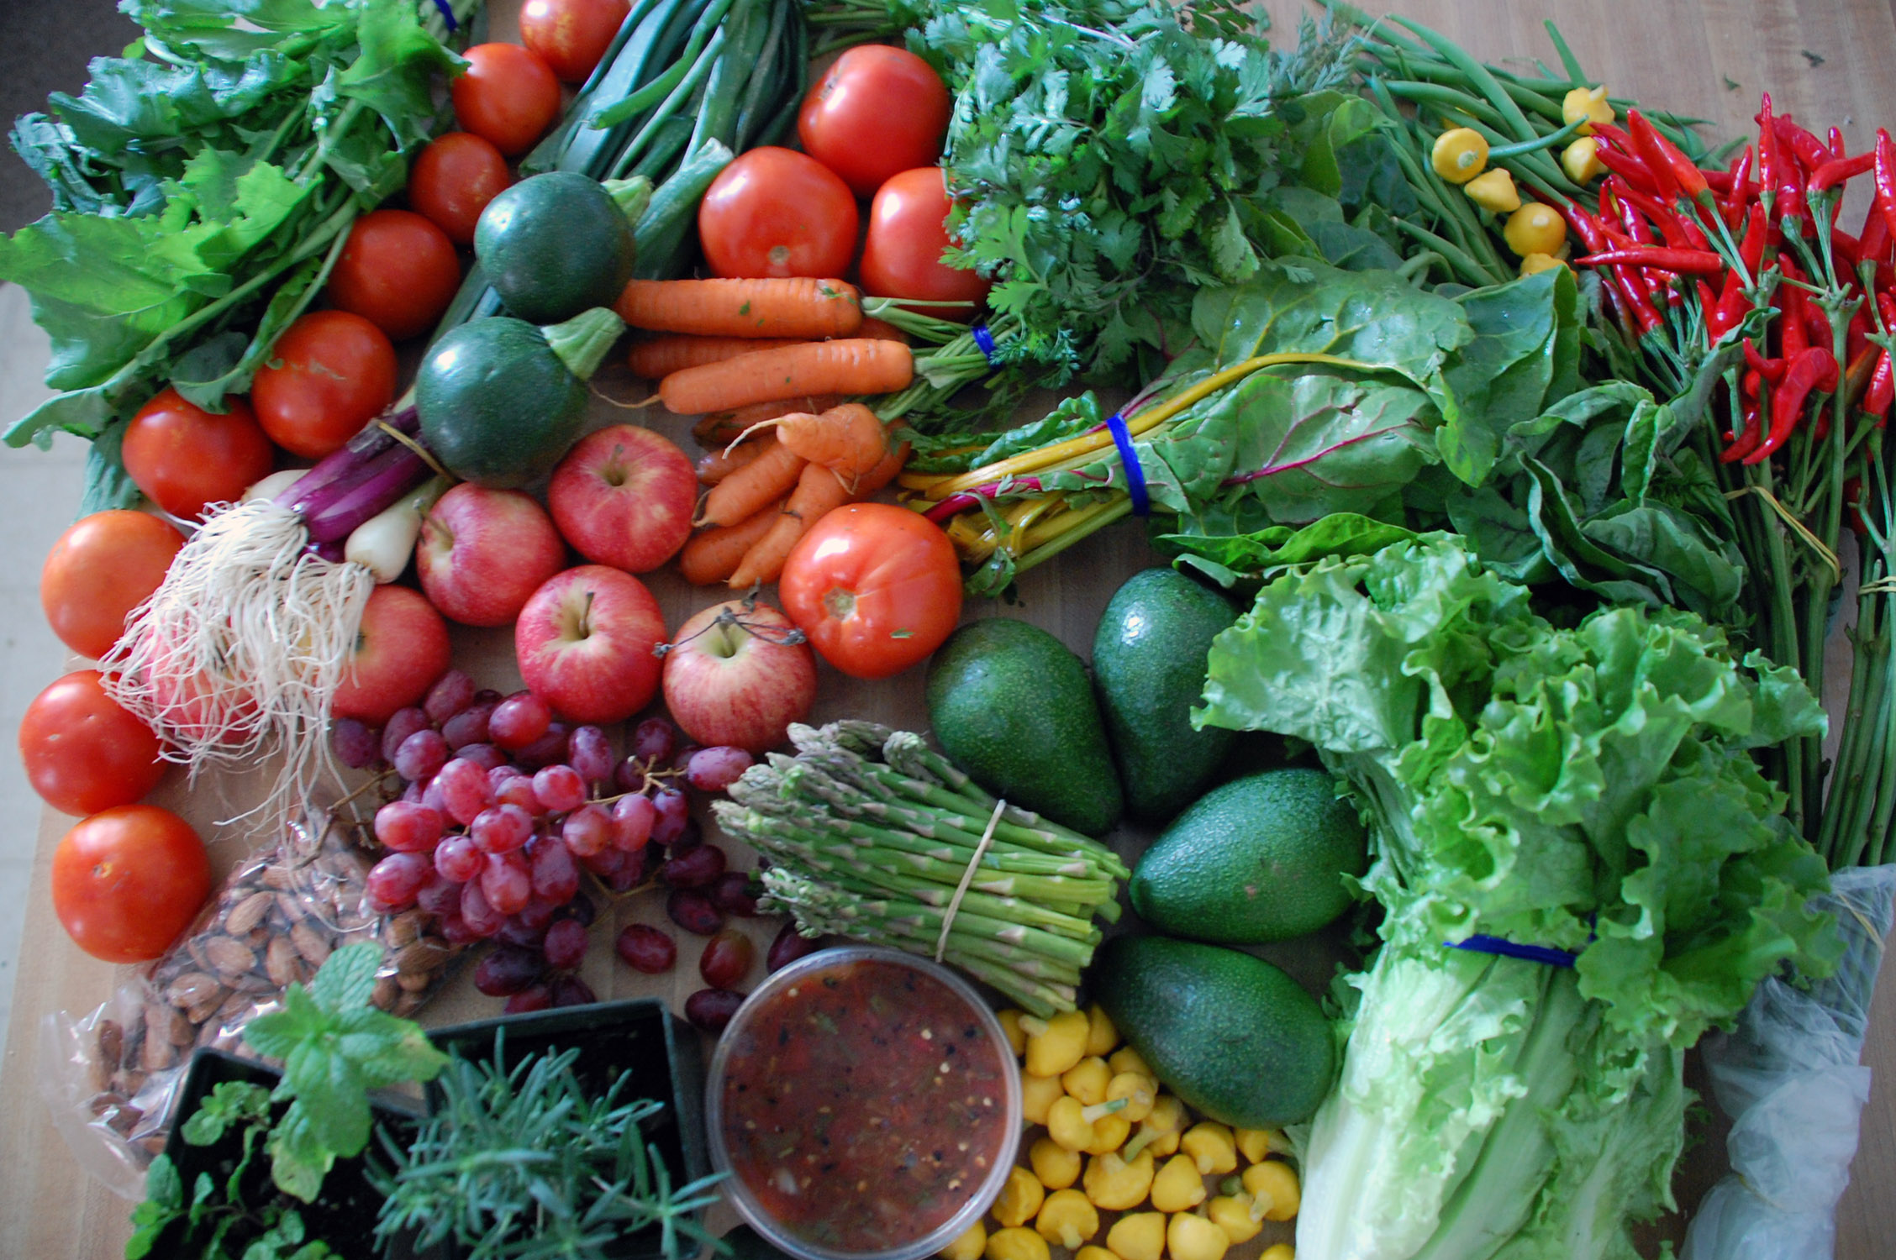

Educating Consumers on the Safe Handling of Fresh Produce
Free Resources
from a trusted source for health and food safety educators.
www.fightbac.org

Slide 2
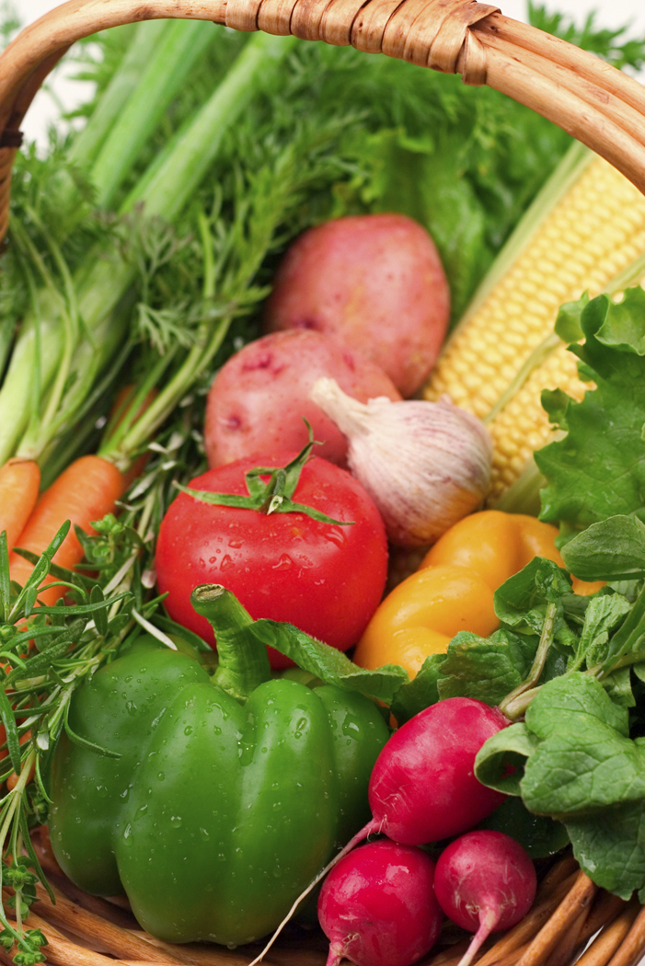
The Partnership for Food Safety Education delivers trusted, science based behavioral health messaging and a network of resources that support consumers in their efforts to reduce risk of foodborne illness.
The mission of the Partnership is to end illness and death from foodborne infections in the United States
Support for the Partnership for Food Safety Education is provided by the Food Marketing Institute & other contributing partners.
www.fightbac.org
The Partnership for Food Safety Education

Slide 3
Produce and Foodborne Illness
Salmonella in top 10 of pathogen-commodity pairings (CDC-MMWR, 2013)
Salmonella and produce are among the top 5 pathogen-commodity pairings responsible for outbreak-related illnesses and hospitalizations (CDC-MMWR, 2013)
Outbreaks and illnesses underreported, therefore underestimated (Morris et al., 2011)
Salmonella contamination of produce a growing problem (Lynch, 2009)
www.fightbac.org
The Partnership for Food Safety Education

Slide 4
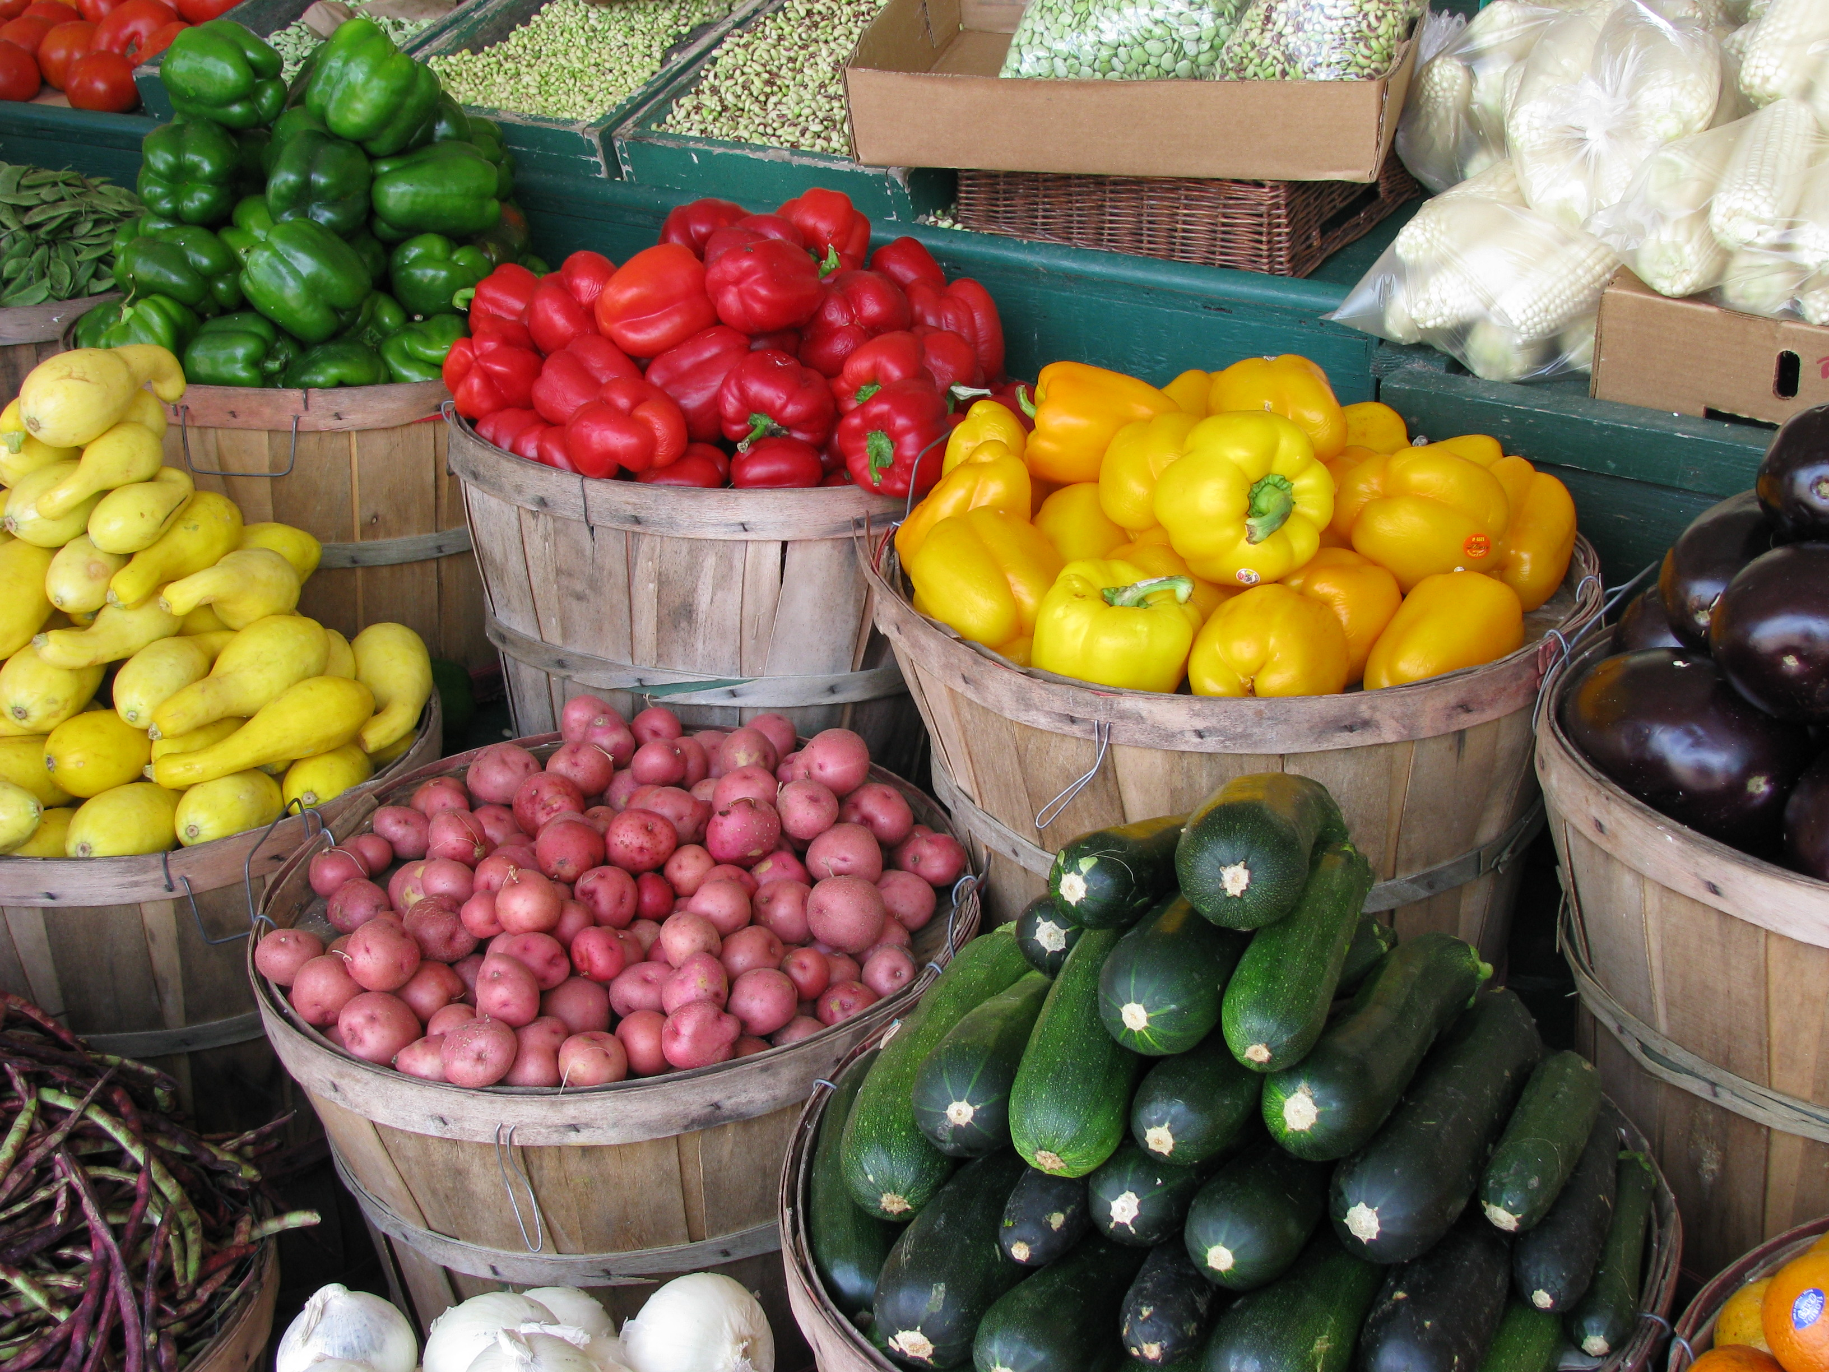
Why are Illnesses from Produce Growing?
                \
Increases in consumption (Lin et al., 2004, Wells and Busby, 2008)
Desire for year-round fresh product
Increase in produce transport
More cutting/coring in field for processed produce
More fields close to animal product
www.fightbac.org
The Partnership for Food Safety Education

Slide 5

Why Focus on Consumer Behavior?
Greatest proportion of food eaten is prepared at home (Carlson et al., 2002)
21% of outbreaks attributed to foods eaten at home (CDC-MMWR, 2013)
Pathogens easily spread across kitchen (Redmond and Griffith, 2004; van Asselt et al., 2008)
Almost ¼ of US population at increased risk for illness:
* Over age 65 * Less than 5 years old
* Pregnant * Immunocompromised
* Home health care
Few consumers think home is source of food contamination 8% (FMI 2011)
Food prepared at home often served to wider community (Byrd-Bredbenner et al., 2013)

Slide 6
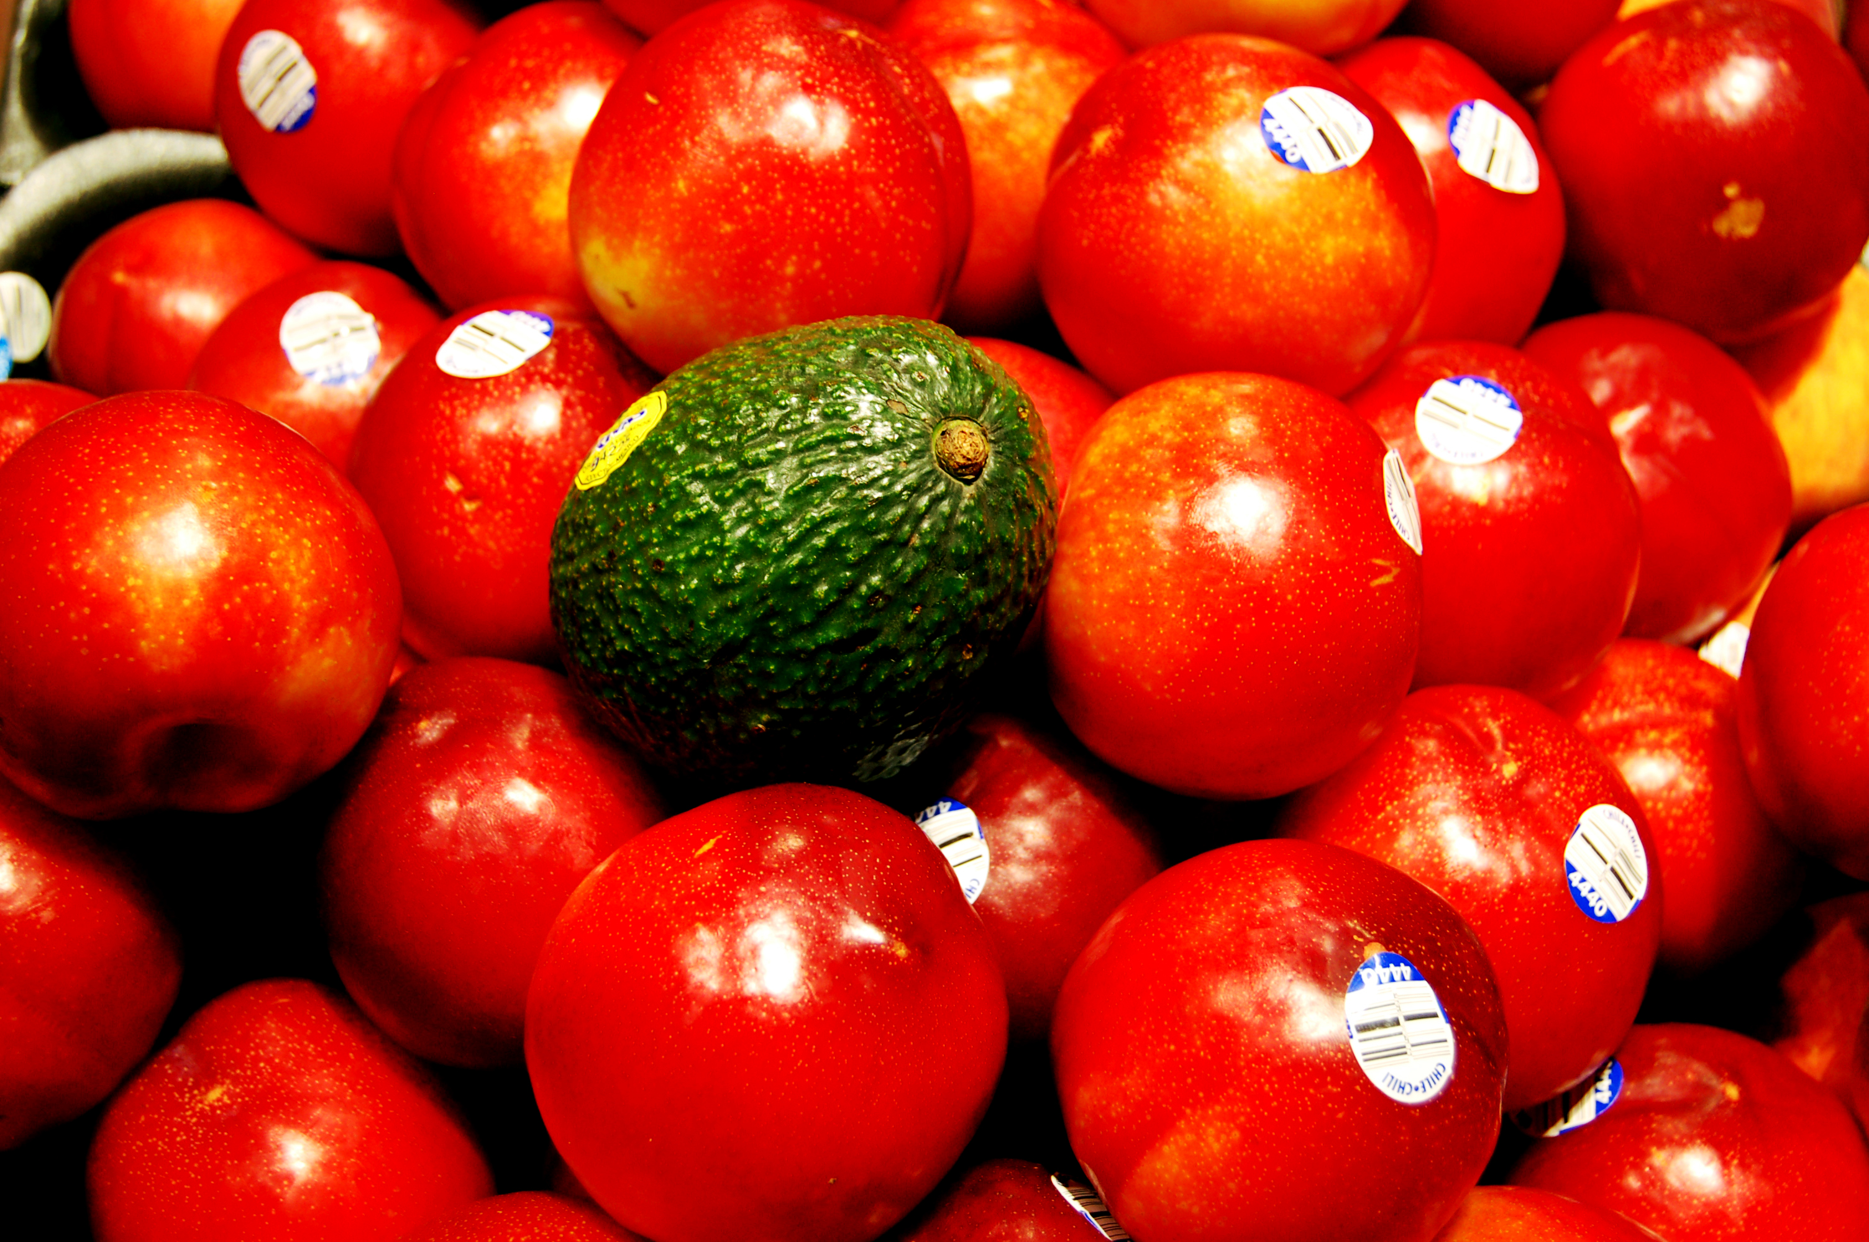
6 Steps for Safer Fruits and Vegetables
  Check
  Clean
  Rinse
  Separate
  Chill
  Throw Away
The Partnership for Food Safety Education, developed in cooperation with industry experts and the Food and Drug Administration.
www.fightbac.org
The Partnership for Food Safety Education

Slide 7
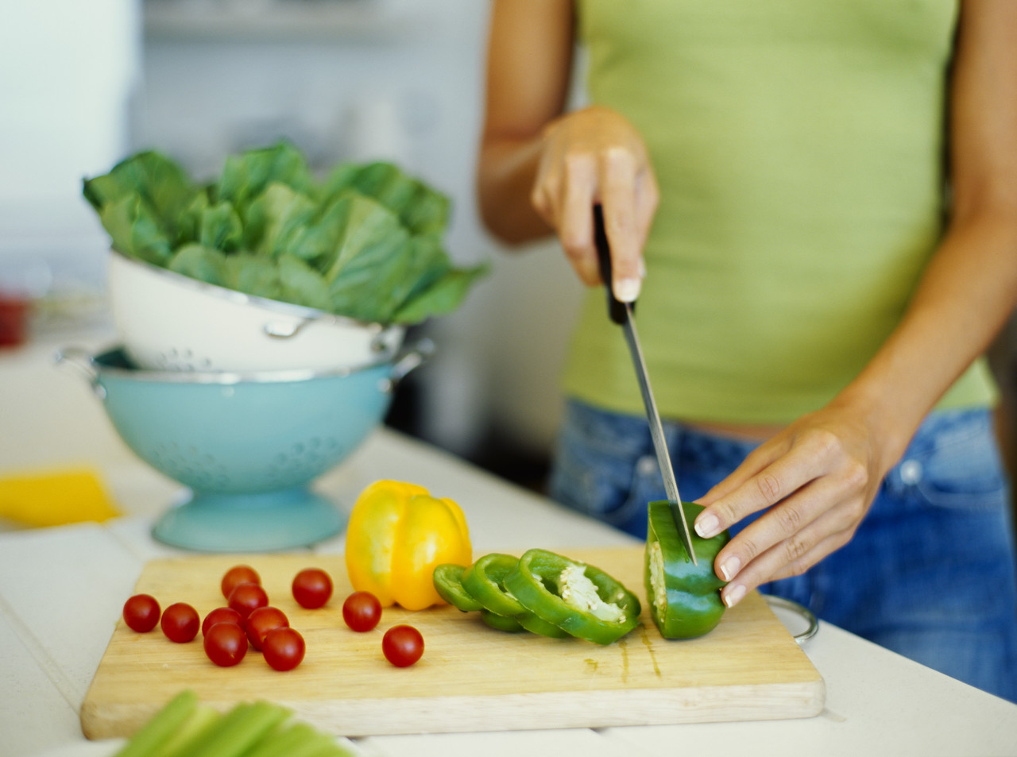
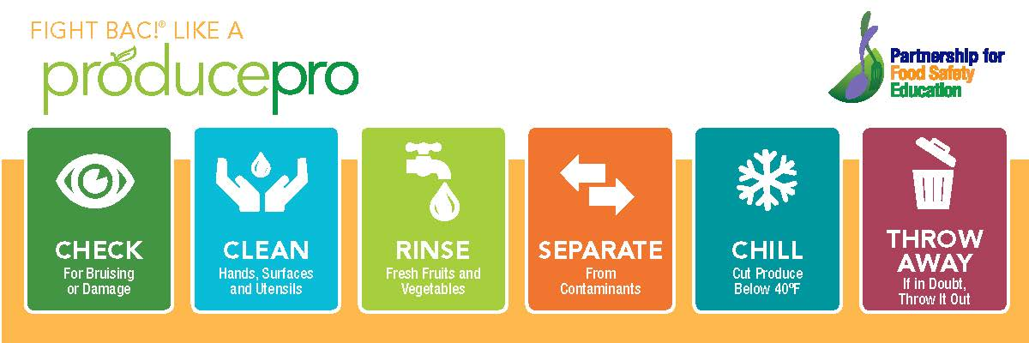
www.fightbac.org
The Partnership for Food Safety Education
Notes:
Often, produce is consumed raw and does not have final ‘kill’ step for pathogens, for example, cooking. Bacteria grow most rapidly in the range 40°F - 140°F, doubling in number in as little as 20 minutes.
Keep cut produce at 40°F and Refrigerated within 2 hours of cutting, peeling, or cooking to prevent growth of bacteria.

Slide 8
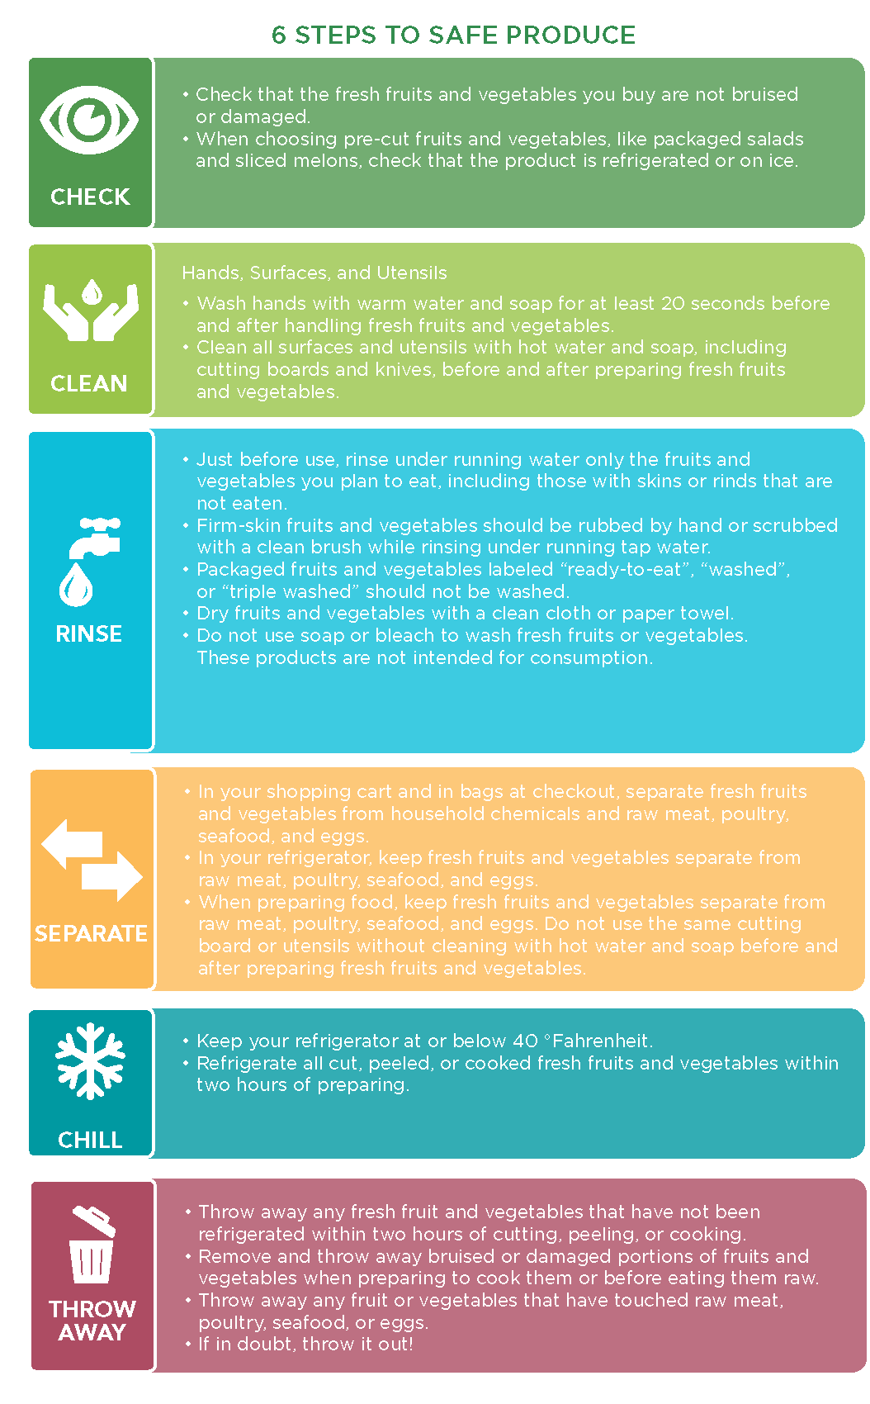
Campaign Elements
Consumer Fact Sheet
Educator Talking Points
Safe Handling Graphic
Retail Circular
Retail Point of Sale
Retail Handouts
Receive our weekly
e-cards for ready-to-use content.

Slide 9

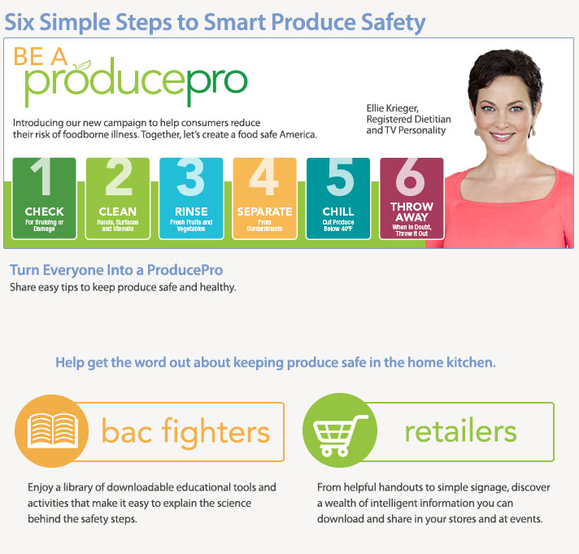

ProducePro designed for retailer use.
www.fightbac.org

Slide 10





We want to support you!
The non-profit Partnership wants to work with you to ensure your customers’ needs for food safety information are met.
/FightBAC
Join our E-List
ashley@fightbac.org
202-220-0705
@Fight_BAC
Upcoming Events
Knowledge Exchange: 7/29 1:00 PM EST
CFSEC Conference: 12/4-12/5
teamfoodsafety.org/field-reports-blog
www.fightbac.org
The Partnership for Food Safety Education

