Slide 1
Measuring Food Safety Success
How To
Gina R Kramer RS/REHS
Savour Food Safety International, Inc. - Executive Director
+1-614-507-5105; gina@savourfoodsafety.com
Food Safety Innovations – President/Co-Founder
STOP Foodborne Illness – Chair of Board of Directors
© Gina (Nicholson) Kramer 2015

Slide 2

Friday, September 26, 2014
© Gina (Nicholson) Kramer 2015

Slide 3

Measuring Food Safety Success
Internal & External Audit Data
Business Performance Measures
Holistic Gap Analysis
Measuring Failures
© Gina (Nicholson) Kramer 2015

Slide 4

Internal & External Audits
Intelligent - in•tel•li•gent (adjective)
reflecting good judgment or sound thought:
success in coping with new situations and solving problems
Audit – au•dit (noun)
a methodical unbiased examination and review
Intelligent Audits = Successfully solving problems using data from a methodical unbiased review
© Gina (Nicholson) Kramer 2015

Slide 5

Intelligent Audits
Measurements that add value to the business daily
  Intelligent Audits capture data that the entire business can:
    Departmentalize
    Dissect
    Utilize
  To solve problems DAILY which will:
    Increase profit margins
    Improve customer satisfaction
    Create overall business success
© Gina (Nicholson) Kramer 2015

Slide 6
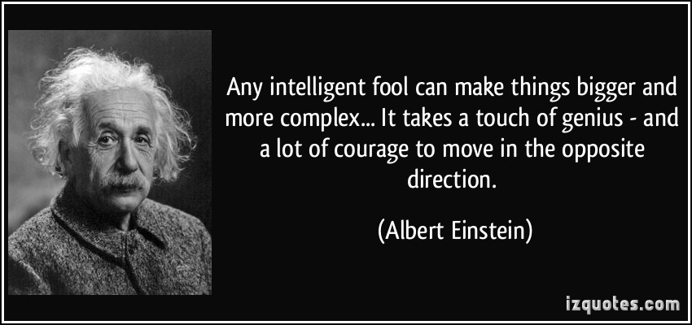
Use the KISS program - KEEP IT SIMPLE SWEETHEART! Do not use your intellectual prowess of food science to motivate business decisions through fear!
© Gina (Nicholson) Kramer 2015

Slide 7

Conventional Audit Metrics
Linear Approach
Focus on Average Score
“Silo-ed” Audit Questions
Every Unit is Audited 100%
Mega $ Investment
“Security Blanket”
© Gina (Nicholson) Kramer 2015
Notes:
Food safety is the foundation of every food business
Customers expect wholesome & safe food
Food safety should be supported across all functions of the organization

Slide 8

Intelligent Audit Metrics
Multi-faceted – using relevant Metrics from multiple sources
  EBITDA
  Shrink
  Labor
  Expense
  Facility & Maintenance
  Sales
  Customer Satisfaction
  Menu Development
Laser Focus – knowing how the score was earned
Identify “Hot Spots” – focusing on individual units that present the greatest risk rather than 100% of units
© Gina (Nicholson) Kramer 2015
Notes:
Food safety is the foundation of every food business
Customers expect wholesome & safe food
Food safety should be supported across all functions of the organization

Slide 9
Business Performance Measures
Food Safety
Shrink/Loss
Labor
EBITDA
Customer Satisfaction
Expense
Facility Maintenance
Sales
Menu Development
Review Business Performance Measures
Food safety affects every aspect of the business
Utilize the data for process improvement
© Gina (Nicholson) Kramer 2015

Slide 10

Data That Speaks “Their Language”
Date Marking Violations
  Translation:
    Over ordering/production of food causing reduced profit margins
Sanitation Violations
  Translation:
    Decreased food quality, customer complaints about taste and shelf-life at home
Temperature Violations
  Translation:
    Increased cost of utilities, repair/replacement of equipment
© Gina (Nicholson) Kramer 2015
Notes:
Food safety is the foundation of every food business
Customers expect wholesome & safe food
Food safety should be supported across all functions of the organization

Slide 11

Data That Speaks “Our Language”
Customer Complaints
  “Food Tastes Funny”
  Translation:
    Possible Cross-Contamination
    Temperature Abuse
    Inadequate Handwashing
Store Shrink #s are HIGH
  Translation:
    Over ordering/production of food causing possible date marking violations
Labor Costs High
  Translation:
    Not following proper SOPs
© Gina (Nicholson) Kramer 2015
Notes:
Food safety is the foundation of every food business
Customers expect wholesome & safe food
Food safety should be supported across all functions of the organization

Slide 12
Holistic Gap Analysis
Values
Business strategies
Technology & Systems
People capabilities & processes
Organizational structures
Business processes
Business culture
Taking a complete look at the:
  Beliefs
  Attitudes
  Behaviors
Towards food safety - as well as the:
  Policies
  Procedures
  Practices
That are in place
© Gina (Nicholson) Kramer 2015

Slide 13
“If you build your program to meet the regulatory minimum standards, then you build a minimum standard program”
Best in Class
Successful food safety professionals
Can your business afford to build a minimum standard Food Safety Program?
© Gina (Nicholson) Kramer 2015

Slide 14
Measuring the Cost of Failures
What is the price?
© Gina (Nicholson) Kramer 2015

Slide 15

Reputational Risk
Measuring the impact of a food safety event
  Stock Market Value
  Sales
  Customer Perception
  Employee Moral
  Customer Complaints
  Company Remediation
    Legal Council
    Labor
    Supplies
    Health Department Fines
    Contractor Costs
    Supplies
    Lab Tests
    Travel/Time of Internal Team Members
  Media Attention
  Profit Margin
© Gina (Nicholson) Kramer 2015

Slide 16
Food Safety Event & Stock Value
What affects stock market value during & after a food safety event?
Food Safety Event
Firm Market Value
Risk Related Factors
Severity of Risk
Recall Execution
Firm Specific
Past History
Firm Size
Situational Factor
Media Attention
Seo, S., et al., The impact of food safety events on the value of food-related firms: An event study approach. Int. I. Hospitality Manage. (2012), http://10.1016/i.iihm.2012.07.008
© Gina (Nicholson) Kramer 2015

Slide 17
Reputational Recovery
How long does recovery take after an event?
57th Trading Day - *CARs significantly negative after outbreak. About two working months before increased movement
264 Trading Days – Negative CARs turned to positive values after almost 1 year from the start of the event
Stock Value Prior to Food Safety Event
Initial Announcement of Event
Event Investigation
Day 57
CAR Values Rise
Continue to rise
Day 264 Pre-Event Values
*CARs Cumulative Abnormal Returns
(Actual Returns) – (Expected Returns) = Abnormal Returns
Seo, S., et al., The impact of food safety events on the value of food-related firms: An event study approach. Int. I. Hospitality Manage. (2012), http://10.1016/i.iihm.2012.07.008
© Gina (Nicholson) Kramer 2015

Slide 18

Protecting Reputation
A company MUST have:
Pre-Crisis Management Strategies
  Provide food safety information to employees during hiring, evaluation & training
  Integrate food safety messaging into every aspect of the business
Post-Crisis Communication Strategies
  Employees - Customers - Shareholders
Seo, S., et al., The impact of food safety events on the value of food-related firms: An event study approach. Int. I. Hospitality Manage. (2012), http://10.1016/i.iihm.2012.07.008
© Gina (Nicholson) Kramer 2015

Slide 19
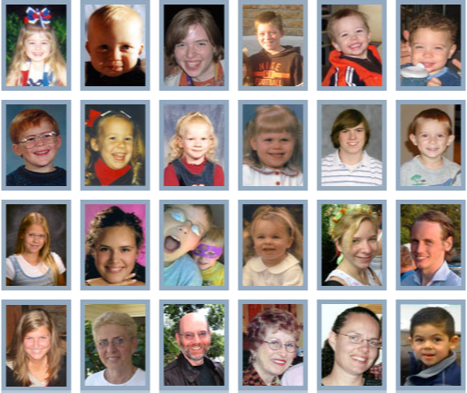


Why we do what we do every single day!
© Gina (Nicholson) Kramer 2015
Notes:
Putting a Face on Food Safety
“I would like you to look at these pictures. These are people that look like normal everyday folks. They are somebody’s Mother, Father, son or daughter, sister or brother, Grandmother or Grandfather. They all have one thing in common. They contracted a foodborne illness. Some of them survived and some did not.
I would like to highlight two individuals on the screen. Look at the cute little boy in the left column in the middle. His name is Alexander Donley. He turned 6 in 1993. He was a lively, energetic little boy with bright red hair and sparkling grey eyes. He would never turn seven. One summer night his parents prepared hamburgers on the grill. Unknown to them, the undercooked ground meat Alex was about to eat contained bacteria, E. coli 0157:H7. His short life ended within four days as he suffered severe abdominal cramps, uncontrollable intestinal hemorrhage, tremors and delusions as the toxins attacked his digestive system then his brain. His last words were, “Don’t worry” as he mouthed a kiss to his Mommy and Daddy.
Next, let me share with you the story of Stephanie and Michael, their picture is in the lower right hand corner. Stephanie was an obstetric ultra-sound tech. She and her husband were expecting their first child. Stephanie did all of right things during her pregnancy. She exercised and ate healthy. Then one morning around 3:00 am she work up suddenly with a severe headache, stiff neck and extremely nauseous. She knew that something terrible was wrong. As she headed for the hospital she began premature labor. She later delivered Michael who was 10 weeks early. However, these parents were faced with a decision no new parent should face. Michael was born with severe brain hemorrhaging which left him on life support without any hope of recovery. These new parents had to make the decision to remove their first born child off of life support. When the lab reports had returned it revealed that Michelle had contracted a foodborne illness called Listeria monocytogenes. The symptoms are typically fatal to an unborn child. It was determined that the bagged salads that Stephanie had been eating were contaminated with the same bacteria.
Our customers trust us with their lives and the lives of their loved ones. It is our obligation to do everything in our power to keep our customers safe. We do that by following the food safety policies and procedures that have been put in place. We check temperatures, wash our hands, we wear gloves and hair restraints and practice good sanitation.
We need to make sure that none of our customers show up on this wall of pictures

Slide 20

Measuring Food Safety Success
Gina R Kramer RS/REHS
Savour Food Safety International, Inc. - Executive Director
+1-614-507-5105; gina@savourfoodsafety.com
Food Safety Innovations – President/Co-Founder
STOP Foodborne Illness – Chair of Board of Directors
© Gina (Nicholson) Kramer 2015

