Slide 1
FMI Foundation Retail Food Safety Forum
Tejas Bhatt
tbhatt@ift.org
June 11, 2015

Slide 2
Today’s Dialogue
Introduction
  IFT
  GFTC
  Traceability
Challenges and Opportunities
  In Traceability
  In Retail
Research and Resources
  Technology Interoperability
  Best Practices
  Regulatory Harmonization
  Return on Investment Tool
  Consumer Preference Tool

Slide 3
Introduction: Institute of Food Technologists
For more than 75 years, IFT has unlocked the potential of the food science community by creating a dynamic global form where members from more than 100 countries can share, learn and grow.
Notes:
So, let’s begin with who we are? For more than 70 years, the Institute of Food Technologists has unlocked the potential of the food science community by creating a dynamic global form where members from more than 100 countries can share, learn and grow.

Slide 4

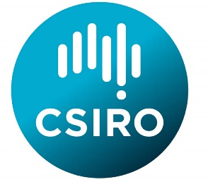
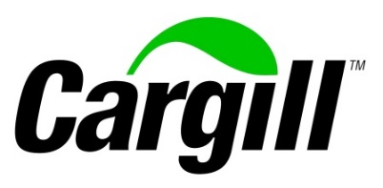



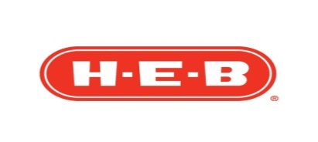













Introduction: Global Food Traceability Center
Logos are the copyright of their respective organizations and are used here for illustrative purposes only

Slide 5
Introduction: Traceability
Traceability is not about data, identifiers, bar codes, RFID, tags, and any information that needs to be linked together to make traceability possible.
  These are all critical, but not sufficient
Traceability is about systematic ability to access any or all information relating to a food under consideration, throughout its entire life cycle, by means of recorded identifications.*
  For this to happen, a traceability system must keep track of when the units (and the associated identifiers) are created, used, joined together, split up and finally disposed
* Olsen P, Borit M. 2013. How to define traceability. Trends in Food Science and Technology
Notes:
Definitions of traceability abound. Unfortunately many of them are not helpful – sometime they present circular descriptions by saying traceability is the ability to trace! Huh? But there was a recent paper by Olsen and Boirt out of Norway that is actually very useful.
Olsen P, Borit M. 2013. How to define traceability. Trends Food Science and Technology

Slide 6

Challenges: Consumer Demands
Consumers are more vocal
  Demand for rapid access to reliable and relevant information whenever they need it
Notes:
Rapidly shifting consumer preferences. They demand rapid access to reliable and relevant information whenever they want it. There is also an increasing level of discomfort regarding product recalls. Their confidence is fragile. And then there is the power of social networks which cannot be overlooked.

Slide 7


Challenges: Different Requirements
Overlapping and conflicting demands from national regulators
Notes:
There are many overlapping and conflicting demands from national regulators around the world. Different regulations on allergens, trace elements, pesticides, and more. And global sourcing means time zones play a significant role in response times. Food fraud and market substitution for economic gain is also a global challenge.

Slide 8
Opportunities: Interoperability
Islands of data
  Accessibility
  Syntax
  Semantics
Interoperability means
  Ability to speak the same ‘language’
  Understand the same words – Vocabulary
  Answer the same questions in a predictable manner
Interoperability does NOT mean
  One system
  Everyone has to use same KDEs and CTEs for everything
  Universal access to data – Loss of confidentiality, control, or capability

Slide 9
Opportunities: Harmonization
Harmonizing traceability is a Win-Win-Win
  Businesses
    Reduced costs
    Increased profits
    Viable industry
  Consumers
    Better informed decision-making
    Encourages responsible food production
  Regulators
    Reduced impact of outbreaks
    More aligned regulations – less duplication/gaps
    Fisheries management

Slide 10
Research: Interoperability Blueprint
Project Purpose
  Design a common technology architecture suitable to the seafood industry, and develop a rollout strategy
  Provide supporting communications, education and training needed to accelerate understanding of the need for a common blueprint and collaborative strategy for an interoperable global seafood traceability system

Slide 11
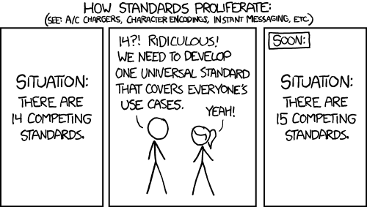
What we do NOT want to do…
Source: http://imgs.xkcd.com/comics/standards.png

Slide 12
Research: Interoperability Blueprint
4 Technical Advisory Groups (TAG)
Content Mapping
  Critical Tracking Events
  Key Data Elements
Context Mapping
  Common information model and terminology (ontology)
  Protocols and standards
Practices and Processes
  Data validity and security (integrity)
  Data governance and principles of operation
Engagement & Communications
  Multi-industry involvement – Interoperability in other industries
  Cross-disciplinary outreach – Engagement – Knowledge transfer

Slide 13
Resources: Education and Training
Best Practices Guidance Document
  Bakery, Dairy, Meat and Poultry, Produce, Processed Foods, and Seafood
Benchmarking Study of Regulations in 21 OECD Countries
  Relative rankings of traceability requirements across jurisdictions
Return on Investment Tool
  Currently for seafood; applicable to all foods
Seafood Consumer Preference Tool
  Based on survey of 2400 consumers from 5 countries
More information at http://www.globalfoodtraceability.org

Slide 14
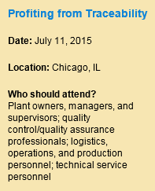
Resources: Profiting from Traceability
A Short Course at IFT 15
This highly-interactive course features an in-depth look at how you can gain a competitive advantage and improve your bottom line by enhancing your existing traceability system.
  Learn the basic principles of traceability through lectures and hands-on group break-out sessions
  Discover how to make your traceability investment work to your advantage
  Evaluate how you currently collect and manage traceability information
Register: http://www.am-fe.ift.org/cms/?pid=1001273

Slide 15
Tejas Bhatt tbhatt@ift.org www.globalfoodtraceability.org

