Slide 1
A Journey Through the Past: Creating and Fostering a Strong Food Safety Culture
Dr. Ben Chapman
NC State University
June 11, 2015

Slide 2
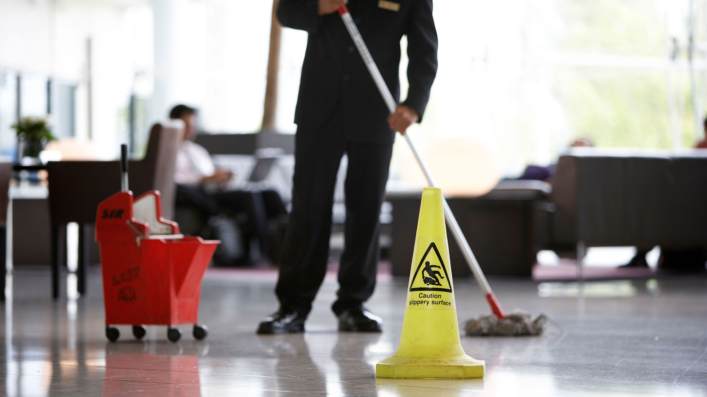

Slide 3
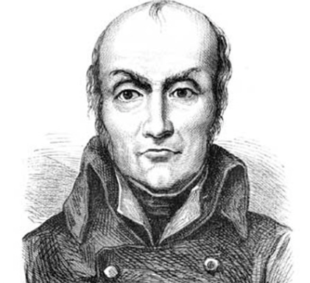
Nicholas Appert
12,000 francs, in 1809 when he submitted his method of “food in glass bottles.”

Slide 4
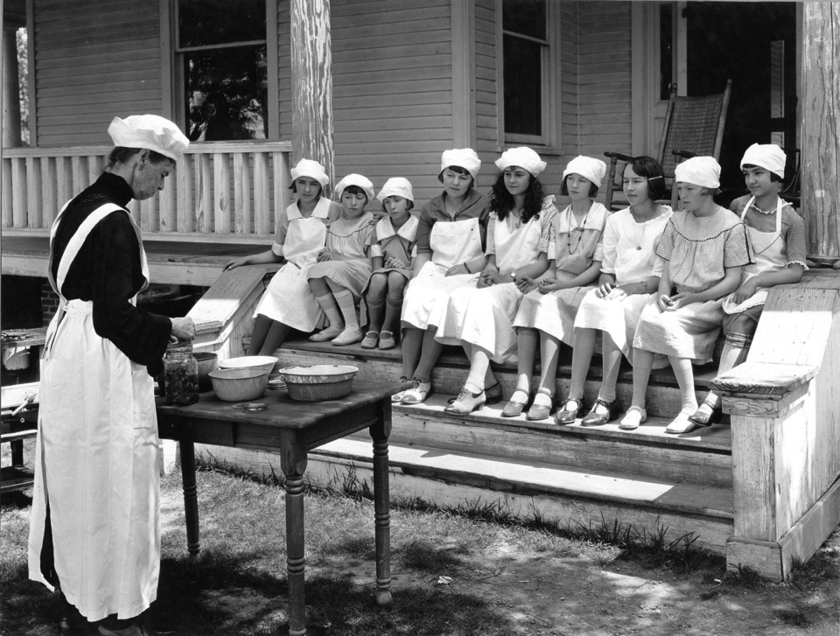
Acidic/acidified foods heat sufficient to destroy vegetative microorganisms
Foods packed into sealed, or airtight containers.
Low acid canned foods are heated under pressure at temperatures of 240-250°F (116-121°C).

Slide 5
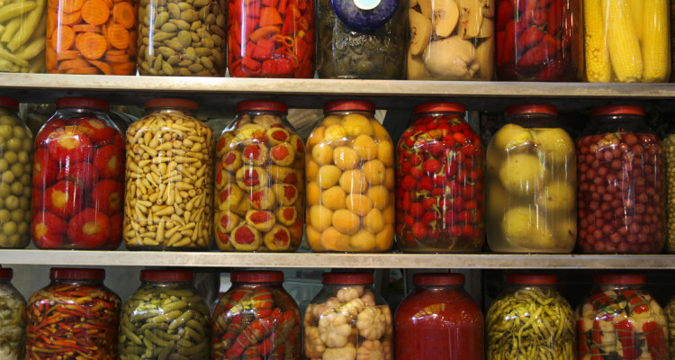
Majority of home canners have reported not following science-based home preservation methods
Receive much of their home preservation information through friends and family
Only 45% of respondents thought that home canned foods could be spoiled without obvious signs of spoilage

Slide 6
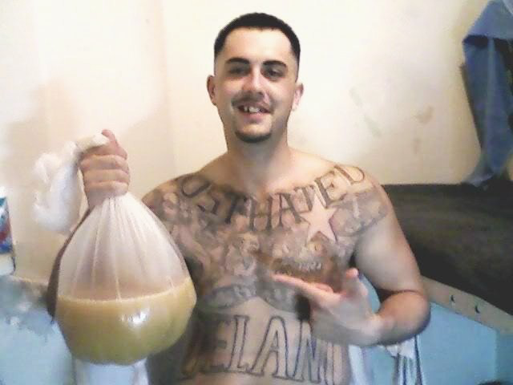
2012 CDC surveillance
160 cases
25 cases foodborne
12 were linked to 2 pruno outbreaks

Slide 7
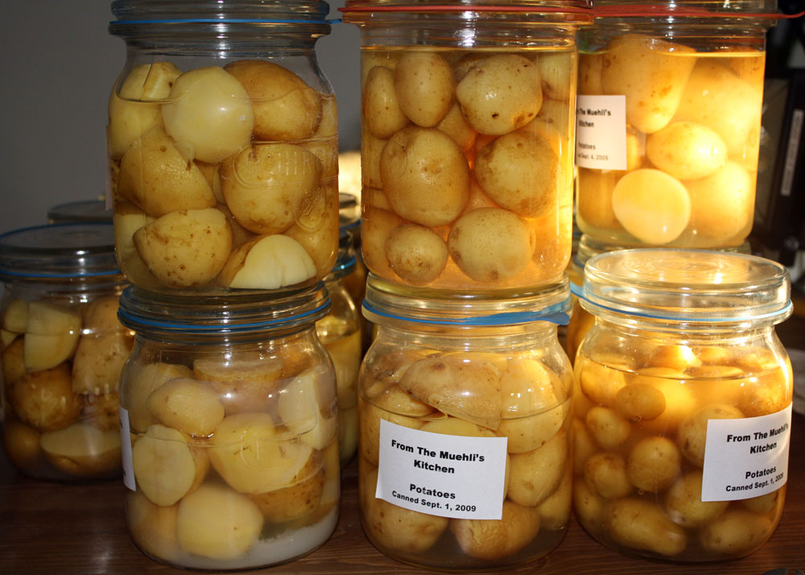
Clostridium botulinum
Lancaster, Ohio
One death and 24 illnesses
Linked to a church potluck
Canned potatoes in potato salad

Slide 8
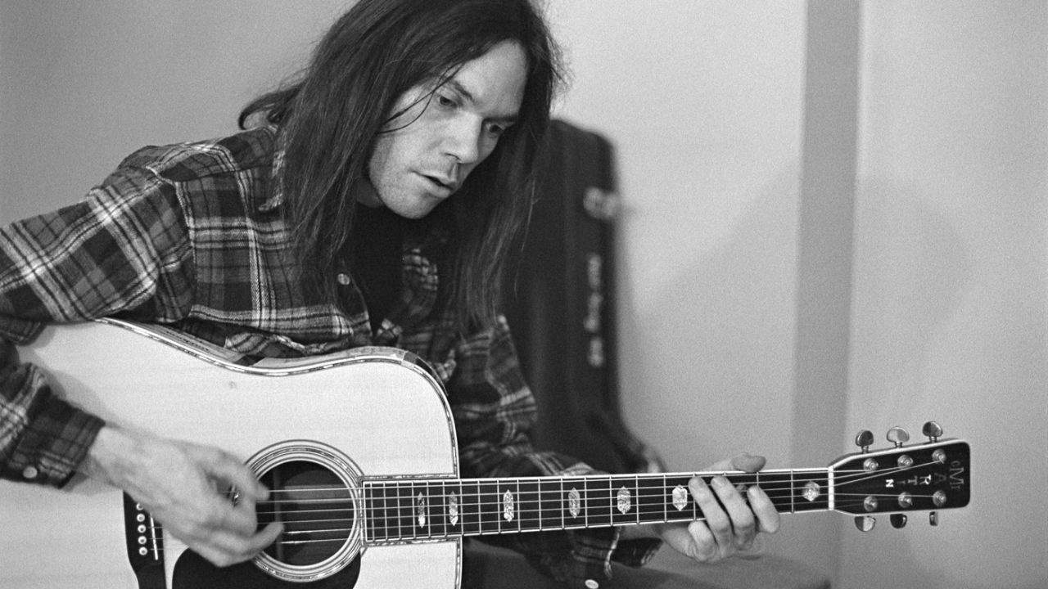
FDA and CDC now go on a journey through the past when it comes to pathogens

Slide 9
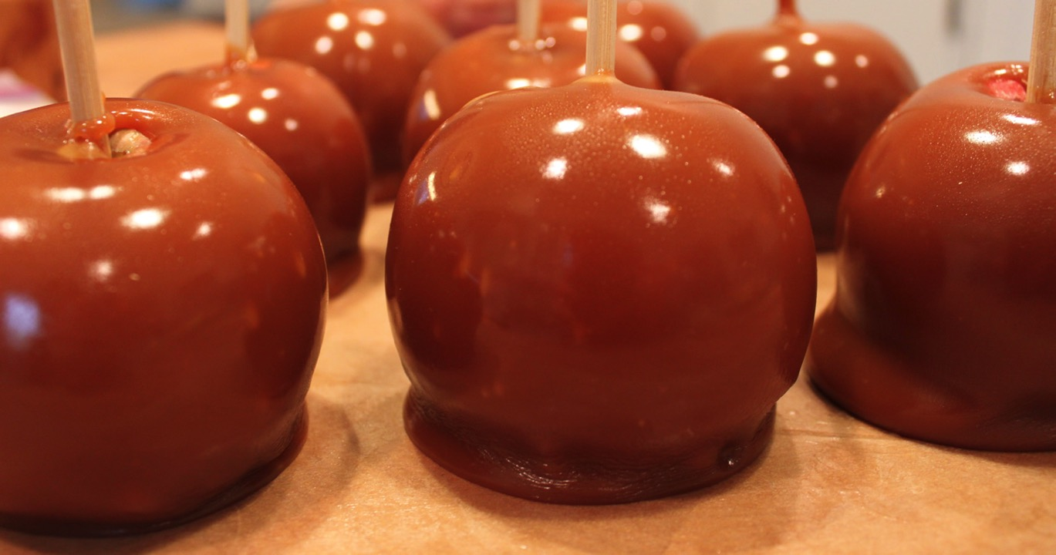
7 deaths, 35 ill from Lm
Outbreak strain with genetic match was found in apple packing plant
Caramel apples

Slide 10
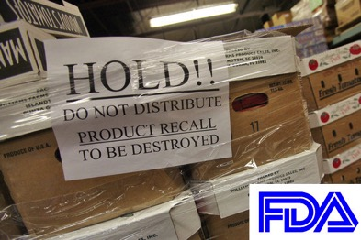
Food industry is not well trusted (outbreaks and recalls contribute to this)
  84% of Americans pay attention to food recalls
  81% report to others
  <60% American check their homes for a recall food item.

Slide 11
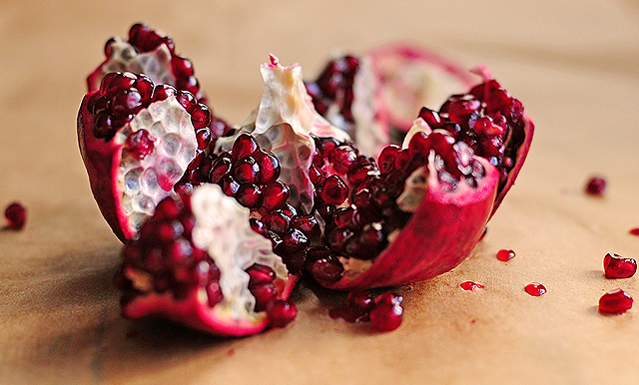

Slide 12
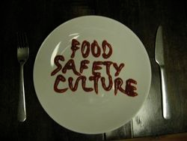

Slide 13
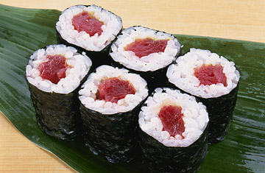
June 5 - Maricopa County Environmental Services Department identified Salmonella Newport in one sample and Salmonella Weltevreden in another sample of frozen raw ground tuna products.
The unopened frozen ground tuna products represented two different lots of product imported from Indonesia by Osamu Corporation of Gardena, California

Slide 14
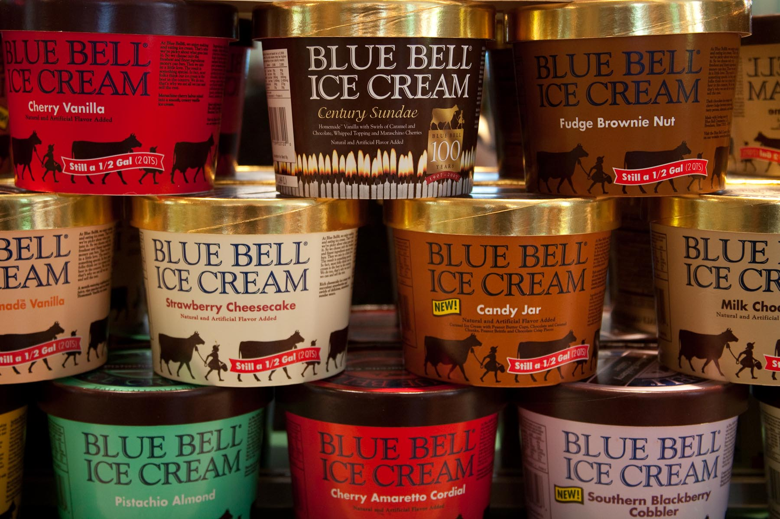
Blue Bell outbreak 2010-2015
10 Listeria illnesses
3 deaths
Inspectors found violations in previous 5 years

Slide 15
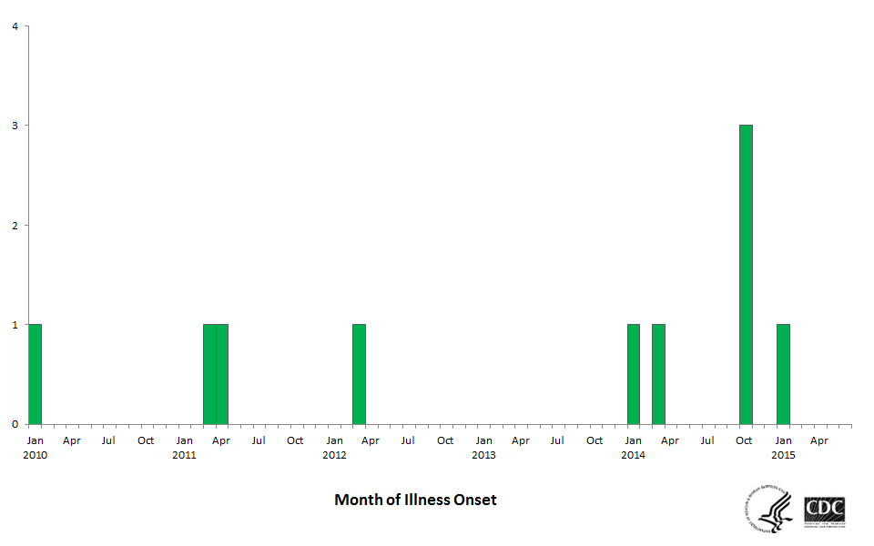

Slide 16
Attitude towards
behavior
Subjective norm
Intention
Behavior
Perceived
behavioral control
Theory of planned behavior, Ajzen, 1991

Slide 17
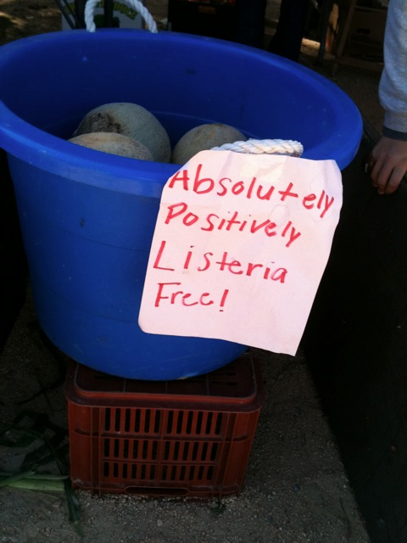

Slide 18
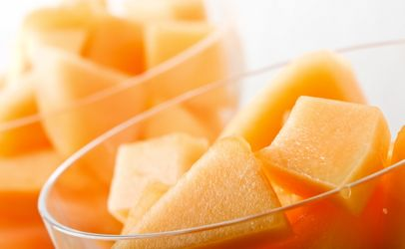

Slide 19
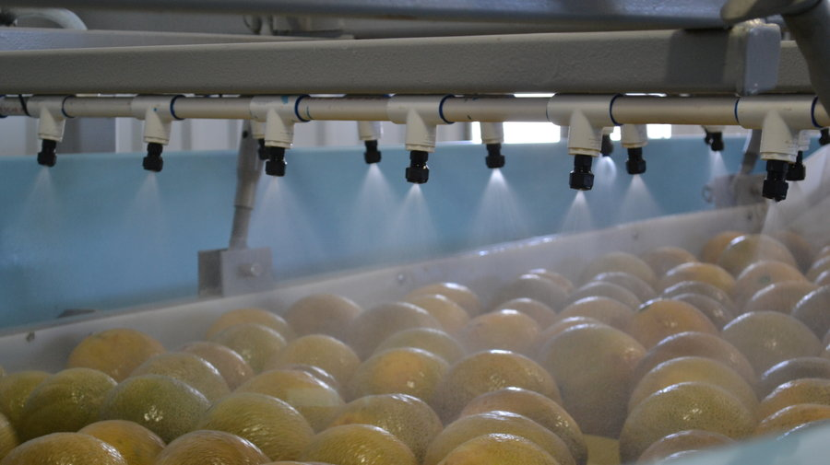
Washing?
Does retailer-required washing increase risk of pathogens?

Slide 20
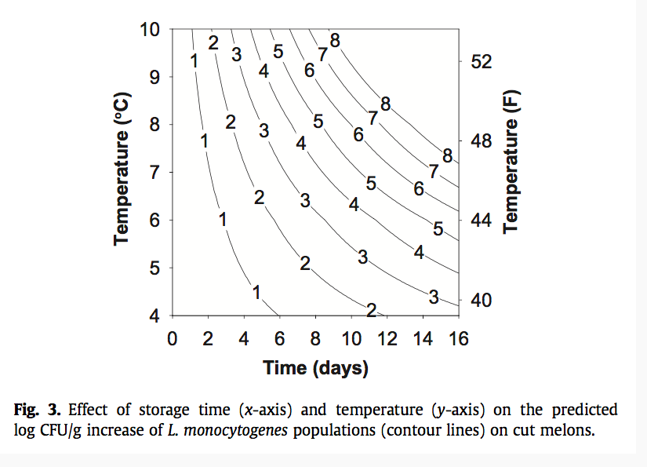
Is a consumer advisory for handling cantaloupes prudent?

Slide 21
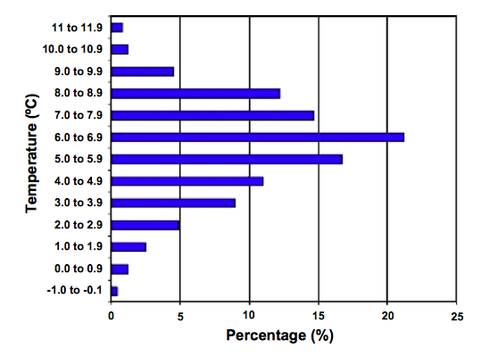
Kosa, 2007: 11% of all respondents had a thermometer

Slide 22
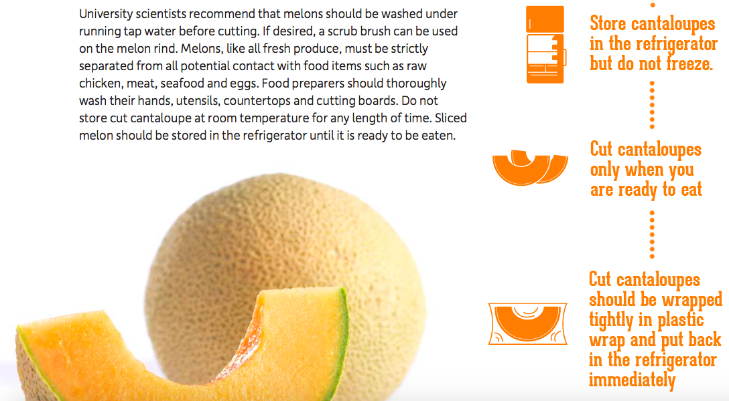
California cantaloupes:
http://www.californiacantaloupes.com/our-fruit/storing-and-preparing

Slide 23
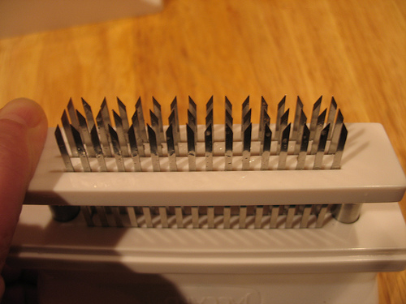

Slide 24
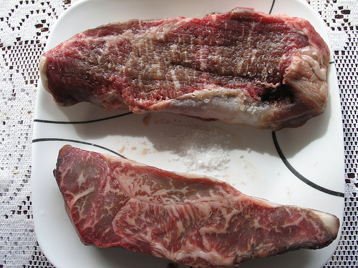
‘Beef steaks that are pierced either at home or in-store/at processing can be enjoyed cooked to medium-rare (63°C/145°F) as long as they are flipped at least twice. 2 flips is the magic number.’

Slide 25
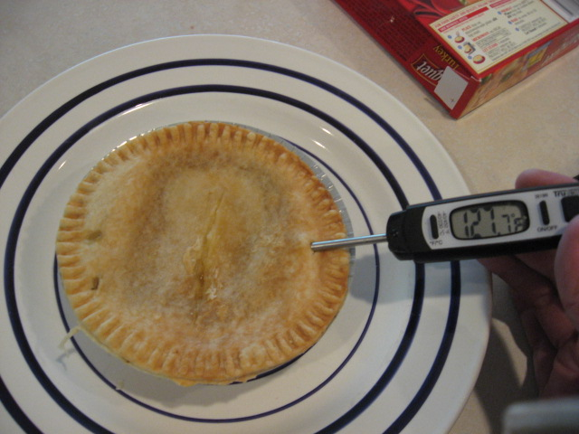
Get it right
The risk to consumers depended on “how badly they followed our directions.”
  Jim Seiple, a food safety official with the Blackstone unit that makes Swanson and Hungry-Man pot pies
  Hungry-Man pot pie asked consumers to ensure that the pie reaches a temperature that is 11 degrees short of the government-established threshold for killing pathogens.
  And when tested in consumer microwaves, and following the directions, it was 30 degrees short

Slide 26
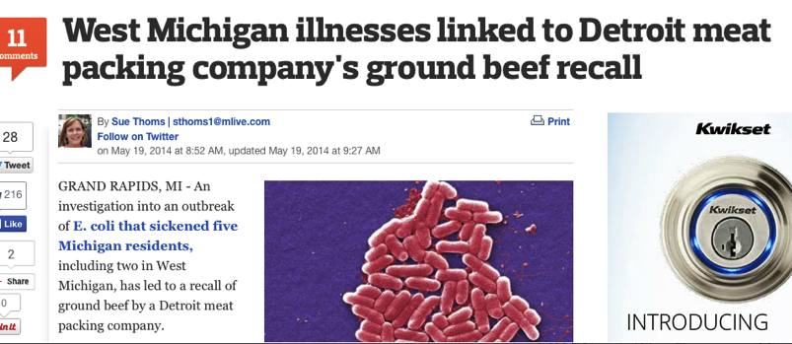

Slide 27
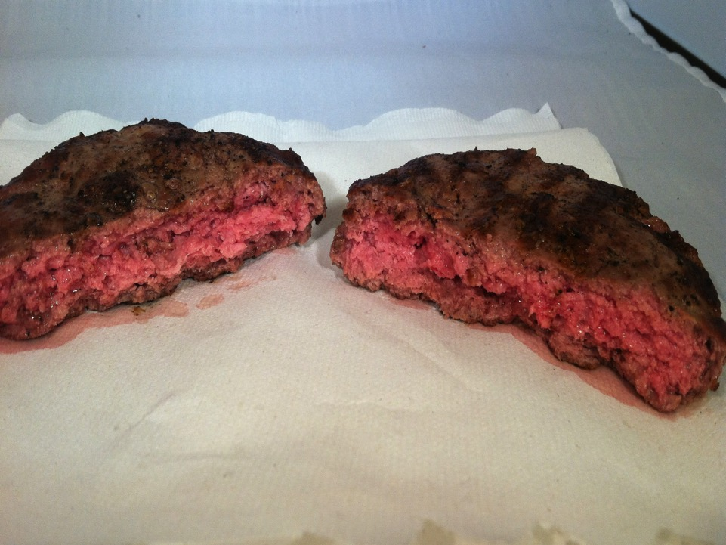
Brian Ronholm, FSIS,
“For consumers, we advise all consumers to safely prepare raw ground beef products by cooking them to 160 degrees Fahrenheit. When dining out, this is equivalent to ordering your burger well done.”

Slide 28
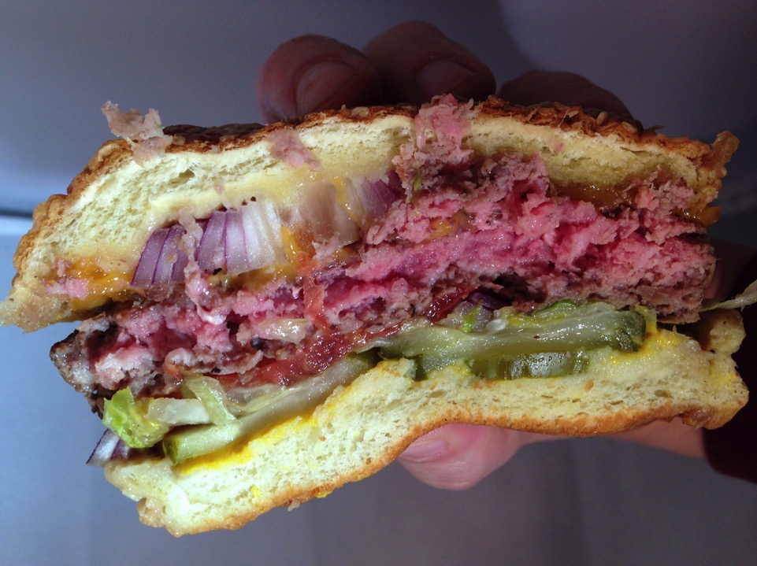

Slide 29
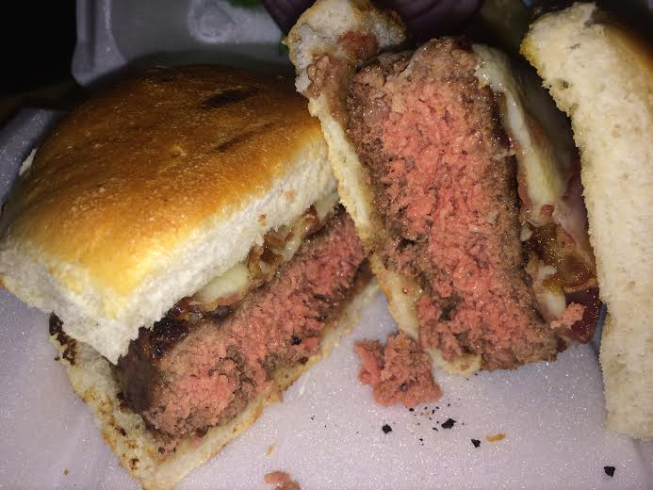

Slide 30
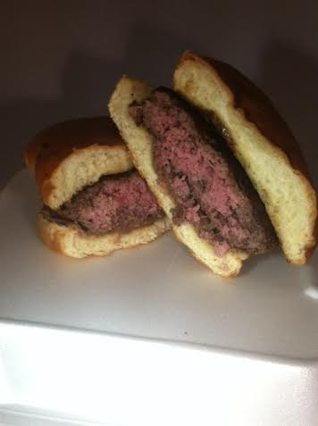

Slide 31
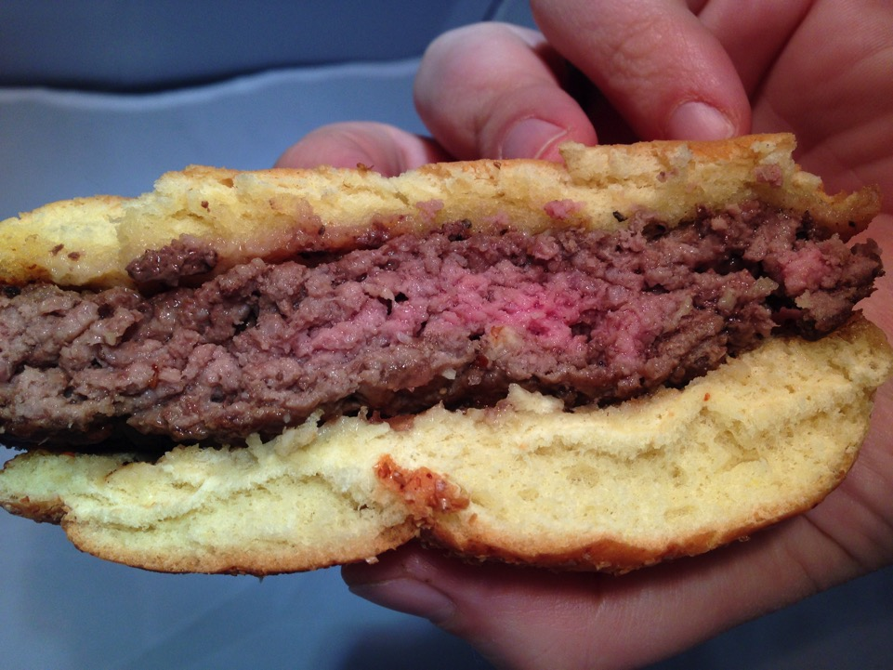

Slide 32
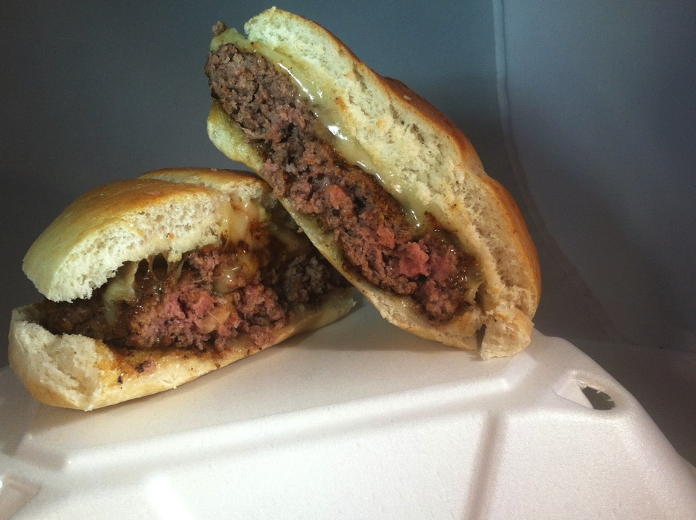

Slide 33
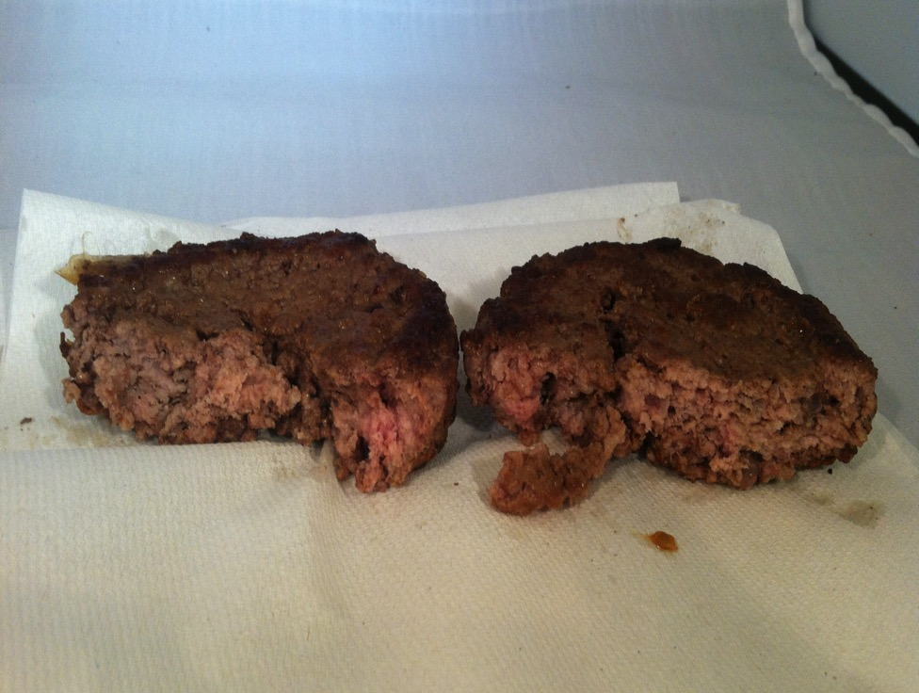

Slide 34
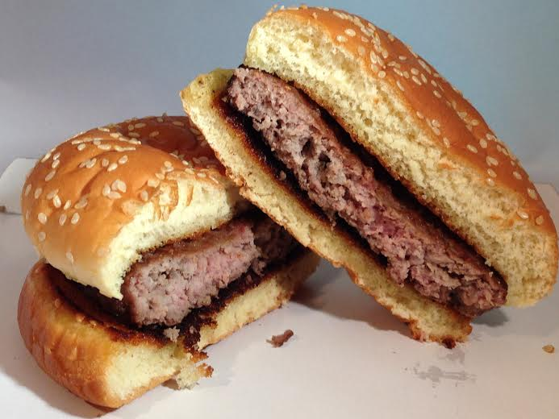

Slide 35
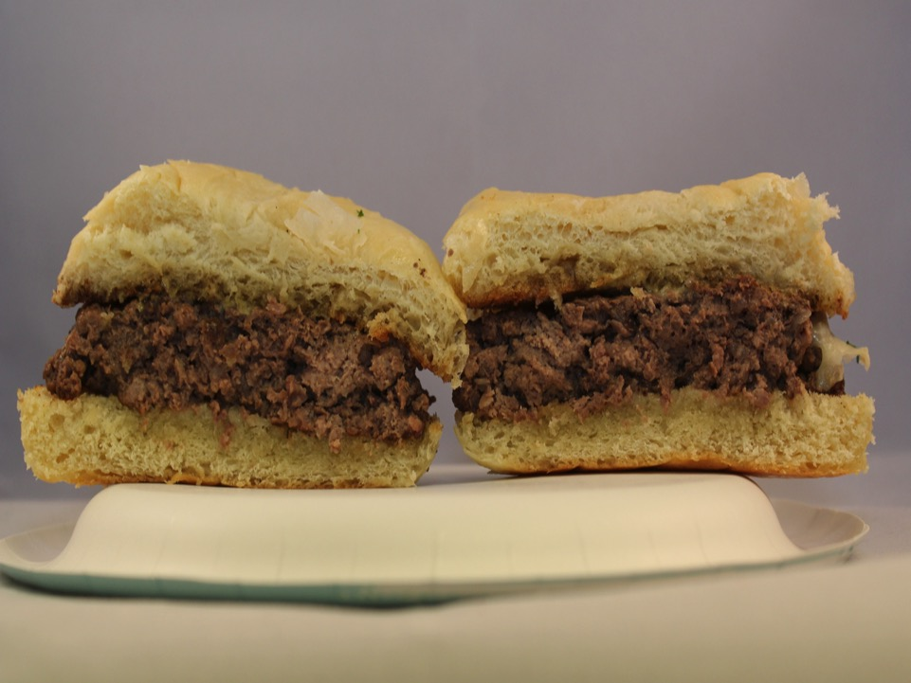

Slide 36
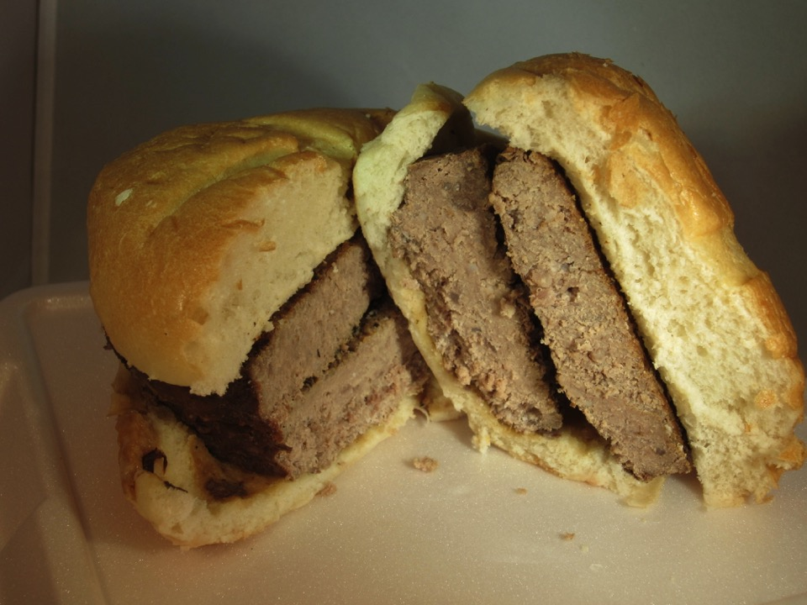

Slide 37
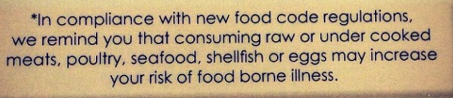
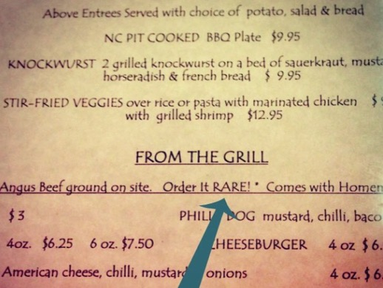

Slide 38
Examples of Server Responses
Assurance of safety, even for at-risk groups
Temperature mentioned, but not safe
“Eating medium rare burgers is perfectly fine and not a problem…" Told us a story about her sister eating barely browned beef (raw in middle) while she was pregnant and she is just fine.
“Medium rare is safe. It will be cooked to about 135.”
Good risk communication
Incorrect information about meat
“The ingredients used are good quality and so it’s not risky…as long as the outside of the burger is cooked it is safe because that is where most of the bad bacteria is.”
“I was actually going to tell you about that- we have to remind you that there is a risk when you order undercooked food. You can still get medium rare, just need to let you know about that.”
Notes:
Overlay with what’s wrong

Slide 39
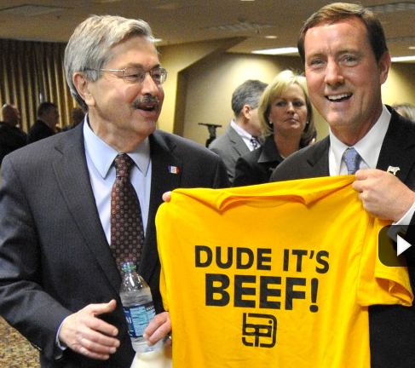

Slide 40
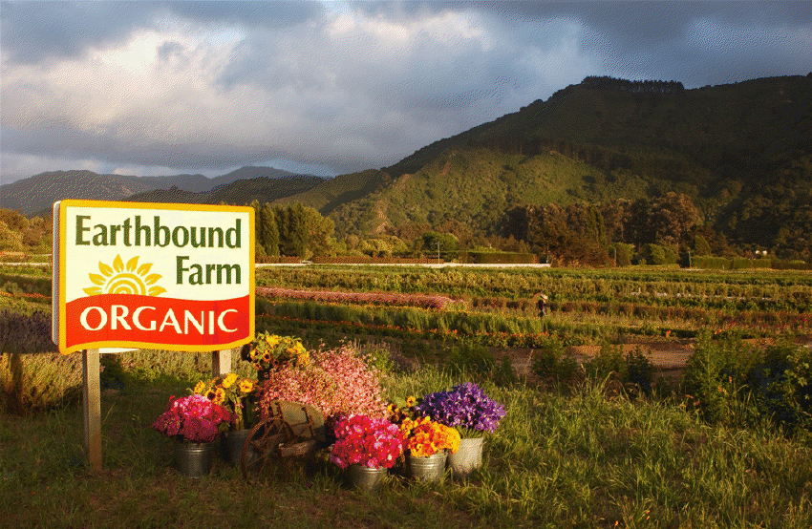
“No one should rely on third-party audits to ensure food safety.”
– Will Daniels, food safety, Earthbound Farm

Slide 41

What do they do?
How do they do it?
What do they value?
Take experts to visit
Provide buyers with more than generics
Be familiar with specific risks/stay up to date on literature
Audit? Sure, but do something with it

Slide 42


Slide 43
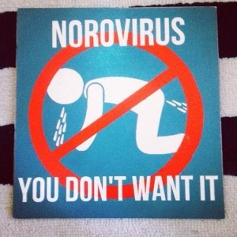

Slide 44

Myth: Our food safety issues would be fixed if…
We just had more education

Slide 45
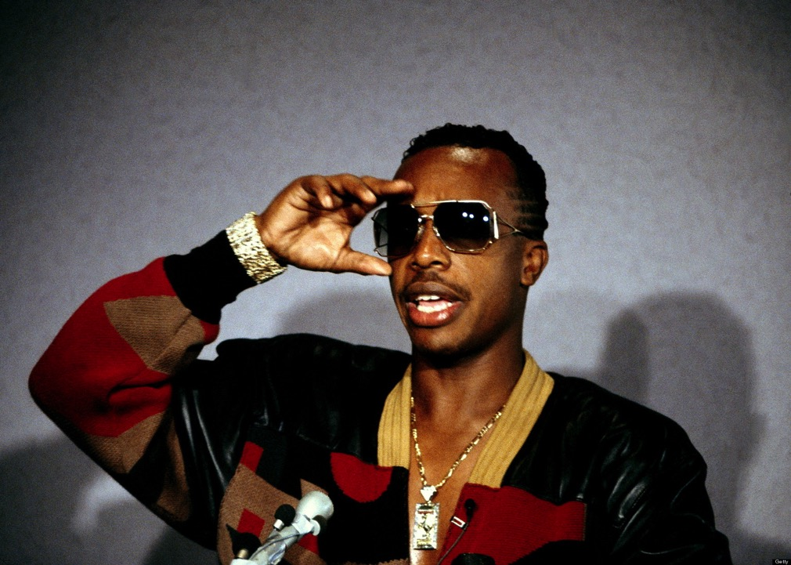
Assuming there are folks whose behavior you’re trying to change, do they see you as legit(imite)

Slide 46

“Legitimacy is based on three things:
(1) The people who are asked to obey authority have to feel like they have a voice - if they speak up, they will be heard;
(2) The law has to be predictable;
(3) The authority has to be fair. It can’t treat one group differently from another.”

Slide 47
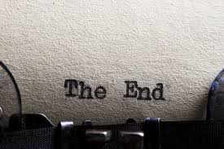
Food safety culture is more than training
Know the past, learn from other’s experiences
Tell consumers more – they want it
Be legitimate
Focus on behavior (staff and consumers)

