Slide 1


Crisis Communications 101
By Stephen McCauley

Slide 2
Our Industry is Ripe for Crises
Consumers Don’t
Know
Trust
Understand
Notes:
If we didn’t know it already, yesterday our speakers confirmed three significant reasons why our industry is ripe for crises.

Slide 3
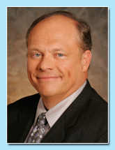
Lack of Knowledge
Notes:
Yesterday Bob Whitaker told us that 60% of consumers don’t have knowledge about where their food comes from or how it is processed.
How would they know this? Who is educating them?

Slide 4
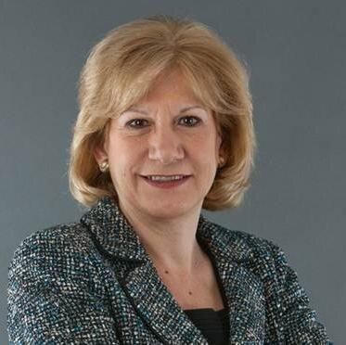
Lack of Trust
Notes:
Yesterday morning, Sue Borra reported that only 13% of consumers feel that food manufacturers are on their side while 45% feel that they are working against them!

Slide 5
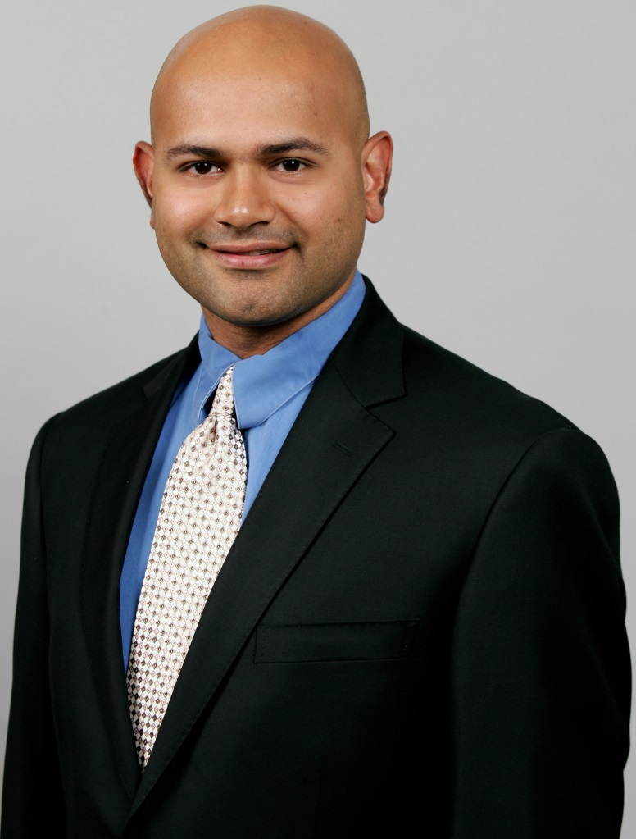
Lack of Understanding
Notes:
Yesterday Tejas Bhatt told us how consumers need access to understandable data

Slide 6
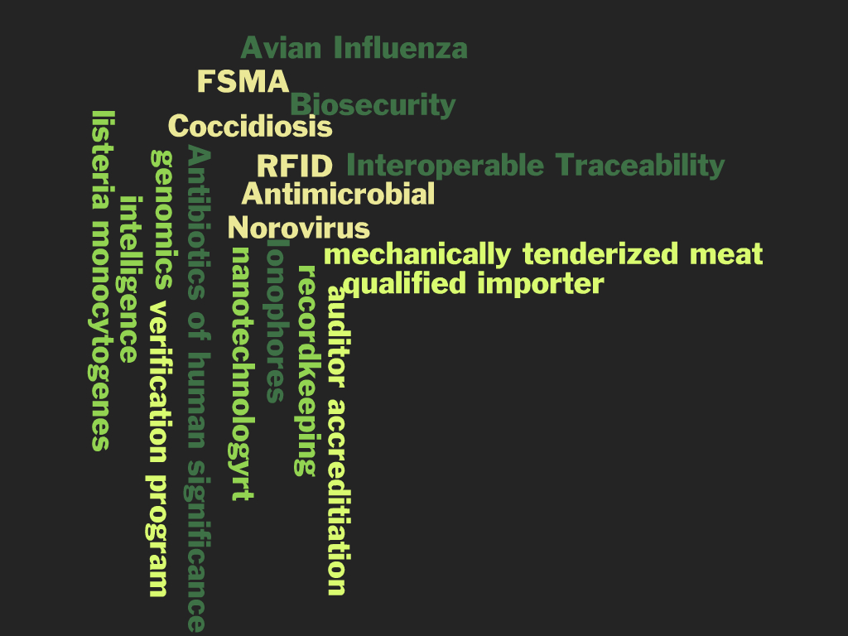
What We Say

Slide 7

What Consumers Hear

Slide 8

What is a Crisis?
Notes:
Chinese symbol aptly defines.
Danger -- must be prepared for damage control
Opportunity -- to generate something positive for your organization -- for your brand and company to shine.
Nissan Case History -- Blizzard in Northeast. Danger = No sales. Opportunity = Partner American Red Cross -- tons of positive visibility for Pathfinders, new 4 wheel drives.

Slide 9
What is a Crisis?
Any incident that potentially has an adverse effect on consumers, an industry, a corporation or product
  Causes loss of customers.
  Causes products to be removed from retail shelves.
  Threatens image with retail trade, consumers or both.
Notes:
Sounds crazy, but “What Is A Crisis?” How can we prepare to manage one if we can’t actually define it.
We always like to get our cards on the table first to make sure that we are on the same wavelength with our clients (or your organization in this case) as to what constitutes a crisis.
For the most part, I help organizations manage crises within the context of the food industry, but my definition here virtually suits any type of company.
Most importantly, in today’s media environment, we must remember that perceptions and misunderstanding can cause crises as much as realities.

Slide 10
Crisis Types
Includes:
Product tampering
Product recall
Domestic or international terrorism
Acts of nature
And may also relate to:
Plant accidents
Environmental damage
Crises of Management Misconduct

Slide 11
Corporate Communications Crisis
The point at which organization cannot pursue its business mission.
Notes:
The point at which adverse or negative publicity (whatever its origins) reaches a level of intensity that so distracts the management of an organization that it cannot pursue its business mission (or at least must interrupt its business mission).
As most of us know -- whether a potential negative situation is real or not, it still has the ability to distract a company from its business mission.
In fact, the issue may have absolutely nothing to do with the product itself (unlike a specific tampering case)
We’ve seen this with in-fighting within family-owned companies, accusations against philandering CEOs, political involvement/corruption or illegal activity among management teams, etc…
Case history Stew Leonard’s -- embezzlement and tax evasion

Slide 12
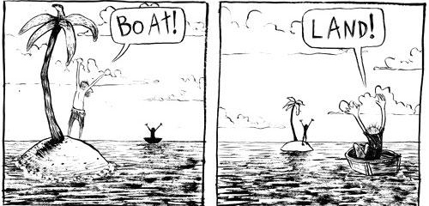
What is a Crisis? -- Perspective
Not all crises are destructive
Evaluate difference between “annoy” and “destroy”
Notes:
We need to help our management realize that while all crises should be taken seriously, not all are destructive.
One or two negative articles in a newspaper may annoy, but not destroy, a fundamentally sound organization.
On the other hand, continued negative publicity over time can and will have a materially negative business impact on a company that is vulnerable to criticisms.
Laughing Cow case history – WSJ “annoyance”
Olean case history -- Lost lots of focus on marketing product by “defending” it against critics

Slide 13
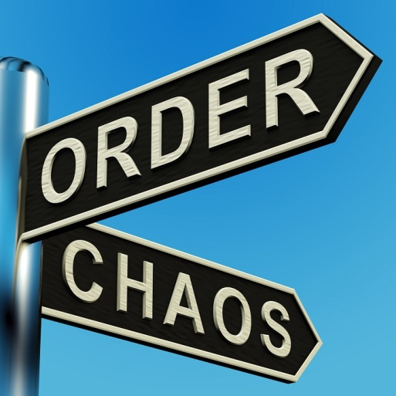
What is a Crisis?
Every crisis is identifiable yet…
You cannot identify every possible crisis.
Notes:
No product or institution is immune. No matter how solid your organization or brand image has been, every company should prepare for worst-case scenarios of most-feared crises.
Certainly, we can all identify broad areas of crises our individual organizations might face i.e. product tampering, bioterrorism, foodborne illnesses and contamination, workplace safety, animal rights, environmental concerns, producer legislation, government regulation, product recalls, …
But none of us can truly predict an exact crisis. Each one is unique depending on current events, news cycles, and unforeseen developments.
Moreover, when “stuff” hits the fan, critics have a way of identifying lots of potential “skeletons” in closets.
An important contribution you can make is to help prepare plans that address the most feared crises and to anticipate variations or combinations of them all.

Slide 14
Audiences
Consumers – domestic and international
Trade partners
Employees/retirees & their families
Shareholders
Competitors
Regulators
Federal and state legislators
Community leaders
Other opinion leaders
Notes:
It’s important to remember that your company has many audiences. Here are just a few. When dealing with a crisis, it is helpful to have your audiences identified in advance and to have someone dedicated to “owning” the communication with each to ensure that all are kept as informed as possible.

Slide 15

Defining Parameters of a Crisis
Notes:
Not every crisis requires major action by our respective organizations.
But every crisis requires major evaluation to determine the proper course of action.
Hopefully, each of you has a communications team leader who is “in tune” with the majority of your company’s target audiences. This person is key to helping realistically evaluate the classification and necessary course of action for each crisis.
This person or team should put together a tool that helps you determine parameters for your particular business
Following is one example.

Slide 16
Defining Parameters
Notes:
Walk through chart and parameters as an example.
You will see that we can’t totally silo any crisis in a category, but having this type of tool serves as a guideline to walk through the process.
Note that any tools -- whether it be evaluative tools, action plans or pre-written potential messages, etc… -- will make everyone’s job easier during a crisis.

Slide 17
Core Forces Shaping the Issue
Issue
Science Facts
Time
Social Values
Constituencies
Notes:
Undeniably, these are forces that shape your current situation and how your react to it.
Unfortunately, most are forces over which you and your company have no control.
However, you as marketing communications professionals CAN help your organization to understand these issues better. Who else at your organization are more in tune with the consumer and his/her positions and needs.
And you CAN control how prepared your organizations are to react to potential crises.
Case History -- News cycle for Sara Lee v. Hudson Beef recalls 4 years ago. Hudson had no deaths, but went out of biz. Sara Lee had deaths, but survived well. Fact is that Princess Diana death took news stage.
Pepsi -- Needles in cans - AIDS, full denial yet exonerated - company pipeline worked.

Slide 18
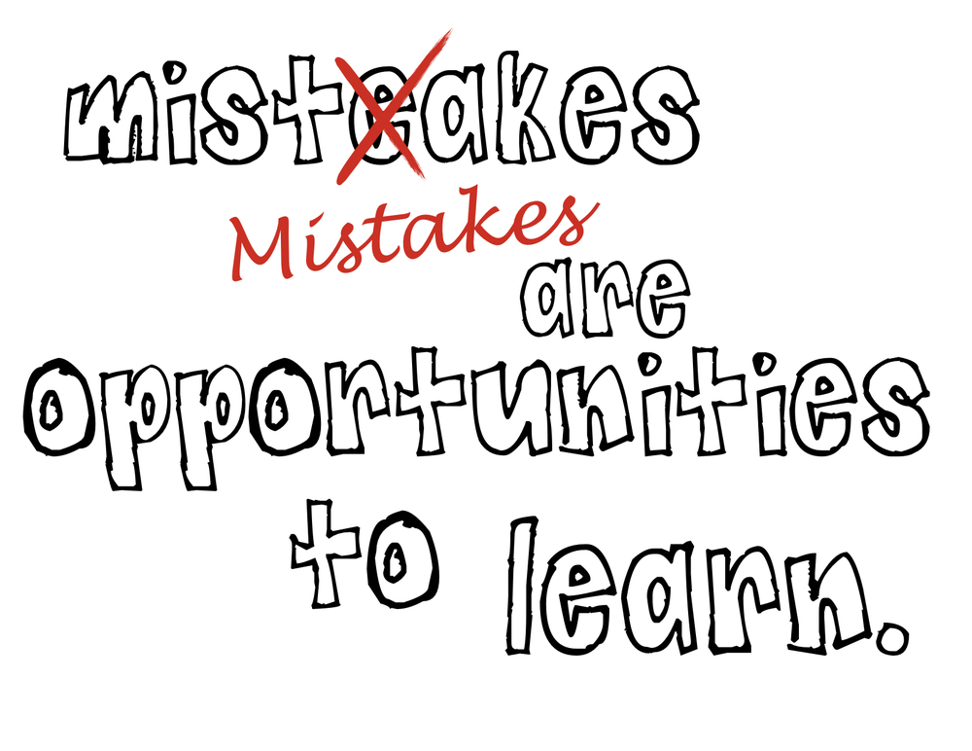
Learning From Other’s Mistakes

Slide 19

Not Familiar with Facts
Notes:
The most innocent mistakes or missteps are the ones that make corporate America look guilty or irresponsible.
We can help our organizations put their best faces forward at the most critical times.
Planning, planning and more planning is essential. It will save our respective companies’ butts, and probably our own.
Case History - Odwalla -- mention lack of plan, lack of spokespeople, lack of messages, lack of crisis team. Call to us 10 minutes before first news conference. Ultimately did well, but not until after a few ulcers.

Slide 20
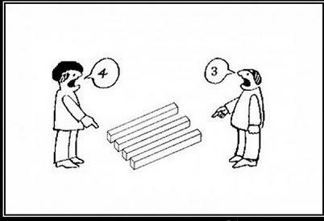
Not Prepared to State Clear Position
Notes:
The most innocent mistakes or missteps are the ones that make corporate America look guilty or irresponsible.
We can help our organizations put their best faces forward at the most critical times.
Planning, planning and more planning is essential. It will save our respective companies’ butts, and probably our own.
Case History - Odwalla -- mention lack of plan, lack of spokespeople, lack of messages, lack of crisis team. Call to us 10 minutes before first news conference. Ultimately did well, but not until after a few ulcers.

Slide 21
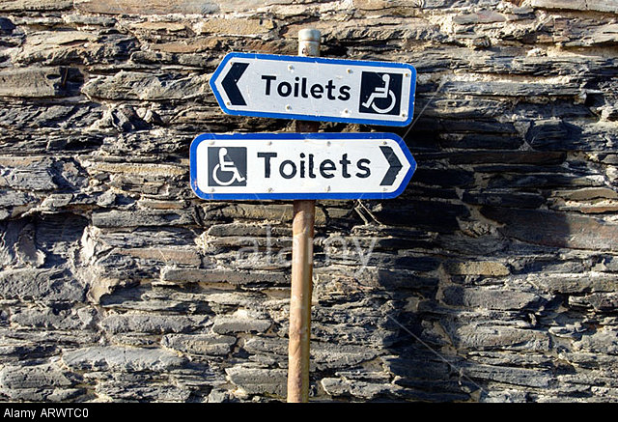
Individuals Tell Conflicting Stories
Notes:
The most innocent mistakes or missteps are the ones that make corporate America look guilty or irresponsible.
We can help our organizations put their best faces forward at the most critical times.
Planning, planning and more planning is essential. It will save our respective companies’ butts, and probably our own.
Case History - Odwalla -- mention lack of plan, lack of spokespeople, lack of messages, lack of crisis team. Call to us 10 minutes before first news conference. Ultimately did well, but not until after a few ulcers.

Slide 22
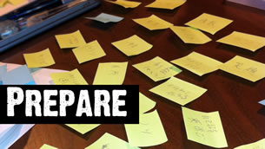
No Materials to Support Position
Notes:
The most innocent mistakes or missteps are the ones that make corporate America look guilty or irresponsible.
We can help our organizations put their best faces forward at the most critical times.
Planning, planning and more planning is essential. It will save our respective companies’ butts, and probably our own.
Case History - Odwalla -- mention lack of plan, lack of spokespeople, lack of messages, lack of crisis team. Call to us 10 minutes before first news conference. Ultimately did well, but not until after a few ulcers.

Slide 23

Media Inquiries Ignored
Notes:
The most innocent mistakes or missteps are the ones that make corporate America look guilty or irresponsible.
We can help our organizations put their best faces forward at the most critical times.
Planning, planning and more planning is essential. It will save our respective companies’ butts, and probably our own.
Case History - Odwalla -- mention lack of plan, lack of spokespeople, lack of messages, lack of crisis team. Call to us 10 minutes before first news conference. Ultimately did well, but not until after a few ulcers.

Slide 24
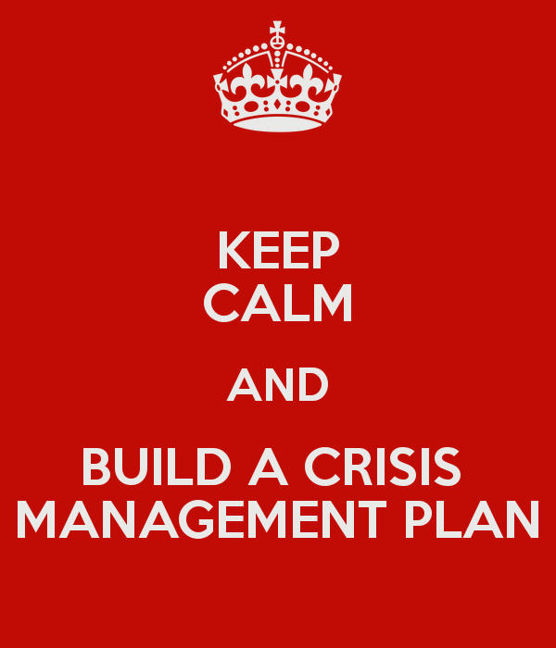
Solution

Slide 25
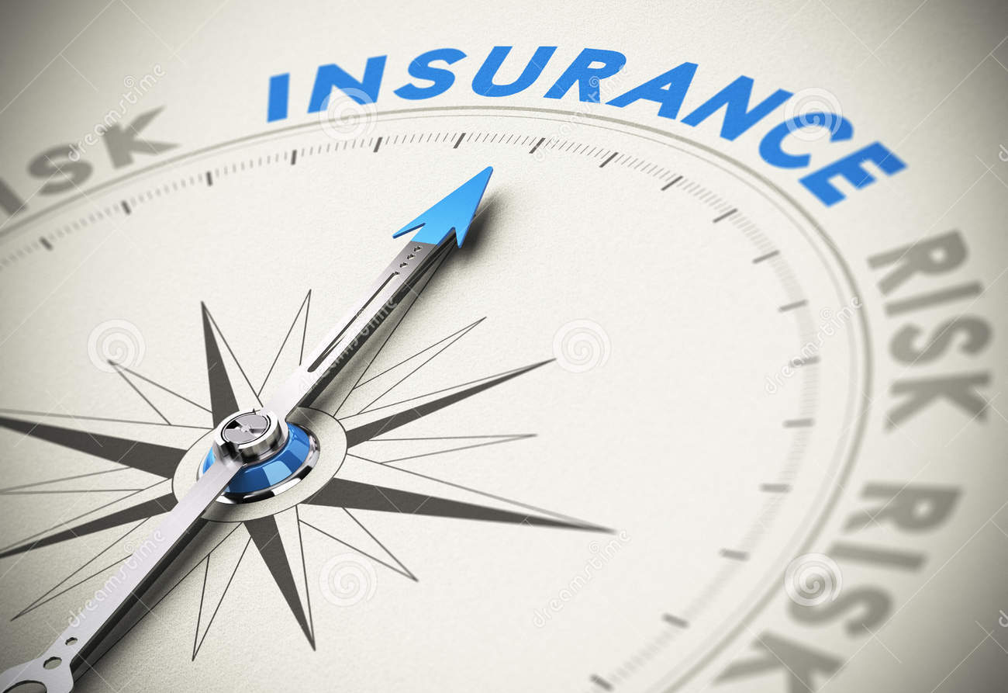
Why Have a Plan?
Literally/Financially
Mentally
Logistically
Notes:
As many of you know, most companies cannot secure product recall insurance without demonstrating that they have a clearly defined recall plan on the shelf.
Beyond getting coverage, a solid plan gets all of your management on the same page BEFORE one of the most stressful episodes in most of your careers. It provides direction and clarity and eliminates a certain level of debate.
It helps us all sleep better at night to know that if something happened tomorrow, we would at least have thought through the process and tools we need to implement -- providing order to absolute mayhem.
Frankly, as marketing communications professionals, YOU are the most likely folks to learn of a crisis first. It is in YOUR best interest to make sure your management can drive the process that enables you to close the loop with consumers. And YOU have to communicate to consumers who call.

Slide 26
What Can a Plan Do?
Protect Brand Reputation
Protect Customer Relationships
Reassure Consumers
Ensure Balanced Media Coverage
Notes:
Having a plan does not solve ALL your problems. But if you use it right, it will help you protect your reputation among many key audiences.
Most importantly, it may help you manage perceptions -- and thus media accuracy so that YOU and your colleagues are actually driving the process in part, and not completely along for the ride.
Everybody will feel the negative impact of a poorly managed crisis.

Slide 27
What’s in the Plan?
Strategies
Action Steps
Response Team ID
Key Messages
Spokes-people
Measure-ment
Notes:
Putting together an effective plan is not impossible, but it is time consuming and requires buy-in from many senior level folks in your organization.
This is a real opportunity for you as marketing professionals to spearhead (or at least advance) a process that is critical to the future of your organization.
Let’s walk through some of the components specifically….

Slide 28
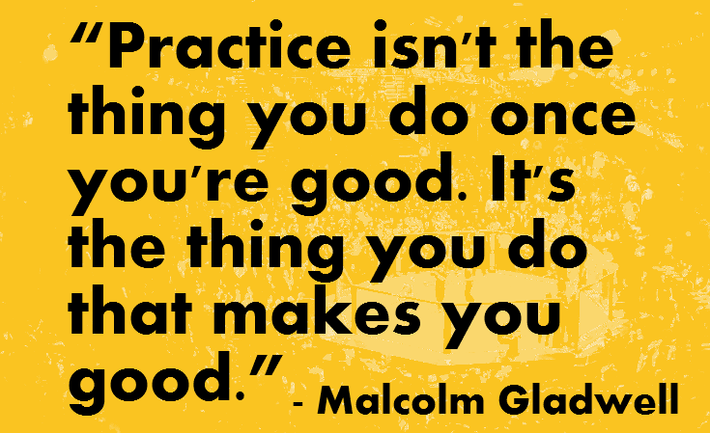
Is the Plan Enough?
Notes:
If you only need to have a crisis plan to obtain the first insurance coverage (financial) and not the other two (logistic and mental), than having a plan on the shelf in a binder is just fine.
However, if you really need a plan to make a meaningful difference during a time of crisis, USE it. In other words, practice using it..
Develop drill scenarios and get management approval to practice.
Case History -- P&G Management and CEC change after three or four drills. Other clients who practice once a year.

Slide 29
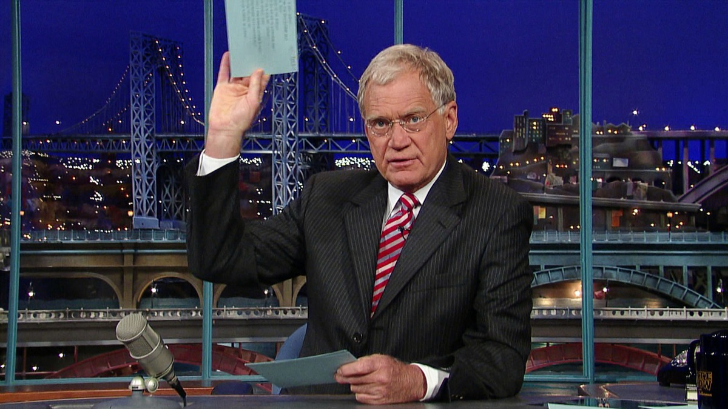
Top 10 Principles for All Crises

Slide 30

#10
Be Prepared

Slide 31

#9
Act Immediately
Find out as much as possible about what happened and why

Slide 32
#8
Don’t Allow For Surprises
Share all possible information quickly

Slide 33
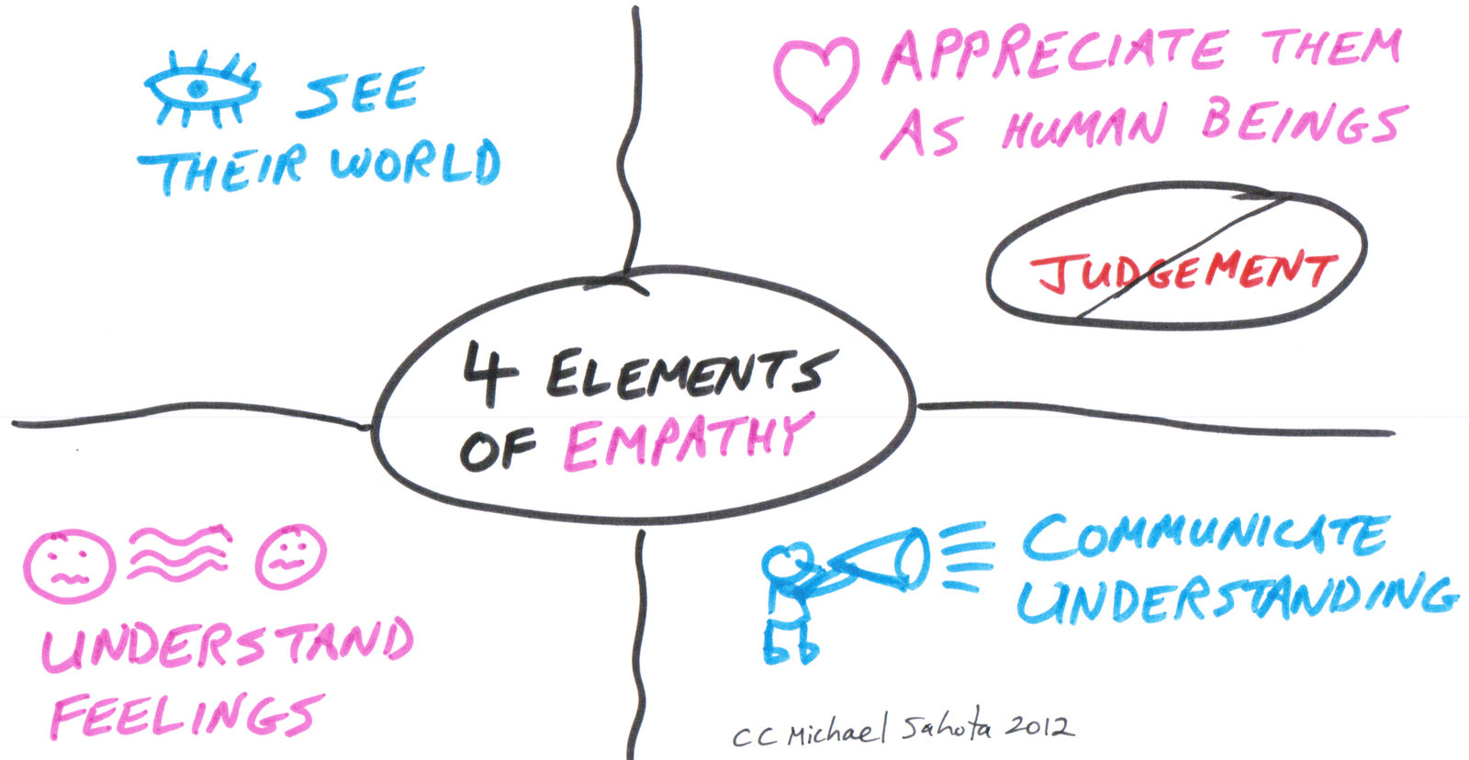
#7
Demonstrate Empathy

Slide 34
#6
Do Not Overreact
Different issues demand different levels of response – and in some cases, no response at all.

Slide 35
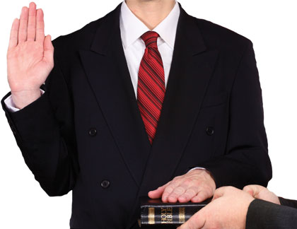
#5
Tell the Truth
Be transparent. Communicate the facts honestly and clearly.

Slide 36
#4
Never Speculate
Share only verified, factual information.

Slide 37

#3
Be Prepared for the Illogical
Especially when dealing with consumers and the media.

Slide 38

#2 Deal with Perceptions As Realities

Slide 39
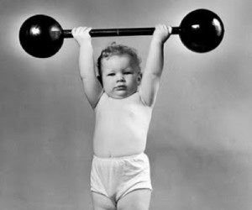
#1 Be Willing To Do
More Than Expected

Slide 40
Crisis Communications 101
By Stephen McCauley

