Slide 1

Proudly Introduces
National Family Meals Month™
September 2015
We’re elevating the role of the grocer as a resource for families faced with the daily challenge of getting wholesome meals on the table.
Notes:
Hello everyone,
I’m Cathy Polley, Vice President of Health & Wellness and Executive Director of the FMI Foundation.
Joining me today is Megan Tinklepaugh, Manager of Health & Wellness and our Foundation and my partner in all things family meals.
We are very excited to share with you exciting details about FMI’s Inaugural National Family Meals Month, set for this September.

Slide 2
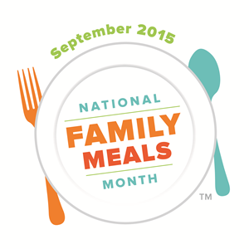
Family Meals Matter:
Research consistently shows that children who regularly share family mealtime . . .
  Are likely to do better in school
  Have a closer relationship with their parents and siblings
  Are more resistant to negative peer pressure
  Are less likely to try drugs or alcohol at an earlier age
  Are less likely to develop disordered eating behaviors
Notes:
Numerous studies underscore the long-term health, academic and societal benefits of consistently eating together as a family, yet, according to a 2013 Harris poll, only 30 percent of American families share dinner every night.
- Refer to bullets above-
Recognizing how valuable family meals are to their customers and communities, FMI’s Health & Wellness Council set out in 2013 to develop a family meal program at FMI, beginning with a website and the introduction of FMI’s Gold Plate Awards.

Slide 3
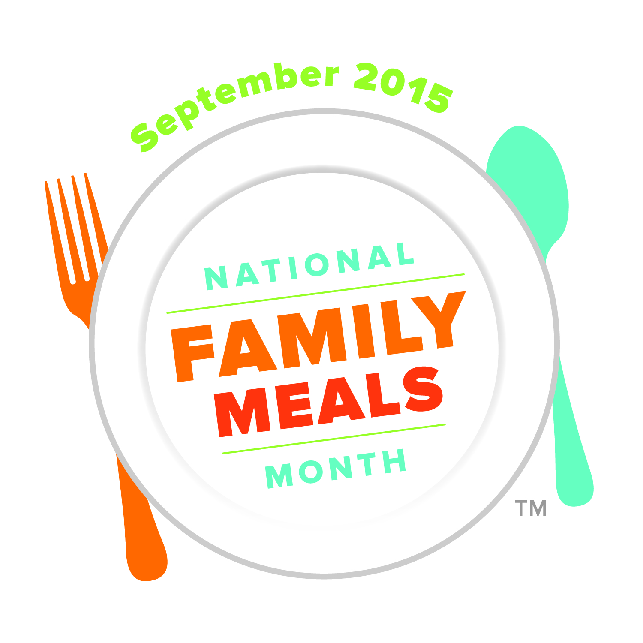
Our Brand Story:
Family meals are at a critical intersection in our nation.
The will to return to the table exists and families just need a friendly, familiar voice to show them the way.
That voice is you, and the way is the National Family Meals Movement.
FMI launched a first-of-its-kind collaboration among FMI Foundation, the food retail industry and their valued customers to share, inspire and help each other prepare more family meals at home. We’re kicking off the movement with National Family Meals Month™ in September 2015.
National Family Meals Month™ will build awareness for food retailers as the solution to family mealtime.
Notes:
Mealtime is precious time, and the FMI Foundation recognizes mealtime struggles are real and shared by families of all shapes and sizes.
The will to return to the table exists, but families just need a friendly, familiar voice to show them the way.
That voice is you, and the way is a movement we’re creating around family meals.
[BREAK]
The nation’s grocers feed families and enrich the lives of their customers every day by selling safe, affordable, nutritious food.
Grocers and their food manufacturer partners are offering more solutions than ever before, giving shoppers the tools they need to make one more family meal at home per week.
[BREAK]
At the Midwinter Executive Conference in January, FMI launched a first-of-its-kind collaboration among the FMI Foundation, grocers and their valued customers to share, inspire and help each other prepare more family meals at home, kicking off a movement with National Family Meals Month in September 2015.

Slide 4
National Family Meals Month™ is:
An industry-wide initiative that underscores the benefits of shared meals
A new way to encourage families to look to grocers and food brands for meal solutions
Activated by FMI Members -̶ grocers and brands
An opportunity to spotlight existing family meals programs
A creative and fun way to engage shoppers
Notes:
National Family Meals Month will build awareness for food retailers and manufacturers as the solution for family mealtime.
It’s not a complicated program, as it simply enhances what you are already doing to promote mealtime solutions.
[BREAK]
Today I’m asking you to commit to help us create a movement – featuring family-meal-inspired programs and assets in-store, online and through the media during the month of September.

Slide 5
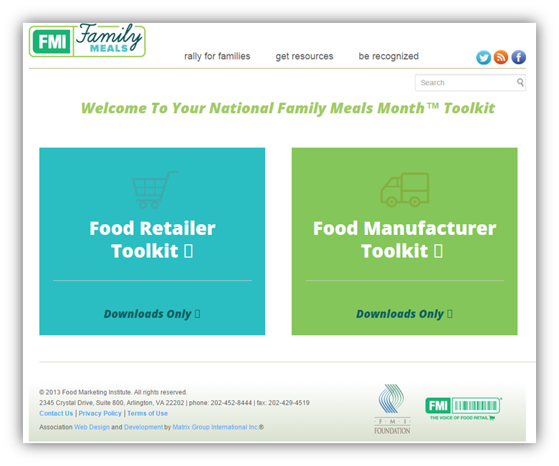
We’re making it easy to participate by providing retailers and manufacturers with a FREE online toolkit including:
Customizable visual assets
Activation ideas
Research supporting the benefits of family meals
Suggested messaging, social media posts and designated hashtags
Template press releases and sample scripts for broadcast and in-store messaging
Download your FREE toolkit at www.fmifamilymeals.com
Notes:
We’re making it easy to participate by providing you with a FREE online toolkit. You will find many great resources on www.fmifamilymeals.com, but important for today’s call, you’ll find our National Family Meals Month toolkit. All logos are trademarked, and you’re free to use them in your own unique ways as part of your existing promotions and/or campaigns.
Here’s how we’re envisioning the customizable program:
Sharing meal plans and photographs from your stores… and from your customers.
Using the tools to remind families that the solution to their mealtime dilemma is at their nearest grocery store – and inspire them with stories of people just like them who have found a way to make family meals work again.
Highlight staff and associates in store or via social media in order to personify programs and make them more accessible.
Utilize ideas and resources in the National Family Meals Month toolkit in September to help bring the message home to shoppers.

Slide 6
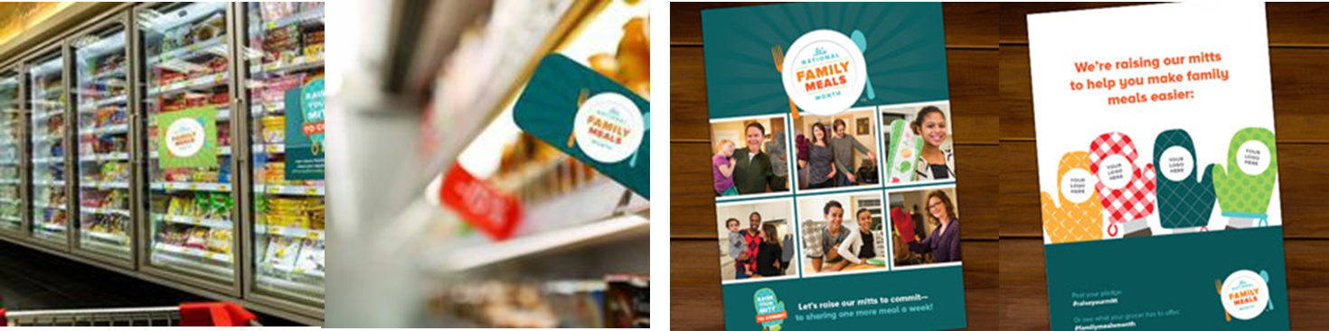
Activation
Partner with retailers to create in-store promotions across all categories.
  National Family Meals Month™ graphics are adaptable for use in every department and every aisle.
Incorporate graphics and messaging into your planned promotions and/or paid advertising this September to raise consumer awareness.
Join with other food manufacturers for the greater good.
  Collaborate with other manufacturers to create a co-op FSI promoting the benefits of family meals.
Notes:
Start by incorporating NFMM logos and messaging into your existing promotions and paid advertising.
Reach out to retailers to explore opportunities to bring NFMM to life in-store.
Remember, the toolkit download is free and the possibilities are limitless. Let your marketing teams run wild. You’ll find ideas to inspire activation as part of the toolkit.
We’ve already talked to several shopper marketing teams who are excited to incorporate NFMM into their September campaigns, both in print and online, and to share activation ideas with their retailer partners.
Food manufacturers have also expressed interest in partnering with noncompetitive brands to work collaboratively in promotion of family meals this September. We’re happy to make these connections for you.

Slide 7

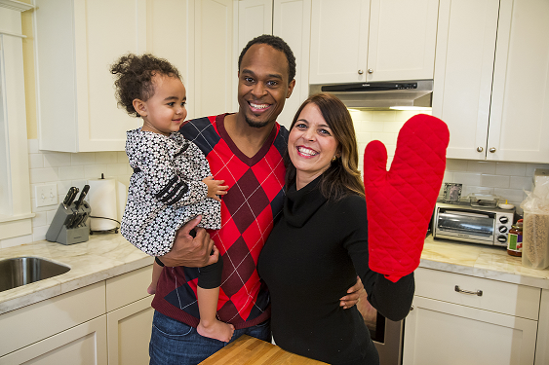

Trigger Customer Engagement
Invite shoppers—in-store and online—to raise their oven mitt to commit to one more family meal at home per week.
  Go viral with Raise Your Mitt to Commit ™ selfies and hashtags. It’s a fun, quick way for everyone to show their support and socialize the message.
  #raiseyourmitt
  #familymealsmonth
Notes:
In addition to your in-store and print efforts, FMI will be supporting National Family Meals Month by:
Tracking the family meals conversation via social media and seeking new opportunities to leverage the conversation for National Family Meals Month
Curating family meals content and featuring participating companies on social media during September
Take part by utilizing hashtags #familymeals month and #raiseyourmitt.
We’re also honoring our 2015 Gold Plate Award Winners -- presented to the most innovative family meals campaigns -- at a September reception with Members of Congress on Capitol Hill. It’s another way we’re bringing national attention to the ways food retailers and manufacturers are promoting the benefits of family meals in their communities.

Slide 8

Share Your Plans
Let us know how your company plans to participate in September so we can recognize your efforts on www.fmifamilymeals.com and share your story in our monthly FMI Family Meals e-Newsletter.
To learn more about FMI Family Meals, National Family Meals Month ™ and our monthly e-Newsletter, please contact Megan Tinklepaugh at mtinklepaugh@fmi.org.
Notes:
In its inaugural year, FMI is initiating a conversation around family meals and we have aspirations to grow the program year over year by measuring message penetration via press and curating stories via social media.
Food retailers will lead a month-long dialog on the subject of family mealtime, bolstered by the actions of their association.
We ask you to share your plans with us so we can recognize and promote your efforts across the industry.

Slide 9

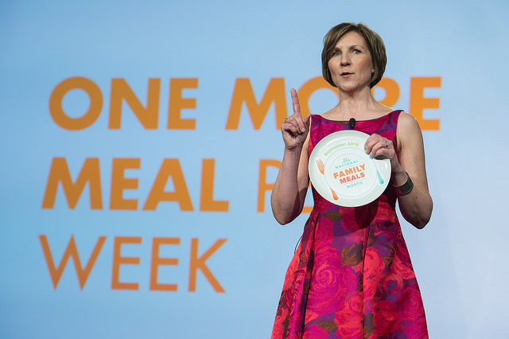

FMI and the FMI Foundation look forward to working with you to promote ONE MORE FAMILY MEAL PER WEEK!
Cathy Polley, RPh
Executive Director, FMI Foundation
Vice President, Health & Wellness
cpolley@fmi.org
202-220-0631

Slide 10

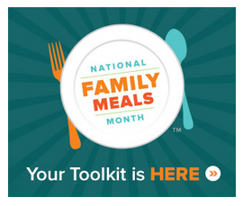
Let’s Continue the Conversation
Join the Movement at www.fmifamilymeals.com
and download your free toolkit today!
Contact us to learn more about National Family Meals Month™ :
  Cathy Polley, RPh
  Executive Director, FMI Foundation
  Vice President, Health & Wellness
  cpolley@fmi.org
  Megan Tinklepaugh
  Manager, FMI Foundation and Health & Wellness
  mtinklepaugh@fmi.org
Notes:
Questions for us?
We’re also available to hop on a call with you and your shopper marketing teams to discuss in greater detail how your company can be involved.

