Slide 1
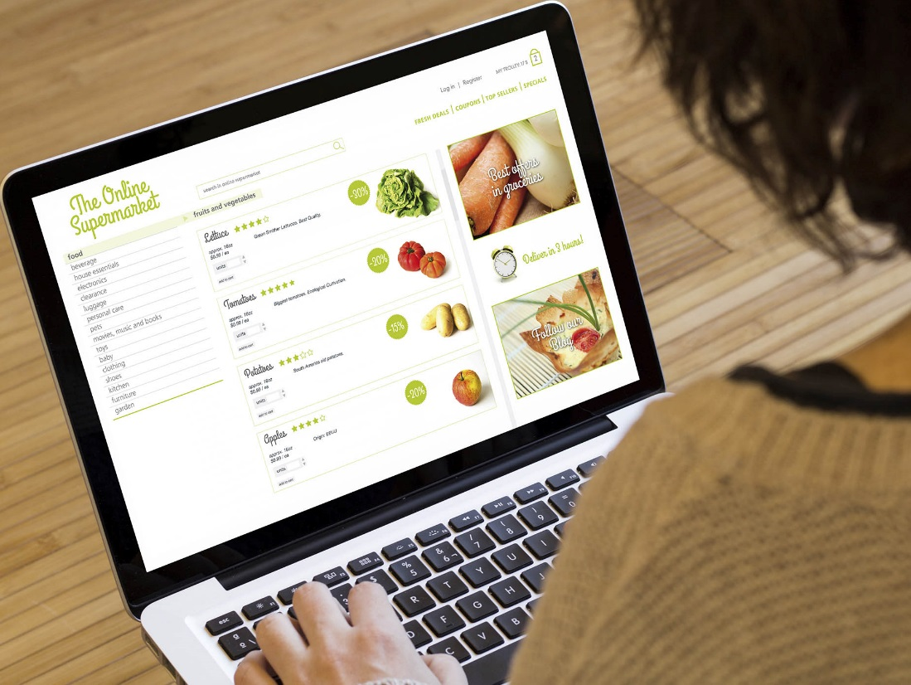
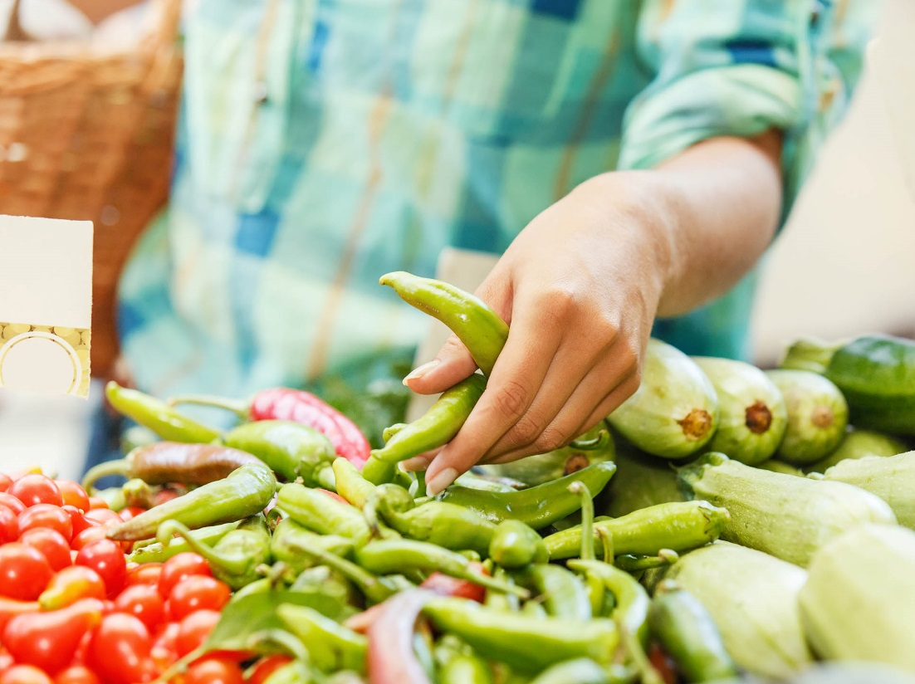
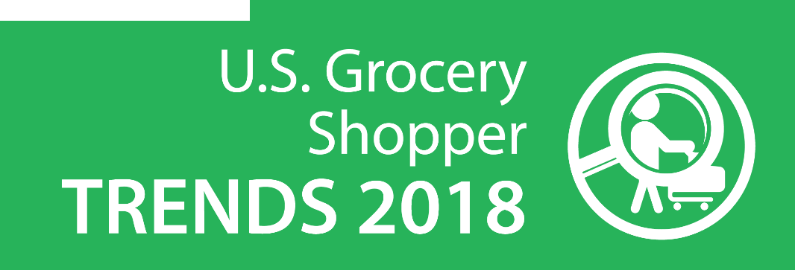
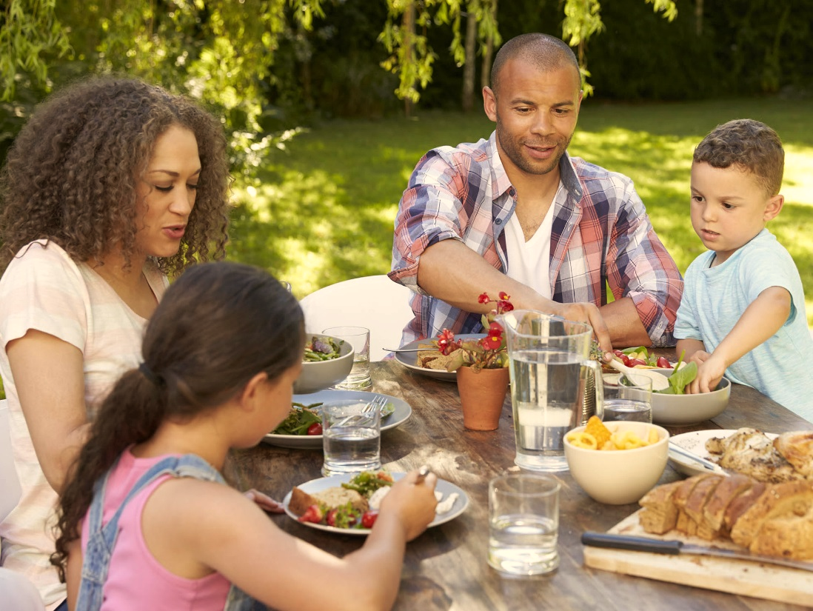
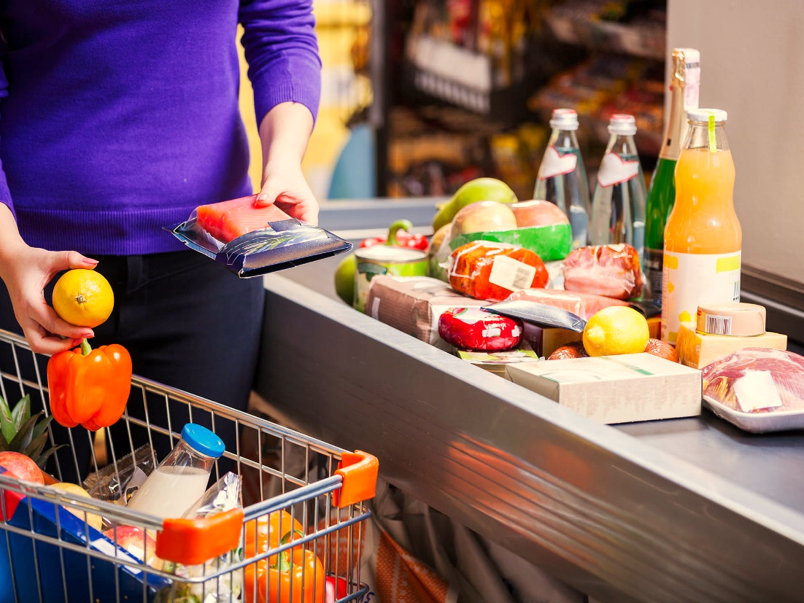
Inside the Grocery Shopper’s Head:
Where They’ve Been, Where They’re Going
June 26, 2018
2pm ET
Conference line: 866-269-6685
Conference ID: 9680617
International Dial In: +1-647-427-3128

Slide 2
FMI antitrust compliance
It is FMI’s policy to comply in all respects with the antitrust laws.
All participants in FMI meetings and events are expected to comply with applicable antitrust and competition laws.
Avoid discussions of sensitive topics that can create antitrust concerns.
Agreements to fix prices, allocate markets, engage in product boycotts and to refuse to deal with third parties are illegal.
Discussions of prices (including elements of prices such as allowances and credit terms), quality ratings of suppliers, and discussions that may cause a competitor to cease purchasing from a particular supplier, or selling to a particular customer, should be avoided.
No discussion that might be interpreted as a dividing up of territories.
It is important to avoid even the appearance of unlawful activity.
Questions or concerns? Please consult with FMI staff.

Slide 3
Meet your presenters
Steve Markenson
Director, Research
Food Marketing Institute
David Emerson Feit
Vice President, Strategic Insights,
The Hartman Group
David Fikes
VP, Communications &
Consumer/Community Affairs
Food Marketing Institute

Slide 4
Research background
For more than four decades, FMI has been tracking the trends of grocery shoppers in the U.S., taking note of where they shop, how they shop and what issues are most important to them as food shoppers. For the past four years, FMI has partnered with The Hartman Group to conduct this research.
Methodology
Quantitative Research
A 25-minute online survey among n=2,136 U.S. shoppers aged 18 and older, responsible for at least 50% or more of the grocery shopping in their household
Fielded February 4-16, 2018
Additional analysis includes U.S. Census, Bureau of Labor Statistics
Qualitative Research
In-depth 1-on-1 interviews with shoppers from 4 multi-person households and 1 single-person household in the Baltimore area, including home tours of kitchens and food-storage areas, as well as shop-along interviews in frequented food retail locations
Five 1-on-1 virtual interviews with shoppers across the nation, augmented with a homework exercise using photos and words for shoppers to show what “eating well” means to them and how shopping supports these needs
Fielded in October 2017

Slide 5
Overview of 2018 findings
2017
2018
Channel fragmentation continues, with ecommerce gaining users
Transparency means context beyond the package
Food retailers are increasingly well-positioned for shopper wellness
Online has evolved from a grocery channel to a grocery touchpoint
Older shoppers are adopting and younger shoppers are discovering a future that differs from industry assumptions
Shoppers evaluate a food retailer by how well it supports their overarching goal of eating well
Individualized and grounded in occasions, eating well includes diverse objectives around taste and enjoyment, health and connection
Shoppers trust in their food store to support their wellness more than ever, even as they rely on a wider variety of stores in order to shop well
Grocery stores increasingly need to fulfill a diversity of food experiences, with strategic opportunities to align in-store and digital touchpoints to enhance choice, enjoyment and personal connection

Slide 6
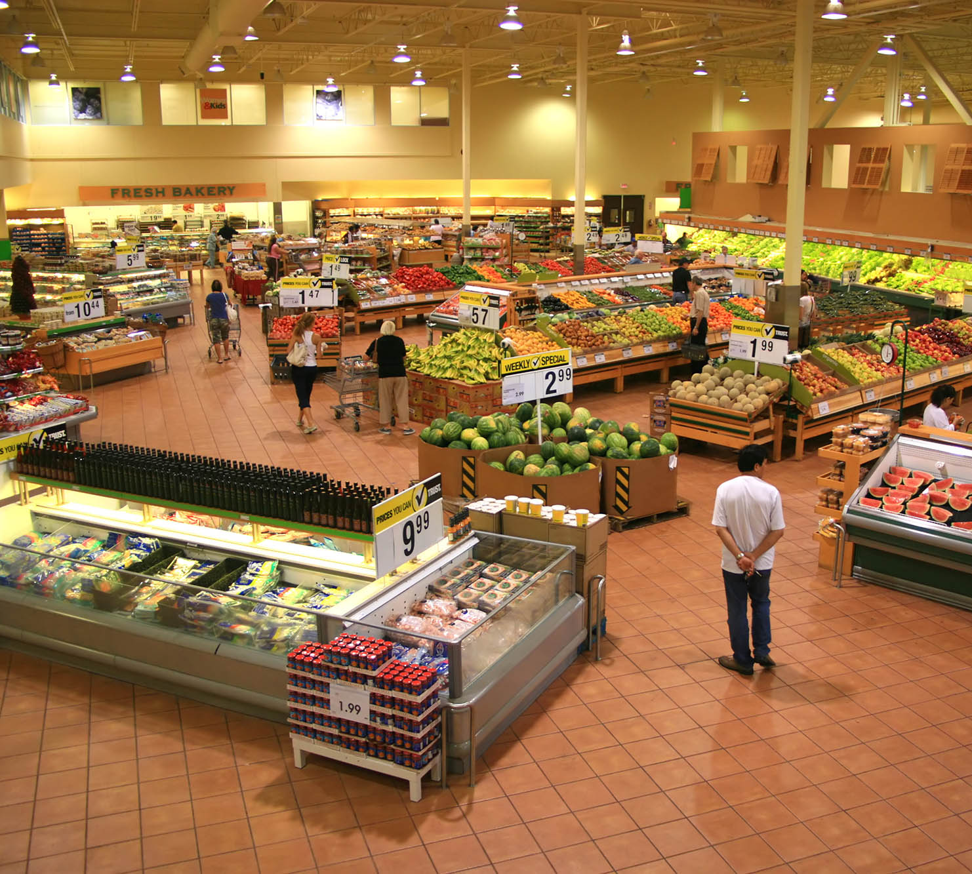
What we plan to cover
State of the Marketplace
2. Inside the Grocery Shopper’s Head:
Where They’ve Been
Where They’re Going

Slide 7
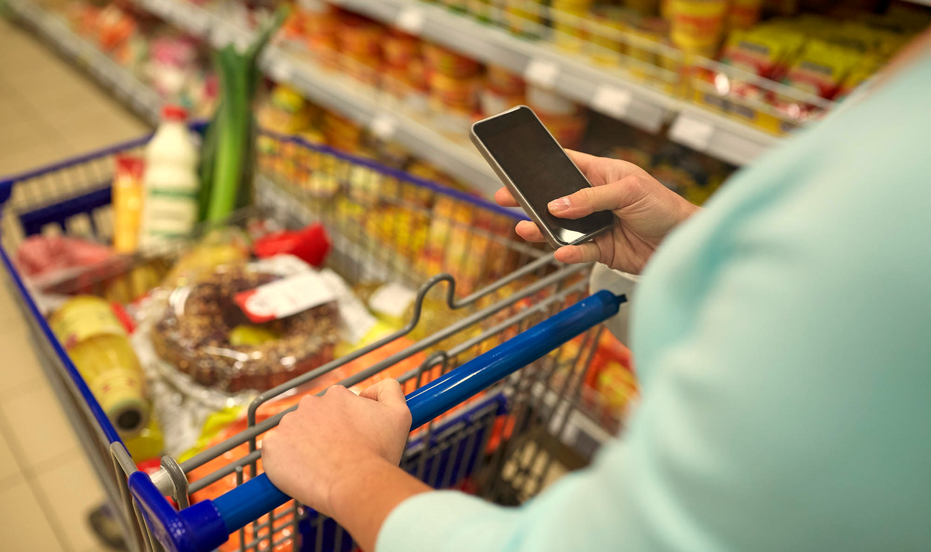
01
State of the Marketplace

Slide 8
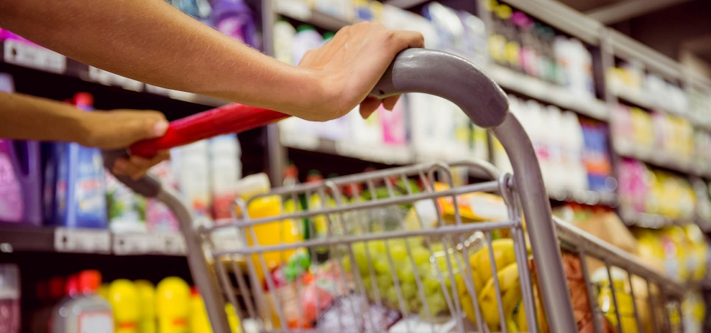
Grocery shopping remains a national pastime
Currently in the U.S.
“He does more of the shopping now. It used to be that he did most of the cooking when I did the shopping, but now our roles have kind of flipped now that we’re eating healthier.”
—Tanya, 45
85%
of all adults say they have at least 50% of the responsibility for household grocery shopping
(compared to 84% in 2017)
89%
80%

Slide 9
Co-shopping is still the prevailing strategy
World of Shoppers
Single-person Households
Multi-person Households
Co-Shoppers
varying degrees of sharing the labor
27%
44%
7%
23%
Self Shopper
Primary Shopper
Secondary Shopper
Shared Shopper
ALL shopping
Majority of shopping
Minority of shopping
Equal shopping
44% 56%
35% 65%
70% 30%
59% 41%
vs. 2017
vs. 2017
vs. 2017
vs. 2017
45% 55%
39% 61%
66% 34%
48% 52%

Slide 10
Weekly trips remain stable
1.6
Online Shoppers
1.6
trips per week
1.5
Not Online Shoppers
T R I P S

Slide 11
Living alone, men shop more often than women, but in multi-person households women report higher share
ADULTS LIVING ALONE
Reported grocery trips/week
Men report
1.5 trips
Women report
1.2 trips
MULTI-PERSON HOUSEHOLDS
Reported trips by self and by others in household
Men report |  | Women report
1.7 | trips they made (64% of HH total) | 1.6 | trips they made (70% of HH total)
+0.9 | trips by others alone | +0.7 | trips by others alone
=2.6 | total HH trips | =2.3 | total HH trips

Slide 12
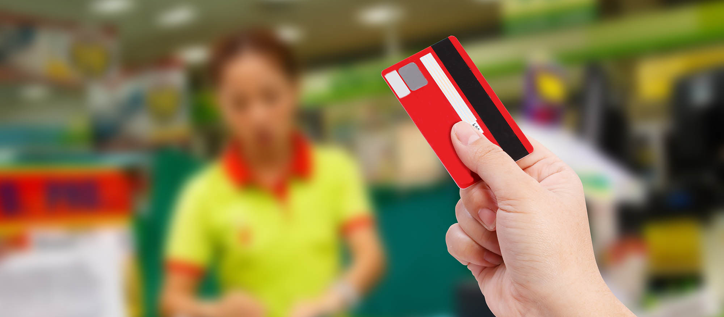
Weekly spend has remained consistent
$109
spent on groceries per week
SPEND

Slide 13
Supermarkets remain a key primary destination for grocery shoppers
Primary Store for Groceries, Historical Trend

Slide 14
Shoppers shop multiple channels/banners
CHANNELS USED ‘ALMOST EVERY TIME’ WHEN SHOPPING FOR FOOD AND GROCERIES, HISTORICAL TREND
Shoppers visit an average of 4.1 retail banners for groceries each month
 | 2015 | 2016 | 2017 | 2018 |  | 3Y Growth
Supermarket | 59% | 58% | 56% | 58% |  | -1%
Supercenter | 22% | 25% | 25% | 25% |  | 3%
Mass | 11% | 14% | 14% | 15% |  | 4%
Club | 7% | 6% | 8% | 9% |  | 2%
Limited Assortment | 6% | 8% | 10% | 10% |  | 4%
Natural/Organic | 4% | 3% | 5% | 5% |  | 2%
Drug | 4% | 4% | 5% | 5% |  | 1%
Dollar | 3% | 4% | 6% | 5% |  | 2%
Online-only/primarily | 1% | 1% | 4% | 4% |  | 3%
Convenience | 1% | 2% | 3% | 3% |  | 2%
Ethnic | 1% | 2% | 4% | 5% |  | 4%
Number of Channels | 1.18 | 1.26 | 1.39 | 1.44 |  | 0.26
Excluding Supermarket | 0.59 | 0.68 | 0.83 | 0.86 |  | 0.27

Slide 15
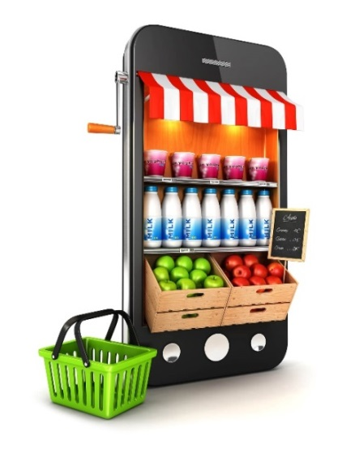
One-third of shoppers now shop online
Today:
34% of shoppers are shopping online, with Millennials (18-37) being most likely to do so (47% of online shoppers)
28% are shopping online-only retailers, up from 16% in 2015

Slide 16
Use of online grocery is spreading across generations
ONLINE FULFILLMENT SERVICES USED, BY GENERATION, HISTORICAL TREND
Same/next-day home delivery
Standard shipping to home
Pickup at my local store
Pickup at other location
2017
2018
2017
2018
2017
2017
2018
2017
2018
2018
2017
2018
2017
2018
2017
2018
2017
2018
2017
2017
2018
2018
Millennials
Gen X
Boomers
Millennials
Gen X
Boomers
Millennials
Gen X
Boomers
Millennials
Gen X
Boomers

Slide 17
But Millennials still lead across all methods of online food sourcing
ONLINE FOOD SOURCES USED, BY GENERATION
ONLINE FULFILLMENT MODELS USED, BY GENERATION
18-37
38-53
54-72
73+

Slide 18
Center store continues to dominate online, though fresh categories are gaining
Categories ordered online least often include many perishables
20% | Milk, non-dairy substitutes
19% | Fresh meats and seafood
18% | Non-prescription drugs
17% | Packaged meats
14% | Deli foods
11% | Fresh bakery items
10% | Fresh prepared
9% | Bulk foods
7% | Meal kits
3% | Baby foods
Past-year online purchases most often include non-perishables
Health & beauty | 38%
Salty snacks | 35%
Coffee & tea | 34%
HH cleaning items | 34%
Paper products | 30%
Packaged/canned foods | 30%
Dairy
Meat / Seafood
Deli
Bakery
Produce
Frozen
Center Aisles
Checkout

Slide 19
02
Inside the Grocery Shopper’s Head: Where They’ve Been, Where They’re Going

Slide 20
Today’s shoppers need a compass to help them eat and shop
Local
Mass
Natural/ Specialty
Online
Dollar
Grocery
Club
How do I want to eat?
Convenience
Drug
Food Service
How can I get the most enjoyment?
How do I make eating convenient?
How do I eat in a way that’s consistent with my values?

Slide 21
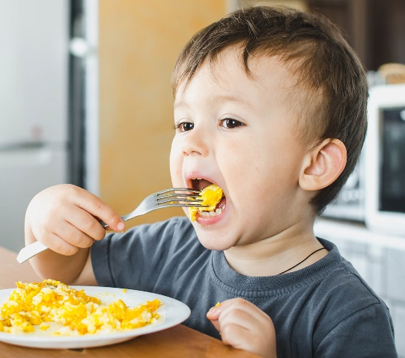
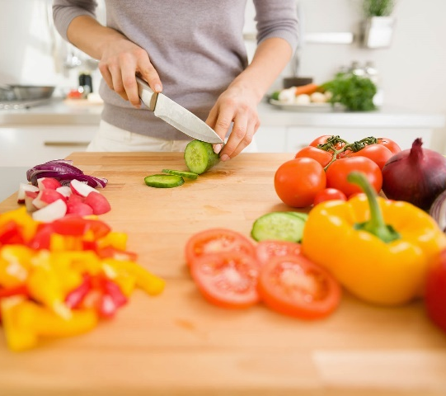
How we eat and shop has become more complex
Sustenance and eating enough
Healthy and nutritious
Enjoyment, discovery and mindful connection
Back then
Not long ago
Today

Slide 22
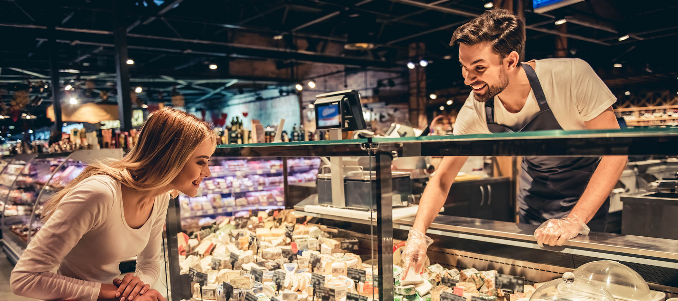
Satisfaction with primary store is at a 10-year high
8.7/10 avg. primary store rating on “meeting my needs”
PRIMARY STORE SATISFACTION

Slide 23
More than ever, shoppers see primary stores as allies
When it comes to helping me stay healthy, these people and institutions are…
Working against me
On my side
Primary Grocery Stores Are an Important Ally
My family
Doctors
Farmers
My friends
Fitness/health clubs
My primary store
Food stores in general
Health insurance companies
Local, independent restaurants
Drugstores
Online grocery providers
Gov't inst./agencies
Celebrity chefs
Manufacturers / Food processors
The news media
Fast food restaurants
The entertainment industry
vs. 53% in 2017
vs. 48% in 2017
“My main store is the number one place I learn about food. They have department experts and demonstrations and classes. To me, it’s a whole experience.”
– David, 45

Slide 24
Quick Poll

Slide 25
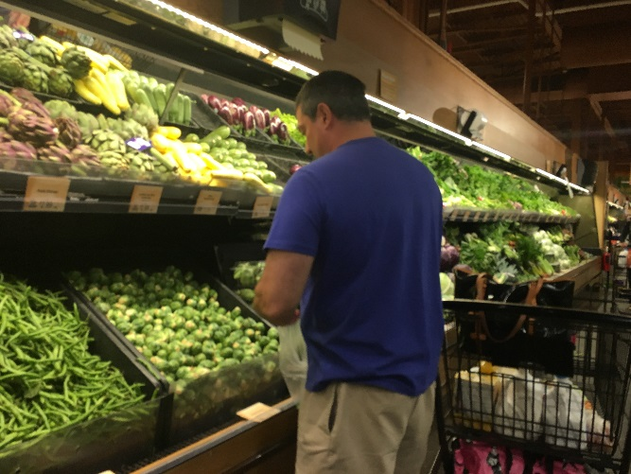
Fresh categories most important features of primary store
MOST IMPORTANT ATTRIBUTES IN PRIMARY STORE
(Showing Very Important on a 3pt scale, showing top 15 attributes)
Anchored by Selection:
Fresh Food First
“Produce is the most important element of a store—that they have good organic selection and a lot of variety in multiple categories. It tells me they are trying to keep up with the times and gives an appearance of quality.”
– Thomas, 45

Slide 26
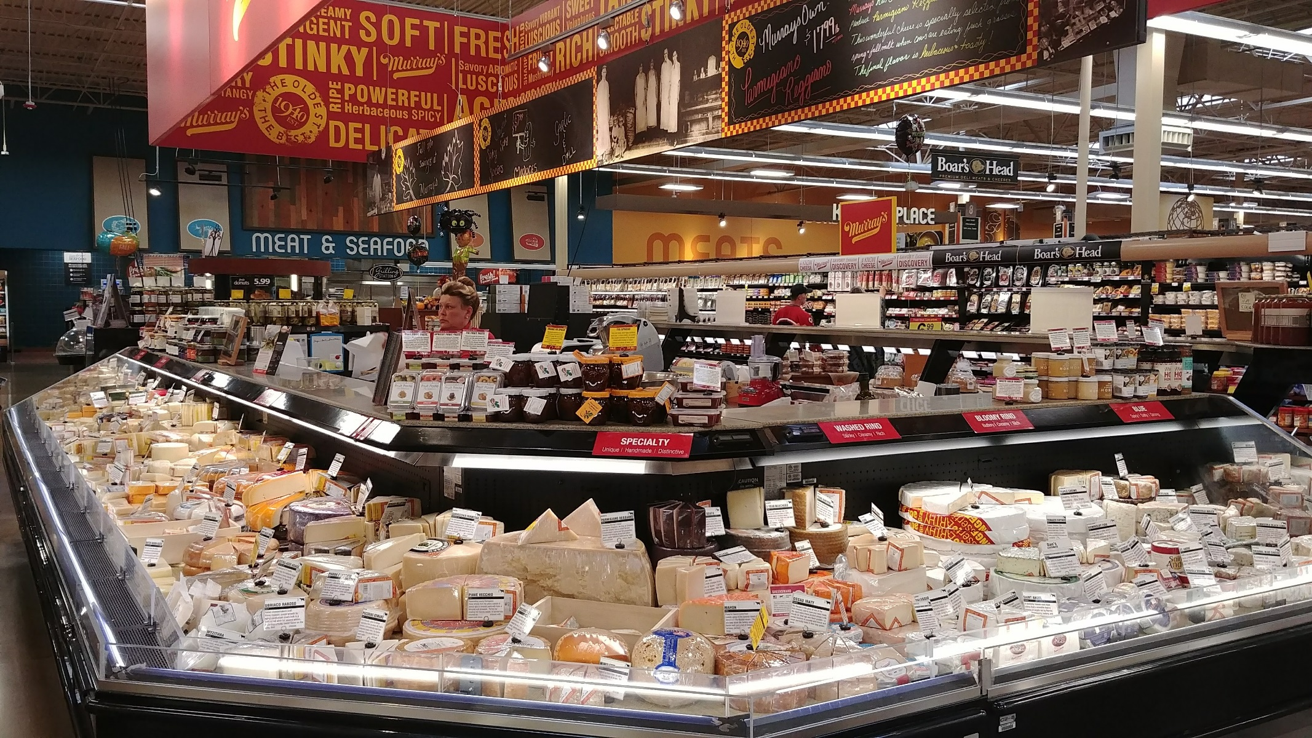
Careful curation of products builds meaningful store experiences
“A cheese and olive bar was installed in my grocery store a few years ago. The cheese-monger behind the counter is very helpful if I’m looking for something specific or to provide good suggestions. There are also regular tastings to introduce new flavors and products. I feel like I’m perusing a cheese shop rather than picking out cheese from the supermarket.” – Stephanie, 33
Taken from a shopper’s photo diary on shopping well

Slide 27
Trust in retailers to provide safe food is at a 10-year high
93%
“TRUST [their] grocery store to ensure that the food [they] purchase is SAFE”
ENTITIES CONSUMERS RELY ON TO ENSURE FOOD BOUGHT AT GROCERY IS SAFE
Myself as an individual
FDA
USDA
Food stores
Food manufacturers
Government institutions*
Consumer groups
Farmers

Slide 28
Shoppers agree food safety problems are most likely to occur at the factory, not in the grocery store
WHERE SHOPPERS BELIEVE FOOD SAFETY PROBLEMS MOST LIKELY TO OCCUR ALONG THE FOOD SUPPLY CHAIN
4%
Grocery
store
47%
Food processing/manufacturing plants
11%
Stored at
warehouse
3%
Farm
5%
Transport
11%
Restaurant
6%
Home
12%
Not sure
Food Supply Chain

Slide 29
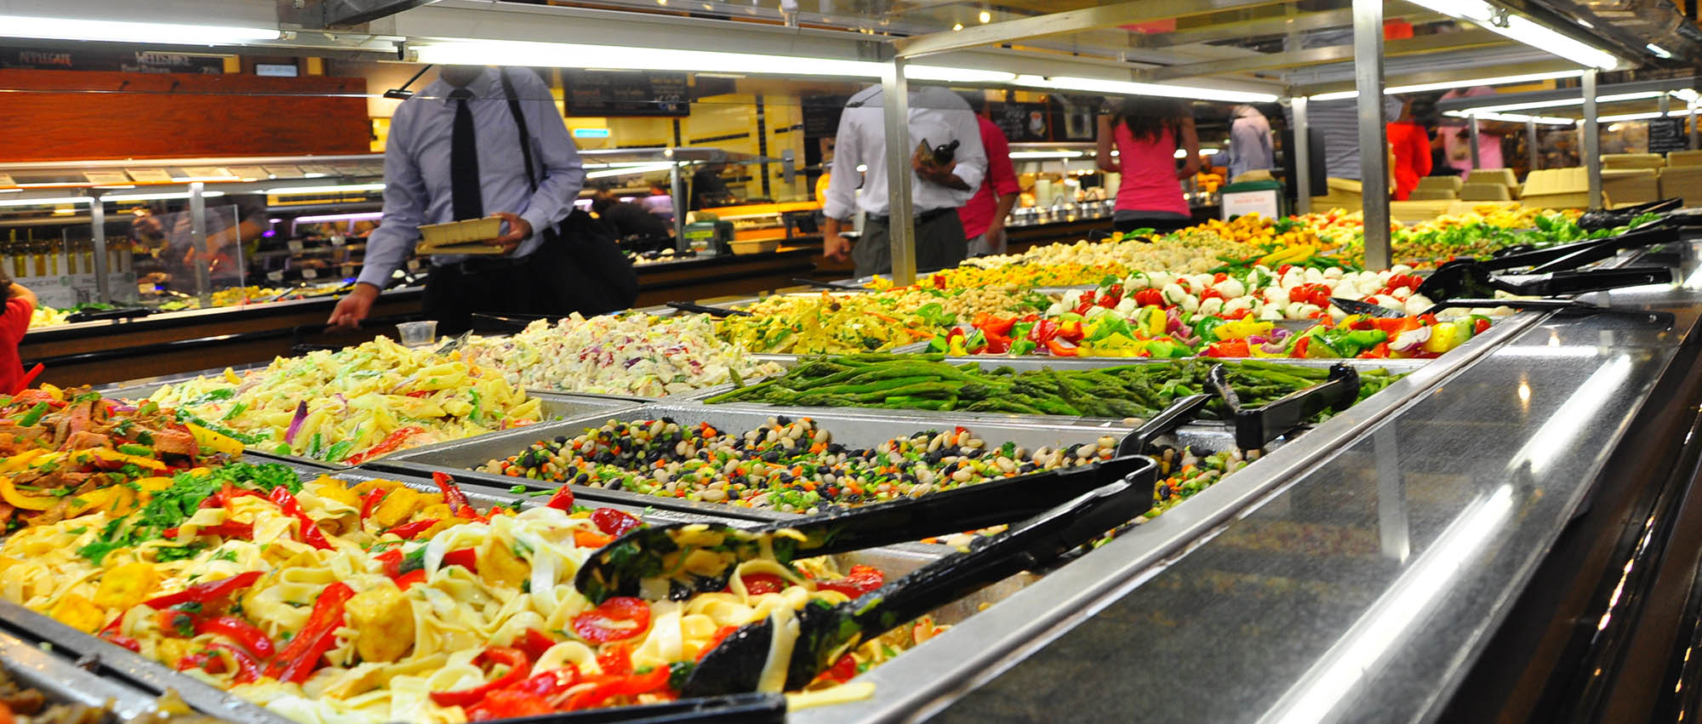
Shoppers have high confidence in grocery food safety
“HOW CONFIDENT ARE YOU THAT THE FOOD IS SAFE?”
GROCERY VS. RESTAURANT FOOD
Grocery stores
CONFIDENCE IN FOOD SAFETY
Restaurants
Shoppers continue to believe restaurants carry a greater risk of food-safety problems than grocery stores.

Slide 30
Consumer trust is important
DRIVERS OF PRODUCT SELECTION
49%
look for store brand products from stores they trust
I look for store brand products from stores I trust

Slide 31
Shoppers want openness and honesty
48%
SELECTION CRITERIA FOR PRIMARY STORE
(Showing top 16 of 32 answer choices)
see openness and honesty as very important in choosing a primary store
Open and honest about business practices

Slide 32
Shoppers hold stores to higher standards
IMPORTANT QUALITIES OF A REGULAR FULL-SERVICE
SUPERMARKET VS. ONLINE FOOD RETAILER
(Showing ‘Very important’)
59%
say a supermarket has to be open and honest
40%
Openness and honesty
see sustainable & ethical practices as a very important quality of a supermarket
Sustainable and ethical practices
Access to detailed product information

Slide 33
What grocery stores can offer
SPECIFIC SERVICES/APPROACHES FOR FOOD RETAILERS TO SUPPORT CONSUMERS IN EATING WELL
Accessible and Inspiring Meals Are a Key Opportunity
“Grocery shopping is a chore for me ... and having to figure out what to eat is the part that makes it difficult.”
– Kayleigh, 31
“The ideal store for me would have a place to eat and a huge healthy section. It should have recipes with all things you need to make the entrée.”
– Gretchen, 36
* Net across: Easy-to-make recipes, Recipes under $10, Easy access to recipes, How-to & recipes for items on sale. ** Net across: Cooking instructions and demonstrations, How-to videos on their website. *** Net across: Online ordering for delivery, Online ordering for pickup.

Slide 34
Retailers should consider multiple touchpoints to engage shoppers
18-37

Slide 35
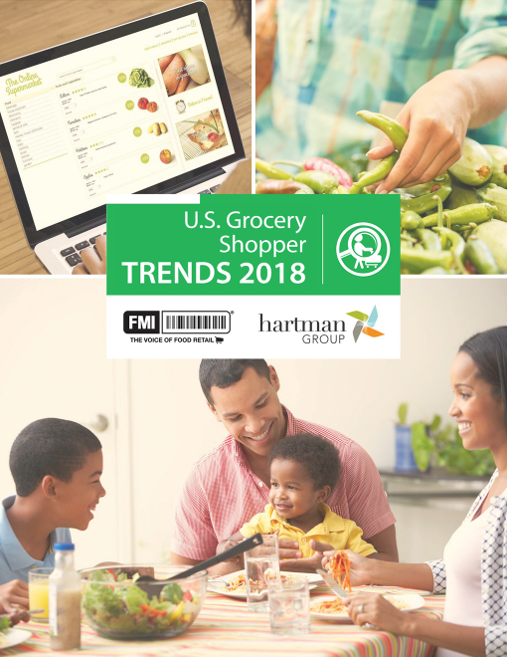
Q&A

Slide 36
Next from FMI
Covered Today
State of the Marketplace
Inside the Grocery Shopper’s Head: Where They’ve Been, Where They’re Going
Future Webinars
The Shopper Desire to Eat Well and the Implications for Shopping.
How Technology is Changing Grocery Shopping, From the Consumer Perspective.

Slide 37
Learn more about Grocery Shopping Trends and download the full report at:
www.fmi.org/grocerytrends

