Slide 1
Webinar: February 14, 2019

Slide 2
FMI ANTITRUST COMPLIANCE
It is FMI’s policy to comply in all respects with antitrust laws.
All participants in FMI meetings and events are expected to comply with applicable antitrust and competition laws.
Avoid discussions of sensitive topics that can create antitrust concerns.
Agreements to fix prices, allocate markets, engage in product boycotts and to refuse to deal with third parties are illegal.
Discussions of prices (including elements of prices such as allowances and credit terms), quality ratings of suppliers, and discussions that may cause a competitor to cease purchasing from a particular supplier, or selling to a particular customer, should be avoided.
No discussion that might be interpreted as a dividing up of territories.
It is important to avoid even the appearance of unlawful activity.
Questions or concerns? Please consult with FMI staff.
2
Notes:
STEVE
What is the Future of Transparency in an Omnichannel World?
February 14, 2019
Good afternoon/morning on the west coast and thank you for joining us today. My name is Steve Markenson. I am the Director of Research at FMI, and I’d like to welcome you to the second of three webinars on the Transparency Imperative. Today’s webinar is called: What is the Future of Transparency in an Omnichannel World? This is the second of our trilogy of webinars focusing on our analysis of consumer research conducted by FMI and Label Insight.
Before we begin, I’d like to take a few minutes to cover some important matters. One is to review FMI’s antitrust policy. FMI believes strongly in competition. Our antitrust laws are the rules under which our competitive system operates and it is our policy to comply in all respects with antitrust laws. Accordingly, it is necessary to avoid discussions of sensitive topics that can create antitrust concerns.
If you have any questions or concerns during this webinar, please bring them to the attention of FMI staff via the chat pod.
I also want to let you know that today’s webinar is being recorded and will be available as an archived program for you to watch or listen to later or share with your colleagues.
Due to the number of participants today, all phone lines have been muted so please use the chat window to reach out to us. We will have time at the end of this webinar for questions, so I encourage you to submit your questions using the chat window at any point during the webinar.

Slide 3
Meet Your Presenters
Nicole Meyerson
Senior Manager, Marketing
Label Insight
Steve Markenson
Director, Research
Food Marketing Institute
Notes:
STEVE
Today’s presenters will be myself, Steve Markenson Director of Research at FMI,
and I am happy to welcome Nicole Meyerson, Senior Manager, Marketing and Communications at Label Insight.
I would also like to acknowledge Label Insight who have been and continue to serve as a valuable partner, supporting FMI in conducting and analyzing this unique and important research. I am looking forward to sharing this research with and particular hearing Nicole’s perspective on what this means for the industry.
Nicole, thank you for joining me today.
NICOLE
STEVE
So, with all the formalities covered, let’s start off with a review of the background of this research …

Slide 4
Introduction and Methodology
FMI and Label Insight dove deep into how transparency is playing out on multiple levels.
Built on an update of previous surveys conducted by FMI and Label Insight
Online survey of nationally representative, random sample of 2,022 U.S. grocery shoppers.
Report underscores the importance of transparency and its direct link to business success.
Success is more likely to be achieved when industry stakeholders understand the fine points, including shopper motivations and behaviors.
The food industry has already taken important steps to boost transparency, including with initiatives such as SmartLabel®.
This research points to additional next steps and provides key resources.
2
Notes:
STEVE
In 2017 FMI’s annual US Grocery Shoppers Trends study devoted a full chapter to focus on Transparency, leveraging survey data, ethnographic research, in-depth interviews, secondary data and information, etc.
Last year, a white paper about transparency, from FMI and The Center for Food Integrity, entitled Transparency Roadmap for Food Retailers explored the link between transparency and consumer trust. It positioned the transparency challenge this way:
“Stakeholders across the food supply chain – from farmers to manufacturers to retailers -- have faced a barrage of questions and skepticism from a new breed of customers, about everything from ingredients to food safety. The focus of inquiries has increasingly extended beyond ingredients to include areas such as animal welfare, business practices, and environmental impact. “
NICOLE - Over the past few years, Label Insights has conducted a number of consumer or shopper studies to understand this phenomena…….
STEVE
So, this FMI and LI decided to combine our knowledge, experience, expertise, unique perspectives and curiosity to conduct the research we are about to share with you.
The report was built on the foundation of the previous surveys conducted by FMI and Label Insight (see Additional Resources section).
This research is based on a online survey of a random sample of 2,022 U.S. grocery shoppers who are 18 years of age or older.
The research was conducted from May 15 to 22, 2018.
NICOLE
FMI and Label Insight, in this current report, aim to take a deep dive into how transparency is playing out on multiple levels…….

Slide 5
Overview
Importance and Role of Transparency
Who is the Online Shopper?
Understanding Online Consumer Transparency Preferences
Transparency in an Omnichannel World
Key Takeaways
Notes:
STEVE
What does this research explore and what will we explore today?
Start by digging into the consumer mindset to understand the importance and role of transparency.
How important is transparency? What are consumers looking for?
Define transparency from the shopper’s perspective---What does transparency mean to the shopper?
Then we will take a look at online shoppers. Who are they and what is shopping profile?
Next, we will try to understand consumer preferences for transparency.
How is the product label doing at providing transparency.
How does the shopper connect transparency with trust, loyalty and shopping behaviors?
To address the ultimate question of – why should the industry care about transparency?
And finally see how transparency translates to an omnichannel shopping world now and going forward into the future.
How do they want transparency delivered?
What are shoppers expectations from their smartphone in aisle and when shopping remotely online?
Nicole and I will be giving you a snap shot of this research and at the end we will tell you where you can get more.
NICOLE

Slide 6
Importance and Role of Transparency
Notes:
STEVE
Let’s start with a look at the importance and role of transparency

Slide 7
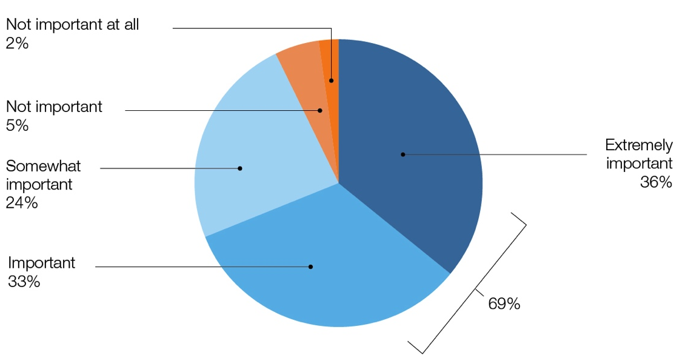
Consumers Emphasize Transparency’s Importance
69% of Consumers say transparency is important to them.
80% of online shoppers say that transparency is important
Notes:
STEVE
As was found in research previously conducted by both FMI and Label Insights, transparency by brands and manufacturers is valued and seen as important by consumers.
Shoppers taking part in this survey were given a definition of transparency to keep in mind.
That definition is -- providing detailed information, such as for what is in food items, and how it is made.
Based on this definition, shoppers place a high level on the importance on transparency.
The vast majority of consumers (69 percent) say it is extremely important or important that brands and manufacturers provide detailed information such as what is in their food and how it is made.
More than one-third say it is extremely important
Only 7 percent of consumers say this detailed product information is not important to them.
There are key and valuable segments of the population that place greater importance on the transparency, one of those is online shoppers at 80%. We will be taking a closer look at those online shoppers as we work our way through the webinar.
NICOLE

Slide 8
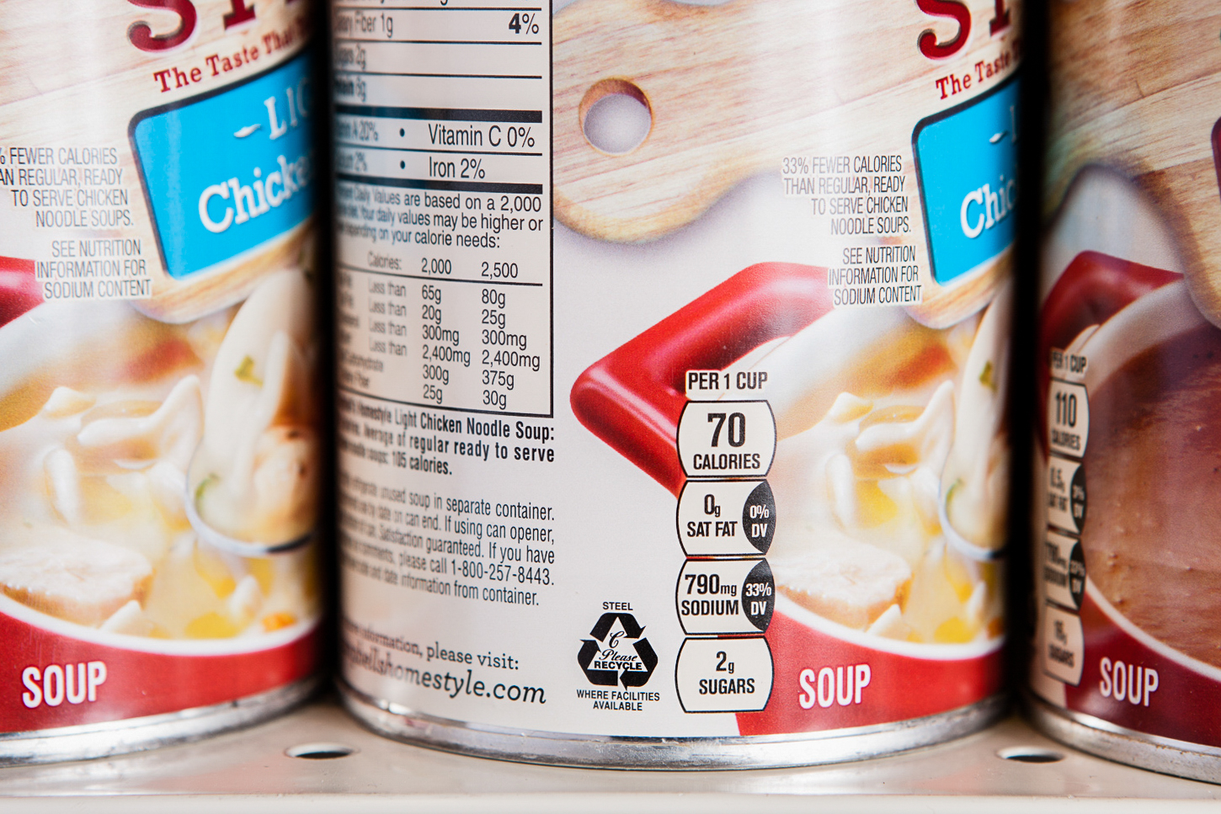
Consumers Emphasize Transparency’s Importance
Clear details about what is in your food and how it is made.
While not as important as price and quality,
69% say clear details are important
when selecting a product or brand.
78% of online shoppers say clear details are important
Notes:
STEVE
NICOLE

Slide 9
How Shoppers
Determine Transparency
65% say complete list of ingredients
59% say easy to understand ingredients
46% say in-depth nutritional information
Allergens, production, sourcing, animal welfare and sustainability also factor highly.
Online shoppers want more of this next tier information
Notes:
STEVE
Lets try to understand - How do shoppers in general define transparency? What determines to them whether a brand or manufacturer is being transparent?
First/Basic level -- Knowing all the ingredients that are in a product with a easy to understand description are key indicators for shoppers that a brand or manufacturer is being transparent.
Ingredients: A majority of shoppers determine if a brand is being transparent based on the brand providing a complete list of ingredients (65 percent) and/or a description of ingredients in plain English (59 percent).
Nutritional Information: Providing in-depth nutritional information is a key indicators to almost one-half of shoppers (46 percent) of a brand or manufacturer being transparent.
Allergens and more: Some shoppers determine transparency based on the brand or manufacturer providing information about allergens (34 percent), how products are produced (33 percent) and how ingredients are sourced (33 percent).
There are smaller segments/some others (20% to 29%) who determine transparency based on certifications/claims, values based information such as animal welfare, explanations of what ingredients are used for or information on sustainability practices.
Consumers clearly have a range and variety of factors that they use to determine transparency.
Not a difference between online and shopper in general in how they determine transparency on the major criteria, but online shoppers are more likely to focus on the these secondary criteria – allergens, sustainability, certs and claims, animal welfare, sourcing, production, etc. information
NICOLE

Slide 10
Considerations when buying products
How Important is Transparency?
67%
65%
57%
51%
50%
44%
44%
43%
42%
Notes:
STEVE
As shoppers evaluate products for purchase, they can be faced with discerning an abundance of information. How do they prioritize the important information they want to consider?
Ingredients and general nutrition information are cited most frequently as key considerations for shoppers when deciding which products to purchase.
But, many other dimensions of transparency are important in the shopper’s buying decision.
In fact, shoppers list an average of more than four of these categories of information as being important in their buying decision.
Ingredients and Nutrition: The most important considerations when deciding which products to buy are simply the ingredients (67 percent extremely important or important) and the general nutrition facts (65 percent).
Health Benefits: Many shoppers also claim that it is important to consider the health benefits the product offers (57 percent), source of ingredients (51 percent) and dietary claims, such as fat-free, high fiber, etc. (50 percent).
Other Product Information: While less likely to be considered important, some shoppers do consider how a product was manufactured or grown (44 percent), possibility of allergens (44 percent), where the product was manufactured or grown (43 percent) or product claims, such as organic, grass-fed, fair trade, etc. (42 percent).
So, again, it is not just one thing that is important to the consumer. There are multiple transparency considerations impacting the consumer’s buying decision.
NICOLE

Slide 11
Considerations when buying products -Online shoppers-
How Important is Transparency?
77% +10
73% +8
70% +13
66% +15
63% +13
59% +15
56% +12
58% +15
58% +16
Notes:
STEVE
But if we look at online shoppers, every one of these is more important to them than the general population.
NICOLE

Slide 12
Who is the Online Shopper?
Notes:
STEVE
Before we go much further, lets take a look at who is shopping online for their groceries.

Slide 13
Who is the Online Shopper?
Online shopping
Who are they?
51% have a college degree
43% have children under 18
26%
Of shoppers have shopped online in the past 30 days
20% shave HHI of $100,000+
50% are males
Notes:
Online shopping is a trend that is changing the industry. Relative to other industries, consumers have been slow to transition to the online purchases of food. But that is quickly changing. By 2022, Nielsen and FMI anticipate that consumers could be spending $100 billion dollars a year on online groceries. Thus, it is important to understand how transparency translates to an online shopping world.
As we previously noted, transparency manifests itself differently online. It can be easier, yet expectations are higher.
Thus it is not surprising that online shoppers place even greater importance on brands and products being transparent.
In the report, we explore this lucrative segment of shoppers this more completely.
But first let’s look at who shops online
How do we define online shoppers, more conservative definition, shopped online for groceries in the past 30 days.
More formal education >50% vs <40%, but not all do
More likely to have children 43% vs <30%, but less than one-half do
Higher income 20% >$100k, vs <10%
50% males vs 40% of instore shoppers
Clearly more educated, affluent, families skew male
NICOLE

Slide 14
Generational Differences
Who is shopping online?
39%
30%
23%
Millennials
GenXers
Boomers
Notes:
STEVE
Let’s take a look at who is shopping online.
As might be expected, Millennials are the age group most likely to be online shoppers, making up 39% of online shoppers
But, GenXers are also a significant segment of the online shopper (30 percent).
And, don’t totally dismiss the Baby Boomers, as 23 percent of the online shoppers are Baby Boomers
Skew to the younger generations, but don’t count out those GenXers and Baby Boomers. They are joining in and catching up.

Slide 15
The Behavior of Online Shoppers
50%
Of online shoppers spend more than $125/week
60%
Have visited three or more different grocery stores in the past 30 days, in addition to online shopping
64%
make 2 or more trips to the grocery store per week, in addition to online shopping
Notes:
Online shopping is a trend that is changing the industry. Relative to other industries, consumers have been slow to transition to the online purchases of food. But that is quickly changing. By 2022, Nielsen and FMI anticipate that consumers could be spending $100 billion dollars a year on online groceries. Thus, it is important to understand how transparency translates to an online shopping world.
NICOLE

Slide 16
Diets and Allergies Online
65%
of online shoppers are themselves or are shopping for someone on a diet or health-related program (vs. 47% overall)
20% High protein
18% Low carb
14% Heart-healthy
14% High fiber
46%
of online shoppers are shopping for someone impacted by allergies, intolerances or sensitivities
(vs. 35% overall)
48% say that it is easier to shop for a specific diet or allergy online
Notes:
STEVE
NICOLE

Slide 17
Understanding Consumer Transparency Preferences

Slide 18
Perspectives on Product Labels – Being Informed -Online shoppers-
83%
83%
80%
56%
51%
51%
54%
83%
Would like to know more about products they are purchasing.
Notes:
STEVE
When shoppers speak of transparency, they use words such as “open,” “honest” and “clear.” The vast majority of shoppers are seeking more information than what appears on product labels.
We explored this further by asking shopper perspective on a number of product labeling issues.
It is not surprising to see here the high level of agreement with the statement “ I would like to know more about the products I am purchasing”
Most online shoppers would like to know more about the products they are purchasing and say they find value in more product information, beyond what is on the label (83 percent).
Online shoppers clearly are clearly seekers of information.
Adequacy of Information: Shoppers are divided as to whether there is enough information on the packaging to help them meet their dietary needs or lifestyle preferences (56 percent agree, 44 percent disagree).
Label Clarity: When it comes to assessing product labels, consumers are truly divided as to whether they are too hard to read (51 percent agree, 49 percent disagree), too confusing (51 percent agree, 49 percent disagree) or not clearly labeled for their needs (54 percent agree, 46 percent disagree).
NICOLE

Slide 19
Transparency Solves Confusion and Drives Purchase Decision
83%
Find value in product information beyond what’s on the label
51%
Say product labeling is too confusing
51%
Say product labels are too hard to read
84%
Are more likely to buy products with in-depth product info, beyond the label
Notes:
STEVE
But online shoppers want more …as I just mentioned ….
Label Clarity: When it comes to assessing product labels, consumers are truly divided as to whether they are too hard to read (51 percent agree, 49 percent disagree) or too confusing (51 percent agree, 49 percent disagree).
While many shoppers talk about the need for more transparency, an important question is what impact does transparency have on the bottom line? Are shoppers’ purchase behaviors impacted by the degree of transparency offered to them? For many the answer is indeed “yes.”
Information Imperative: Most shoppers (84 percent) say they are more likely to buy food products that provide more in-depth product information, beyond what is on the physical label.
So we see that transparency can impact the bottom line.
NICOLE

Slide 20
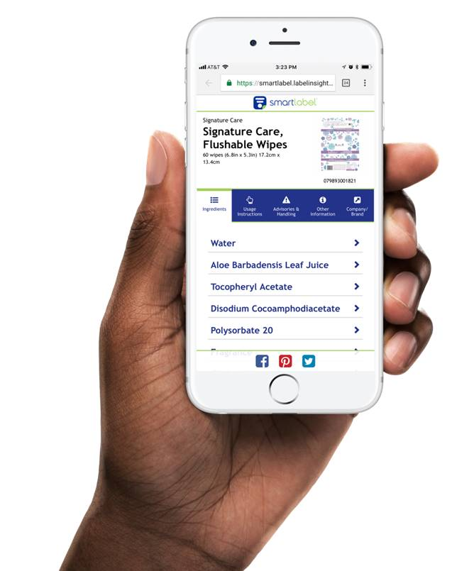
Transparency Boosts Trust and Loyalty
-Online shoppers-
83%
Are more loyal to a brand that provides in-depth product info, beyond the label.
88%
Trust brands and retailers more when they provide ingredient definitions beyond the label.
67%
Are willing to pay more for products that provide information beyond the label.
Notes:
STEVE
Building trust and loyalty among shoppers is indeed critical to the survival and growth of a brand.
Transparency is seen as a fundamental consumer demand that serves as the foundation on which brand trust and loyalty are built.
Providing product information can generate shopper trust and loyalty, along with producing a willingness among some shoppers to pay more.
Building Trust: The statement that generated the highest level of agreement focuses on the role that transparency has in building trust. Some 88 percent of shoppers said, if food manufacturers or retailers provided access to complete and easy to understand definitions for all the ingredients, it would result in more trust.
Boosting Loyalty: Almost as many shoppers (83 percent) agree that they are more likely to be loyal to a brand that provides more in-depth information, beyond what is provided on the physical label. And more than one-half say they are wiling to pay more for products that provide information beyond what is on the label.
Willing to Pay:
NICOLE

Slide 21
Responses to Ingredients Confusion
-Online shoppers-
69%
Are confused after reading a product label.
When faced with confusion, the most common response is to look to other products.
56%
Look at other products to find better information.
34%
To try and find better ingredient information.
26%
Don’t buy the product and buy another one they understand better.
When faced with confusion, many online shoppers seek information.
41%
Research ingredients online
20%
Seek assistance from a store employee
Notes:
STEVE
As the food industry has learned, physical product labels have their limitations.
As such, shoppers often find themselves both informed and confused when reading product labels.
But, will new online options like SmartLabel®® or other information sources simply provide more information or help serve to eliminate shopper confusion.
More than two-thirds (69 percent) of shoppers sometimes or always find themselves confused about the ingredients lists on the package.
Only one-third (31 percent) are rarely or never confused about the ingredients listed on the package label.
View Alternatives: If shoppers find ingredients on the label confusing, a majority of them will look to other products (56 percent) either to see if they try to understand their ingredients better (34 percent) or simply not buy that product and buy another product instead (26 percent).
This obviously represents potential lost sales for those who are not transparent.
NICOLE

Slide 22
Transparency in an Omnichannel World

Slide 23
When the label is not enough, where else do you look for information?
Where Else Shoppers Seek Information
-Online shoppers-
Notes:
STEVE
When the label alone does not do the job …
Look Elsewhere: Almost nine in ten online shoppers (88 percent) say that when the information of the product packaging is not enough to be sure if it meets their dietary needs, they look elsewhere. The most common source of information is online (59 percent), while other will ask someone in the store (25 percent), family or friends (20 percent), or their doctor or physician (20 percent). A small proportion (14 percent) will reach out to the manufacturer.
Do Nothing: Only about one in ten (12 percent) do not look elsewhere for information.
NICOLE

Slide 24
Choosing the Most Valuable Transparency Platforms
How valuable would each of the following be if offered by your food retailers?
On-shelf detailed product information
90%
Notation on products letting you know whether they meet dietary criteria
87%
Ability to get detailed product information in-store on smartphone/device
80%
Icon on products letting you know whether retailer considers them healthy
79%
Map/brochure to help shop for products that meet dietary needs/goals
74%
Dietary consulting services
66%
80%
Would value detailed product information in-store on a smartphone.
Notes:
STEVE
On package, on shelf or via smartphones are ways that manufacturers and brands can provide needed product information. But where do shoppers find the most valuable information? It turns out shoppers found value, though to varying degrees, in a variety of options.
On Shelf Top Choice: On shelf detailed product information is seen as offering shoppers the most value, as nine in ten shoppers (90 percent) say this approach is valuable to them. This is an opportunity for retailers to provide value to shoppers.
On Product Important: Almost as many shoppers (87 percent) find notations right on products letting shoppers know whether the product meets certain dietary criteria to be valuable.
Devices Play Big Roles: The vast majority of shoppers (80 percent) find value in being able to get detailed product information in store on their smartphone or other device.
Icons Make a Difference: Icons on products letting shoppers know whether retailers consider them healthy are also considered somewhat or very valuable to the vast majority of shoppers (80 percent).
Maps, Brochures Also Used: While still considered valuable to most shoppers, maps or brochures to help shoppers shop for products that meet their dietary needs or goals(74 percent) and dietary consulting services (66 percent) are not considered as valuable as the other methods of providing information.
NICOLE

Slide 25
Online Shoppers Value Transparency Platforms
How valuable would each of the following be if offered by your food retailers?
-Online shoppers-
On-shelf detailed product information
93%
Notation on products letting you know whether they meet dietary criteria
92%
Ability to get detailed product information in-store on smartphone/device
89%
Icon on products letting you know whether retailer considers them healthy
86%
Map/brochure to help shop for products that meet dietary needs/goals
83%
Dietary consulting services
77%
89%
Of online shoppers value product information in-store on a smartphone.
Notes:
STEVE
Online shoppers more likely to mention every option ….
On Shelf Top Choice: On shelf
On Product Important: Almost as many shoppers (
Devices Play Big Roles: The vast majority of shoppers (89 percent) find value in being able to get detailed product information in store on their smartphone or other device.
Icons Make a Difference: Icons on products letting shoppers know whether retailers consider them healthy are also considered somewhat or very valuable to the vast majority of shoppers (86 percent).
Online shoppers even lik …e
Maps, Brochures Also Used: While still considered valuable to most shoppers, maps or brochures to help shoppers shop for products that meet their dietary needs or goals
(83 percent) and dietary consulting services (77 percent) are not considered as valuable as the other methods of providing information.
NICOLE

Slide 26
Smart Phones Help Support Transparency
77%
Likely
35%
Very likely
Notes:
STEVE
With this in mind, shoppers were asked how likely they would be to access more information about a product on their smartphone or other device. More than three in four shoppers (77 percent) say they are very or somewhat likely to take advantage of this method to access more product information, with 35 percent saying they are very likely to do so.
NICOLE
The food industry has been stepping up to shopper demands for transparency. SmartLabel®® is a prime example of this. The initiative was created by the Grocery Manufacturers Association and FMI under the industry’s Trading Partner Alliance. SmartLabel®® provides information to consumers on hundreds of attributes that could never fit on a package label. SmartLalbel covers ingredients and nutrition information, but also much more. While the initiative currently covers about 40,000 products, it is expected to grow substantially in the coming years

Slide 27
Smart Phones Help Support Transparency
Among Online Shoppers
89%
Likely
52%
Very likely
Notes:
STEVE
Online shoppers ….With this in mind, shoppers were asked how likely they would be to access more information about a product on their smartphone or other device. More than three in four shoppers (77 percent) say they are very or somewhat likely to take advantage of this method to access more product information, with 35 percent saying they are very likely to do so.
NICOLE

Slide 28
Smartphone is Preferred for Transparency
77%
Are likely to seek more information about products via Smartphone.
Interested in learning more about…
Ingredient definitions | 40%
In-depth nutritional info | 34%
Sourcing of ingredients | 32%
Production of ingredients | 31%
Country of origin | 26%
Manufacturing process | 26%
Animal welfare practices | 20%
Notes:
STEVE
Shoppers were asked how likely they would be to access more information about a product on their smartphone or other device. More than three in four shoppers (77 percent) say they are very or somewhat likely to take advantage of this method to access more product information, with 35 percent saying they are very likely to do so.
Those likely to seek more product information cite myriad types of information they are interested in learning about. The most frequently mentioned is ingredient definitions (40 percent). Other frequently mentioned areas of interest include in-depth nutritional information (34 percent), sourcing of ingredients (32 percent), production of ingredients (31 percent), country of origin (26 percent) and manufacturing processes (26 percent). And even animal welfare.
NICOLE

Slide 29
Transparency Eyed as Easier Online
55%
Find it easier to discover new products online.
Most online shoppers find discovery and transparency much easier online compared to in physical, brick and mortar stores.
Find it easier to learn more in-depth product information online.
51%
Find it easier it easier to know what ingredients are in a product when shopping online.
46%
Find it easier to know a product’s nutritional information when shopping online.
45%
Notes:
STEVE
Most online shoppers find discovery and transparency much easier online compared to in physical, brick and mortar stores.
Discovery Online: More than one-half of online shoppers (55 percent) say discovering new products is easier online compared to when they are in a physical store.
Learning Online: About one-half of online shoppers (45 to 51 percent) say that various aspects of transparency are easier online than in a physical store, including learning about a product’s story, shopping for a specific diet or allergy, knowing what ingredients are in a product, and knowing a product’s nutritional information.
Do shoppers hold online merchants/commerce to different standards of transparency than they do for their physical store experience? In fact, most online shoppers do have higher expectations of transparency when shopping online.
NICOLE

Slide 30
Transparency Eyed as Easier Online
Shoppers hold online merchants/commerce to different standards of transparency than they do for their physical store experience. In fact, most online shoppers do have higher expectations of transparency when shopping online.
Want more detailed information when shopping online.
76%
Feel it’s more important to get detailed information when shopping online.
72%
Notes:
STEVE
Most online shoppers find discovery and transparency much easier online compared to in physical, brick and mortar stores.
Want More: Three-fourths of online shoppers (76 percent) want more product information when shopping online than if they were shopping a physical store.
More Important: A similar proportion (72 percent) say that being able to get information about a product is more important when shopping online than if shopping in the physical store.
NICOLE

Slide 31
Online Shoppers Willing to Pay More
84%
More likely to buy product with more information
91% value in-depth product information beyond what is on the label
67%
willing to pay more
83%
In-store support to help achieve goals
77%
Ingredient confusion, less likely to buy
81%
Willing to switch to a brand that provides more in-depth product information
30
Notes:
STEVE
Most online shoppers find discovery and transparency much easier online compared to in physical, brick and mortar stores.
NICOLE

Slide 32
Key Takeaways
Who
Highly Educated, High Income, Parents.
Surprisingly, even split male female – skews younger.
Shop multiple different stores / trips a week, both on and off line
What
Seeking more information - always
Confused and disappointed in what they are able to know / learn
Will switch to buying better information, will pay more
Expect to get information digitally, even in store, expect online to provide more and be easier, don’t always trust what they find.
Notes:
NICOLE

Slide 33
Q&A

Slide 34
Thank You Learn more about transparency and download the full report at: www.fmi.org/transparency
Notes:
STEVE
Thank you to Nicole for joining me today in presenting and to everyone attending today’s webinar. As a reminder, this presentation was recorded and will be available for viewing at your convenience on fmi.org. Also, the report is available on the FMI store at FMI.org. After the meeting you’ll receive an email with a link to that page. Thank you and have a great afternoon.

