Slide 1



The Power of Foodservice at Retail 2018
An in-depth look at the Foodservice at Retail
through the shoppers’ eyes
Presented by:
Rick Stein| FMI
&
Anne-Marie Roerink | 210 Analytics
Made possible by:

Slide 2


FMI is the trade association that serves as the voice of food retail.
We assist food retailers in their role of feeding families and enriching lives.

Slide 3
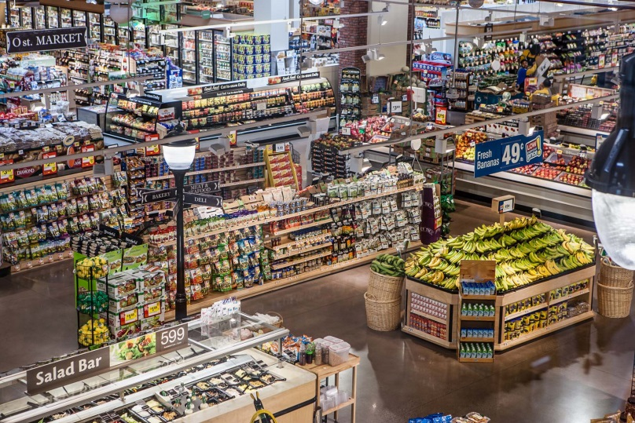















The Association:
Our members are food retailers, wholesales and suppliers of all types and sizes
FMI provides comprehensive programs, resources and advocacy for the food, pharmacy and grocery retail industry
CONSUMER &
COMMUNITY AFFAIRS
FOOD SAFETY
& DEFENSE
GOVERNMENT
RELATIONS
INDEPENDENT
OPERATOR
PRIVATE BRANDS
CENTER STORE
SUPPLY CHAIN
TECHNOLOGY
ASSET
PROTECTION
COMMUNICATION
EDUCATION
FRESH FOODS
HEALTH & WELLNESS
INFORMATION SERVICE
RESEARCH
SUSTAINABILITY
WHOLESALER

Slide 4


Fresh @ FMI
FMI is committed to the growth and success of fresh companies and their partners. FMI provides resources and networks that support the interests of member companies throughout the global, fresh produce supply chain, including family-owned, private and publicly traded businesses as well as regional, national and international companies.
Fresh Foods
Emphasis on fresh
Produce
Meat
Seafood
Deli/In-store, fresh prepared foods and assortments
Bakery
Floral
Rick Stein
Vice President, Fresh Foods
Food Marketing Institute
rstein@fmi.org
202.220.0700

Slide 5



FMI Fresh Foods
Research and Education
In-depth information, trends and insights to foster innovation, take advantage of new opportunities and help develop winning strategies
Networking
Share ideas, explore best practices and develop business relations
Advocacy
Understand what is going on in Washington and make your voice heard

Slide 6
FMI Fresh Executive Committee (FEC)
John Ruane (Chair)
Ahold USA
Rick Steigerwald (Co-Chair)
Lund Food Holdings, Inc.
Tom DeVries
Giant Eagle, Inc.
John Beretta
Albertsons, LLC
Dave Bornmann
Publix Super Markets, Inc.
Scott Bradley
Target Corporation
Jerry Chadwick
Lancaster Foods, LLC
Alex Corbishley
Target Corporation
Buddy Jones
MDI Distributors
Dan Koch
Associated Wholesale Grocers, Inc.
Brett Bremser
Hy-Vee
John Haggerty
Burris Logistics
Mark Hilton
Harris Teeter LLC
Christopher Lane
Wakefern Food Corporation
Geoff Wexler
Wakefern Food Corporation
Koen Vermeylen
Brookshire Grocery Company
Dan Murphy
SuperValu
Pat Pessotto
Longo Brothers Fruit Markets Inc.
Nick Carlino
MDI Distributors
Jerry Suter
Meijer, Inc.
Geoff Waldau
Food Lion
John Grimes
Weis Markets
Richard Cashion
Healthy Home Market
Shana DeSmit
Walmart
Mark Doiron
Fresh Thyme
Jim Lemke
CH Robinson Fresh
Steve Howard
Bristol Farms/Lazy Acres
Emily Coborn
Coborns
Jerry Goldsmith
Spartan Nash
Mike Papaleo
C&S Wholesalers
Pat Brown
Albertsons LLC
Terry Murphy
Wakefern
Scott Evans
Price Chopper/Mkt 32
Nicole Wegman*
Wegmans Food Markets, Inc.
* Silent members
Fresh Foods
The FEC is..
Comprised of FMI Member companies, Retailers and Wholesalers

Slide 7
FMI Fresh Foods Leadership Council
John Ruane (Co-Chair)
Ahold USA
Rick Steigerwald (Co-Chair)
Lund Food Holdings, Inc.
All- FEC Members
FMI Fresh Executive Council
Chris Dubois
IRI
Michael Eardley
International Dairy-Deli-Bakery Assoc.
Bridget Wasser
National Cattleman's Beef Association
Sarah Schmansky
Nielsen Perishables Group
Paul Mastronardi
Mastronardi Produce
David Sherrod
SE Produce Council
Jeff Oberman
United Fresh Produce Assoc.
Janet Riley
North American Meat Institute
Galit Feinreich
Ready Pac Foods, Inc.
Tom Super
National Chicken Council
Patrick Fleming
National Pork Board
Joe Watson
Produce Marketing Assoc.
Joe Weber
Smithfield Foods Inc.
Art Yerecic
Yerecic Label
Brad Roche
Hill Phoenix
Greg Livelli
Hussmann
Robb MacKie
American Bakers Assoc.
Jim Huston
Johnsonville
Chad Gregory
United Egg Producers
Joe DePetrillo
Earthbound/White Wave
Shawna Lemke
Monsanto
John Knorr
Phillips Seafood
Mike Celani
Wonderful
Chandra Macleod
Aqua Star Seafood
Jeff Thompson
Trident Seafood
Emily Blair
Miliken
John Dunne
Acosta
Scott Aakre
Hormel Foods
Sally Lyons-Wyatt
IRI
Wendy Reinhardt Kapsak
Produce for Better Health (PBH)
Abby Prior
Bright Farms
Michael Lang
Invatron
Tom Daniel
Sterilox/Chemstar
Randy Evins
SAP
Tom Windish
Cargill

Slide 8
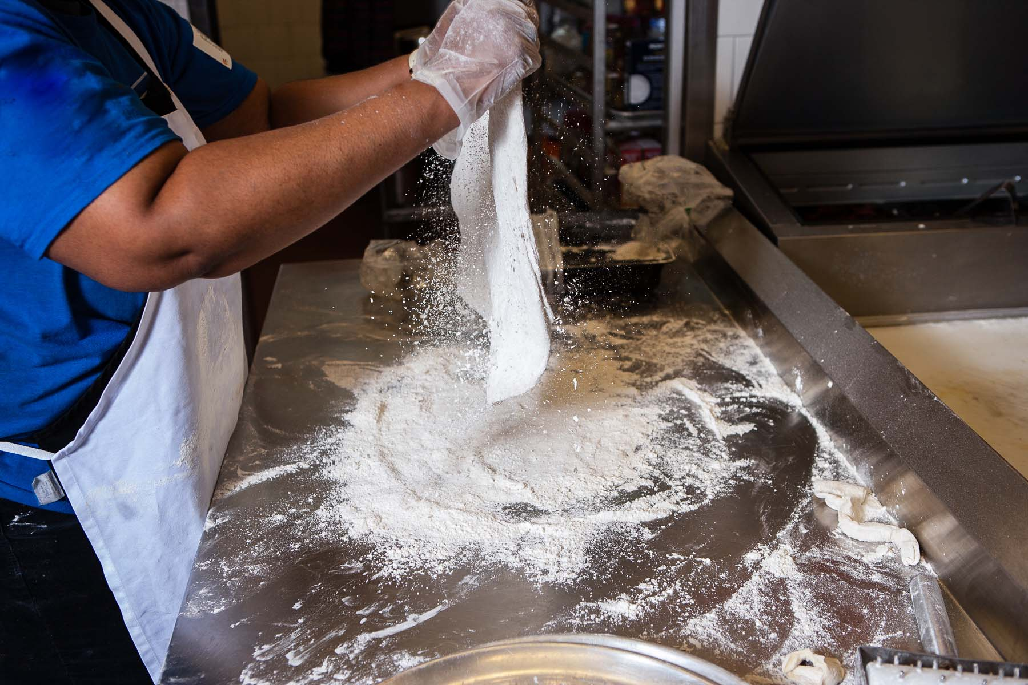
Today’s reality: growing sales isn’t easy
Focusing on pockets of growth
YTD

Slide 9
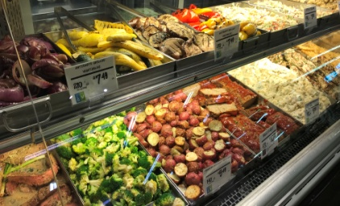
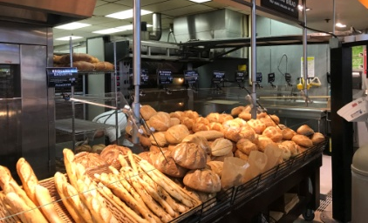
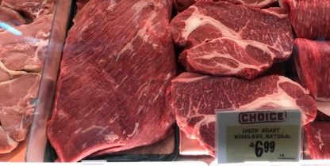
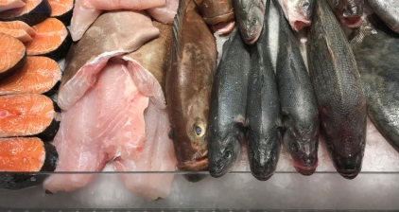
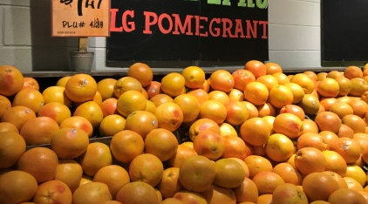
Finding growth & differentiation
While center store = 69% of sales, perimeter drives the growth
$147M
Total fresh
dollars
$324M
Total center
store dollars
+0.8%
vs YAGO
-1.0%
vs YAGO
Source: Nielsen, 52 weeks ending 08/26/17 | Pictures: 210 Analytics

Slide 10
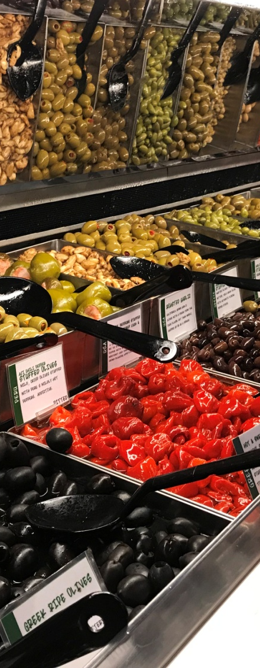
But not all fresh growth is equal
Produce and foodservice drive performance for U.S. retailers
 | Produce | Meat | Deli | Bakery | Seafood
$ growth | +1.6% | -0.4% | +1.6% | +1.3% | +0.9%
Volume growth | +0.6% | +1.0% | +1.3% | +1.5% | -3.1%
Source: Nielsen, 52 weeks ending 08/26/17 | Picture: 210 Analytics

Slide 11


Within deli, foodservice is the crown jewel
The largest, yet fastest growing segment
 | Total deli | Deli prepared | Deli meats | Deli cheese
$ growth | +1.6% | +2.7% | -0.6% | -0.1%
Volume growth | +1.3% | +1.9% | -0.3% | -0.5%
Dollar share | 100% | 60% | 20% | 16%

Slide 12






Retailers seek to capitalize on its popularity
Adding SKUs, space and labor to foodservice
88%
More space to
grab-and-go
59%
More space to
made-to-order
59%
More space to
self-service bars/
buffets
30%
More trained/
certified labor
and chefs
Source: FMI The Food Retailing Industry Speaks 2017

Slide 13
After all, there is great opportunity to grow
While penetration is at 96%, room to improve purchase frequency & spend per trip
1 in 10
Trips include deli prepared
.
$8.42
Average deli prepared basket

Slide 14
However, one size fits no one
Sustaining growth requires constant innovation and tailored assortment
Frequency, habits and preferences differ by:
Age
Income
Ethnicity
Area of the country
Cooking practices
Family size/composition
And more
KEY
DELI
DECISIONS

Slide 15




The Power of Foodservice at Retail 2017
Second annual study
  Commissioned by the Food Marketing Institute
  Conducted by 210 Analytics
  Made possible by Hussmann and The Shelby Report
360° view of foodservice at retail
  Understanding opportunities, habits, preferences and trends
    Shopper survey to determine attitudes, interests and behaviors
    Sales overlay by IRI and Nielsen
    Visuals to illustrate report findings
Developed for the industry by the industry

Slide 16









Today’s agenda
UNDERSTANDING THE OPPORTUNITY
CHANNEL
CHOICE
DINNER DECISION TREE
TECHNOLOGY INFLUENCE
ORDERING EASE AND SPEED
NUTRITION,
BALANCE & HEALTH
AMBIANCE & SERVICE
VARIETY AND SELECTION
SOLUTION TYPES &
MEAL KITS
KEY
TAKEAWAYS

Slide 17
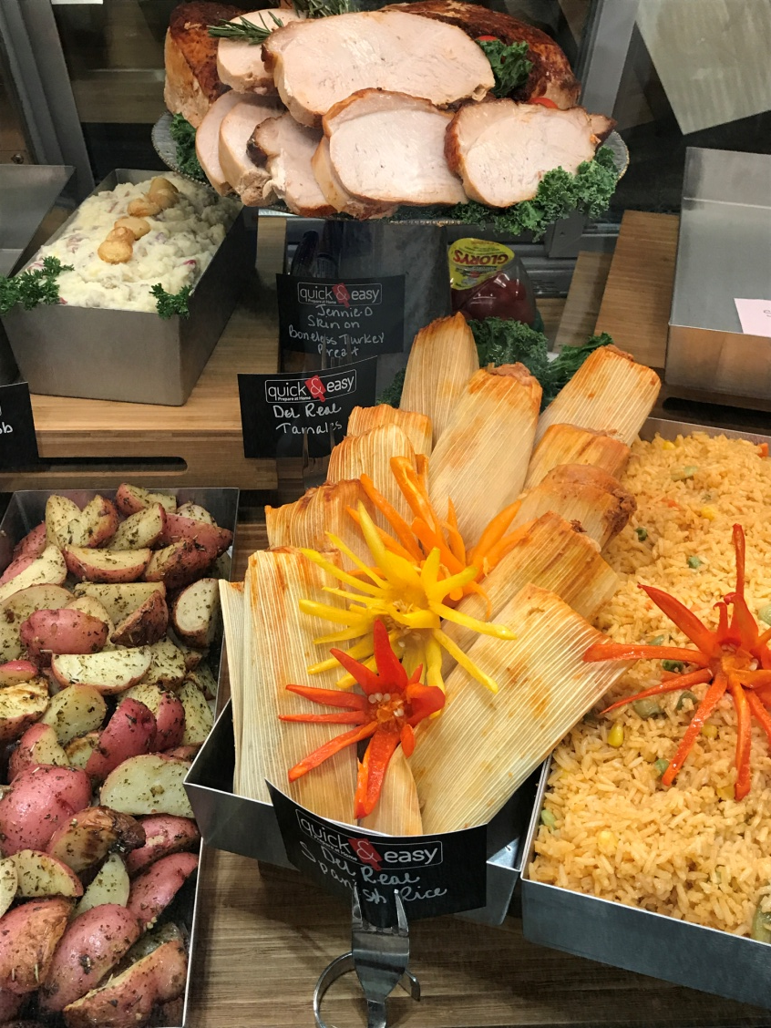
the opportunity
Home-cooking
Meal composition
Time crunch
Not in the mood to cook
Lunch

Slide 18
Shoppers split up the week
High correlation between meal preparation and 1) grocery trips and 2) per person spend
4-5 days/week:
Home-cooked with
some level of
preparation
2.1
2-3 days/week:
Takeout, delivery, dining out or deli/fresh prepared
4.9
Opportunity all 7 days

Slide 19
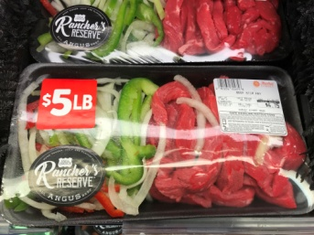
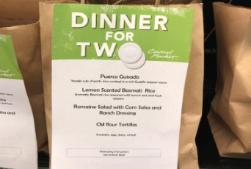
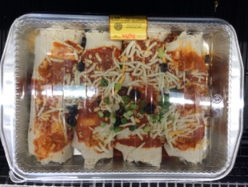
Consumers mix scratch with convenience
Drive deli as a time-saving solution, particularly in urban and high-income areas
4.9 Weekly home-cooked dinners
37% Mostly cooked from scratch
55% Mix of scratch & semi/fully-prepared items
8% Mostly rely on semi/fully-prepared items

Slide 20

Shoppers buy deli prepared once every 3 weeks
Leveraging deli prepared to drive convenience and win one more weekly dinner occasion

Slide 21
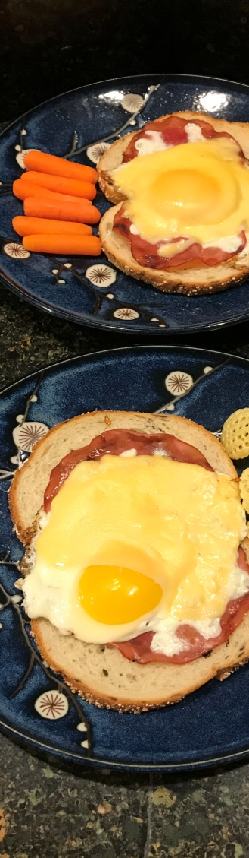
The opportunity is clear, but how about reality?
When stressed for time, restaurants are >2x as likely to get the business
In a rush?
52% Easy meal that takes little time/effort
33% Eat out/pick up/order in from a restaurant
14% Pick up from/eat at the grocery deli/prepared foods

Slide 22
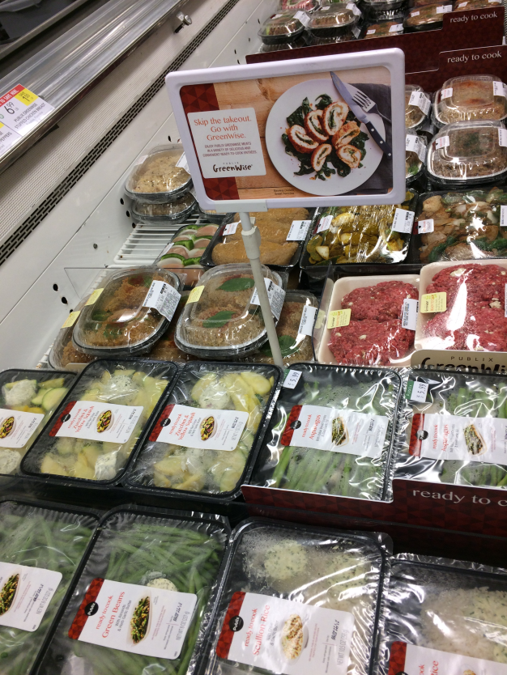

Directly reference being a restaurant alternative

Slide 23
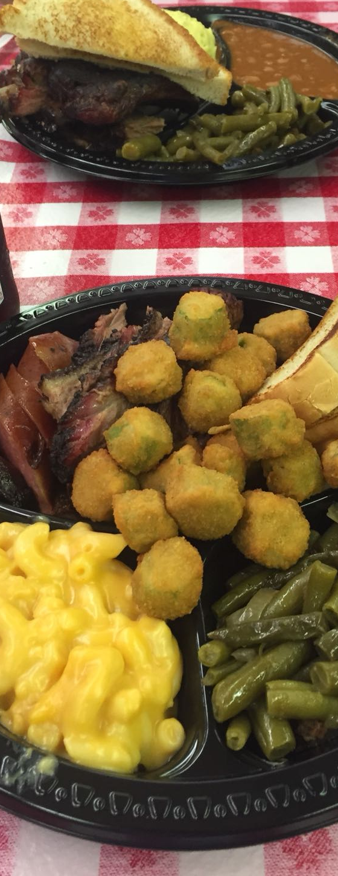
And, when not in the mood to cook?
Again, restaurants are >2x as likely to get the business
Not in the mood to cook?
69% Eat out/pick up/order in from a restaurant
31% Pick up from/eat at the grocery deli

Slide 24
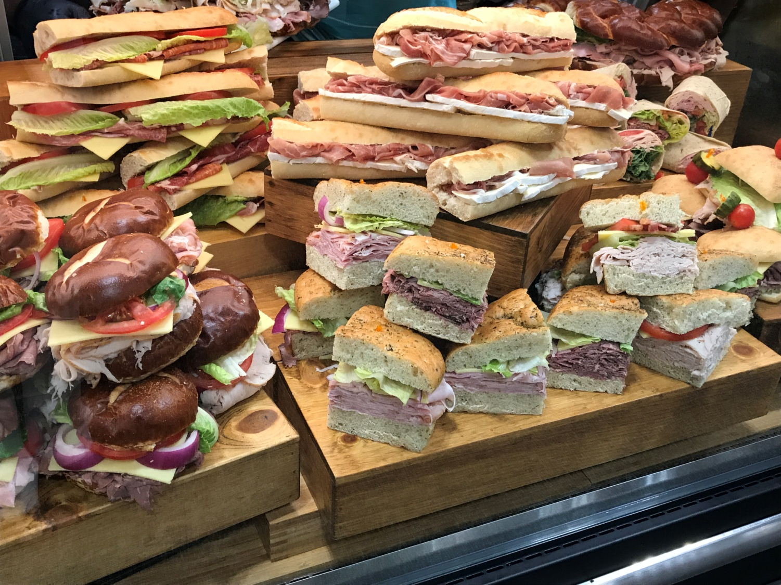
Why not foodservice? Not on the radar
Two-thirds have a foodservice deli that presents a viable alternative
Reason for choosing a restaurant over
foodservice
68% Just don’t think about the grocery deli,
even though it is a perfectly good option
32% The grocery deli is just not a viable option,
it doesn’t have what I/we want

Slide 25





Fixing the disconnect
Drive visibility, conversion and leverage trip drivers in marketing messaging/positioning
Reasons for buying from the grocery deli versus going to a restaurant
92% Combine with grocery shopping | 83% Cheaper 82% More cuisines 77% Closer/ Easier to get to | 68% Healthier | 64% Better quality 56% Faster/time consideration | 20% Home delivery

Slide 26

Channel choice
Supermarket dominance
Conversion
Stealing from ourselves or restaurants
Channel leakage

Slide 27
Supermarkets claim the top spot overall
Millennials underindex. Can foodservice be a way to connect?
Highest conversion
and purchasing frequency
for supermarkets

Slide 28
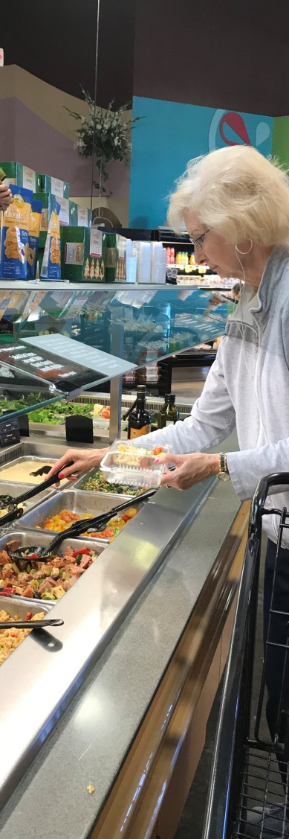
Deli prepared is a very scattered purchase
Channel leakage is rampant; supermarkets are the most likely destination
If switch, where to?
53% Supermarkets
22% Supercenter
10% Club
7% Specialty/organic
50%
buy deli prepared
at stores = the
primary store

Slide 29


The big question…
Do we “steal” from ourselves, or restaurants? Foodservice often replaces cooking
When buying a foodservice meal, does it typically…
50%
Replaces a home-cooked meal
12%
Replaces a restaurant meal
38%
Both equally

Slide 30
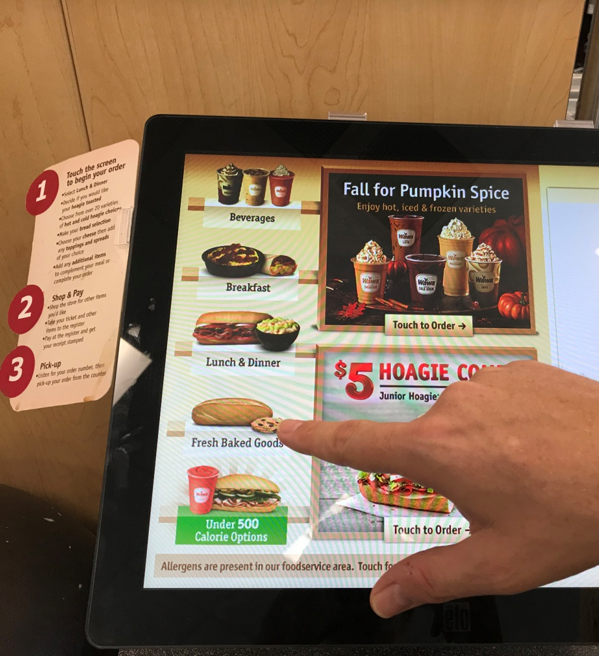
technology
Out of home dinner plans
Desired functionality
Application usage
Digital outreach

Slide 31
Dinner planning frequently involves technology
Matching restaurants in consumer-facing technology to elevate visibility

Slide 32
Highly-desired functionality: menu, prices & specials
Technology-focused shoppers are more demanding, but also an interesting target for grocers
Important features on apps or websites to help determine where/what to eat
77% Full menu | 71% Clear prices | 57% Sales specials | 35% Map/directions 33% Online payment 39% Online ordering w/delivery 32% Nutrition info 29% Customize orders 32% Order for pickup

Slide 33
Technology usage provides marketing venues
Shoppers use an average of 4-5 platforms ideal to advertise foodservice specials
Technology applications used | 2007 | Younger Millennial | Older Millennial | Boomers
Playing music | 74% | 91% | 90% | 49%
Finding recipes/meal ideas | 70% | 73% | 85% | 53%
Checking grocery ad/promotions | 59% | 53% | 68% | 51%
Researching dinner options on menu/ location/reservation apps | 54% | 66% | 72% | 31%
Keeping a calendar/scheduling events | 54% | 58% | 70% | 35%
Creating grocery lists | 50% | 63% | 67% | 30%
Ordering meals directly from restaurants | 46% | 58% | 60% | 28%
Ordering meals using a delivery service | 27% | 47% | 43% | 7%
Ordering routine groceries | 23% | 40% | 32% | 10%
Ordering catering or deli at the grocery store | 21% | 28% | 33% | 7%

Slide 34
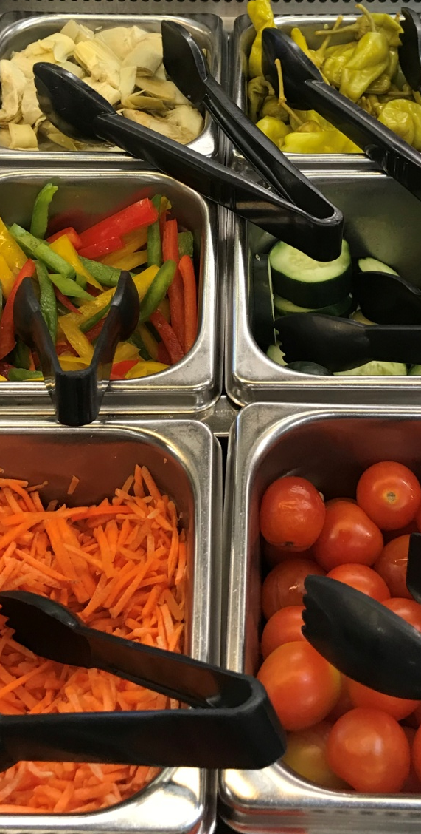



Choosing the right vehicles
Addressing the 4 p.m. dinner plan void
Signing up for messages with tonight’s dinner specials from your primary store
Likely/very likely | Not likely
40% | 37%
32% | 48%
26% | 56%

Slide 35
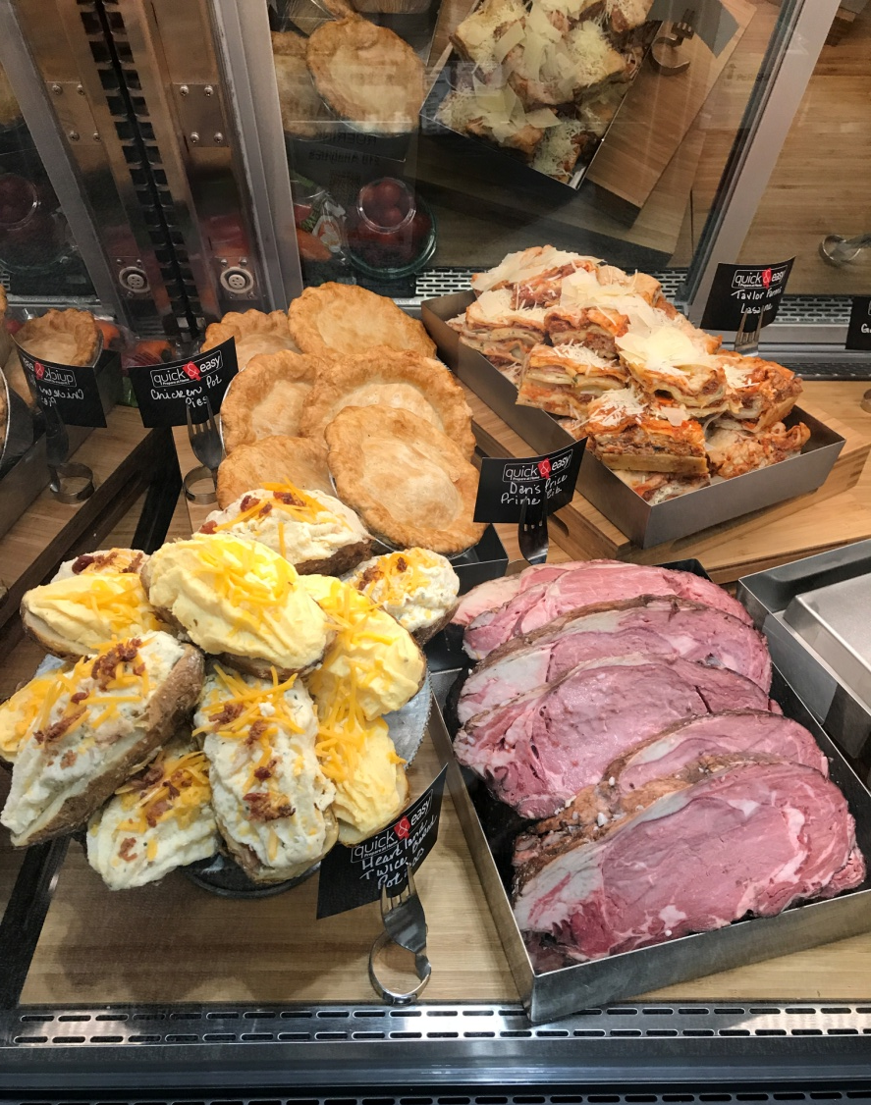
Dinner decision tree
Price
Speed
Nutrition
Ambiance

Slide 36

Price dominates in “quick dinner out” decision
Speed is second with nutrition a close third
Price
57% rank 1st
3.34 average
Speed
18% rank 1st
2.56 average
Ambiance
7% rank 1st
1.71 average
Nutrition
18% rank 1st
2.38 average

Slide 37
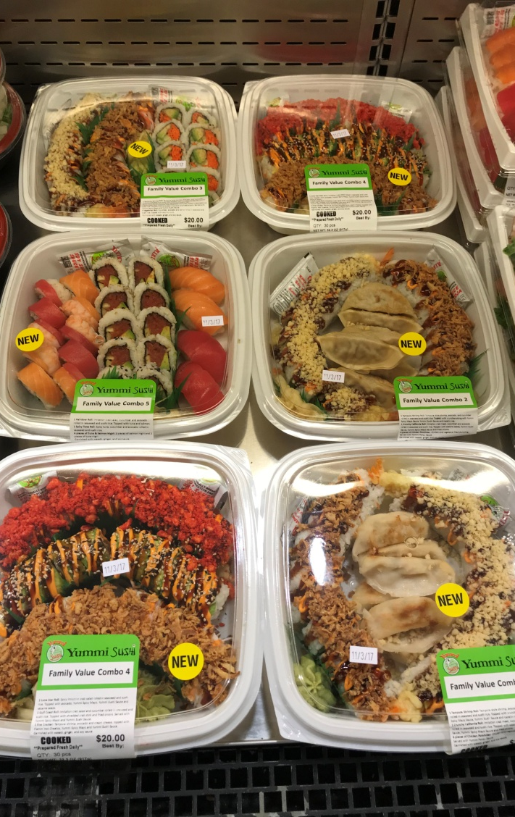
Ordering ease & speed
Speed-focused profile
Speed & ease feature importance

Slide 38
Speed-focused shopper profile
Generation X
Men, particularly young men
Higher-income households
Technology users when deciding where and what to eat
Less likely to value customization ability and nutrition
Rural areas
Like convenience items as partial or full dinner solution
vs. cooking from scratch
Shoppers with kids living at home, particularly ages 0-6
Rank speed:
18% 1st
52% 1st or 2nd

Slide 39


Grab-and-go and ordering ahead highly-desired features
Urban shoppers approach speed and ease differently ( )
Important features focused on speed
71% Extensive grab & go options 65% Order ahead | 64% Extensive heat- and- eat 58% Separate deli checkout | 54% Drive through 45% Home delivery | 42% Dedicated parking 40% Kiosk ordering 39% Table devices for ordering 39% Click and collect

Slide 40
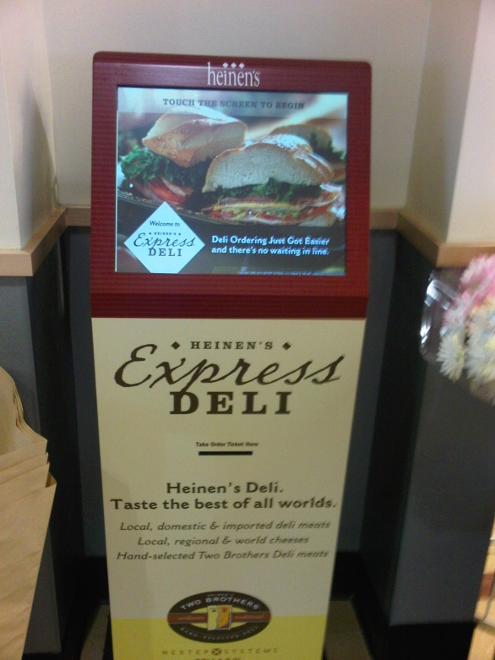
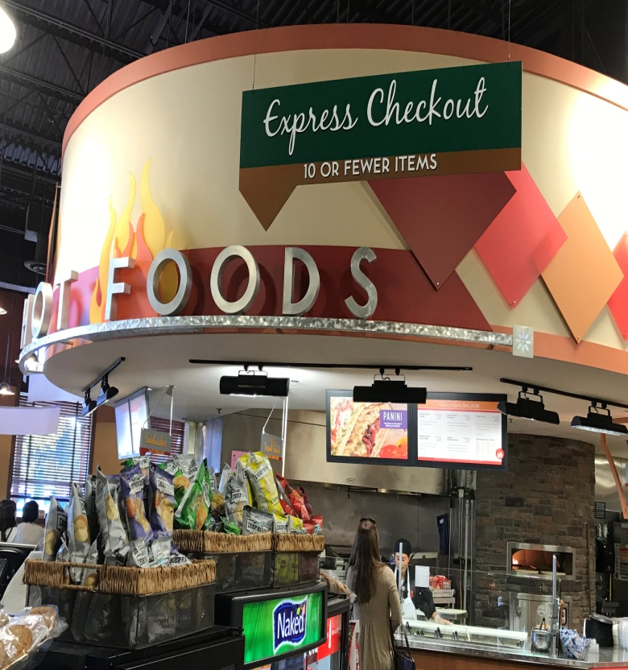
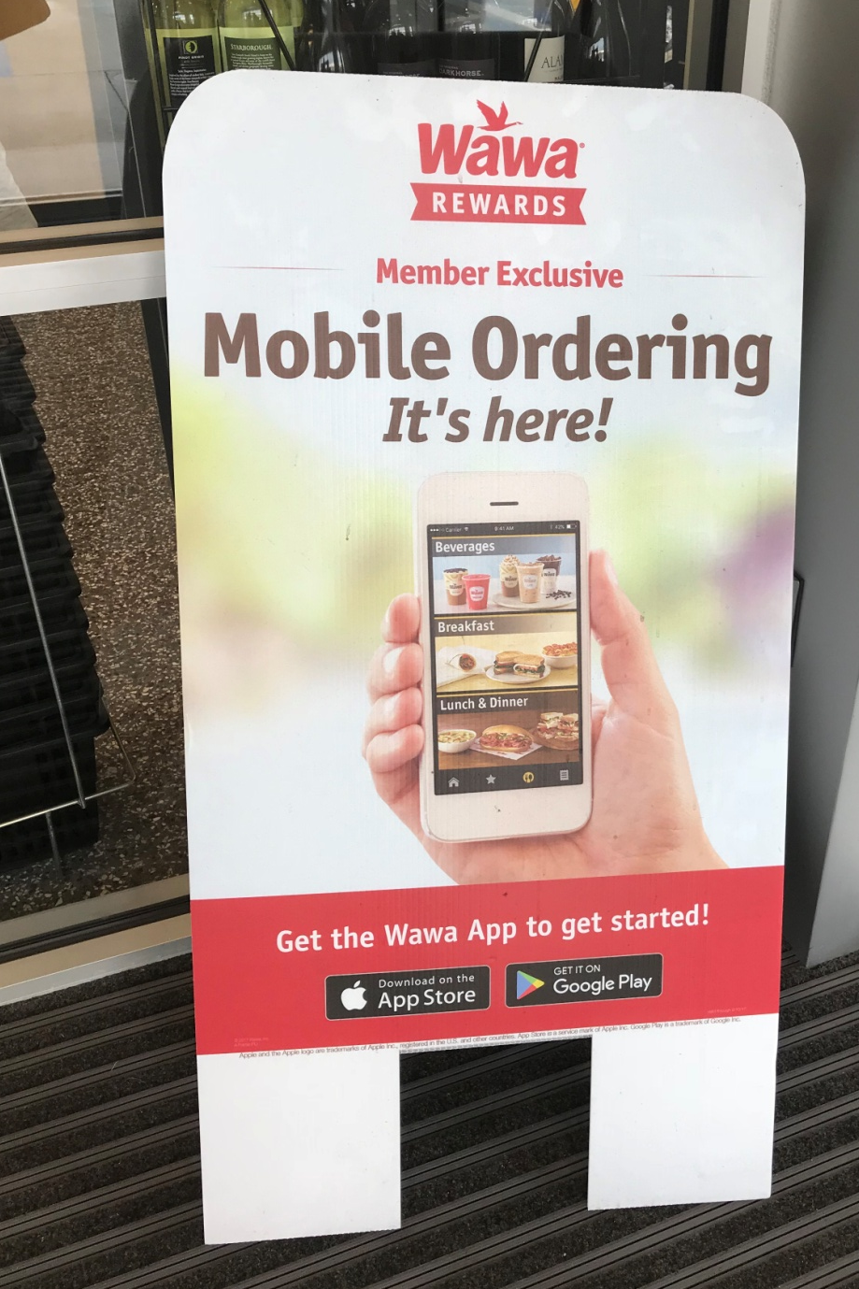
Leveraging technology to drive speed

Slide 41
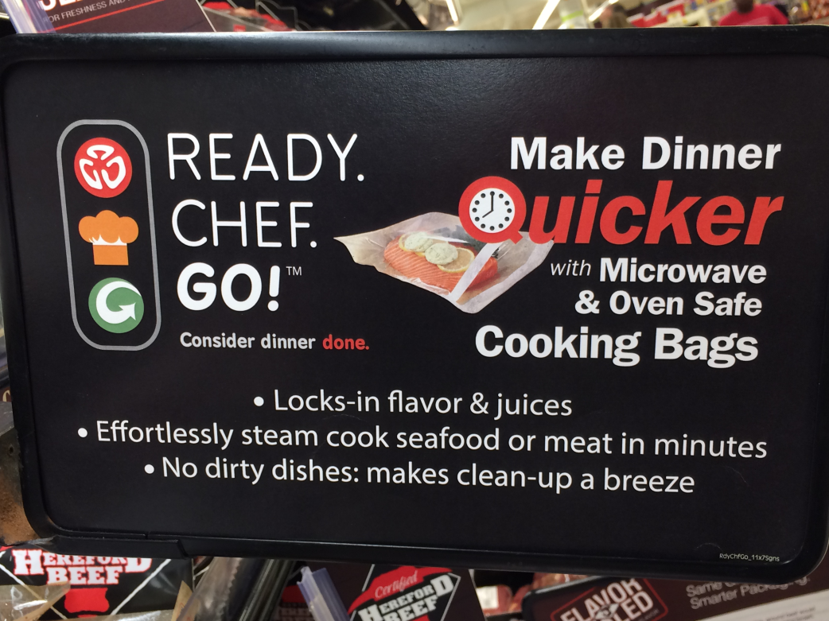
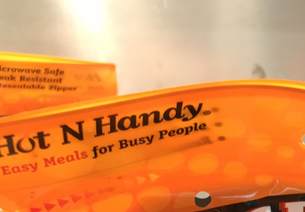
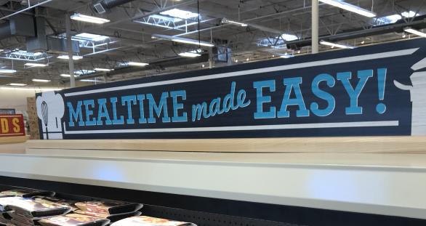
Emphasis on communicating speed across solutions

Slide 42
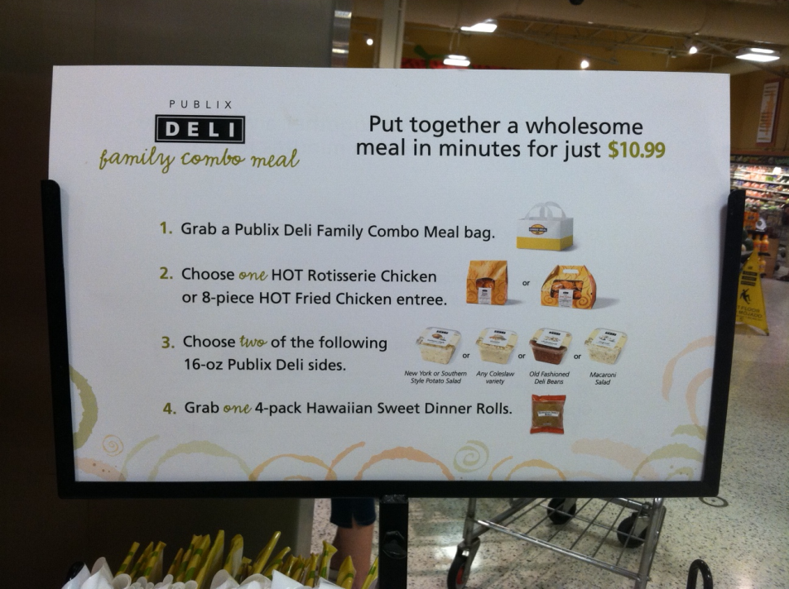
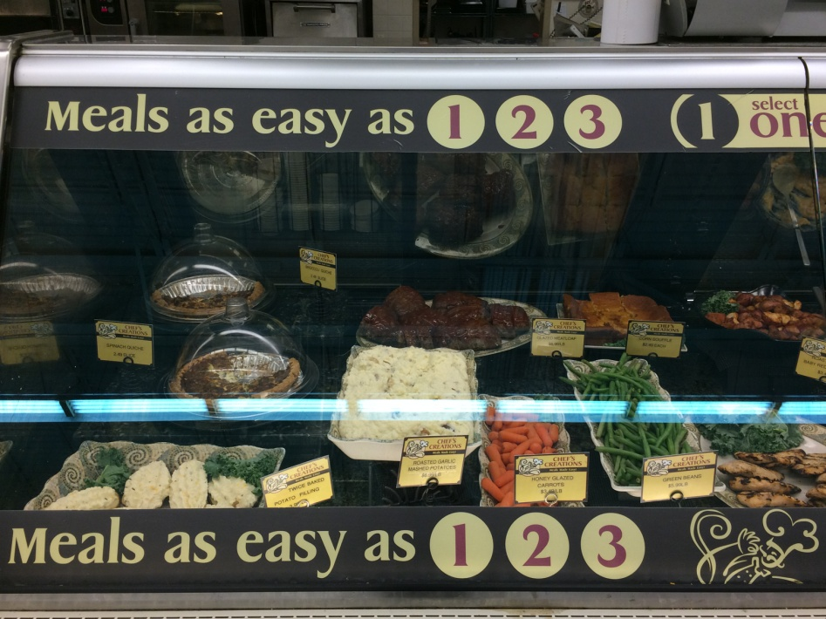
From ready-to-eat to heat-and-eat

Slide 43
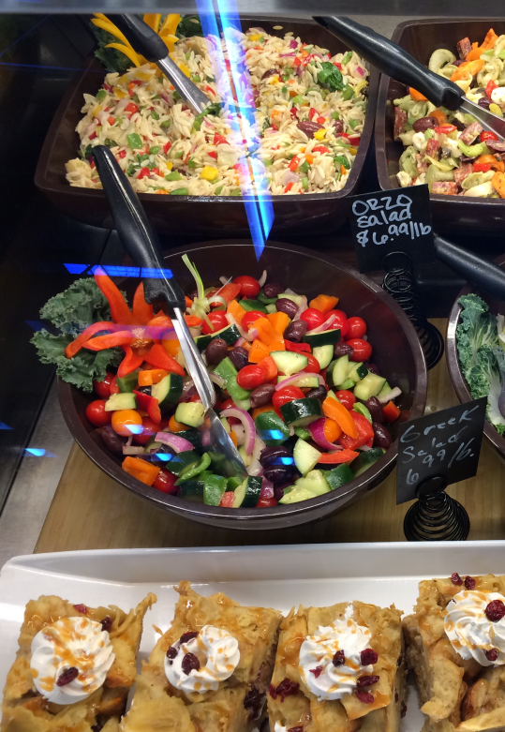
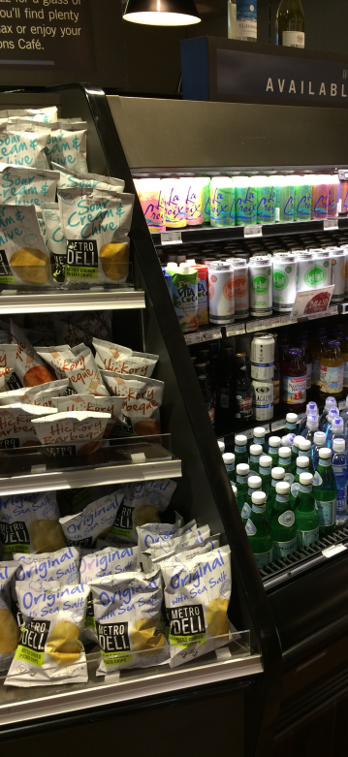
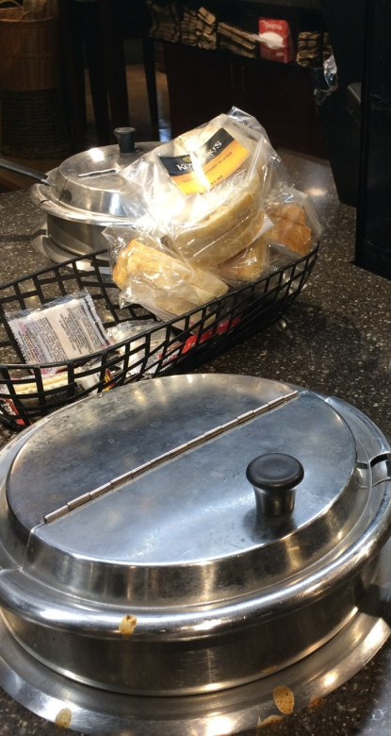
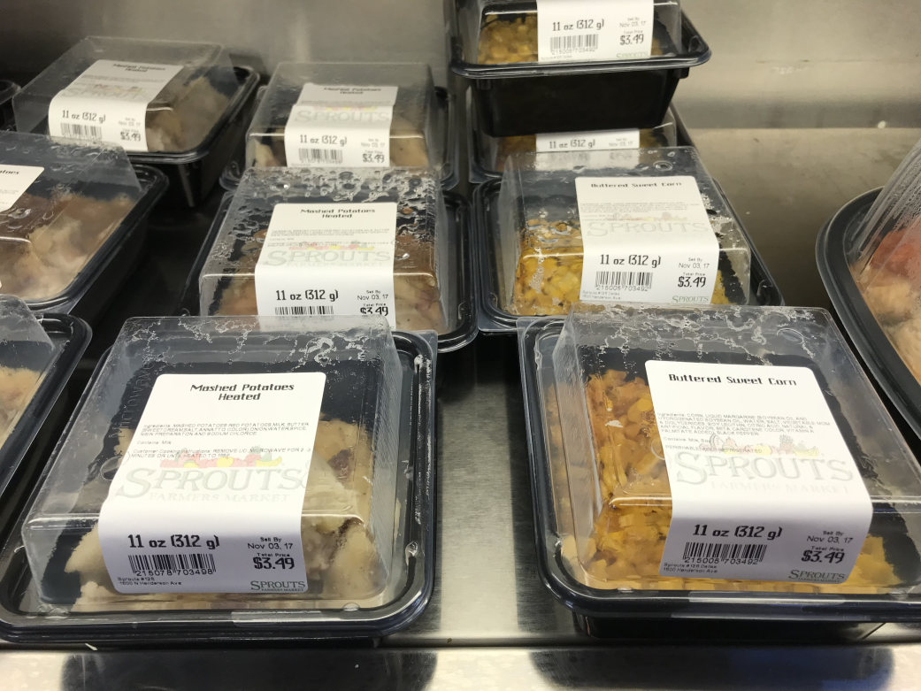
Cross-merchandise for shopping speed/ease

Slide 44
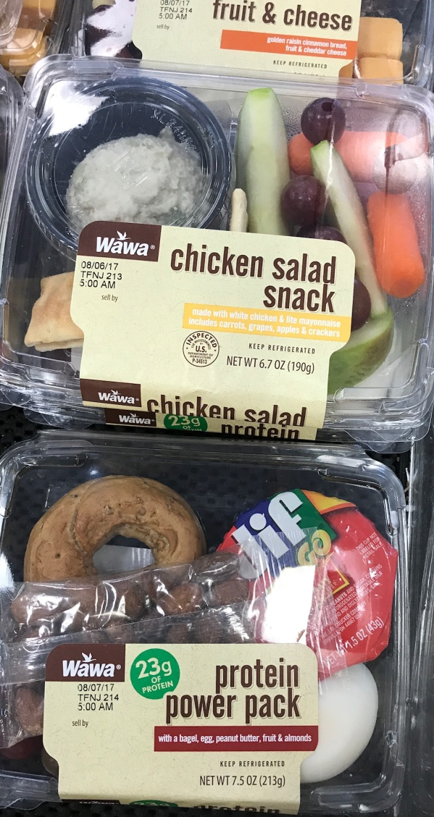
Nutrition, balance & health
Focus on healthy eating
Nutrition-focused shopper profile
Top nutrition features
Claims driving sales
Calorie labeling

Slide 45
Healthy eating carries through in deli prepared choices
Opportunity to emphasize nutrition and health callouts
Focus on healthy/nutritious meals
Health-focused shoppers also put nutrition 1st in foodservice
55%
12%

Slide 46
Nutrition-focused shopper profile
Older Millennials
Women, particularly when kids live at home
Higher-income
Value customization
Technology focused
Urban areas
Use deli prepared items to mix and match with scratch cooking
Kids living at home
Club and organic/specialty store shoppers
>Average trip frequency and weekly grocery spending
Rank nutrition:
18% 1st
45% 1st or 2nd

Slide 47
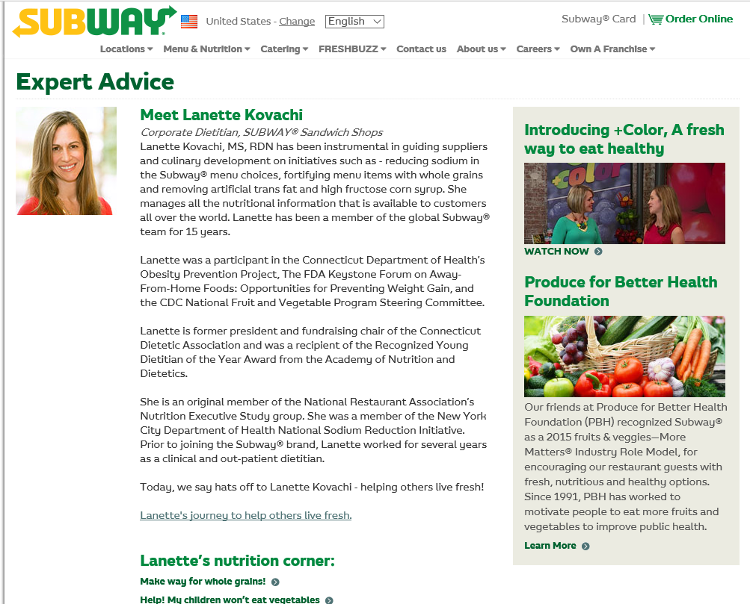
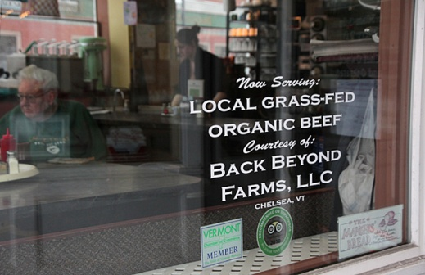
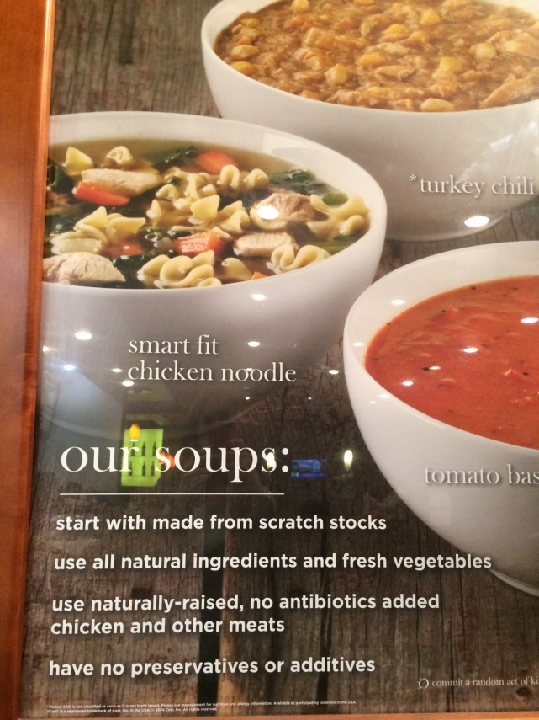
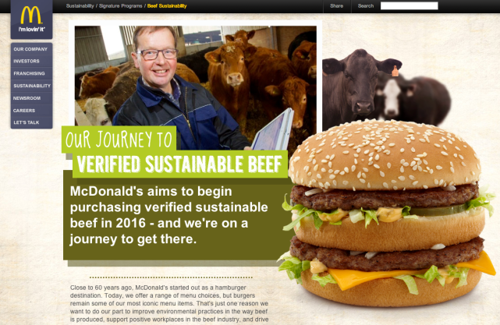
Restaurants increasingly leverage health & wellness

Slide 48
Top nutrition features: info & healthier alternatives
Higher-income shoppers overindex for nearly all features
Important features focused on nutrition, balance and health
84% Info on freshness and quality | 69% Call out artificial ingredients 67% Healthier alternatives 66% Control portion size | 63% Food safety measure info 61% Calorie info 59% Dietary callouts | 46% Organic items | 34% Retail dietitian or expert

Slide 49
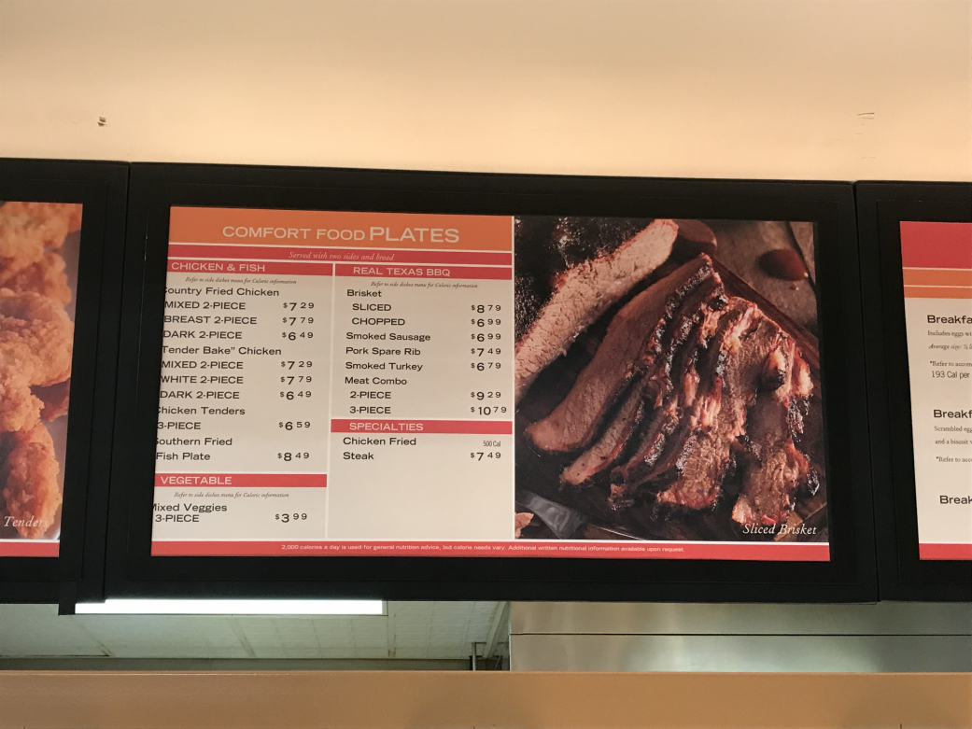
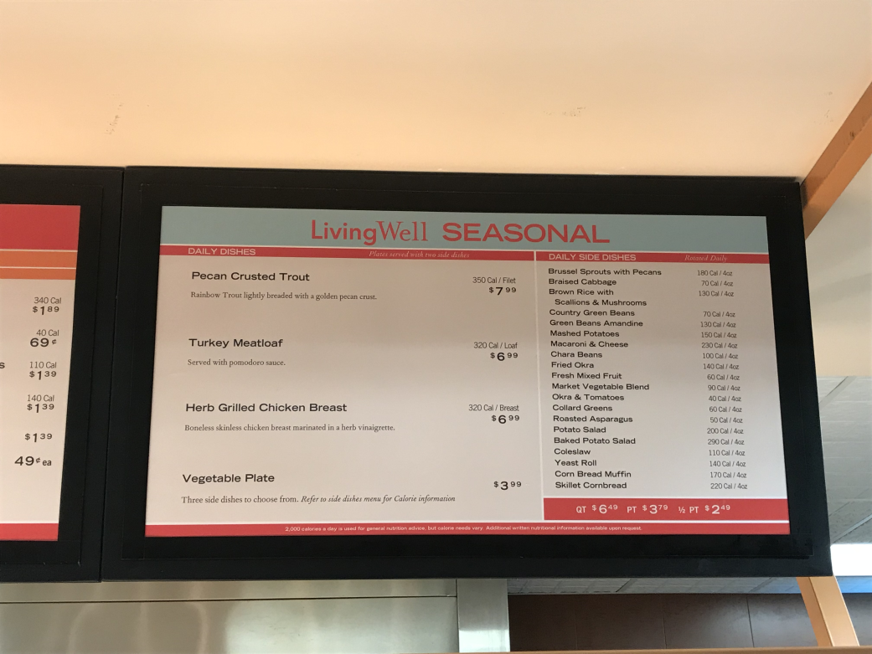
Address different need states
&
Comfort food Living well

Slide 50
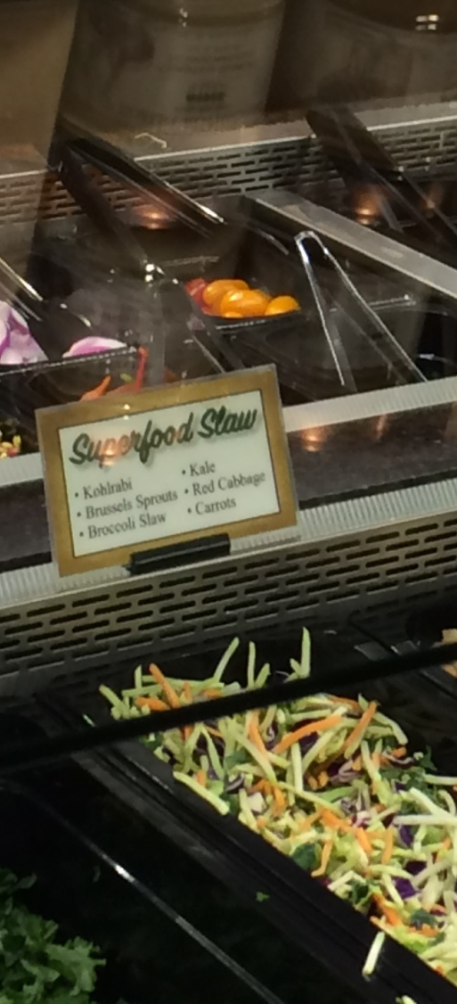
Rapid growth for health-focused items and claims
Claim | Category size | $ growth | Unit growth
Free from artificial preservatives | $1.4B | +9% | +5%
Antioxidant group | $1.4B | +8% | +9%
All natural ingredients | $1.4B | +8% | +7%
Vegetarian diet | $1.3B | +3% | +1%
Free from artificial ingredients | $1.2B | +9% | +7%
Superfoods | $292M | +25% | +28%
Free from GMO ingredients | $265M | +22% | +23%
Low cholesterol | $225M | +6% | +4%
Good/excellent source of protein | $210M | +16% | +20%
Low calorie | $185M | +6% | +5%

Slide 51
Restaurant calorie labeling influences 1/3
Variety in portion sizes and healthier alternatives will help secure business
Awareness of calorie labeling
25% Not noticed
38% Seen but no action
30% Seen and influences decisions
Nutrition focused shoppers (42%) or organic shoppers (53%) are more likely to alter choices

Slide 52
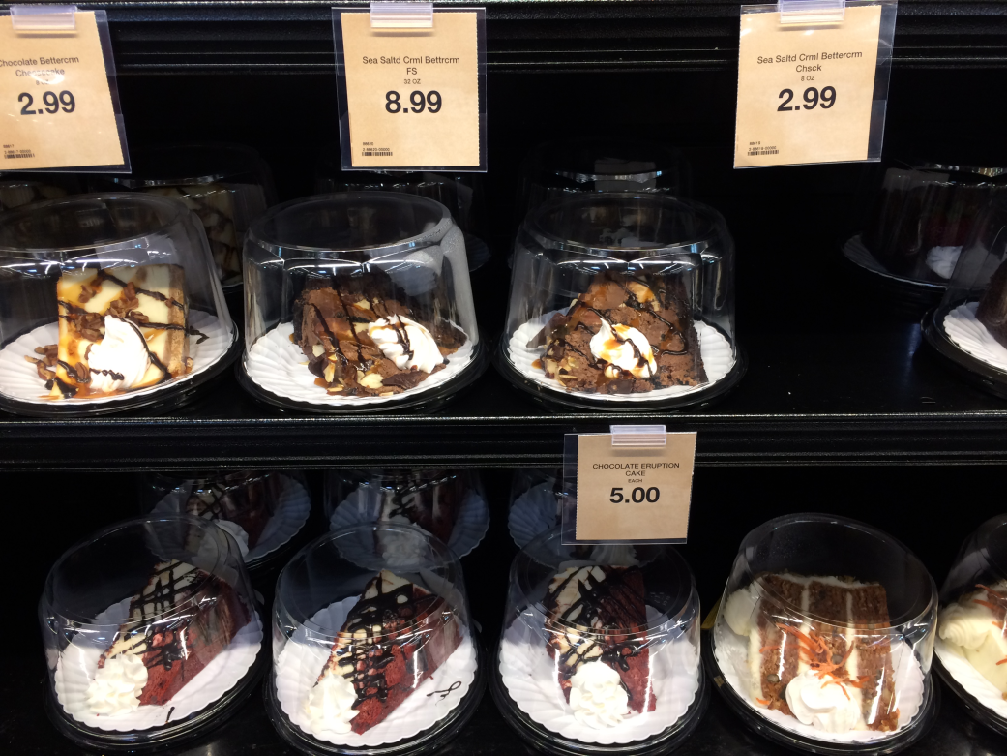
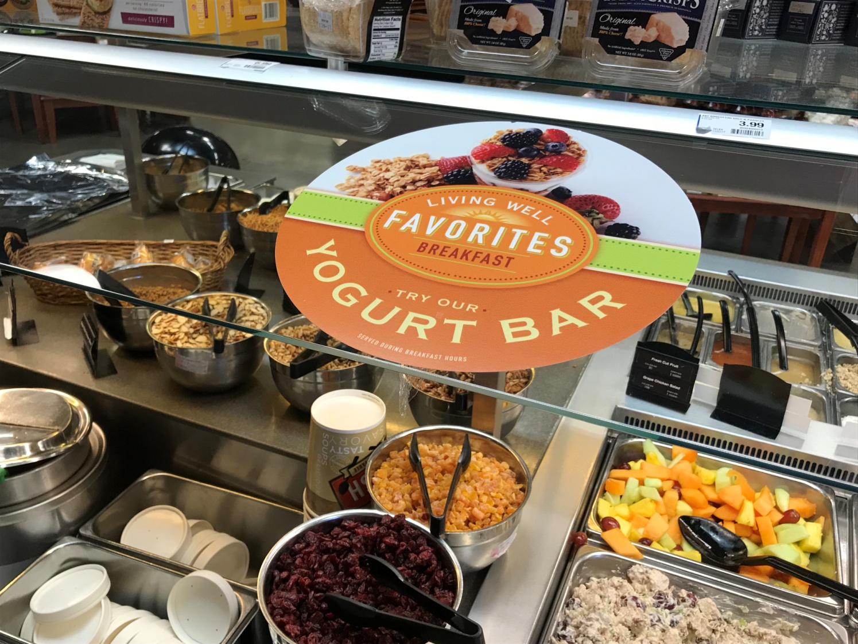
Offer variety to win
&
Sweet indulgence Healthier alternative

Slide 53
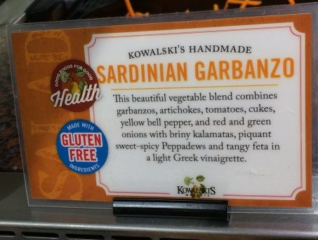
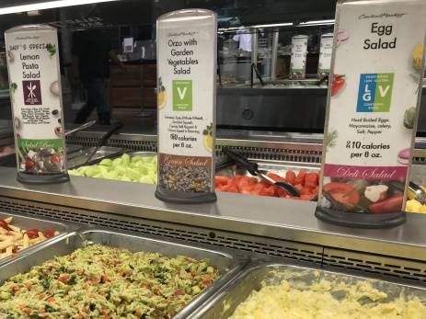
Leverage nutrition callouts on signage

Slide 54
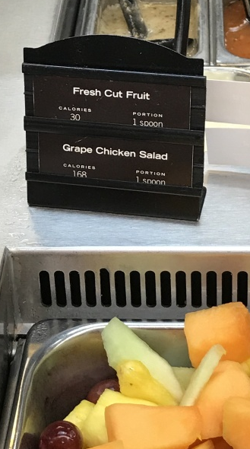
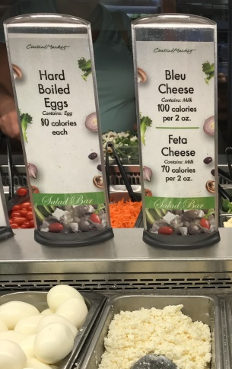
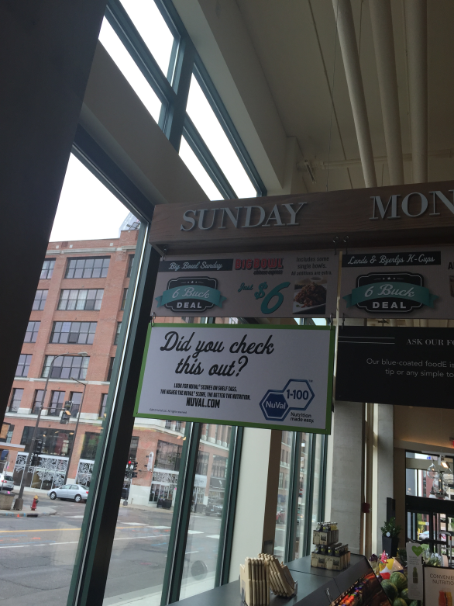
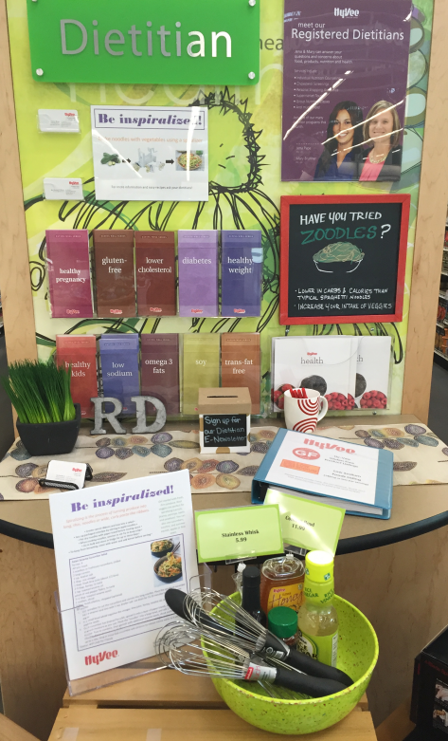
Various calorie & nutritional insight approaches
Per spoon Per ounce or each NuVal Retail dietitians

Slide 55
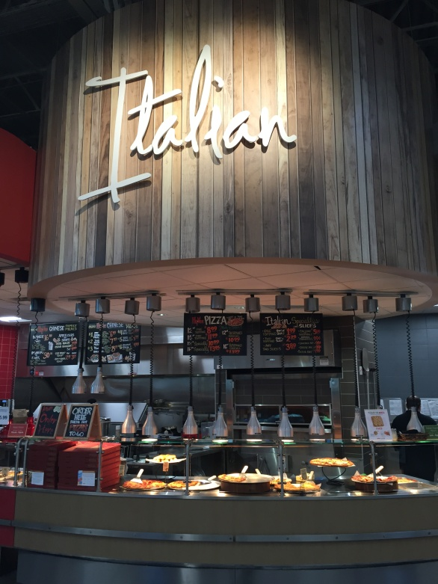
Ambiance & customer service
Ambiance-focused shopper profile
Ambiance features
Chef angle

Slide 56
Ambiance-focused shopper profile
Close overlap with shoppers more likely to eat in store
Millennials, especially 18-25
Urban and suburban shoppers
Lower-income shoppers
>average weekly trip frequency
Eat at home more (6-7 per week)
Rank ambiance:
7% 1st
19% 1st or 2nd

Slide 57




Restaurants, including fast food, are beefing up ambiance

Slide 58
Top ambiance features: clean & made-to-order
Urban shoppers focus on in-store features (nice seating, Wi-Fi, service, patio, entertainment)
Important features focused on ambiance & customer service
77% Clean seating area | 70% Made-to-order variety 67% Pre-made variety 65% Trained chefs | 58% Nice seating | 51% Free Wi-Fi | 44% Table service 35% Outside patio ---- 28% Entertainment

Slide 59







Slide 60
Opportunity to drive the “chef angle”
Customer service and consumer education will be increasingly important platforms
65% trained chefs/deli personnel are important
Comparing grocery deli employees to quick-serve restaurant employees
29% More knowledgeable | 56% Equally knowledgeable | 16% Less knowledgeable

Slide 61



Chef inspired
Chef-created or chef-inspired can drive home professionalism

Slide 62

Variety & selection
Ideal deli
Variety in the consumer’s mind
Customization
Steady featured days
Cuisine variety

Slide 63
Careful, targeted investment can drive consumer interest
Image influenced by shopping reality; expanding beyond basics will likely drive interest
Ideal deli/prepared foods department
48%
A handful of cuisines beyond deli basics w/customization
36%
Simple with some deli basics
16%
Resemble a mall food court w/many different cuisines

Slide 64


Slide 65
Shoppers who have variety, love variety
Food destinations are on their shoppers’ radars
Ideal deli/prepared food department | All | Foodservice destinations | Basic deli offering
Simple with deli classics | 36% | 13% | 37%
A few different food choices beyond the basics | 48% | 57% | 48%
Resemble a mall food court | 16% | 30% | 15%

Slide 66


Variety takes on many forms
Creating the illusion of variety by item rotation rather than many cuisines alone
Features focused on variety and rotation that are important
83% Meat variety beyond chicken | 74% Seasonal 73% Frequent rotation of offerings | 62% Local 58% Menu lineup for week 55% Chef meal of the day | 53% Good drink selection 48% Kid-friendly options | 39% Vegetarian options 37% Good beer/ wine variety

Slide 67
Urban shoppers see variety very differently
Emphasize features relative to in-store dining and transparency
+11 Good beer/wine selection
+10 Vegetarian options
+8 Good drink selection
+6 Surprise, chef-inspired meal of the day
+5 Locally-sourced
+4 Have the menu lineup for the week

Slide 68




Shaking up the rotisserie case with meat variety

Slide 69




Leveraging LTOs and seasonal

Slide 70


Allow shoppers to look ahead
Weekly menu or standard featured day

Slide 71
Importance of steady featured days rises along with usage
Steady featured days could help drive awareness and loyalty among low and medium users
42% Steady sales/featured day by cuisine is important
Never:
24%
Every few weeks:
39%
Weekly:
53%
Every few days/daily:
73%
<1x month
30%

Slide 72
Offering customization wins hearts
Importance rises along with usage; 75% of frequent deli users value customization
Importance of
customization
Importance rises along with…
Higher usage
Greater focus on health/nutrition
Frequent technology usage
Presence of kids
Among Millennials
54%
14%

Slide 73



Millennials emphasize customization

Slide 74

The rise of meal adventures
Millennials seek authentic experiences; don’t view it as ethnic food
Broad appeal | Strong demographic differences
American Salads Italian Mexican Chinese | Southern Japanese/sushi Thai/Vietnamese Indian Middle Eastern Caribbean Mediterranean Korean
Opportunity in elevating
experience surrounding
“classics”
Match to the core consumer

Slide 75




Universal appeal with a twist
Adding experiential elements to proven classics, such as wood-oven pizza or hip flavors

Slide 76

Hot new flavors
Sales gains reflect better-for-you items, nostalgic, fun and flavorful
Flavor growth in deli prepared
Traditional (-9.2%) Barbecue (-3.6%) Plain (-6.9%) Fried (-1.2%) | Oven-roasted (+29.4%) Chef sampler (+26.9%) Home-style (+22.7%) Hot and spicy (+18.2%) Cheese (+8.8%) American (+7.7%) Savory (7.3%) Lemon pepper (+7.2%)

Slide 77

Solution types &
MEAL KITS
Ideal deli
Variety in the consumer’s mind
Customization
Steady featured days
Cuisine variety

Slide 78


Shopper interest is high across solution types
Interest rises along with usage — underscoring the importance of driving trial
Prepackaged ready-to-eat
Prepackaged heat-and-eat
Buffet (hot & cold items)
Made-to-order
66% 65% 59% 58%
% interested + very interested (top 2 box)

Slide 79
Most have heard of meal kits, but haven’t used them
Meal Kits Definition
“Meal kits offer fresh ingredients to make one meal, including the meat, vegetables, sauce, herbs, spices, etc. The kits come with step-by-step preparation instructions. Most are based on a subscription model and are shipped to your home, such as Hello Fresh, Blue Apron or Plated. Some grocery stores offer fresh meal kits as well.”
Meal kit company awareness/use
Used
Aware,
but not used
Unaware

Slide 80

Greater interest in primary store meal kits
73% of frequent foodservice users interested vs. 38% of infrequent users
51%
Interested in primary store offering meal kits
versus 22% using delivery
% interested + very interested (top 2 box)

Slide 81


In-store meal kits show many variations

Slide 82


From assembly-needed to oven-ready

Slide 83

Ease of preparation is important
82% of frequent foodservice users interested in oven or microwave-ready packaging vs. 51% of infrequent users
57%
Having oven or
microwave-ready
packaging is important
% important + very important (top 2 box)

Slide 84





Variety is key in meal kit offering
Millennials more interested in ethnic dishes; Boomers in home-style
Home-style,
familiar dishes
Healthy
choice dishes
International/
ethnic dishes
A variety of
all these
29% 24% 14% 33%

Slide 85

Variety is key in portion sizes too
Mostly driven by household size with strong area differences
Family
Variety
2 people
1 person
18% 34% 35% 13%
Urban Suburban Rural

Slide 86




Kid & adult options; lunch & dinner options

Slide 87

conclusions
Perfecting the deli “eco-system” to
drive sales, loyalty and total store
success

Slide 88
Growing foodservice at retail
Focus on conversion
While in a store multiple times/week, shoppers buy deli prepared only every 3 weeks
Strive to be top of mind
When in a rush or not in the mood to cook, restaurants are 2x as likely to get the biz
Leverage technology
Improve visibility and awareness of foodservice as a viable restaurant alternative
Maximize your share of market
Half of shoppers purchase deli prepared at stores beyond their primary grocer
Connect with shoppers
Shoppers prefer email and text to learn about deli prepared offerings/promotions

Slide 89
Provide options for speed-focused shoppers
52% put speed as the 1st or 2nd highest decision factor for a quick dinner out
Answer health & wellness calls
Provide options for nutrition-focused shoppers who deemphasize price/speed but value customization
Leverage ambiance and customer service
Millennials focus on ambiance; customer service helps differentiate from restaurants
Optimize assortment
Expanded variety matched to the core consumer can win over shoppers at mealtime
Consider meal kits as a foodservice extension
Interest and usage in meal kits greatly overlaps with strong interest for made-to-order, self-serve buffets and grab-and-go

Slide 90

The Power of Foodservice 2018
Access your copy now: www.fmi.org/store/
For questions or information:
Anne-Marie: aroerink@210analytics.com
Rick: rstein@fmi.org

