Slide 1

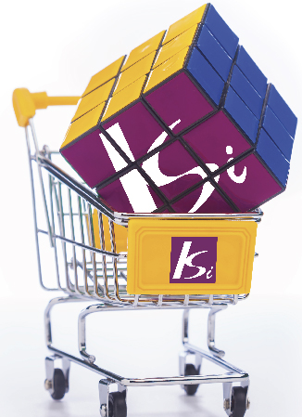

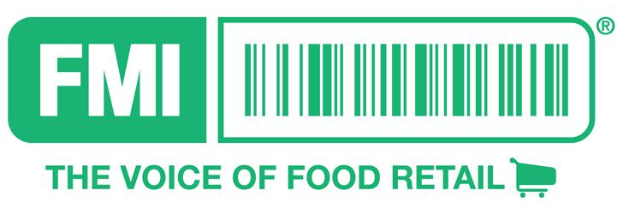
PRESENTED BY: KEITH SWIEDNICKI
PRESIDENT & CEO KSI
2018 SUPPLY CHAIN BENCHMARKING
SURVEY HIGHLIGHTS

Slide 2
















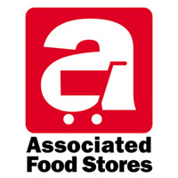








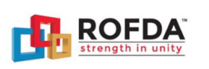
2018 SUPPLY CHAIN BENCHMARKING
PARTICIPANTS
2018

Slide 3
2018 SUPPLY CHAIN BENCHMARKING
PARTICIPANT PROFILE
2018
143 SURVEYS FROM 4 COUNTRIES
1 SURVEY
29 COMPANIES
2 SURVEYS
71 FACILITIES
3 SURVEYS
4 SURVEYS
29% UNIONIZED
6+ SURVEYS
70% EMPLOY CONTRACT LABOR

Slide 4
2018 SUPPLY CHAIN BENCHMARKING
3rd SURVEY
2018
We created a new (more comprehensive) distribution survey document and issued it to several Sr. VP’s in the food industry to solicit their opinions on what they would like to benchmark and know more about. We received their valued feedback and incorporated into the new survey questionnaire.
Part A consists of general facility information that typically remains the same throughout the year as well as costs associated with operating distribution centers, operational data, fixed and mobile equipment, technology and outlook.
Part B is comprised of operational metrics, same unique four-week sample period as past surveys to provide historical comparisons.
The goal was not to provide you with more data... But to provide precise operator actionable intelligence.
As before the STUDY PARTICIPANTS WILL RECEIVE
PERSONALIZED PRODUCTIVITY REPORT
FMI/ROFDA SUPPLY CHAIN INDUSTRY REPORT AND FINDINGS PRESENTATION

Slide 5
2018 SUPPLY CHAIN BENCHMARKING
SURVEY HIGHLIGHTS
2018
The American Retail Food Distribution Industry has not changed in the last 3 years surveyed, let alone the past 30 years!
Using the same materials handling equipment: pallets jacks, forklifts as we did in 1980 (DC and Store)
Have added some technology: Voice Systems (1990); RF scanning (1993) to reduce paperwork and labels. Most companies have a WMS in place

Slide 6
2018 SUPPLY CHAIN BENCHMARKING
SURVEY HIGHLIGHTS
2018
  Inventory turns have declined as most companies buy more product than they need because money is basically free!
  Still finger printing as much as 40% of the inbound product
  Associate turnover is extremely high and expensive
  Stores have to receive 40-60 DSD loads every day, creating significant paperwork and jamming the backrooms with product
  Number of items continues to grow

Slide 7
2018 SUPPLY CHAIN BENCHMARKING
CHALLENGES / OPPORTUNITES
The world food industry is changing faster than most executives understand or comprehend!!!!
Let’s Look at what is happening.

Slide 8
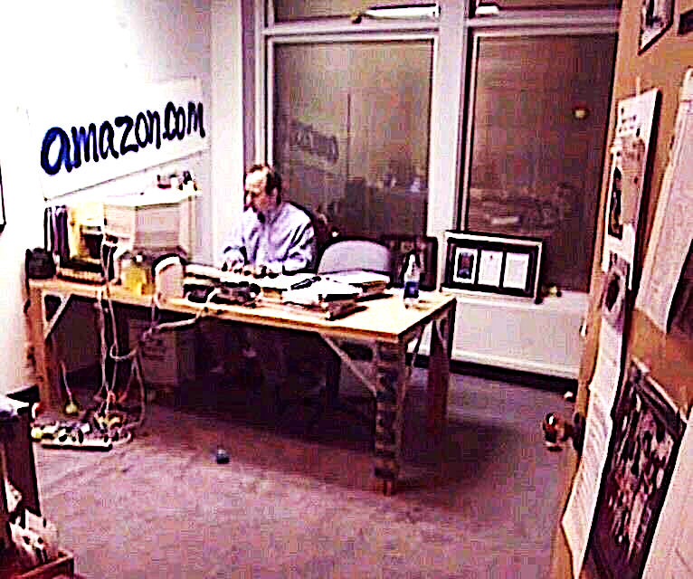
2018 SUPPLY CHAIN BENCHMARKING
WHO IS THIS GUY?

Slide 9
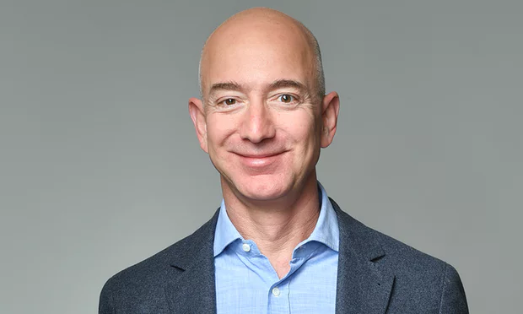
2018 SUPPLY CHAIN BENCHMARKING
JEFF BEZOS
RICHEST MAN IN THE WORLD!
Does not operate with a
1% net profit!
Bezos founded Amazon.com in 1994 after making a cross-country drive from New York to Seattle, writing up the Amazon business plan on the way. He initially set up the company in his garage.^{[31]} He had left his well-paying job at a New York City hedge fund after learning "about the rapid growth in Internet use," which coincided with a new U.S. Supreme Court ruling that exempted mail order companies from collecting sales taxes in states where they lack a physical presence.^{[20]}. Bezos' parents invested $300,000 from their retirement savings into Amazon
He originally thought he could outsource most business activities…………Today, he manages one of the most sophisticated supply chain systems in the world……with millions of items, hundreds of DC’s, owns Robots, Airplanes, Trailers and now Trucks.

Slide 10
2018 SUPPLY CHAIN BENCHMARKING
WHO IS THIS GUY?

Slide 11
2018 SUPPLY CHAIN BENCHMARKING
JACK MA
GLOBAL RETAIL DISRUPTER
Does not operate with a
1% net profit!
Jack Ma applied for 30 different jobs and got rejected by all. "I went for a job with the police; they said, 'you're no good,'" Ma told interviewer Charlie Rose. "I even went to KFC when it came to my city. Twenty-four people went for the job. Twenty-three were accepted. I was the only guy...".^{[24]} In addition he applied 10 times for Harvard and got rejected

Slide 12

2018 SUPPLY CHAIN BENCHMARKING
HEMA SUPERMARKETS
NEW RETAIL EXPERIENCE
Hema is Alibaba’s move into the retail food industry. Currently, there
are 14 stores open with several hundred planned for this year.

Slide 13

2018 SUPPLY CHAIN BENCHMARKING
WHO ARE THESE GUYS?

Slide 14
2018 SUPPLY CHAIN BENCHMARKING
ALBRECHT FAMILY
LEADING FOOD DISCOUNTERS
They are the leading food discounters in the world
Discounters were laughed at when they entered the British Market. They now hold 12% share.

Slide 15
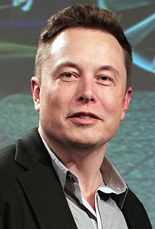
2018 SUPPLY CHAIN BENCHMARKING
WHO IS THIS GUY?

Slide 16
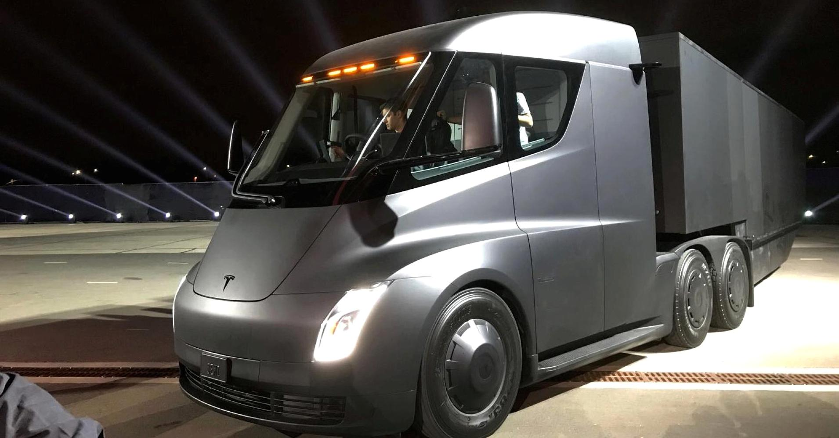
2018 SUPPLY CHAIN BENCHMARKING
ELON MUSK
REVOLUTIONIZING TRANSPORTATION
Does not operate with a
1% net profit!
Musk was severely bullied throughout his childhood,^{[39]} and was once hospitalized when a group of boys threw him down a flight of stairs and then beat him until he lost consciousness.^{[40]}
Just introduced an Electric Tractor, that will cost $150,000. Has orders from major players such as Walmart, Meijer, Sysco

Slide 17
2018 SUPPLY CHAIN BENCHMARKING
WHAT’S THE POINT?
“Outsiders, who have no background in the retail food industry are now setting the future!”
Their focus:
  Take care of customers no matter the costs.
  Make shopping easier, interesting, interactive
  Use tools: AI, Digital technology whenever possible/practical.
  Provide transparency throughout the supply chain
  Offer fresh product supported by speed in the supply chain
  Execute at the lowest cost

Slide 18
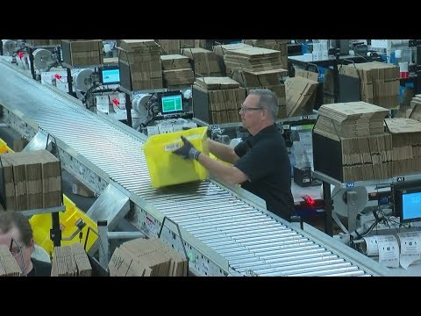
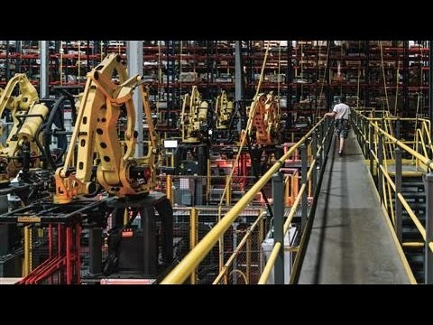
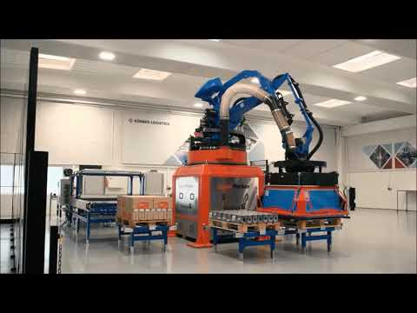
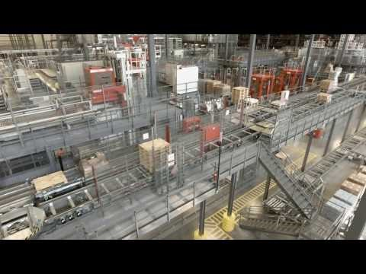
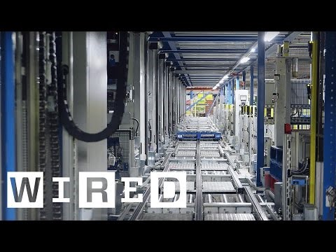
Amazon DC Robots
2018 SUPPLY CHAIN BENCHMARKING
C&S Newburgh, NY
Kuecker's Solution
Witron Meijer
Ocado
No one wants to work in a Food DC, therefore look at these successful operations.
Turnover costs are significant and expensive, look at new technologies
World’s Largest Direct to Consumer food supply chain system.

Slide 19
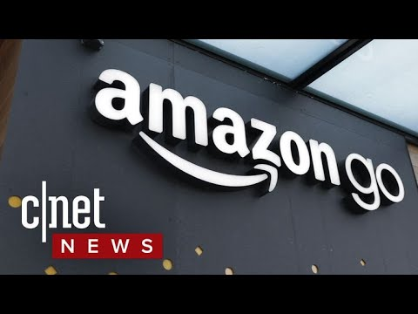
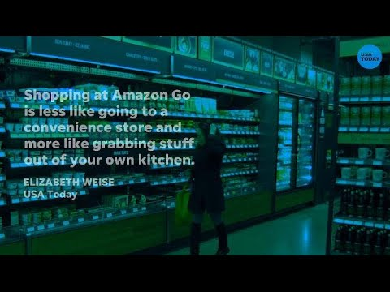

2018 SUPPLY CHAIN BENCHMARKING
Amazon Go Store
World’s Largest Direct to Consumer food supply chain system.

Slide 20
2018 SUPPLY CHAIN BENCHMARKING
INVENTORY OPPORTUNITIES
Over half of the participating companies reported inventory cube exceeding 80% space capacity.
55% indicate that they are holding inventory in outside storage.
As a result, many DC’s are experiencing negative productivity issues and additional costs.

Slide 21
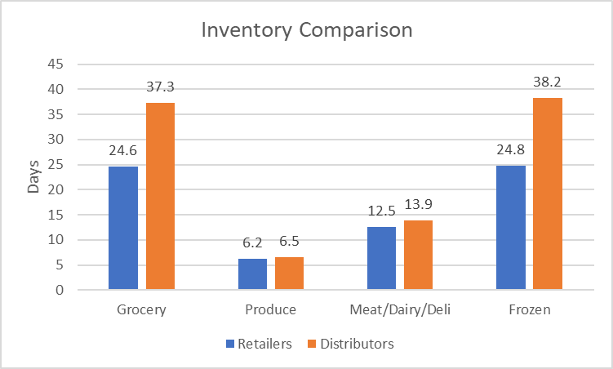
2018 SUPPLY CHAIN BENCHMARKING
INVENTORY OPPORTUNITIES
Current Days/Supply by Product
Expected Days/Supply by Product
- Produce <5 days
- Meat/Dairy/Del: 10 days
- Grocery/Frozen: 14 Days

Slide 22

2018 SUPPLY CHAIN BENCHMARKING
LABOR RETENTION
People don't want to work in a food distribution center no matter what you pay.
  The work is hard..........boring.............physical.
  Not interested in working nights or weekends
  No longer viewed as a career!
NET RESULT: TURNOVER: Over 83% identified a problem
Turnover is expensive.................$4-10,000 per employee due to hiring costs, drug tests, lost productivity, mistakes, damage, poor customer service.
Late deliveries and out of stocks anger your customers

Slide 23
2018 SUPPLY CHAIN BENCHMARKING
LABOR SOLUTION
Solutions: Automate....... Amazon/Alibaba use robots. Meijer, Target, Supervalu, Kroger, CVS use Witron or if you can’t afford the capital investment to eliminate labor then:
Listen to your employee/associates.
Have regular meetings to discuss what is going on...........daily, weekly, period.
The number one reason people leave their jobs is supervision.................may require the company to utilize outside executives so that the group/employees will openly talk without repercussions.
Every person who leaves should be interviewed (outside source) or given the opportunity to answer questions via survey monkey
Respond to issues immediately. Do not over promise.
Communicate with the associates on their terms....................smart phone. Set up email, website, snapchat, etc. so that they can send and receive information
Operationally, move as many functional activities to day light hours. i.e. order selection.
Employ job rotation weekly so that the daily grind varies.

Slide 24
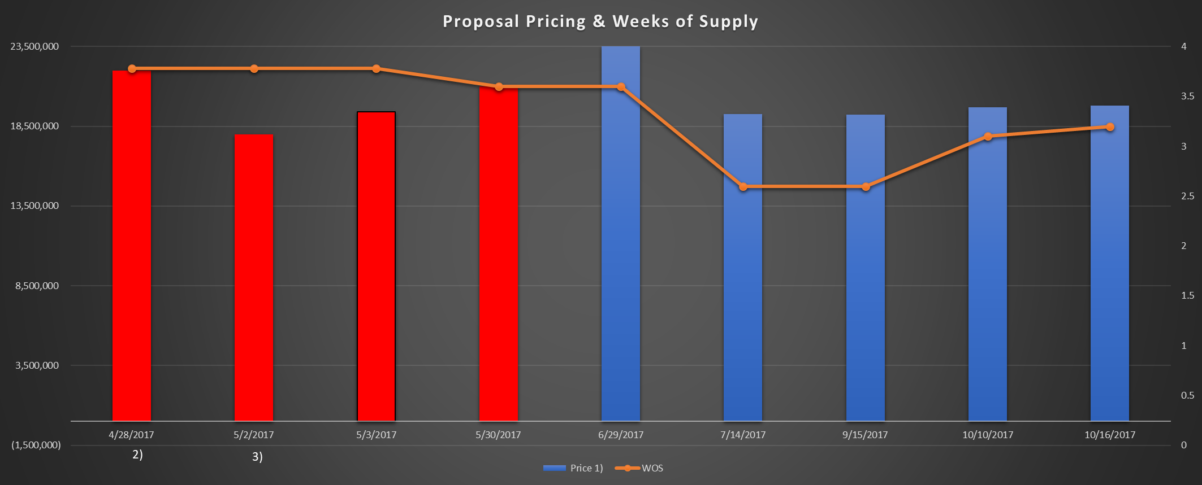
2018 SUPPLY CHAIN BENCHMARKING
AUTOMATION COSTS
Costs
Square Footage
IRR
Net Labor

Slide 25
2018 SUPPLY CHAIN BENCHMARKING
COST FACTORS
Food Retailers operate at far lower costs as a percent of sales vs. Food Distributors 3.21% vs. 2.50%
Why?
Food Retailers typically seek efficiency first; Control Delivery Schedules, Item Count, Manage assets/people based on costs.
Food Distributors typically seek effectiveness first; that is, they take care of customers even when it is not financially practical. Carry more items in inventory. Unbalanced delivery times

Slide 26
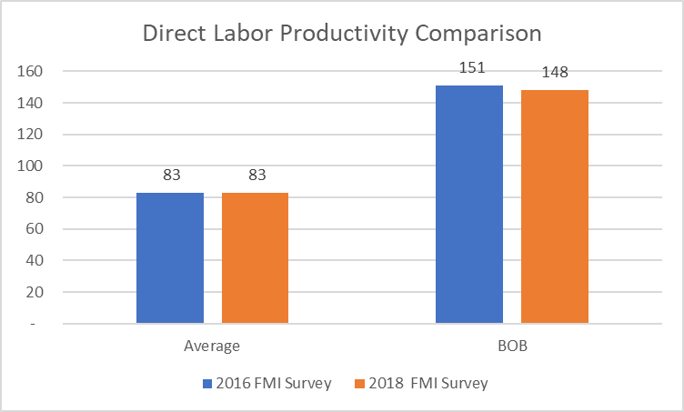
2018 SUPPLY CHAIN BENCHMARKING
DIRECT LABOR RATES

Slide 27
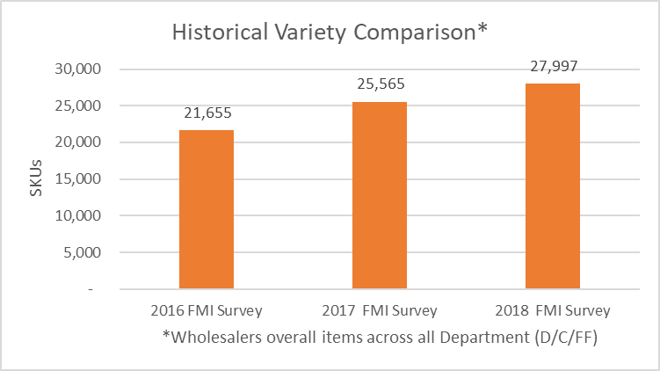
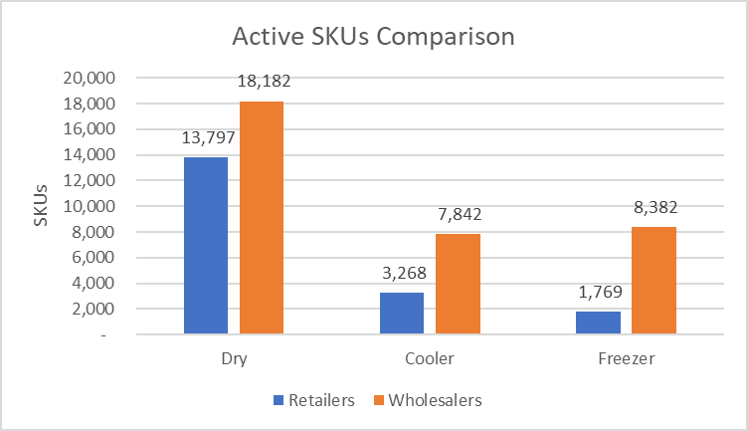
2018 SUPPLY CHAIN BENCHMARKING
ITEM COUNT
Item Count has grown by 10% per annum over the past 3 years surveyed.
Future count will continue to expand as new products from all over the world are expected by customers.
Saying NO to additional items has helped specialty food distributors such as UNFI and Kehe.
In 2003: Grocery Item Count was 8,820

Slide 28
2018 SUPPLY CHAIN BENCHMARKING
FINANCIAL IMPLICATIONS
A. Retailers are far more efficient than food distributors for various reasons
- Order size, inventory levels, number of items, controlled schedules,
Their entire focus is on cost controls.
Improve cash flow by reducing the amount of inventory carried.
Analyzing the true costs of DSD.
D. Everyone needs to offer in house online shopping solutions. The services currently offered will disappear or be bought out
- ie., Target buying Shipt.

Slide 29
2018 SUPPLY CHAIN BENCHMARKING
NEXT STEPS
FMI/ROFDA SUPPLY CHAIN INDUSTRY REPORT
FMI SC FINDINGS PRESENTATION
PERSONALIZED PRODUCTIVITY REPORT

Slide 30



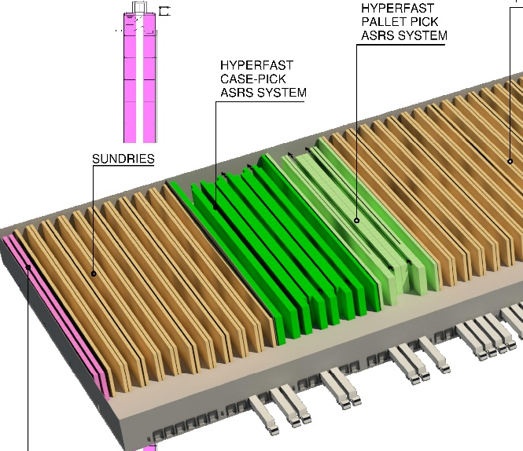

SERVICES
WHAT WE DO
DISTRIBUTION NETWORK OPTIMIZATION
WAREHOUSE
OPTIMIZATION AND TRANSFORMATION
PRODUCTIVITY BENCHMARKING AND ANALYSIS
WHAT’S NEW
ENGINEERED STANDARDS
SERVICES
KSI CONFERENCE
TRANSPORTATION
AUDIT IMPLEMENTATION
FACILITY DIGITAL MAPPING

Slide 31
2018 SUPPLY CHAIN BENCHMARKING
COLLABORATORS:
THANK YOU!
2018

Slide 32
LABOR ISSUES
1
LABOR AVAILABILITY
KSI can help you do more with less people, drive performance with fewer people is a reality today

Slide 33


